Slide 1


Exploiting XSS for Session Hijacking
This presentation explores how malicious scripts can be injected into websites, leading to the theft of user sessions and sensitive information. It is the answer response of CA3
by: Avinash Sharma

Slide 2
Definition: Cross-Site Scripting (XSS)
XSS occurs when an attacker injects malicious scripts into a trusted website, which are then executed by other users' browsers, potentially giving the attacker access to their data or actions.
XSS or cross-site scripting refers to the action where an attacker tries to inject a malicious code into an in-secure website on order to steal cookies, steal data, etc.

Slide 3
Types of XSS
Stored XSS
Reflected XSS
DOM-based XSS
Malicious scripts are permanently stored on the server, triggered when users access affected pages.
Scripts are injected into requests, reflected back by the server, and executed in the user's browser.
Scripts are injected into the DOM (Document Object Model) of a web page, exploited using browser features.

Slide 4
Impact
Data Theft
Stolen login credentials, cookies, and other sensitive data.
User Impersonation
Attackers can perform actions on behalf of compromised users, potentially causing damage or financial loss.
Session Hijacking
The currenlty logged in session of a valid user is taken over by a malicious user because of insecure access to session information

Slide 5





Session Hijacking through XSS
Step 1: XSS Injection
Attackers inject malicious scripts into websites, potentially exploiting vulnerable forms or input fields.
Step 2: Script Execution
When users visit the compromised website, the malicious script is executed in their browser.
Step 3: Cookie Theft
The script steals the user's session cookies, which contain sensitive information used for authentication and authorization.
Step 4: Session Hijacking
The attacker uses the stolen cookies to impersonate the user, gaining access to their accounts and resources.
Step 5: Persist The Session
The attacker can then act as the legitimate user until the session cookies expires, in some cases, it can be never expiring session cookie!

Slide 6
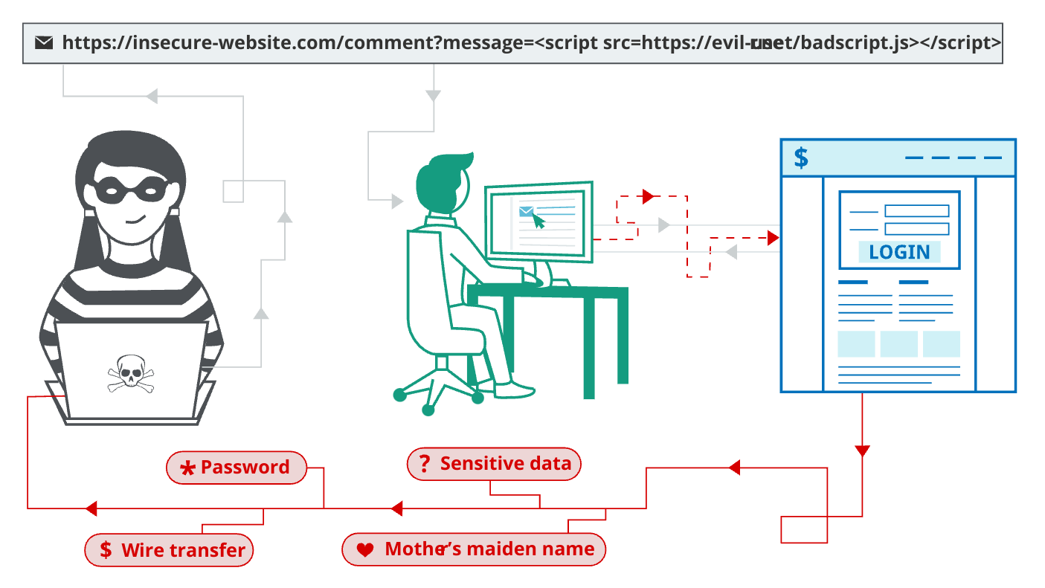
Above picture explains XSS and how it can be used for many things including Session Hijacking.
The Malicious actor adds a comment which actually loads a shady script, which might be stealing session cookies, and other things and uploading it to, for example, the hacker's website.

Slide 7
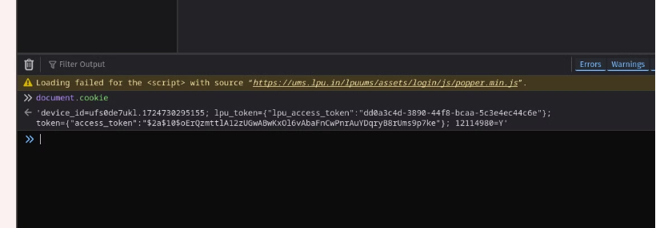
Looking for Cookies
Here we can see some cookies for a legitimate user.
document.cookie
above command can be used to get cookie from a logged in session

Slide 8
How it all works
The attacker setups a c2-server or website which takes ?cookies paramater
The attacker comments his malicious link and injects it into the comment/Forum page so that whenever someone visits the forum, the link steals the users cookies with document.cookie and uploads it to attacker's website
The attacker then retrieves the cookies from his own site and impersonates different users, hence Hijacking their session

