Slide 1

Cryptography

Slide 2
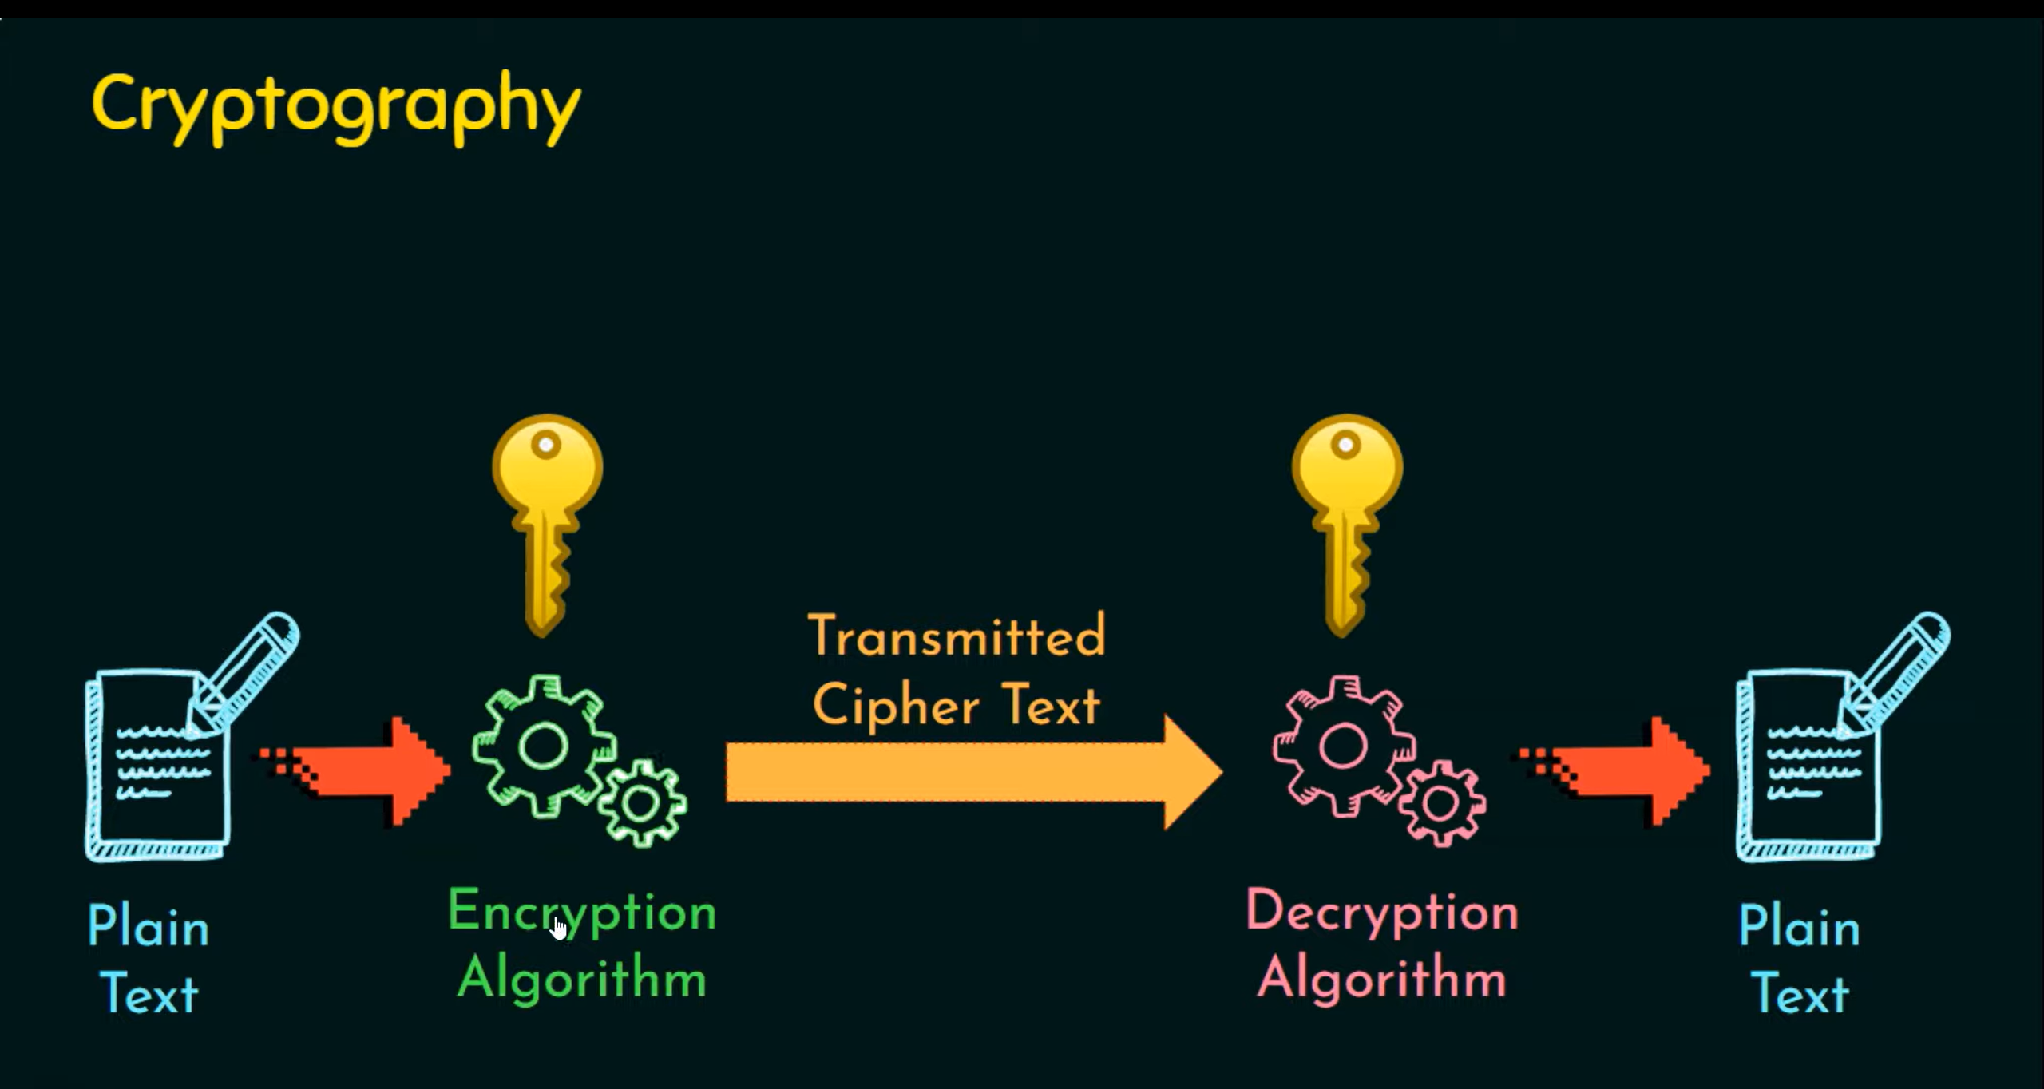

Slide 3

Definition
Cryptography is technique of securing information and communications through use of codes so that only those person for whom the information is intended can understand it and process it. Thus preventing unauthorized access to information. The prefix “crypt” means “hidden” and suffix “graphy” means “writing”.

Slide 4

In today’s age of computers cryptography is often associated with the process where an ordinary plain text is converted to cipher text which is the text made such that intended receiver of the text can only decode it and hence this process is known as encryption. The process of conversion of cipher text to plain text this is known as decryption.

Slide 5
Features Of Cryptography are as follows:
Confidentiality: Information can only be accessed by the person for whom it is intended and no other person except him can access it.
Integrity: Information cannot be modified in storage or transition between sender and intended receiver without any addition to information being detected.
Non-repudiation: The creator/sender of information cannot deny his intention to send information at later stage.
Authentication: The identities of sender and receiver are confirmed. As well as destination/origin of information is confirmed.

Slide 6

Types of Cryptography
Symmetric Cryptography
Asymmetric Cryptography
Hash Function

Slide 7
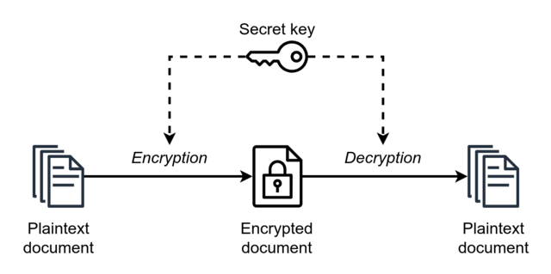
Symmetric Cryptography

Slide 8
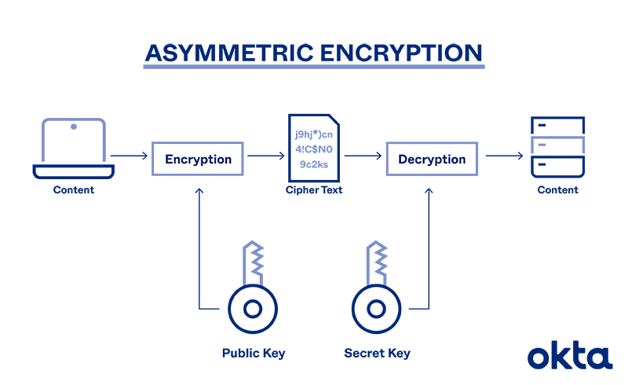
Asymmetric Cryptography

Slide 9
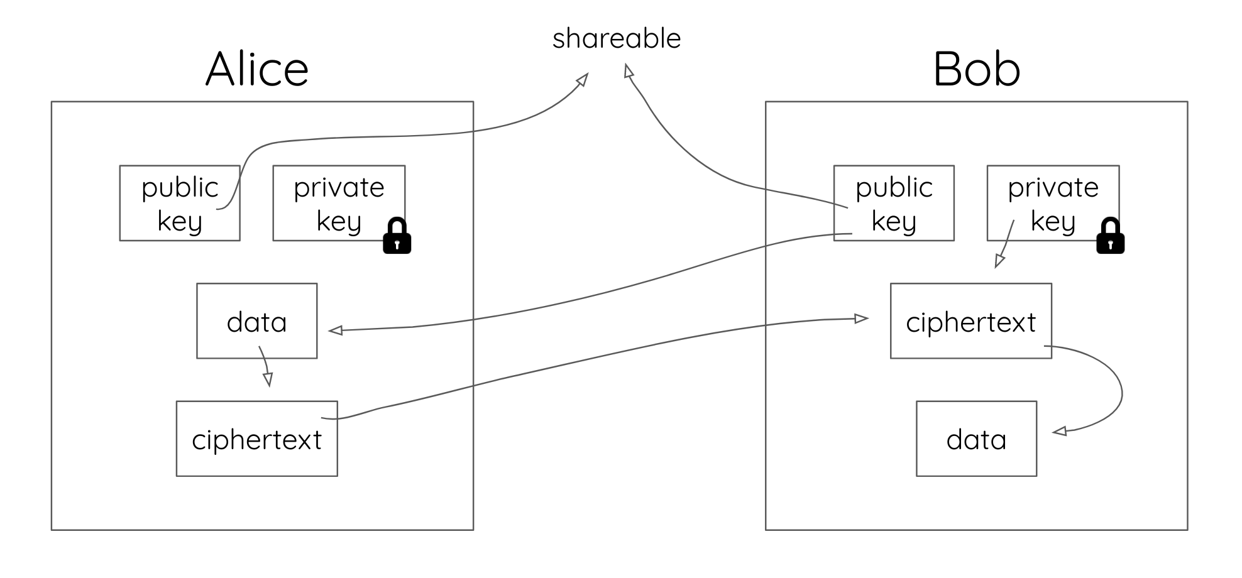

Slide 10

Characteristics of Public Encryption key:
Public key Encryption is important because it is infeasible to determine the decryption key given only the knowledge of the cryptographic algorithm and encryption key.
Either of the two keys (Public and Private key) can be used for encryption with other key used for decryption.
Due to Public key cryptosystem, public keys can be freely shared, allowing users an easy and convenient method for encrypting content and verifying digital signatures, and private keys can be kept secret, ensuring only the owners of the private keys can decrypt content and create digital signatures.

Slide 11
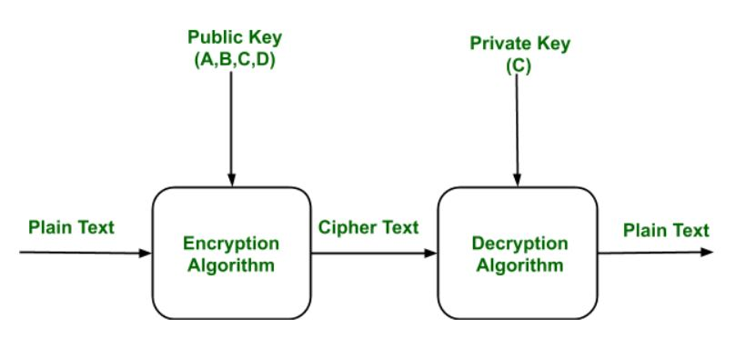
Example
Public keys of every user are present in the Public key Register. If B wants to send a confidential message to C, then B encrypt the message using C Public key. When C receives the message from B then C can decrypt it using its own Private key. No other recipient other than C can decrypt the message because only C know C’s private key.

Slide 12
Basis | Private Key Encryption | Public-Key Encryption
Required for Work: | Same algorithm with the same key is used for encryption and decryption. The sender and receiver must share the algorithm and key. | One algorithm is used for encryption and a related algorithm decryption with pair of keys, one for encryption and other for decryption. Receiver and Sender must each have one of the matched pair of keys (not identical) .
Required for Security: | Key must be kept secret. If the key is secret, it is very impossible to decipher message. Knowledge of the algorithm plus samples of ciphertext must be impractical to determine the key. | One of the two keys must be kept secret. If one of the key is kept secret, it is very impossible to decipher message. Knowledge of the algorithm plus one of the keys plus samples of ciphertext must be impractical to determine the other key.

Slide 13
Key Terms
Cryptography : Cryptography is the process of hiding or coding information so that only the person a message was intended for can read it.
PlainText : plaintext is usually ordinary readable text before it is encrypted into ciphertext.
Ciphertext : Ciphertext is encrypted text transformed from plaintext using an encryption algorithm. Ciphertext can't be read until it has been converted into plaintext
Cipher : A cipher is an algorithm for encrypting and decrypting data.

Slide 14
Key : key is a string of characters used within an encryption algorithm for altering data so that it appears random.
Cryptanalysis : Cryptanalysis is the study of the cryptographic algorithm and the breaking of those secret codes. The person practicing Cryptanalysis is called a Cryptanalyst.

Slide 15
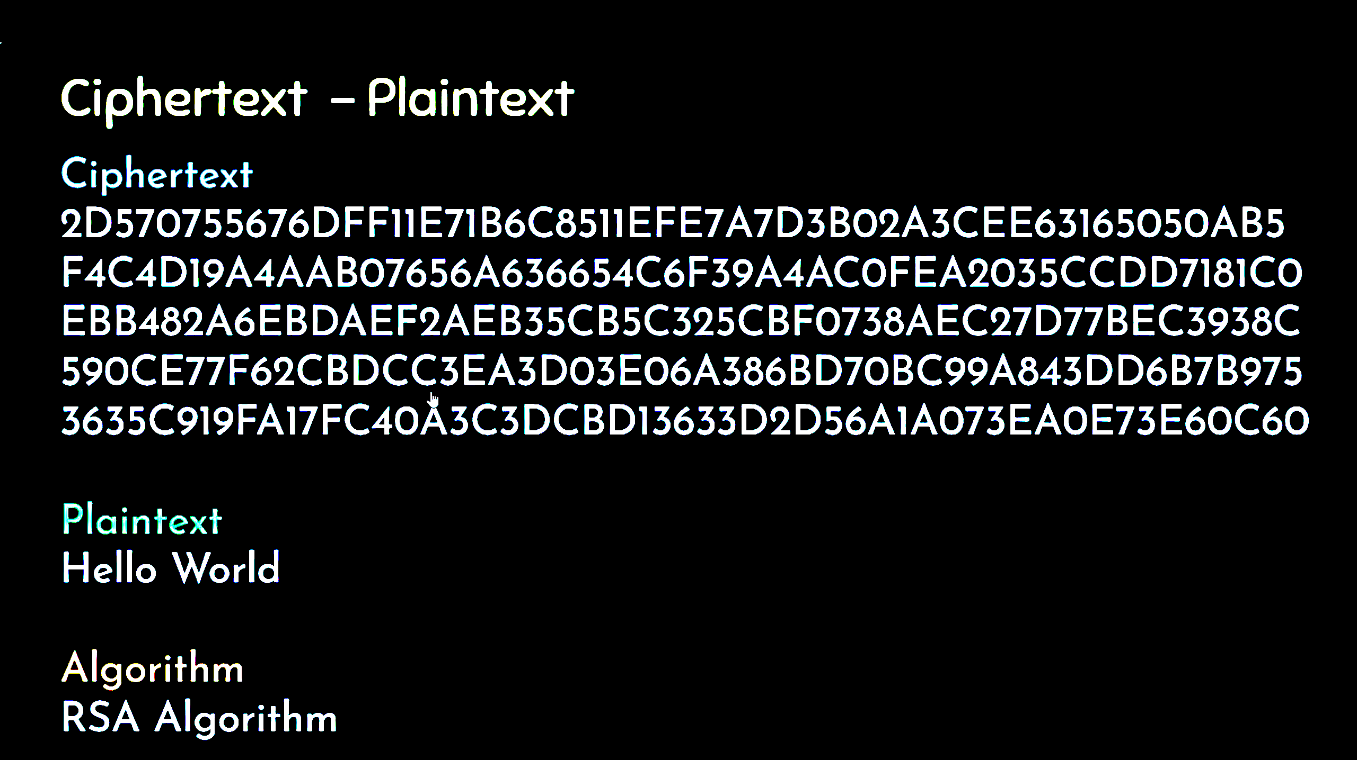

Slide 16
Hash Functions
Hash Functions: There is no usage of any key in this algorithm. A hash value with fixed length is calculated as per the plain text which makes it impossible for contents of plain text to be recovered. Many operating systems use hash functions to encrypt passwords.

Slide 17
Hash functions are extremely useful and appear in almost all information security applications.
A hash function is a mathematical function that converts a numerical input value into another compressed numerical value. The input to the hash function is of arbitrary length but output is always of fixed length.
Values returned by a hash function are called message digest or simply hash values. The following picture illustrated hash function

Slide 18
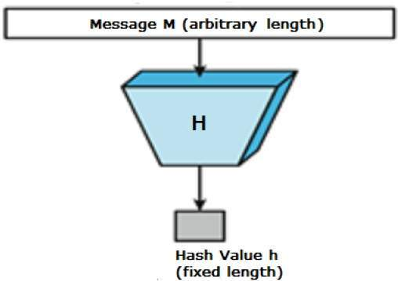

Slide 19
Features of Hash Functions
Fixed Length Output (Hash Value)
Hash function coverts data of arbitrary length to a fixed length. This process is often referred to as hashing the data.
In general, the hash is much smaller than the input data, hence hash functions are sometimes called compression functions.
Since a hash is a smaller representation of a larger data, it is also referred to as a digest.
Hash function with n bit output is referred to as an n-bit hash function. Popular hash functions generate values between 160 and 512 bits

Slide 20
Efficiency of Operation
Generally for any hash function h with input x, computation of h(x) is a fast operation.
Computationally hash functions are much faster than a symmetric encryption.

Slide 21
Properties of Hash Functions
Pre-Image Resistance
This property means that it should be computationally hard to reverse a hash function.
In other words, if a hash function h produced a hash value z, then it should be a difficult process to find any input value x that hashes to z.
This property protects against an attacker who only has a hash value and is trying to find the input.

Slide 22
Second Pre-Image Resistance
This property means given an input and its hash, it should be hard to find a different input with the same hash.
In other words, if a hash function h for an input x produces hash value h(x), then it should be difficult to find any other input value y such that h(y) = h(x).
This property of hash function protects against an attacker who has an input value and its hash, and wants to substitute different value as legitimate value in place of original input value.

Slide 23
Collision Resistance
This property means it should be hard to find two different inputs of any length that result in the same hash. This property is also referred to as collision free hash function.
In other words, for a hash function h, it is hard to find any two different inputs x and y such that h(x) = h(y).
Since, hash function is compressing function with fixed hash length, it is impossible for a hash function not to have collisions. This property of collision free only confirms that these collisions should be hard to find.
This property makes it very difficult for an attacker to find two input values with the same hash.
Also, if a hash function is collision-resistant then it is second pre-image resistant.

Slide 24
Applications of Hash Functions
Password Storage
Hash functions provide protection to password storage.
Instead of storing password in clear, mostly all logon processes store the hash values of passwords in the file.
An intruder can only see the hashes of passwords, even if he accessed the password. He can neither logon using hash nor can he derive the password from hash value since hash function possesses the property of pre-image resistance.

Slide 25
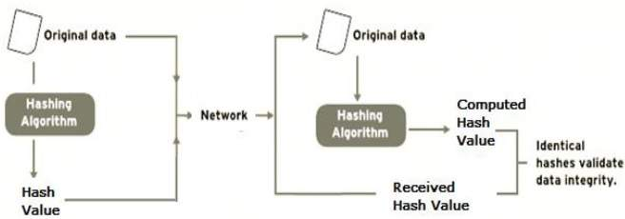
Data Integrity Check
Data integrity check is a most common application of the hash functions. It is used to generate the checksums on data files. This application provides assurance to the user about correctness of the data.

Slide 26
The integrity check helps the user to detect any changes made to original file. It however, does not provide any assurance about originality. The attacker, instead of modifying file data, can change the entire file and compute all together new hash and send to the receiver. This integrity check application is useful only if the user is sure about the originality of file.

Slide 27
Popular Hash Functions
Message Digest (MD)
MD5 was most popular and widely used hash function for quite some years.
The MD family comprises of hash functions MD2, MD4, MD5 and MD6. It was adopted as Internet Standard RFC 1321. It is a 128-bit hash function.
MD5 digests have been widely used in the software world to provide assurance about integrity of transferred file. For example, file servers often provide a pre-computed MD5 checksum for the files, so that a user can compare the checksum of the downloaded file to it.
In 2004, collisions were found in MD5. An analytical attack was reported to be successful only in an hour by using computer cluster. This collision attack resulted in compromised MD5 and hence it is no longer recommended for use.

Slide 28
Secure Hash Function (SHA)
Family of SHA comprise of four SHA algorithms; SHA-0, SHA-1, SHA-2, and SHA-3. Though from same family, there are structurally different.
The original version is SHA-0, a 160-bit hash function, was published by the National Institute of Standards and Technology (NIST) in 1993. It had few weaknesses and did not become very popular. Later in 1995, SHA-1 was designed to correct alleged weaknesses of SHA-0.
SHA-1 is the most widely used of the existing SHA hash functions. It is employed in several widely used applications and protocols including Secure Socket Layer (SSL) security.
In 2005, a method was found for uncovering collisions for SHA-1 within practical time frame making long-term employability of SHA-1 doubtful.

Slide 29
SHA-2 family has four further SHA variants, SHA-224, SHA-256, SHA-384, and SHA-512 depending up on number of bits in their hash value. No successful attacks have yet been reported on SHA-2 hash function.
Though SHA-2 is a strong hash function. Though significantly different, its basic design is still follows design of SHA-1. Hence, NIST called for new competitive hash function designs.
In October 2012, the NIST chose the Keccak algorithm as the new SHA-3 standard. Keccak offers many benefits, such as efficient performance and good resistance for attacks.

Slide 30
Applications Of Cryptography
Computer passwords: Cryptography is widely utilized in computer security, particularly when creating and maintaining passwords. When a user logs in, their password is hashed and compared to the hash that was previously stored. Passwords are hashed and encrypted before being stored. In this technique, the passwords are encrypted so that even if a hacker gains access to the password database, they cannot read the passwords.
Digital Currencies: To safeguard transactions and prevent fraud, digital currencies like Bitcoin also use cryptography. Complex algorithms and cryptographic keys are used to safeguard transactions, making it nearly hard to tamper with or forge the transactions.

Slide 31
Secure web browsing: Online browsing security is provided by the use of cryptography, which shields users from eavesdropping and man-in-the-middle assaults. Public key cryptography is used by the Secure Sockets Layer (SSL) and Transport Layer Security (TLS) protocols to encrypt data sent between the web server and the client, establishing a secure channel for communication.
Electronic signatures: Electronic signatures serve as the digital equivalent of a handwritten signature and are used to sign documents. Digital signatures are created using cryptography and can be validated using public key cryptography. In many nations, electronic signatures are enforceable by law, and their use is expanding quickly.

Slide 32
Authentication: Cryptography is used for authentication in many different situations, such as when accessing a bank account, logging into a computer, or using a secure network. Cryptographic methods are employed by authentication protocols to confirm the user’s identity and confirm that they have the required access rights to the resource.
Cryptocurrencies: Cryptography is heavily used by cryptocurrencies like Bitcoin and Ethereum to safeguard transactions, thwart fraud, and maintain the network’s integrity. Complex algorithms and cryptographic keys are used to safeguard transactions, making it nearly hard to tamper with or forge the transactions.

Slide 33
End-to-End Encryption: End-to-end encryption is used to protect two-way communications like video conversations, instant messages, and email. Even if the message is encrypted, it assures that only the intended receivers can read the message. End-to-end encryption is widely used in communication apps like WhatsApp and Signal, and it provides a high level of security and privacy for users.

Slide 34
Adventages
Access Control: Cryptography can be used for access control to ensure that only parties with the proper permissions have access to a resource. Only those with the correct decryption key can access the resource thanks to encryption.
Secure Communication: For secure online communication, cryptography is crucial. It offers secure mechanisms for transmitting private information like passwords, bank account numbers, and other sensitive data over the internet.

Slide 35
Adventages
Protection against attacks: Cryptography aids in the defence against various types of assaults, including replay and man-in-the-middle attacks. It offers strategies for spotting and stopping these assaults.
Compliance with legal requirements: Cryptography can assist firms in meeting a variety of legal requirements, including data protection and privacy legislation.

Slide 36
GAK – Government Access to Keys
GAK means that software companies will give copies of all keys to the government The government promises that they will hold on to the keys in a secure way, and will only use them when a court issues a warrant to do so To the government, this issue is similar to the ability to wiretap phones

Slide 37
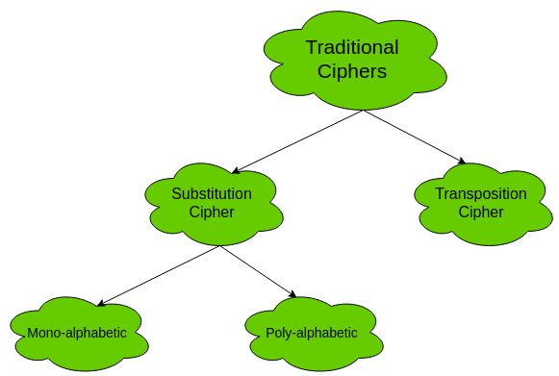

Slide 38
Substitution Cipher:
Substitution Ciphers are further divided into Mono-alphabetic Cipher and Poly-alphabetic Cipher.
Mono-alphabetic Cipher – In mono-alphabetic ciphers, each symbol in plain-text is mapped to one cipher-text symbol. No matter how many times a symbol occurs in the plain-text, it will correspond to the same cipher-text symbol. For example, if the plain-text is ‘follow’ and the mapping is :f -> g
o -> p
l -> m
w -> x
The cipher-text is ‘gpmmpx’.

Slide 39
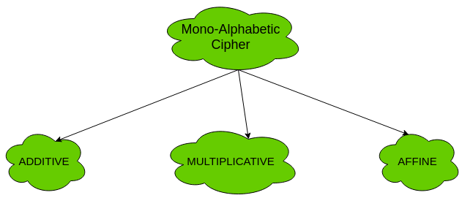

Slide 40
Caesar Cipher
It is a mono-alphabetic cipher wherein each letter of the plaintext is substituted by another letter to form the ciphertext. It is a simplest form of substitution cipher scheme.
This cryptosystem is generally referred to as the Shift Cipher. The concept is to replace each alphabet by another alphabet which is ‘shifted’ by some fixed number between 0 and 25.
For this type of scheme, both sender and receiver agree on a ‘secret shift number’ for shifting the alphabet. This number which is between 0 and 25 becomes the key of encryption.

Slide 41
Process of Shift Cipher
In order to encrypt a plaintext letter, the sender positions the sliding ruler underneath the first set of plaintext letters and slides it to LEFT by the number of positions of the secret shift.
The plaintext letter is then encrypted to the ciphertext letter on the sliding ruler underneath. The result of this process is depicted in the following illustration for an agreed shift of three positions. In this case, the plaintext ‘tutorial’ is encrypted to the ciphertext ‘WXWRULDO’. Here is the ciphertext alphabet for a Shift of 3 −

Slide 42
On receiving the ciphertext, the receiver who also knows the secret shift, positions his sliding ruler underneath the ciphertext alphabet and slides it to RIGHT by the agreed shift number, 3 in this case.
He then replaces the ciphertext letter by the plaintext letter on the sliding ruler underneath. Hence the ciphertext ‘WXWRULDO’ is decrypted to ‘tutorial’. To decrypt a message encoded with a Shift of 3, generate the plaintext alphabet using a shift of ‘-3’ as shown below −

Slide 43
Caesar Cipher is not a secure cryptosystem because there are only 26 possible keys to try out. An attacker can carry out an exhaustive key search with available limited computing resources.

Slide 44
Simple Substitution Cipher
It is an improvement to the Caesar Cipher. Instead of shifting the alphabets by some number, this scheme uses some permutation of the letters in alphabet.
With 26 letters in alphabet, the possible permutations are 26! (Factorial of 26) which is equal to 4x10²⁶. The sender and the receiver may choose any one of these possible permutation as a ciphertext alphabet. This permutation is the secret key of the scheme.

Slide 45
Write the alphabets A, B, C,...,Z in the natural order.
The sender and the receiver decide on a randomly selected permutation of the letters of the alphabet.
Underneath the natural order alphabets, write out the chosen permutation of the letters of the alphabet. For encryption, sender replaces each plaintext letters by substituting the permutation letter that is directly beneath it in the table. This process is shown in the following illustration. In this example, the chosen permutation is K,D, G, ..., O. The plaintext ‘point’ is encrypted to ‘MJBXZ’.

Slide 46
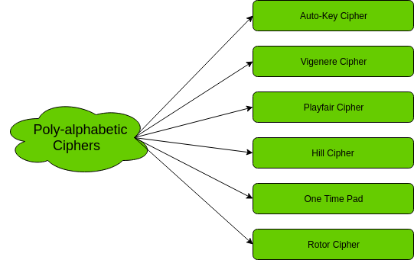

Slide 47
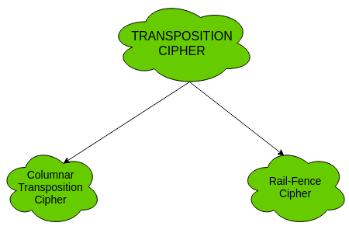

Slide 48
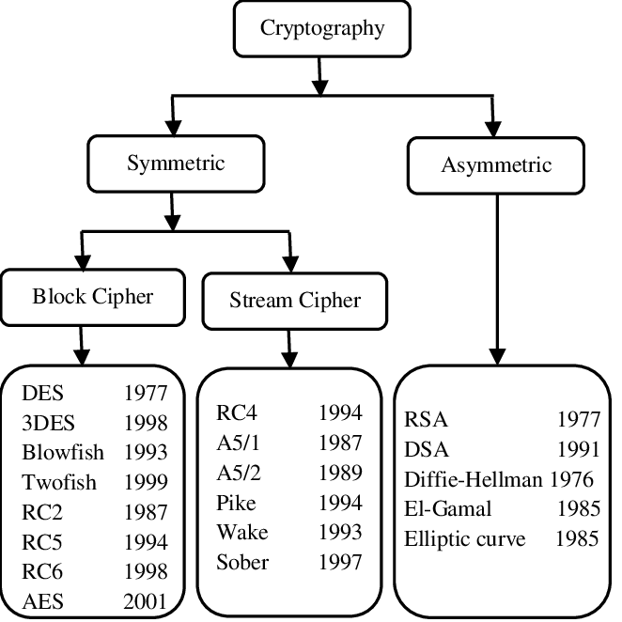

Slide 49
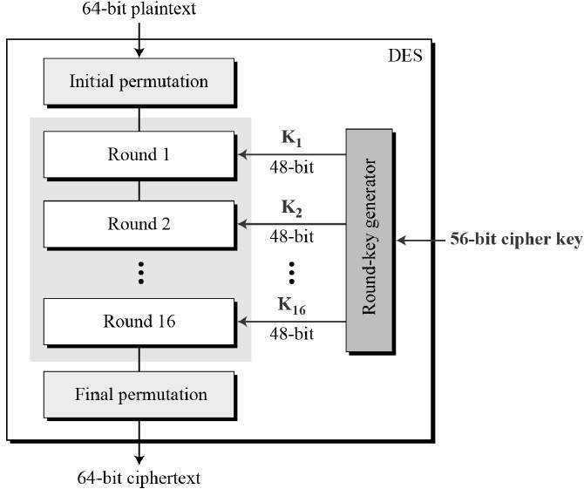
Data Encryption Standard (DES)

Slide 50
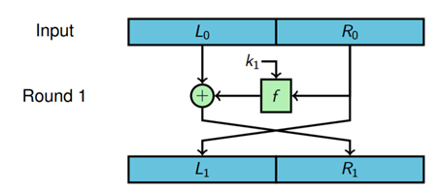
1 Fiestal Round

Slide 51
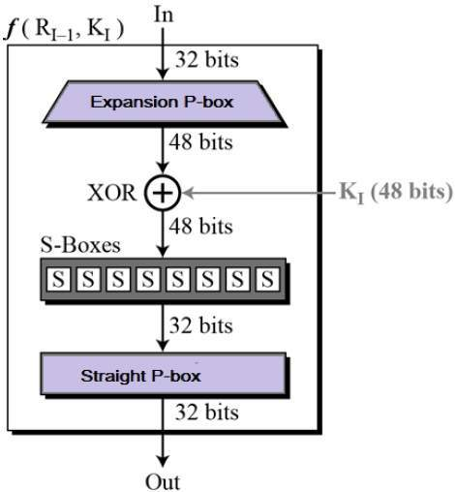
Round Function

Slide 52
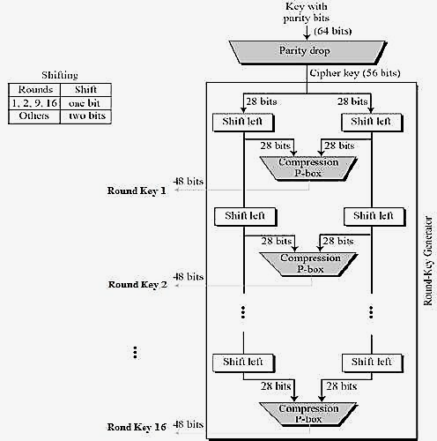
Key Generation

Slide 53
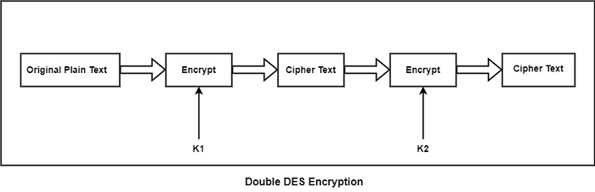
2DES ( Double DES)

Slide 54
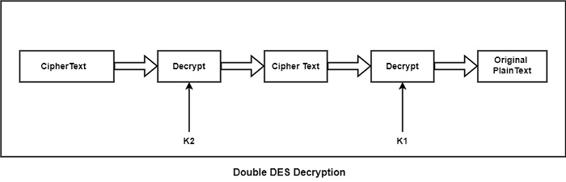

Slide 55
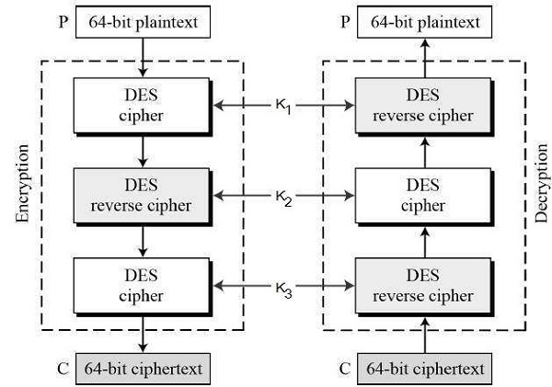
Tripple DES (3DES)

Slide 56
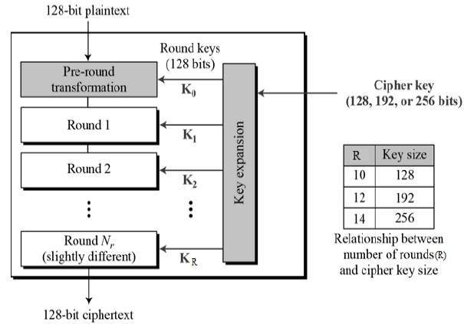
Advanced Encryption Standard

Slide 57
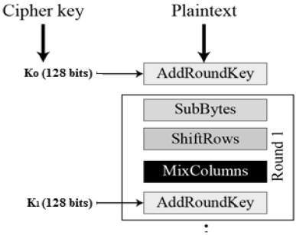

Slide 58
Digital Signature
A digital signature is a mathematical technique used to validate the authenticity and integrity of a message, software, or digital document.

Slide 59
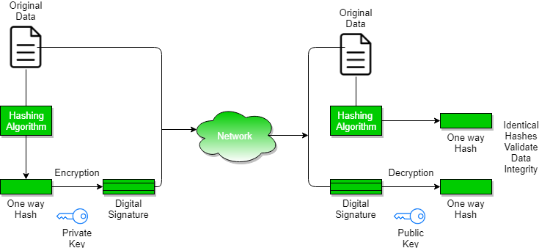

Slide 60

Steps in Creating Digital Signature
Message digest is computed by applying hash function on the message and then message digest is encrypted using private key of sender to form the digital signature. (digital signature = encryption (private key of sender, message digest) and message digest = message digest algorithm(message)
Digital signature is then transmitted with the message.(message + digital signature is transmitted)

Slide 61
Receiver decrypts the digital signature using the public key of sender.(This assures authenticity, as only sender has his private key so only sender can encrypt using his private key which can thus be decrypted by sender’s public key).
The receiver now has the message digest.
The receiver can compute the message digest from the message (actual message is sent with the digital signature).
The message digest computed by receiver and the message digest (got by decryption on digital signature) need to be same for ensuring integrity.

Slide 62
Public Key Infrastructure
PKI (public key infrastructure) is the underlying framework that enables entities -- users and servers -- to securely exchange information using digital certificates. The entities that facilitate and use PKI typically involve general internet users, web clients or browsers, and company servers.
It is a standard followed for managing, storing and revoking the digital certificate.

Slide 63
Architecture of PKI
Certificate repository
Entity
Registration authority (RA)
Certification authority (CA)

Slide 64
Certificate Authority : In cryptography, a certificate authority or certification authority is an entity that stores, signs, and issues digital certificates. A digital certificate certifies the ownership of a public key by the named subject of the certificate.
Entity : An Entity is a user of PKI certificates and/or the end user system that is the subject of a certificate, such as an e-mail client, a web server, a web browser, or a VPN-gateway.

Slide 65
Registration Authority : A registration authority (RA) is an authority in a network that verifies user requests for a digital certificate and tells the certificate authority (CA) to issue it
The main goal of a CA is to verify the authenticity and trustworthiness of a website, domain and organization so users know exactly who they're communicating with online and whether that entity can be trusted with their data.
When a CA issues a digital certificate for a website, users know they are connected with an official website, not a fake or spoofed website created by a hacker to steal their information or money.

Slide 66

Digital Certificate
Digital certificate is issued by a trusted third party which proves sender’s identity to the receiver and receiver’s identity to the sender.
A digital certificate is a certificate issued by a Certificate Authority (CA) to verify the identity of the certificate holder. The CA issues an encrypted digital certificate containing the applicant’s public key and a variety of other identification information.
Digital certificate is used to attach public key with a particular individual or an entity.

Slide 67
Digital certificate contains:
Name of certificate holder.
Serial number which is used to uniquely identify a certificate, the individual or the entity identified by the certificate
Expiration dates.
Copy of certificate holder’s public key.(used for decrypting messages and digital signatures)
Digital Signature of the certificate issuing authority.

Slide 68

Applications of Cryptography
SSL
PGP
Ipsec

Slide 69

IP Security (IPSec)
IPsec (Internet Protocol Security) is a suite of protocols designed to secure Internet Protocol (IP) communications by authenticating and encrypting each IP packet in a data stream. It operates at the network layer, making it versatile for securing various types of traffic, such as those from applications, web traffic, and email.

Slide 70

Key Features of IPsec:
Encryption: IPsec uses cryptographic algorithms to ensure that data remains confidential while in transit.
Authentication: It verifies the identity of the parties involved in the communication to ensure that the data is being sent and received by the intended users.
Integrity: IPsec ensures that the data has not been altered during transmission by using hash functions.
Key Management: IPsec uses protocols like Internet Key Exchange (IKE) to manage the keys used for encryption and decryption.

Slide 71

IPsec Protocols:
Authentication Header (AH): Provides data integrity and authentication but does not encrypt the data.
Encapsulating Security Payload (ESP): Provides data confidentiality through encryption, as well as optional authentication and integrity.

Slide 72
IP Security Architecture
IPSec (IP Security) architecture uses two protocols to secure the traffic or data flow. These protocols are ESP (Encapsulation Security Payload) and AH (Authentication Header). IPSec Architecture includes protocols, algorithms, DOI, and Key Management. All these components are very important in order to provide the three main services:
Confidentiality
Authenticity
Integrity

Slide 73
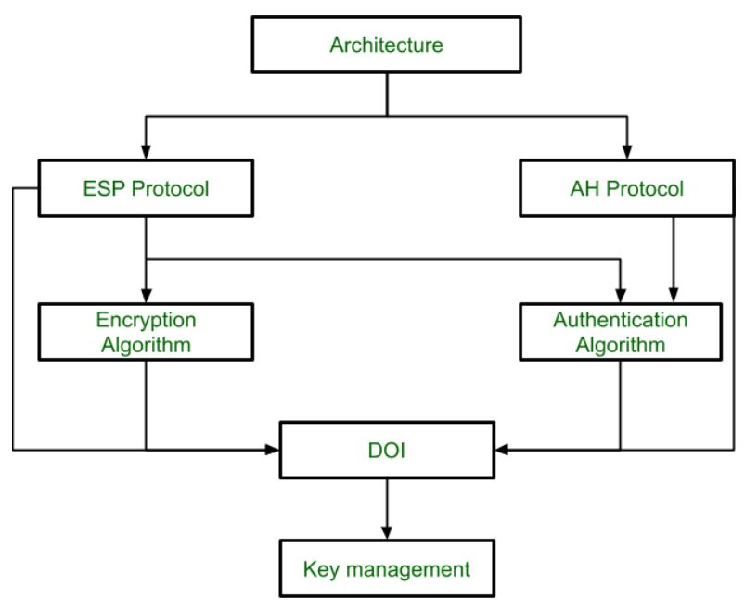

Slide 74
Secure Socket Layer (SSL)
SSL, or Secure Sockets Layer, is an encryption-based Internet security protocol. It was first developed by Netscape in 1995 for the purpose of ensuring privacy, authentication, and data integrity in Internet communications. SSL is the predecessor to the modern TLS encryption used today.
A website that implements SSL/TLS has "HTTPS" in its URL instead of "HTTP."

Slide 75
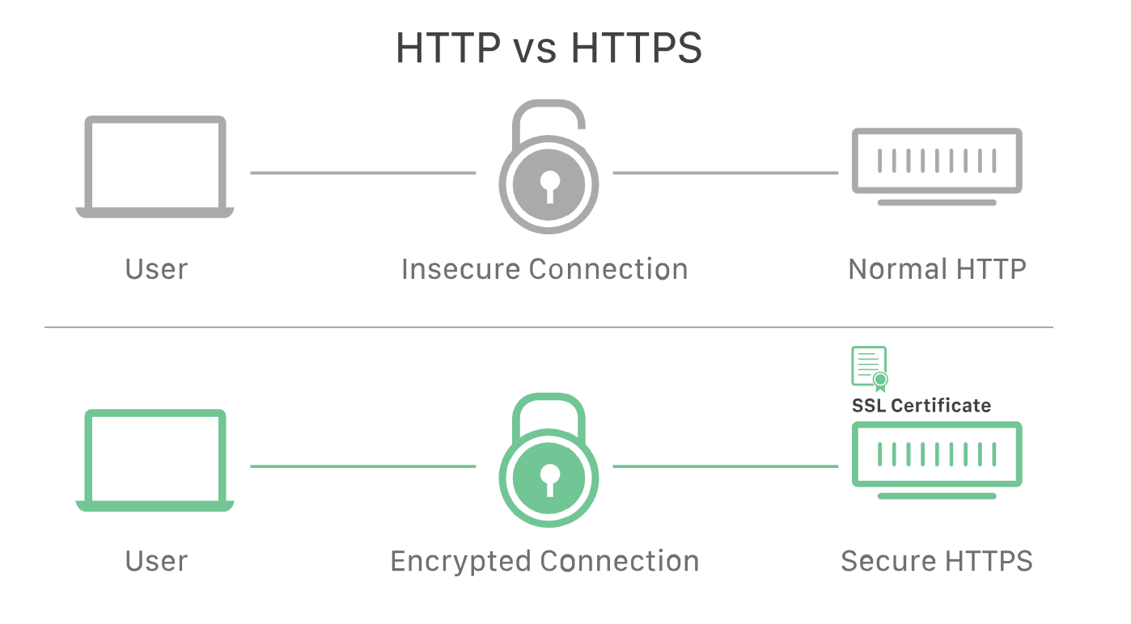

Slide 76
How does SSL/TLS work?
In order to provide a high degree of privacy, SSL encrypts data that is transmitted across the web. This means that anyone who tries to intercept this data will only see a garbled mix of characters that is nearly impossible to decrypt.
SSL initiates an authentication process called a handshake between two communicating devices to ensure that both devices are really who they claim to be.
SSL also digitally signs data in order to provide data integrity, verifying that the data is not tampered with before reaching its intended recipient.

Slide 77
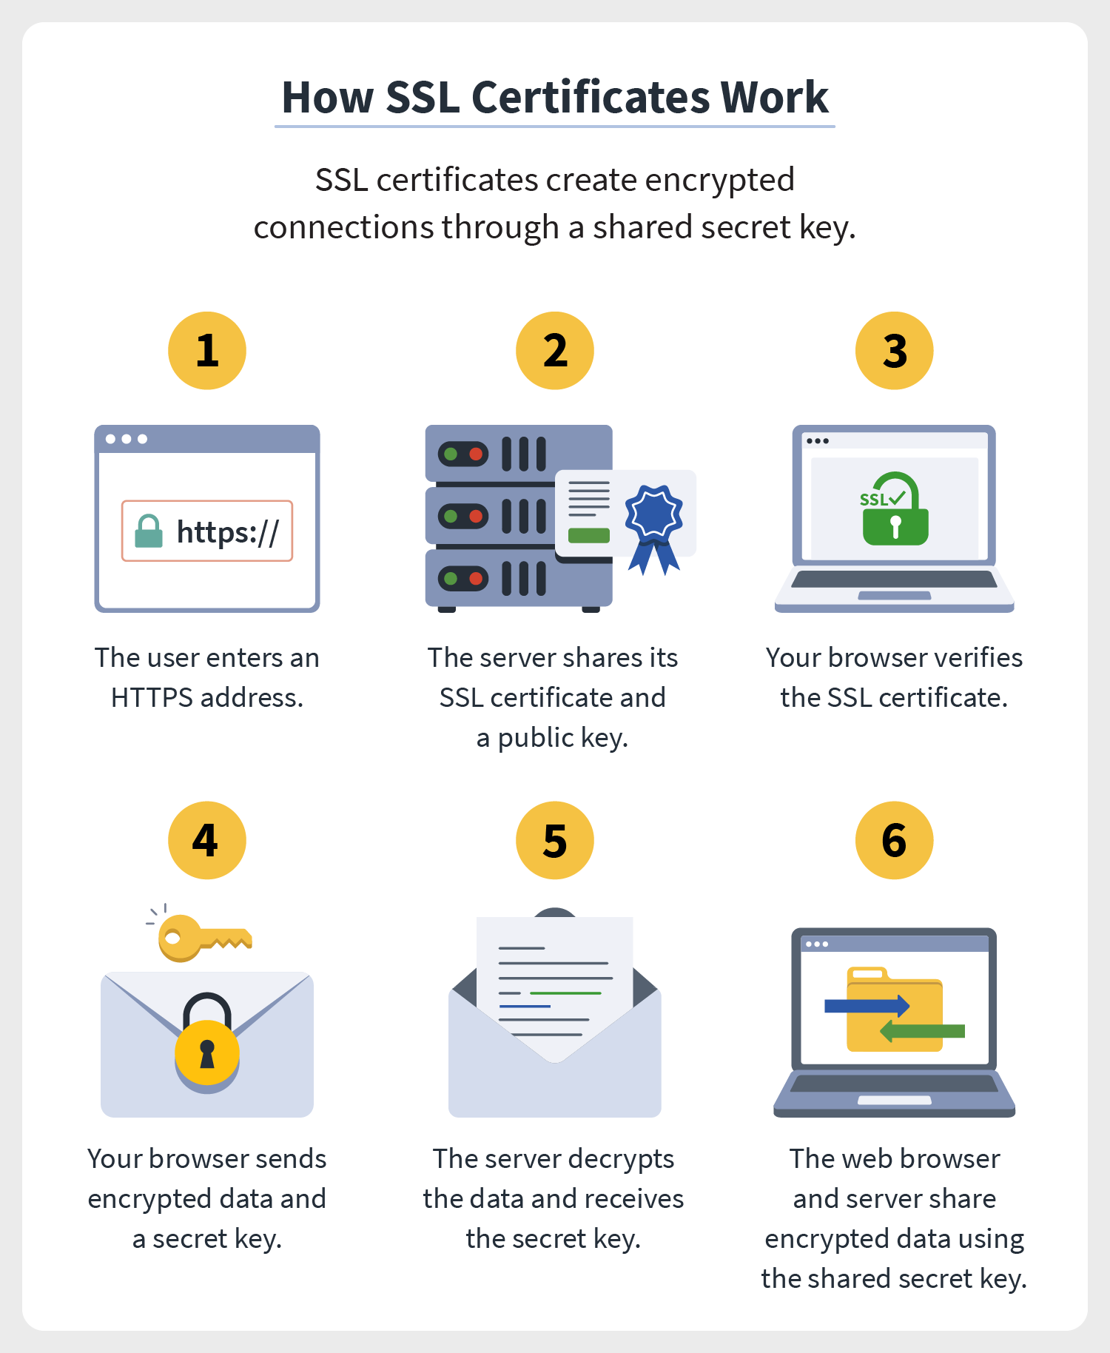

Slide 78
Why is SSL/TLS important?
Originally, data on the Web was transmitted in plaintext that anyone could read if they intercepted the message. For example, if a consumer visited a shopping website, placed an order, and entered their credit card number on the website, that credit card number would travel across the Internet unconcealed.
SSL was created to correct this problem and protect user privacy. By encrypting any data that goes between a user and a web server, SSL ensures that anyone who intercepts the data can only see a scrambled mess of characters. The consumer's credit card number is now safe, only visible to the shopping website where they entered it.
SSL also stops certain kinds of cyber attacks: It authenticates web servers, which is important because attackers will often try to set up fake websites to trick users and steal data. It also prevents attackers from tampering with data in transit, like a tamper-proof seal on a medicine container.

Slide 79
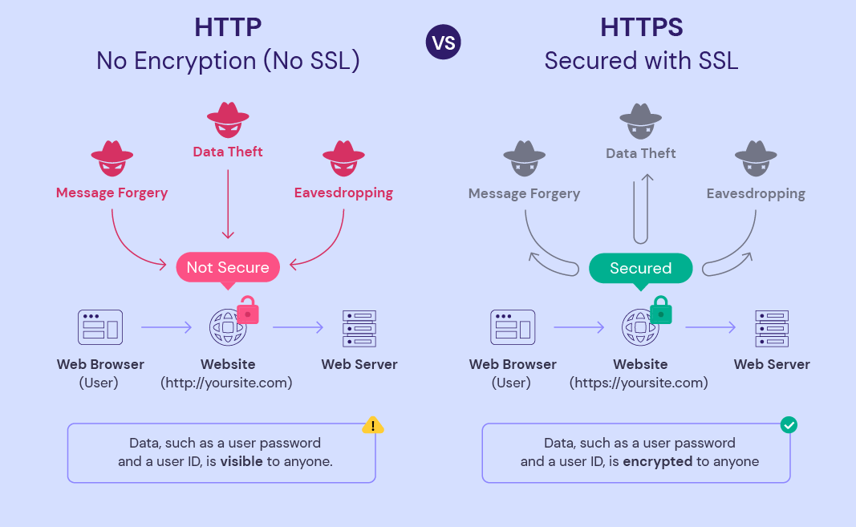

Slide 80
PGP
PGP stands for Pretty Good Privacy (PGP) which is invented by Phil Zimmermann.
PGP was designed to provide all four aspects of security, i.e., privacy, integrity, authentication, and non-repudiation in the sending of email.
PGP uses a digital signature (a combination of hashing and public key encryption) to provide integrity, authentication, and non-repudiation. PGP uses a combination of secret key encryption and public key encryption to provide privacy. Therefore, we can say that the digital signature uses one hash function, one secret key, and two private-public key pairs.
PGP is an open source and freely available software package for email security.
PGP provides authentication through the use of Digital Signature.
It provides confidentiality through the use of symmetric block encryption.
It provides compression by using the ZIP algorithm, and EMAIL compatibility using the radix-64 encoding scheme.

Slide 81
Following are the steps taken by PGP to create secure e-mail at the sender site:
The e-mail message is hashed by using a hashing function to create a digest.
The digest is then encrypted to form a signed digest by using the sender's private key, and then signed digest is added to the original email message.
The original message and signed digest are encrypted by using a one-time secret key created by the sender.
The secret key is encrypted by using a receiver's public key.
Both the encrypted secret key and the encrypted combination of message and digest are sent together.

Slide 82
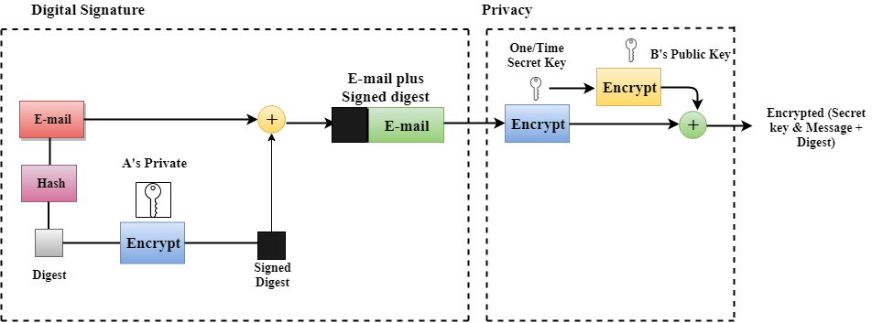
PGP at the Sender site (A)

Slide 83
Following are the steps taken to show how PGP uses hashing and a combination of three keys to generate the original message:
The receiver receives the combination of encrypted secret key and message digest is received.
The encrypted secret key is decrypted by using the receiver's private key to get the one-time secret key.
The secret key is then used to decrypt the combination of message and digest.
The digest is decrypted by using the sender's public key, and the original message is hashed by using a hash function to create a digest.
Both the digests are compared if both of them are equal means that all the aspects of security are preserved.

Slide 84
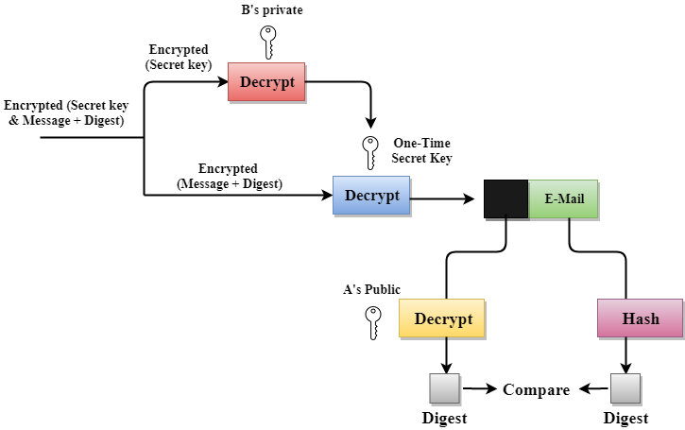
PGP at the Receiver site (B)

