Slide 1

Enumeration

Slide 2
What is Enumeration?
Enumeration is extracting a system’s valid usernames, machine names, share names, directory names, and other information. It is a key component of ethical hacking and penetration testing, as it can provide attackers with a wealth of information that can be used to exploit vulnerabilities. It can also be defined as collecting detailed information about the target systems, such as operating and network infrastructure details. Enumeration can be used in both an offensive and defensive manner.

Slide 3
Enumeration is one of the most important steps in ethical hacking because it gives hackers the necessary information to launch an attack. For example, hackers who want to crack passwords need to know the usernames of valid users on that system. Enumerating the target system can extract this information

Slide 4
Enumeration can be used to gather any of the following information:
Operating system details
Network infrastructure details
Usernames of valid users
Machine names
Share names
Directory names
Printer names
Web server details

Slide 5
Why Is Enumeration Important?
Enumeration lets you understand what devices are on your network, where they are located, and what services they offer. To put it simply, enumeration can be used to find security vulnerabilities within systems and networks. By conducting an enumeration scan, you can see what ports are open on devices, which ones have access to specific services, and what type of information is being transmitted. This information can then be used to exploit weaknesses and gain unauthorized access.
Carrying out an enumeration scan requires both time and patience. However, it’s a crucial step in the hacking process as it allows you to gather intelligence about your target. Enumeration can be performed manually or with automated tools. Whichever method you choose, it’s important to be thorough in your scan to maximize the amount of information you can collect.

Slide 6
Techniques for Enumeration
When it comes to network security, enumeration is key. By enumerating a system, you can gain a better understanding of that system and how it works. This knowledge can then be used to exploit vulnerabilities and gain access to sensitive data.
Several techniques can be used for enumeration, and your method will depend on the type of system you are targeting. The most common methods include email IDs and usernames, default passwords, and DNS zone transfer.

Slide 7
Using email IDs and usernames is a great way to gather information about a system. You can use this information to brute force passwords or gain access to sensitive data. Default passwords are another common method of enumeration.
By using default passwords, you can gain access to systems that have not been properly configured.
DNS zone transfer is a technique that can be used to expose topological information. This information can be used to identify potential targets for attack.
Understanding the techniques available for enumeration can better protect your systems from attack.

Slide 8
Process of Enumeration
Enumeration is the process of identifying all hosts on a network. This can be done in several ways, but active and passive scanning is the most common method. Active scanning involves sending out requests and analyzing the responses to determine which hosts are active on the network. Passive scanning involves listening to traffic and then analyzing it to identify hosts.
Both methods have their advantages and disadvantages. Active scanning is more likely to identify all hosts on a network, but it is also more likely to cause disruptions because it generates a lot of traffic. Passive scanning is less likely to identify all hosts, but it is also less likely to cause disruptions because it does not generate any traffic.

Slide 9
The Types of Enumeration
There are many different types of enumeration. The most appropriate type will depend on the situation and the required information:
NetBIOS Enumeration: NetBIOS is a protocol that allows devices on a network to share resources and communicate with each other. NetBIOS enumeration is querying a device to identify what NetBIOS resources are available. This can be done using tools like nbtstat and net view.
SNMP Enumeration: SNMP is a protocol that allows devices to be managed and monitored remotely. SNMP enumeration is querying a device to identify what SNMP resources are available. This can be done using tools like SNMP-check and snmpwalk.
LDAP Enumeration: LDAP is a protocol that allows devices on a network to share information about users and resources. LDAP enumeration is querying a device to identify what LDAP resources are available. This can be done using tools like ldapsearch and ldapenum.
NTP Enumeration: NTP is a protocol that allows devices on a network to synchronize their clocks with each other. NTP enumeration is querying a device to identify what NTP resources are available.

Slide 10
NetBIOS Enemuration
NetBIOS is an acronym that stands for Network Basic Input Output System. It enables computer communication over a LAN and the sharing of files and printers. TCP/IP network devices are identified using NetBIOS names (Windows). It must be network-unique and limited to 16 characters, with 15 reserved for the device name and the 16th reserved for identifying the type of service running or name record type.

Slide 11
Uses of NetBIOS Enumeration:
An attacker who discovers a Windows OS with port 139 open can investigate what resources are accessible or viewable on the remote system. To enumerate the NetBIOS names, the remote system must have file and printer sharing enabled. Depending on the availability of shares, NetBIOS enumeration may allow an attacker to read or write to the remote computer system or launch a (Dos).

Slide 12
NetBIOS Enumeration Tools:
NetBIOS’s enumeration tools explore and scan the network for security loopholes or flaws in networked systems within a given range of IP addresses and computer lists. In addition, these tools list the operating system, users, password policies, groups, service packs and hotfixes, services, NetBIOS shares, discs, transmits, sessions, SIDs and security event logs.

Slide 13
Netstat:
Netstat is a utility for obtaining protocol statistics, NetBIOS name table, name cache information and current TCP/IP connections over NBT (NetBIOS over TCP/IP), assisting in the resolution of NetBIOS name resolution issues. Name resolution is normally performed when NetBIOS over TCP/IP is operational.

Slide 14
Nbtst Parameters | Functions
-a RemoteName | Displays the NetBIOS name table of a remote computer, where RemoteName is the remote computer’s NetBIOS computer name.
-A IPAddress | Displays the NetBIOS name table of a remote computer, as specified by the remote computer’s IP address (in dotted decimal notation).
-c | The contents of the NetBIOS name cache, as well as the table of NetBIOS names and their resolved IP addresses, are listed.
-n | Displays the names that NetBIOS applications, such as the server and redirector, have registered locally.
-r | Displays the total number of names resolved by a broadcast or WINS server.
-R | Removes all #PRE entries from LMHOSTS and clears the name cache.
-RR | All names are released and reregistered with the name server.
-s | The NetBIOS sessions table is listed, with destination IP addresses converted to computer NetBIOS names.
-S | Lists the current NetBIOS sessions, along with their status and IP addresses.
Interval | Displays selected statistics again, pausing for the amount of time specified in Interval between each display.

Slide 15
SNMP Enumeration
Simple Network Management Protocol (SNMP) is an application layer protocol that runs on UDP and maintains and manages IP network routers, hubs, and switches. SNMP agents run on networking devices in Windows and UNIX networks.
SNMP (Simple Network Management Protocol) is an application layer protocol that utilizes the UDP protocol to manage routers, hubs, and switches on an IP network. SNMP is a widely used protocol that is enabled on a wide range of operating systems, including Windows Server, Linux servers, and network devices such as routers and switches. On a target system, SNMP enumeration is used to list user accounts, passwords, groups, system names, and devices.

Slide 16
Components
SNMP Enumeration is made up of three major parts:
Managed Device: A managed device is a device or a host (technically referred to as a node) that has the SNMP service enabled. These devices include routers, switches, hubs, bridges, computers, and so on.
Agents: An agent is a software component that runs on a managed device. Its primary function is to convert data into an SNMP-compatible format for network management via the SNMP protocol.
Network Management System (NMS) : NMS are software systems that are employed to monitor network devices.

Slide 17
Working
The process of enumerating user accounts and devices on a target machine using SNMP is known as SNMP enumeration. SNMP is made up of a manager and an agent; the agent is embedded in every network device, while the manager is installed on a separate computer. To access and configure the SNMP agent from the management station, SNMP stores two passwords:

Slide 18
Read the community string: By default, it is public and allows viewing of device/system configuration.
Read/write community string: It is private by default and allows remote configuration editing.
These default community strings are used by attackers to gather information about a machine. Attackers use SNMP to gather data on the network’s resources such as hosts, routers, devices, shares, and so on, as well as network information such as ARP tables, routing tables, traffic, and so on.

Slide 19
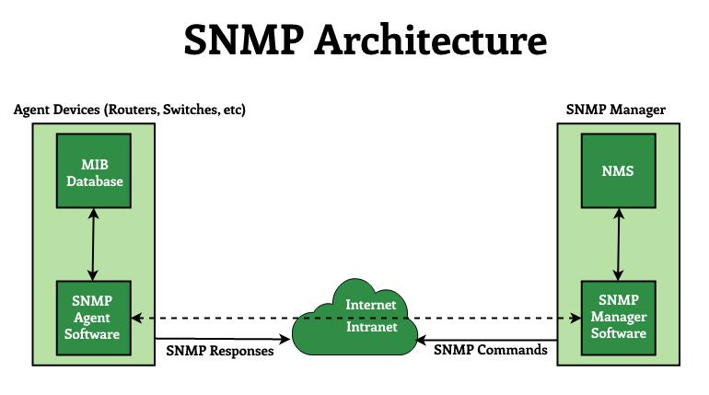

Slide 20
Management Agent: An application that resides in managed devices such as hosts, bridges, routers, and so on. The agent responds to the operative’s requests for data and actions and may send asynchronous messages to the operative in the event of a critical event.
Management Station: It serves as the human network manager’s interface to the network management station (or network operation center NOC), from which he monitors and manages the network and assists in fault recovery.

Slide 21
Network Management Protocol: The network management protocol (SNMP) is used to transfer data and commands between agents and managing entities. For communication between managers and agents, SNMP employs the User Datagram Protocol (UDP) as the transport protocol. The reasons for exploitation of UDP for SNMP area unit are as follows:
First, it has low overheads in comparison to the protocol, which uses a 3-way handshake for the association.
Second, in large networks, SNMP over protocol may be a risky strategy because the protocol to ensure dependability can flood the network with retransmissions. SNMP sends and receives requests on UDP port 161, and receives traps from managed devices on UDP port 162.

Slide 22
Management database (MIB) : A management database is represented as a collection of managed objects. These objects together form the MIB virtual database. Although an agent may implement multiple MIBs, all agents must implement a single MIB, known as MIB-II. This standard defines variables for things like interface statistics (interface speeds, MTU, octets sent, octets received, and so on) as well as various other things related to the system itself (system location, system contact, etc.). MIB-primary II’s goal is to generate general TCP/IP management data.

Slide 23
Protective Measure from SNMP Enumeration
SNMP agents on hosts should be removed or disabled.
All perimeter network access devices should block port 161.
Access should be limited to specific IP addresses.
Make use of SNMPv3 (more secure)
Add the Group Policy security option “Additional restrictions for anonymous connections” to your configuration.
Null session pipes, null session shares, and IPsec filtering should all be restricted as well.

Slide 24
LDAP Enemuration
Lightweight Directory Access Protocol (LDAP) is an internet protocol that works on TCP/IP, used to access information from directories. The LDAP protocol is used to access an active directory. LDAP enumeration is a technique used to enumerate the active directory. This service mainly runs on TCP ports 389 and 639 as default. LDAP enumeration can help enumerate usernames, addresses, and much juicy information that can be later used for other attacks including social engineering attacks.
LDAP queries can be used to enumerate various things like usernames, groups, and much more stuff.

Slide 25
Tools
Nmap
enum4linux
windapsearch
ldapsearch
Jxplorer

Slide 26
SMTP Enemuration
SMTP (Simple Mail Transfer Protocol) is a set of communication guidelines that allow web applications to perform communication tasks over the internet, including emails. It is a part of the TCP/IP protocol and works on moving emails across the network. SMTP enumeration allows us to identify valid users on the SMTP server. This is done with the built-in SMTP commands using them. VRFY – This command is used to authenticate the user. EXPN – This command displays the actual mailing address for aliases and mailing lists. RCPT TO – It identifies the recipient of the message. SMTP enumeration is a technique used to enumerate the SMTP service that is running on the target server.

Slide 27
Predefined Commands
VRFY: It is used to validate the user on the server.
EXPN: It is used to find the delivery address of mail aliases
RCPT TO: It points to the recipient’s address.

Slide 28
Test for SMTP Enumeration:
SMTP enumeration can be performed by using different tools and scripts like telnet, Nmap, and smtp-user-enum.

Slide 29
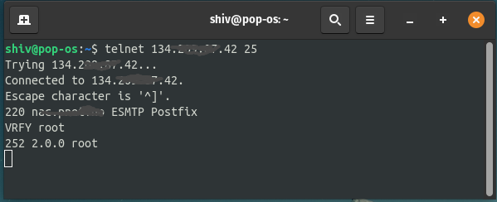
1. Using Telnet for SMTP enumeration:
Telnet comes in handy in SMTP enumeration as it provides a communication channel with the host.
Example: $ telnet <domain name/ip> <port no.>

Slide 30
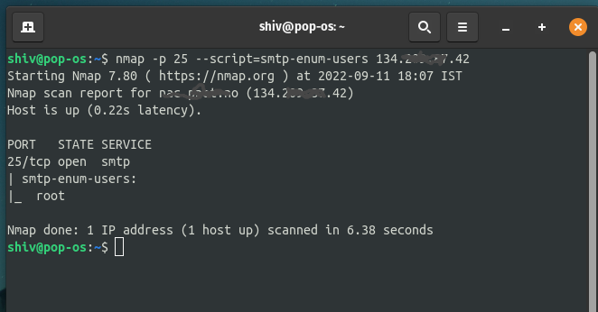
2. Using Nmap for SMTP enumeration:
Nmap is a powerful tool and is used in different enumeration phases. Nmap provides special scripts for SMTP enumeration. smtp-enum-users is one of the scripts that is provided by Nmap.
$sudo nmap -p 25 --script = smtp-enum-users <target Domain/IP>

Slide 31
Mitigation Of Different Types Of Enumeration
SNMP Enumeration:
Eliminate the specialist or shut off the SNMP administration.
In the event that stopping SNMP isn’t a choice, at that point change the default network string names.
Move up to SNMP3, which encodes passwords and messages.
Actualize the Group Policy security alternative.

Slide 32
LDAP Enumeration
Utilize SSL technology to encrypt the traffic.
Select a username unique in relation to your email address and empower account lockout.

Slide 33
SMTP Enumeration
Ignore email messages to unknown recipients.
Disable open relay feature.
Breaking point the number of acknowledged associations from a source to forestall brute force exploits.
Not to include sensitive mail server and localhost information in mail responses.

