Slide 1


INT 244
Securing Computing Systems
Lecture 0

Slide 2
Course details
LTP – 2 0 2
Text Books
1. CEH V9: CERTIFIED ETHICAL HACKER - VERSION 9 STUDY GUIDE - SEAN-PHILIP ORIYANO
References:
1. MASTERING KALI LINUX FOR ADVANCED PENETRATION TESTING - VIJAY KUMAR VELU

Slide 3
Course Outcomes
Through this course students should be able to:
CO1 :: describe the basic concepts of operating systems, cryptography and ethical hacking
CO2 :: discuss various methods of performing footprinting and scanning the target systems
CO3 :: illustrate the process of enumerating and compromising a target system
CO4 :: examine the usage of sniffers, social engineering techniques and denial of service attacks for compromising the target
CO5 :: analyze the functionality of session hijacking, web applications and SQL injection in testing the security of target
CO6 :: understand the process of identifying the threats to WiFi, Bluetooth, mobile devices, cloud services and SOC and SIEM solutions

Slide 4
Program Outcomes as specific to the particular course
PO-1:Engineering knowledge::Apply the knowledge of mathematics, science, engineering fundamentals, and an engineering specialization to the solution of complex engineering problems.
PO-2: Problem analysis::Identify, formulate, research literature, and analyze complex engineering problems reaching substantiated conclusions using first principles of mathematics, natural sciences, and engineering sciences.
PO-3:Design/development of solutions::Design solutions for complex engineering problems and design system components or processes that meet the specified needs with appropriate consideration for the public health and safety, and the cultural, societal, and environmental considerations.
PO-4:Conduct investigations of complex problems::Use research-based knowledge and research methods including design of experiments, analysis and interpretation of data, and synthesis of the information to provide valid conclusions.
PO-5: Modern tool usage::Create, select, and apply appropriate techniques, resources, and modern engineering and IT tools including prediction and modeling to complex engineering activities with an understanding of the limitations
PO-8:Ethics::Apply ethical principles and commit to professional ethics and responsibilities and norms of the engineering practice.
PO-9:Individual and team work::Function effectively as an individual, and as a member or leader in diverse teams, and in multidisciplinary settings.
PO-12: Life-long learning::Recognize the need for, and have the preparation and ability to engage in independent and life-long learning in the broadest context of technological change.
PO-13: Competitive Skills::Ability to compete in national and international technical events and building the competitive spirit

Slide 5
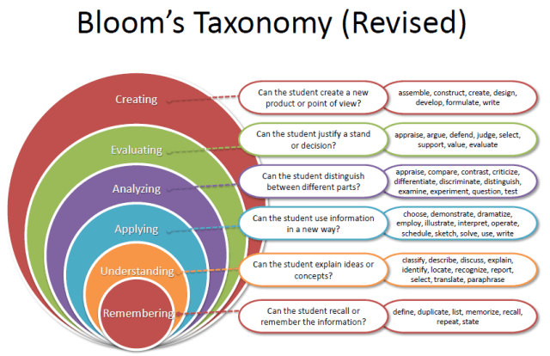
Revised Bloom’s Taxonomy

Slide 6
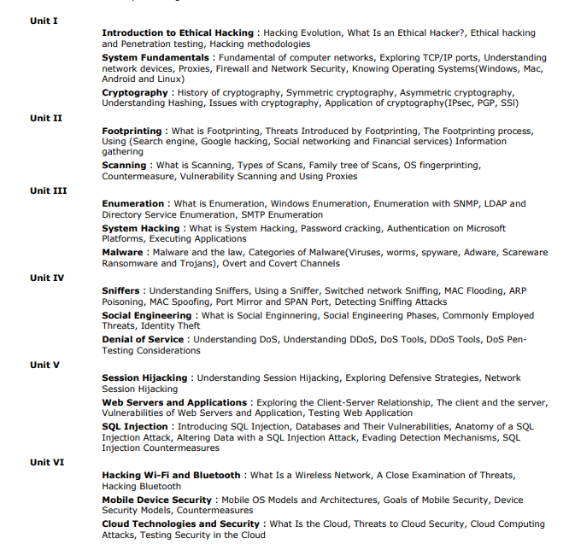
The course contents

Slide 7
List of practicals
Foot-printing: Demonstration of the process of active and active and passive information gathering using search engines, GHDB and Netcraft.
Scanning: Demonstration of port, network and vulnerability scanning with the help of Nmap, Nessus and Rapid7 and AngryIP
Enumeration: Demonstration of windows, Linux enumeration and network protocol enumeration with the help of inbuilt utilities and open-source tools.
System Hacking: Demonstration of offline and online password cracking with the help of dictionary, brute force and hybrid attack and generating rainbow tables.
Sniffing: Demonstration of network sniffing with the help of packet sniffers such as Wireshark, Tcpdump and Dsniff and understand the data that is being sniffed by the respective tools
Denial of Service: Demonstration of various Dos attacks such as Service Request Floods, ICMP Flooding, Smurf and Fraggle Attacks using different tools.
Sql Injection: Demonstration of various types of Sql injection with the help of different tools.
SIEM: Demonstration of Log Data Management, Network visibility, Threat Intelligence, Analytics, Real-time Alerting

Slide 8
Relevant resources
https://www.cybrary.it/course/ethical-hacking/
https://www.cybrary.it/course/metasploit/
https://s3-us-west-2.amazonaws.com/stationx-public-download/nmap_cheet_sheet_0.6.pdf
What is SQL Injection? Tutorial & Examples | Web Security Academy (portswigger.net)
https://davidbombal.com/wireshark-tutorial-installation-and-password-sniffing/
https://www.exploit-db.com/google-hacking-database

Slide 9
Course Assessment Model
Marks break up
Attendance 5%
CA 25%
MTE 20%
ETE 50%
Total 100%
Three Class test – One before MTE and Two after MTE
CA 1-Scenario based questions
CA 2- BYOD practical
CA 3- MCQs based questions

Slide 10
Recommended MOOCs course
Certification Name | URL | Mapping Percentage | Exemption
CEH (Certified Ethical Hacking) | https://www.eccouncil.org/programs/certified-ethical-hacker-ceh/ | 100% | Completed Course exempted

Slide 11
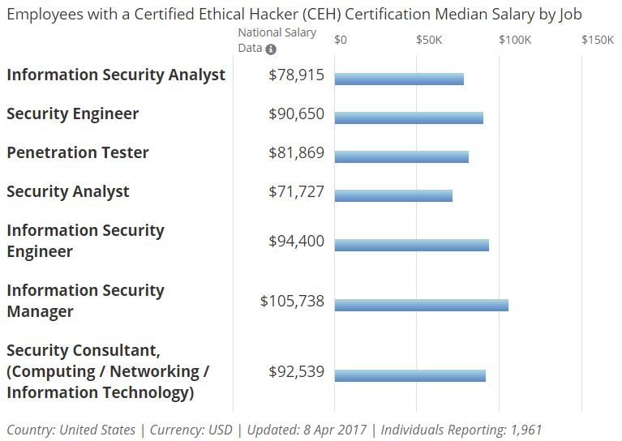
Career prospects of CEH(Certified Ethical Hacker)

Slide 12
What is Ethical Hacking?
Ethical hacking are terms used to describe hacking performed by a company or individual to help identify potential threats on a computer or network.
An ethical hacker attempts to bypass way past the system security and search for any weak points that could be exploited by malicious hackers.
This information is then used by the organization to improve the system security, in an effort to minimize or eliminate, any potential attacks.

Slide 13
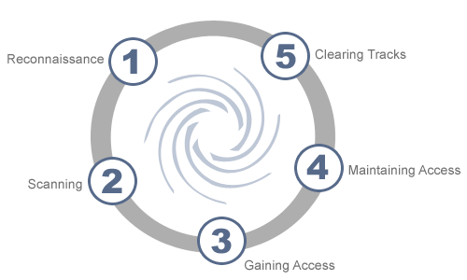
Phases of Hacking

Slide 14
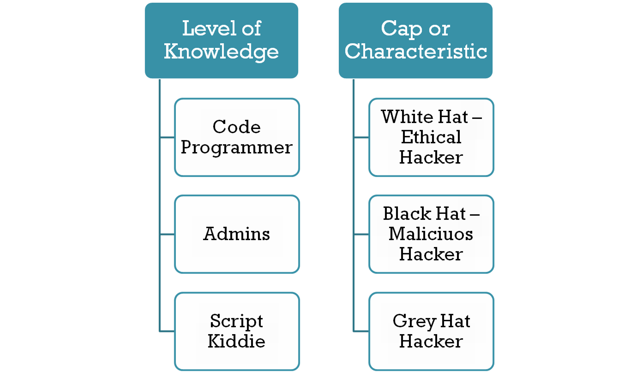
Types of Hackers and Testers
Hacktivists
Cyberwarrior
Black Box Penetration Testers
White Box Penetration Testers

