Slide 1
Using HTML Tables

Slide 2
Defining a Table Structure
The first step for creating a table is to specify the table structure:
  the number of rows and columns
  the location of column headings
  the placement of a table caption
Once the table structure is in place, you can start entering data into the table.

Slide 3
Using the <table>,
<tr>, and <td> Tags
Tables are enclosed within a two-sided <table> tag that identifies the start and ending of the table structure.
Each row of the table is indicated using a two-sided <tr> (for table row).
Within each table row, a two-sided <td> (for table data) tag indicates the presence of individual table cells.

Slide 4

The General Table Syntax
  <table>
  <tr>
  <td> First Cell </td>
  <td> Second Cell </td>
  </tr>
  <tr>
  <td> Third Cell </td>
  <td> Fourth Cell </td>
  </tr>
  </table>
two rows
two columns

Slide 5
Columns within a Table
HTML does not provide a tag for table columns.
In the original HTML specifications, the number of columns is determined by how many cells are inserted within each row.
  for example, if you have four <td> tags in each table row, that table has four columns
Later versions of HTML provide increased support for controlling the appearance of table columns.

Slide 6
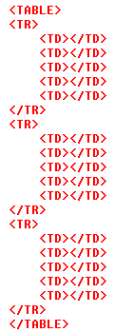
HTML Structure of a Table
beginning of the table structure
table cells
You do not need to indent the <td> tags or place them on separate lines, but you may find it easier to interpret your code if you do so.
After the table structure is in place, you’re ready to add the text for each cell.
first row of six in the table
end of the table structure

Slide 7
Creating Headings with the <th> Tag
HTML provides the <th> tag for table headings.
Text formatted with the <th> tag is centered within the cell and displayed in a boldface font.
The <th> tag is most often used for column headings, but you can use it for any cell that you want to contain centered boldfaced text.

Slide 8
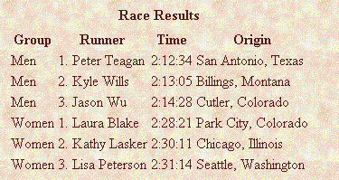
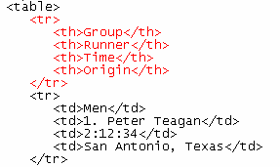
Adding Table Headings to the Table
Text in cells formatted with the <th> tag is bold and centered above each table column.
table headings

Slide 9
Creating a Table Caption
HTML allows you to specify a caption for a table.
The syntax for creating a caption is: <caption align=“alignment”>caption text</caption>
  alignment indicates the caption placement
  a value of “bottom” centers the caption below the table

Slide 10
Table Captions
Only Internet Explorer supports all caption values.
Netscape supports only the “top” and “bottom” values.
The <caption> tag works only with tables, the tag must be placed within the table structure.
Captions are shown as normal text without special formatting.
Captions can be formatted by embedding the caption text within other HTML tags.
  for example, place the caption text within a pair of <b> and <i> tags causes the caption to display as bold and italic

Slide 11
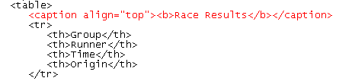
Result of a Table Caption
caption text
caption will be centered above the table

Slide 12
Modifying the Appearance of a Table
You can modify the appearance of a table by adding:
  gridlines
  borders
  background color
HTML also provides tags and attributes to control the placement and size of a table.

Slide 13
Adding a Table Border
By default, browsers display tables without table borders.
A table border can be added using the border attribute to the <table> tag.
The syntax for creating a table border is: <table border=“value”>
  value is the width of the border in pixels
The size attribute is optional; if you don’t specify a size, the browser creates a table border 1 pixel wide.

Slide 14
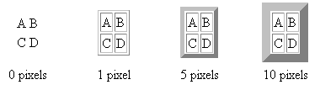
Tables with Different Borders Values
This figure shows the effect on a table’s border when the border size is varied.

Slide 15
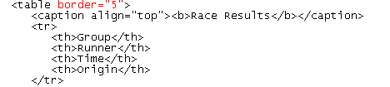
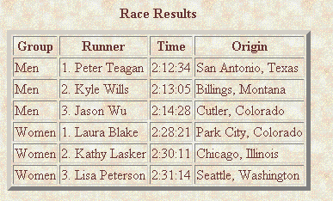
Adding a 5-Pixel Border to a Table
Only the outside border is affected by the border attribute; the internal gridlines are not affected.

Slide 16
Controlling Cell Spacing
The cellspacing attribute controls the amount of space inserted between table cells.
The syntax for specifying the cell space is:
  <table cellspacing=“value”>
  value is the width of the interior borders in pixels
  the default cell spacing is 2 pixels
Cell spacing refers to the space between the cells.

Slide 17
Defining Cell Padding
To control the space between the table text and the cell borders, add the cellpadding attribute to the table tag.
The syntax for this attribute is:
<table cellpadding=“value”>
  value is the distance from the table text to the cell border, as measured in pixels
  the default cell padding value is 1 pixel
Cell padding refers to the space within the cells.

Slide 18

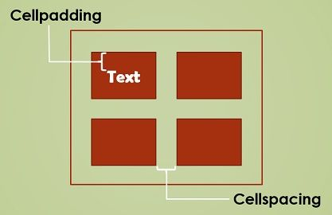
<table style="width:70%;" cellspacing="20px” cellpadding=“10px”>

Slide 19
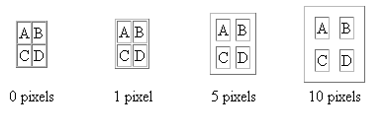
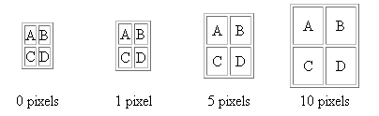
Tables with Different
Cell Spacing Values
different cell spacing values
different cell padding values

Slide 20
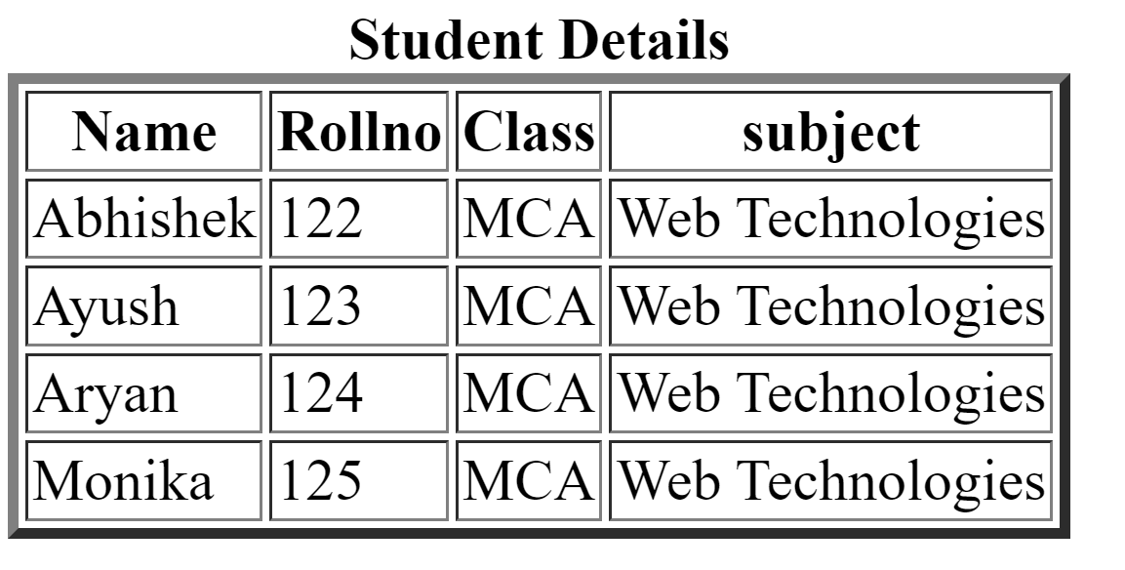
Try This…..!

Slide 21
Table Frames and Rules
Two additional table attributes introduced in HTML 4.0 are the frames and rules attributes.
With the frame and rule attributes you can control how borders and gridlines are applied to the table.
The frames attribute allows you to determine which sides of the table will have borders.
The frame attribute syntax is: <table frame=“type”>
  type is either “box” (the default), “above”, “below”, “hsides”, “vsides”, “lhs”, “rhs”, or “void”

Slide 22
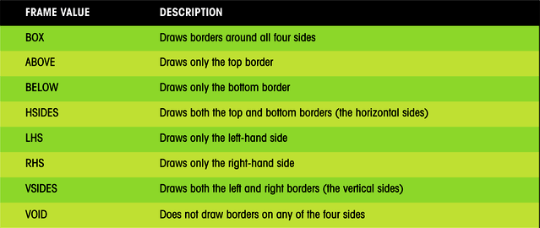
Values of the Frame Attribute

Slide 23
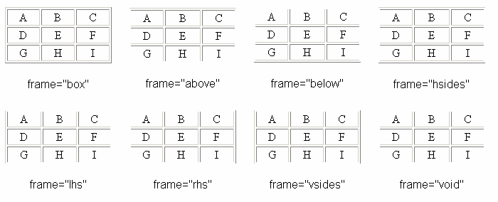
Effect of Different Frame Values
This figure shows the effect of each of the frame values on the table grid.

Slide 24
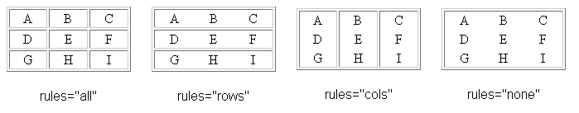
Creating Frames and Rules Continued
The rules attribute lets you control how the table gridlines are drawn (not supported by Netscape)
The syntax of the rules attribute is:
<table rules=“type”>
  type is either “all”, “rows”, “cols”, or “none”
the effect of each of the rules attribute values on a table

Slide 25
Working with Table and Cell Size
The size of a table is determined by text it contains in its cells.
By default, HTML places text on a single line.
As you add text in a cell, the width of the column and table expands to the edge of the page.
  once the page edge is reached, the browser reduces the size of the remaining columns to keep the text to a single line
You can insert line break, paragraph, or other tags within a cell.
When the browser can no longer increase or decrease the size of the column and table it wraps the text to a second line.
As more text is added, the height of the table expands to accommodate the additional text.
But, you can manually define the size of the table and its cells.

Slide 26
Defining the Table Size
The syntax for specifying the table size is:
<table width=“size” height=“size”>
  size is the width and height of the table as measured in pixels or as a percentage of the display area
To create a table whose height is equal to the entire height of the display area, enter the attribute height=“100%”.
If you specify an absolute size for a table in pixels, its size remains constant, regardless of the browser or monitor settings used.
Remember that some monitors display Web pages at a resolution of 640 by 480 pixels.

Slide 27
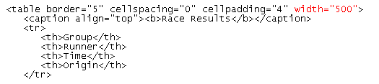
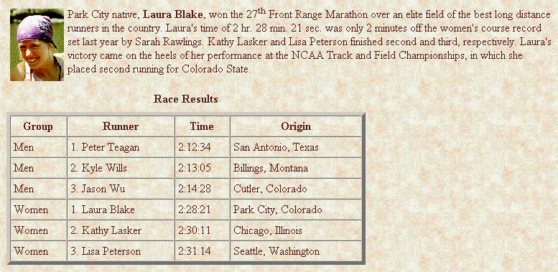
Setting the Width of the
Table to 500 Pixels

Slide 28
Defining Cell and Column Sizes
To set the width of an individual cell, add the width attribute to either the <td> or <th> tags.
The syntax is: width=“value”
  value can be expressed in pixels or as a percentage of the table width
  width value of 30% displays a cell that is 30% of the total width of table.
The height attribute can also be used in the <td> or <th> tags to set the height of individual cells.
  The height attribute is expressed either in pixels or as a percentage of the height of the table.
  If you include more text than can be displayed within that height value you specify, the cell expands to display the additional text.

Slide 29
Defining Cell and Column Sizes
Specifying a width for an individual cell does not guarantee that the cell will be that width when displayed in the browser.
  the reason for this is that the cell is part of a column containing other cells.
Set the width of all the cells in the column to the same value to ensure that the cells do not change in size.

Slide 30
Aligning a Table on the Web Page
By default, a browser places a table on the left margin of a Web page, with surrounding text placed above and below the table.
To align a table with the surrounding text, use the align attribute as follows: align=“alignment”
  alignment equals “left”, “right”, or “center”
  left or right alignment places the table on the margin of the Web page and wraps surrounding text to the side
  center alignment places the table in the horizontal center of the page, but does not allow text to wrap around it
The align attribute is similar to the align attribute used with the <img> tag.

Slide 31
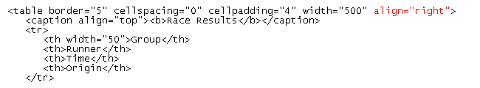

Results of a Right-Aligned Table

Slide 32
Aligning the Contents of a Table
By default, cell text is placed in the middle of the cell, aligned with the cell’s left edge.
By using the align and valign attributes, you can specify the text’s horizontal and vertical placement.
To align the text for a single column, you must apply the align attribute to every cell in that column.

Slide 33
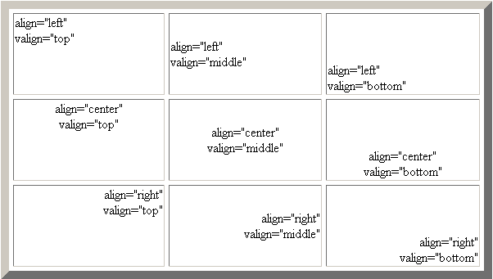
Values of the Align and Valign Attributes

Slide 34
Spanning Rows and Columns
To merge several cells into one, you need to create a spanning cell.
A spanning cell is a cell that occupies more than one row or column in a table.
Spanning cells are created by inserting the rowspan and colspan attribute in a <td> or <th> tag.
The syntax for these attributes is: rowspan=“value” colspan=“value”
  value is the number of rows or columns that the cell spans in the table

Slide 35
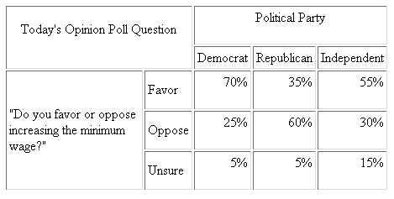
Example of Spanning Cells
This cell spans two columns and two rows
this cell spans three columns
This cell spans three rows

Slide 36
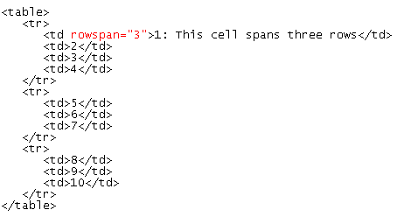

A Table Structure with a
Row-Spanning Cell
four table cells in the first row
only three table cells are required for the second and third rows
HTML code
resulting table

Slide 37
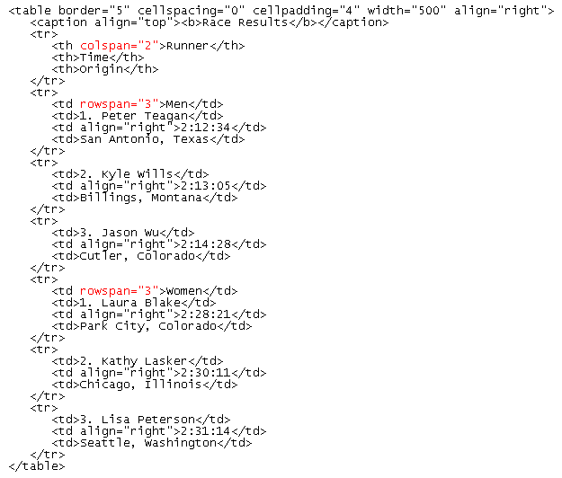
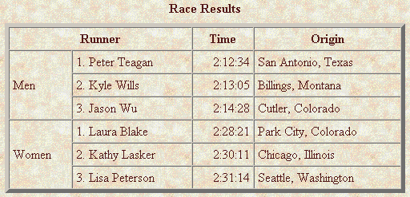
Adding Spanning Cells to a Table

Slide 38
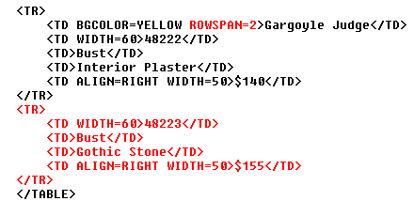
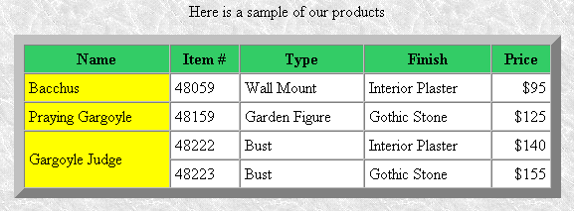
Another Example of Spanning Cells

Slide 39
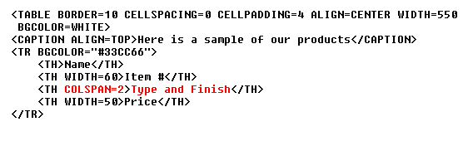
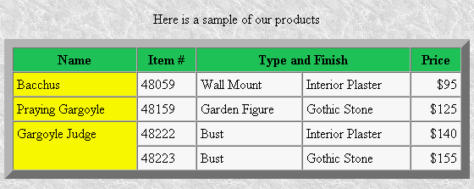
Another Example of Spanning Cells

Slide 40
Applying a Background Color
Table elements support the bgcolor attribute.
To specify a background color for all of the cells in a table, all of the cells in a row, or for individual cells, by adding the bgcolor attribute to either the <table>, <tr>, <td>, or <th> tags as follows:
  <table bgcolor=“color”>
  <tr bgcolor=“color”>
  <td bgcolor=“color”>
  <th bgcolor=“color”>
  color is either a color name or hexadecimal color value

Slide 41
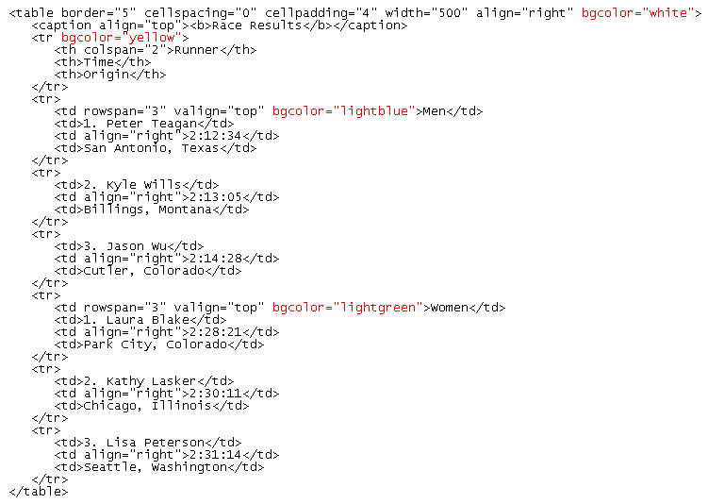
Specifying Table, Row, and Cell Colors

Slide 42
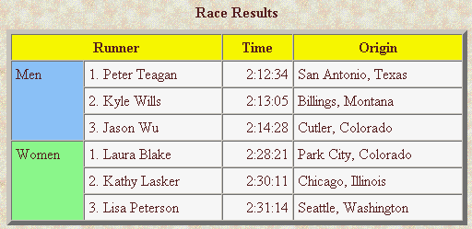
Specifying Table, Row, and Cell Colors

Slide 43

The bordercolor Attribute
By default, table borders are displayed in two shades of gray that create a three-dimensional effect.
The syntax for the bordercolor attribute is:
<table bordercolor=“color”>
  color is an HTML color name or hexadecimal color value
Internet Explorer and Netscape apply this attribute differently.
<table border=“10” bordercolor=“blue”>
Internet Explorer

Slide 44

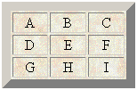
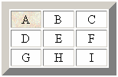
Applying a Table Background
Add a background image to your tables using the background attribute.
A background can be applied to the entire table or to a cell.
parch.jpg
<table background=“parch.jpg”>
<td background=“parch.jpg”>

Slide 45
Designing a Page Layout with Tables
HTML tables are most often used to define the layout of an entire Web page.
If you want to design a page that displays text in newspaper style columns, or separates the page into distinct sections, you’ll find tables an essential and useful tool.

Slide 46
Table Layout of a Web Page
620 pixels
1) newspaper logo
120 pixels
500 pixels
2) list of
links
3) articles
a sample table layout of a Web page.
4) address and phone number

Slide 47
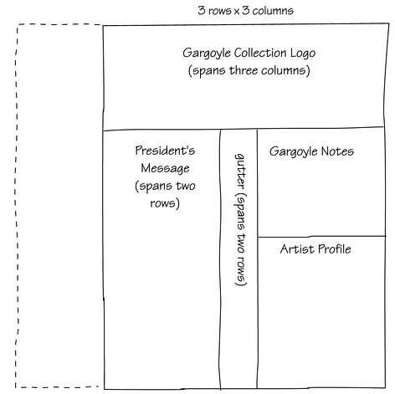
Using Nested Table
Tables can be created within another table making the Web page easier to manage.
a sketch of a web page using nested tables

Slide 48
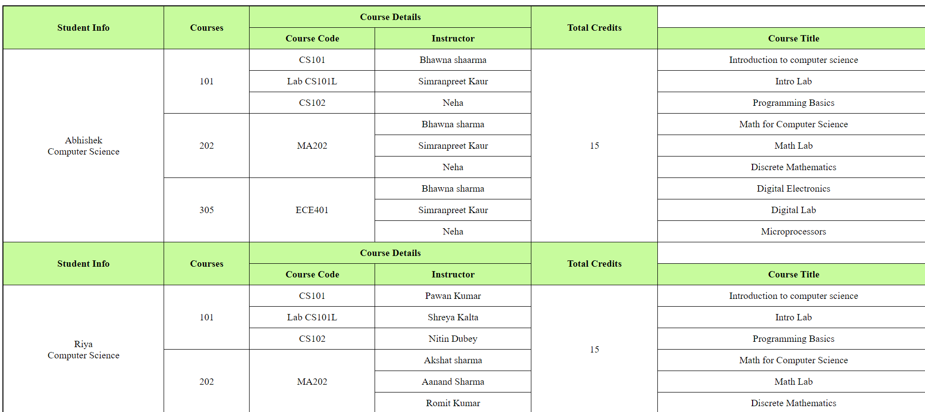

Slide 49

The Result of the Web Page using Nested Tables
a sample web page using nested tables

Slide 50
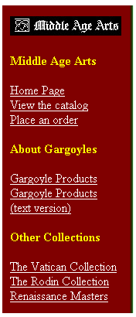
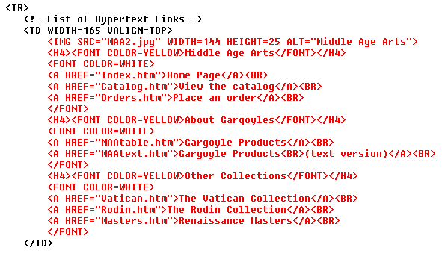
An Example of the Contents

Slide 51
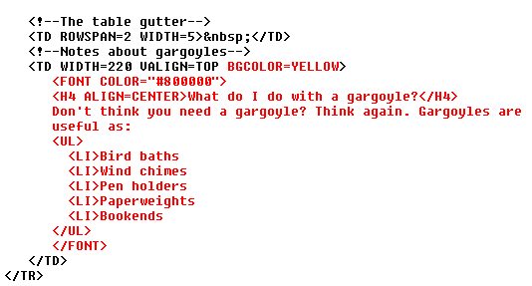
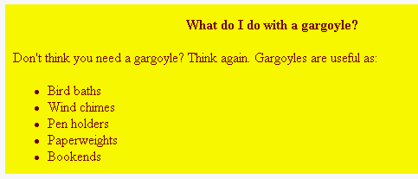
An Example of the Gargoyle Notes

Slide 52

Example from Class Web Site

Slide 53
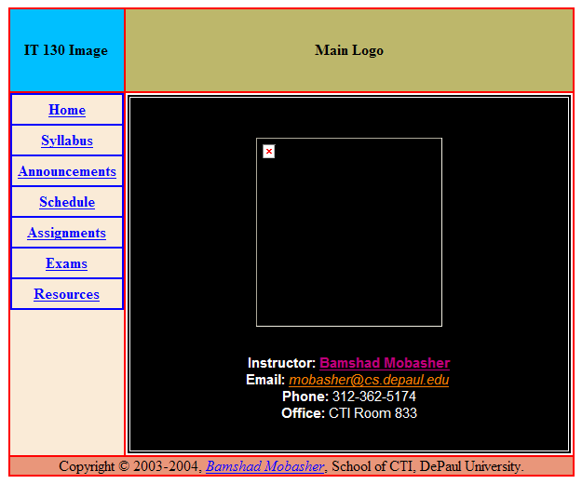
Sample Template based on Class Web Page
http://maya.cs.depaul.edu/~classes/it130/html/index-template.html
HTML code

