Slide 1
UNIT-4

Slide 2
TOPICS TO BE COVERED
Performing Basic Linux Tasks
Managing Users and Groups
Managing Permissions and Ownership
Managing Storage

Slide 3
PERFORMING BASIC LINUX TASKS
General Purpose Utilities
THE CLI:- The Command –line interface is a text-based interface between the user and the operating system that accepts input in the form of commands.
The CLI presents a command prompt to the user, and the user enters a command to interact with the system in a variety of ways.
Developers and administrators often use the CLI, whereas regular users will typically rely on a graphical user interface (GUI)

Slide 4
CLI ADVANTAGES
It’s faster for the system to process
It’s faster for administrators to enter information
Commands can be stored in text files called scripts that you can execute with one command.
Scripts can be scheduled to execute on a regular basis
Additional options are available in the CLI that may not be present in the GUI

Slide 5
CHALLENGES
It’s more difficult to learn than a GUI
Commands have many options and are not always consistent
There are many command-line environments among the Linux, Unix, macOS, and Windows platforms

Slide 6
SHELLS
Bourne shell(sh) This is the original Unix shell that is still available on Linux systems.
Bash(bash) This is the default Linux shell and a replacement for the Bourne shell. Its full name comes from the learn Bourne-again shell.
C shell(csh) this shell in based on C programming language and was designed to support C language development environments.
KornShell(ksh) This shell uses the features of the C shell with the syntax of the Bourne shell. It is common on Unix systems.

Slide 7
BASH SYNTAX
Syntax Format | Command | Description
Command only | ls | List directory content with default output.
Command with options | ls-la | List directory contents in long format (-l) and showing “hidden” files(-a).
Command with an argument | ls/var/log | List directory contents of /var/log directory with default output.
Command with options and an argument | ls-la/var/log | List directory contents of /var/log directory in long format and showing “hidden” files.

Slide 8
BASIC BASH COMMANDS
Command | Command | Description
echo | Repeats input back to user on the screen. Commonly used to send information to the user in a script. | echo ‘Good Morning’ returns “Good Morning” at CLI
ls | Lists the contents of a directory. Can be given options to view permission, hidden files, etc. | • ls lists contents of current directory. • ls -a includes hidden files. • ls -l outputs in long format. • ls /var/log lists contents of specified directory.
pwd | Displays the current working directory . | pwd returns the path to your current working directory.
cd | Changes your current working directory. | • cd /var/log changes your current directory to /var/log • cd /etc changes your current directory to /etc

Slide 9
BASIC BASH COMMANDS
Command | Command | Description
touch | Updates timestamp on an existing file, but can also be used to create an empty file. | touch file1 updates the timestamp on file1 if it exists; creates file1 if it doesn't.
cp | Copies a file or directory to another location. | cp file1 file2 copies the contents of file1 to file2.
mkdir | Creates a directory. | mkdir newdir creates a new directory called newdir.

Slide 10
FILE EDITING COMMANDS
Commands | Description | Examples
vim | Starts a powerful text editor and the default for Linux. | 1. vim file1 to open a text file in command mode. 2. Press i to enter insert mode. 3. Press Esc to leave insert mode. 4. :wq to save the file and quit.
nano | Starts a simple, user-friendly text editor. It may not be installed on all distros. | 1. nano file1 to open a text file. 2. Enter text directly in the interface. 3. Press Ctrl+O to save changes. 4. Press Ctrl+X to quit.
gedit | Starts a GUI text editor that is easy to use. Requires a desktop environment to be installed. | 1. Select Applications→Accessories→Text Editor. 2. Enter text directly in the interface. 3. Use the menu to save and quit.

Slide 11
USERS AND GROUPS
User accounts represent identities that authenticate to the system and can use authentication credentials to do specific tasks. User information includes group memberships.
Types of user accounts:-
  Root
  Standard user
  Service

Slide 12
SUPERUSER
The root account is also referred to as the superuser. The security best practice is to never log on to the system with administrative credentials, but rather to log on with a non-privileged account and elevate credentials when necessary.
One way of elevating privileges is to "substitute user“ using the su command.

Slide 13
ADDING USER
THE useradd COMMAND
The useradd command is used to create user accounts and configure basic settings. As part of the account creation process, useradd references several files:
  • The account is stored in the /etc/passwd file.
  • The account is configured according to various options set in the /etc/login.defs file.
  • The account's home directory is created at the /home/<account name> directory.
  • The account's home directory is populated using files from the /etc/skel directory.
SYNTAX
The syntax of the useradd command is useradd [options] [username]

Slide 14
For adding comments while adding user useradd username –c “comments”
To set home directory while adding user useradd username –d path
To set home userid while adding user useradd username –u uid
To add user in existing group useradd username –g groupname
To delete user userdel username

Slide 15
USERADD COMMAND OPTIONS
Option | Descreption | Example
-c | Sets the comment field, which is typically used as the field for the user's full name. | useradd -c "User One" user1
-e | Sets the account expiration date. | useradd -e 2019/12/31
-s | Sets the user's default shell. | useradd -s /bin/ksh
-D | View the default configurations for new users. | useradd -D

Slide 16
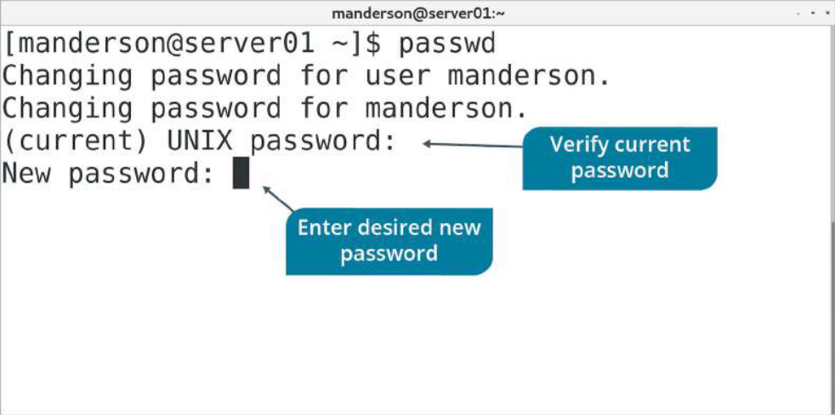
THE passwd COMMAND
The passwd command is used by root to set or reset a password for any user. A user can use the passwd command themselves to reset their own password. It is also used to set the initial password for a user after creating the account with the useradd command.
SYNTAX
The syntax of the passwd command is passwd [user name] where [username] can be used by root to set a specific user's password

Slide 17
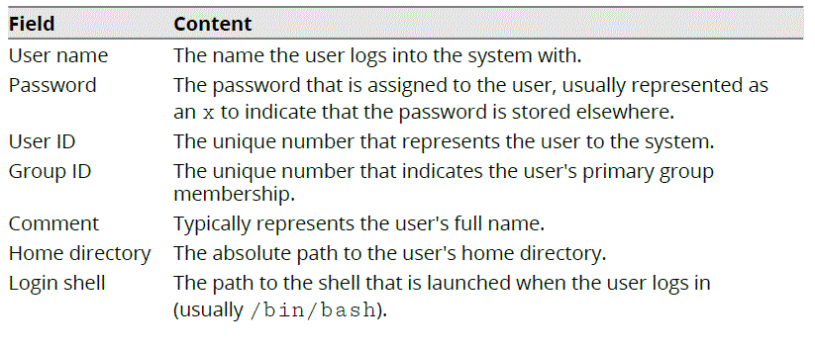
The /etc/passwd file stores user account information. All accounts, default or user-specific, will be found in this file. Each account contains seven fields of information. Each field is separated by a colon.

Slide 18
THE /ETC/SHADOW FILE
The /etc/passwd file was once used to store the cryptographically hashed version of passwords. That file is world-readable, however, meaning that one user could see the hashed version of another user's password.
The /etc/shadow file is the modern storage location for hashed passwords, as well as additional account information. This additional information includes password requirements and expiration information. Only root has access to the content of the /etc/shadow file, preventing users from attempting to crack each other's passwords.

Slide 19
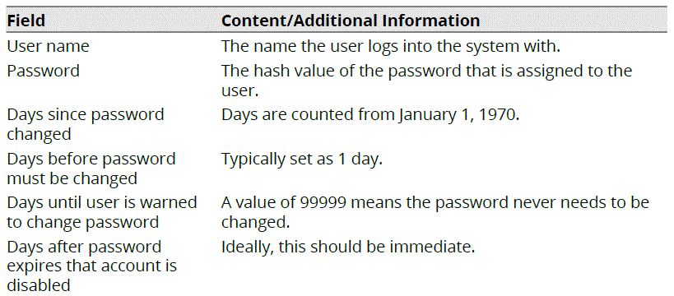
FORMAT

Slide 20
usermod COMMANDS

Slide 21

For changing home directory
Shift content from home directory
To set expiry date for account
For making account inactive
Lock User passwd
To change UID

Slide 22
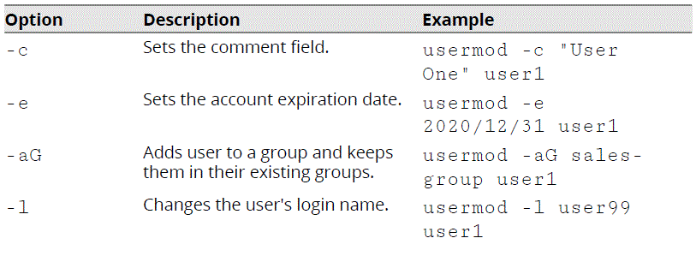
THE usermod COMMAND
The usermod command is used to modify settings for regular users. It edits the /etc/passwd file, avoiding the need for administrators to edit the file directly.
SYNTAX
The syntax of the usermod command is usermod [options] {username}

Slide 23
Option –c $ usermod Username –c “comment”
Option –d $ usermod Username –d /home/path
Option –e $ usermod Username –e yyyy-mm-dd
Option –l $ usermod Username –l newusername
Option –u $ usermod Username –u UID

Slide 24
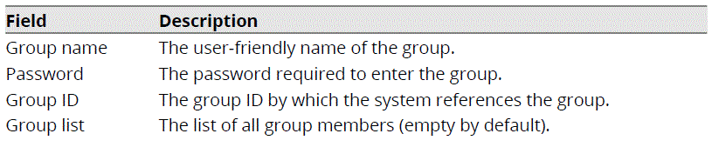
GROUP ACCOUNTS
Groups associate user accounts that have similar security requirements. Groups simplify administrative tasks, allowing multiple users to be granted permissions to resources. Groups are represented on the system by a group ID number (GID). Users may be a member of more than one group
The /etc/group file is the storage location for groups. All groups, default or userspecific will be found in this file.

Slide 25
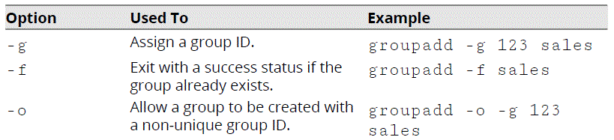
The groupadd command creates a group. By default, the group has no members and no password.
SYNTAX
The syntax of the groupadd command is groupadd [options] {groupnames}

Slide 26
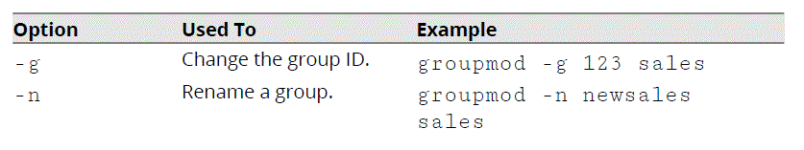
The groupmod command is used to change the group's own attributes. It will edit the /etc/group file for you.
SYNTAX
The syntax of the groupmod command is groupmod [options] {groupnames}
The groupdel command will delete groups from the /etc/group file. It does not delete user accounts that are members of the group.
SYNTAX
The syntax of the groupdel command is groupdel [options] {groupnames}

Slide 27
QUERY USERS AND GROUPS
ACCOUNT QUERYING
Administrators and users may need to gather information about their identity on the system. There are many commands that will report user and group information.
THE whoami COMMAND
The whoami command is used to display the user name with which you are currently logged in to the system.

Slide 28
THE last COMMAND
The last command displays the history of user login and logout actions, along with the actual time and date. It also has options that enable you to filter users who have logged in through a specific terminal.
The last command retrieves information from the /var/log/wtmp file.

Slide 29
MODIFY FILE AND DIRECTORY PERMISSIONS
PERMISSIONS
Permissions are access rights assigned to users, which enable them to access or modify certain files and directories. Permissions can be set at different levels and for different access contexts. They enable you to configure who is allowed to access an object, and who is restricted from accessing that object.
THE ls -l COMMAND
The ls -l command gives you a long list of the files and directories in your current working directory.

Slide 30
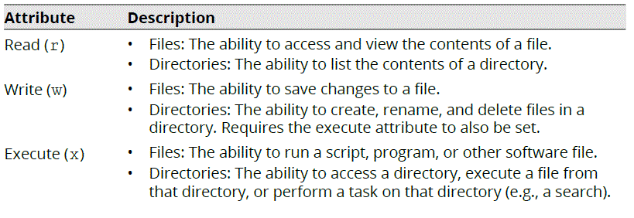
PERMISSION ATTRIBUTES
Permission attributes define exactly what a user is allowed to do with a particular file or directory.

Slide 31
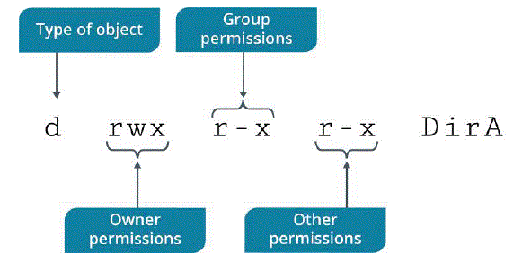
FILE PERMISSIONS
Every file has its own access rights for different groups of users. Access rights are – Read, Write and Execute. These rights are provided to different groups of users which are- Owner, Groups, Other Users. A file’s permission appears to be in format of three group of letters. Here three groups represent the permissions given to groups of the user.
• Owner (u): The owner of the file or directory, also simply referred to as the user.
• Group (g): The file or directory's group and all users belonging to that group.
• Other (o): All other users (neither owner nor group member).

Slide 32
CHMOD-ABSOLUTE METHOD
chmod command is used to change the permissions of files and directories.
We can view the permissions of a file by using ‘ls -l’ command in the terminal. For example let’s say we have output in terminal as follows:
$ ls –l
rwx-r--r-- 1 root root 415 Feb 19 21:04 file1
First part: rwx : Represents the access rights of the owner of the file.
Second part: r-- : Represents the access rights of group.
Third part: r-- : Represents the access rights of other users
Here, meaning of symbols is as following: r- readable, w- writeable and x- executable.

Slide 33
CHMOD-COMMANDS
Now in order to change the permissions we use ‘chmod’ command. Suppose we want the permissions of file1.txt to be Readable, Writeable and Executable for Owner.
Readable and Executable for Group.
No Permissions for others.
$ chmod 750 file1
$ls -l
rwx-r-x--- 1 root root 415 Feb 19 21:04 file1

Slide 34
OCTAL CODES FOR PERMISSIONS
7- We are granting all rights- reading, writing and executing a file
6- We are granting two rights- reading and writing on file.
5- We are granting two rights- read and execute file.
4- We are granting one right- read a file.
3- We are granting two rights – write and execute a file.
2- We are granting one right- write on a file.
1- We are granting one right- execute a file.
0- We are granting no rights at all.

Slide 35
CHMOD-RELATIVE METHOD
chmod can also be used in relative method. In this method we tell which permissions is to be granted and which permission is to be denied.
Now suppose that you want to deny execute permissions to owner.
$chmod u-x file1
$ls -l
rw--r--r-- 1 root root 415 Feb 19 21:04 file1
Now suppose that you want to allow write permissions to group.
$chmod g+w file1
$ls -l
rw--rw-r-- 1 root root 415 Feb 19 21:04 file1
In the similar manner chmod can be used to change permissions of directories also.

Slide 36
DEFAULT PERMISSIONS
For files created by the root user, the default permissions are 644, which means that the root user has read and write permissions, while group users and others will have only read permission. For directories created by the root user, the default permissions are 755, which means that the root user has read, write, and execute permissions, while group users and others will have only read and execute permissions.

Slide 37
UMASK
chmod can change permissions of existing files and directories. But if you want to change the default permissions that are given when you create a new file or directory then the command is umask.
Suppose you want that every newly created file be given the following permissions
Read and write to the owner
Read to the group
None to others

Slide 38
UMASK-COMMAND
$umask 137
The interpretation of the octal number is opposite to chmod. Here 1 means execute permission is denied to the owner, 3 means write and execute and denied to group and 7 means no permission to others.
Note: A regular can never be given execute permission by default.

Slide 39
Managing Storage

Slide 40


