Slide 1


z
$$300 ∗ \frac{λ}{4}$$
$$λ$$
x

Slide 2
z
x

Slide 3


$$\frac{λ}{2}$$
$$λ$$
x

Slide 4


z
$$λ$$
$$300 ∗ \frac{λ}{4}$$
…
$${ant}_{4,0}$$
…
…
…
…
$${ant}_{1,0}$$
$${ant}_{0,0}$$
$${ant}_{0,4}$$
$${ant}_{0,8}$$
x

Slide 5
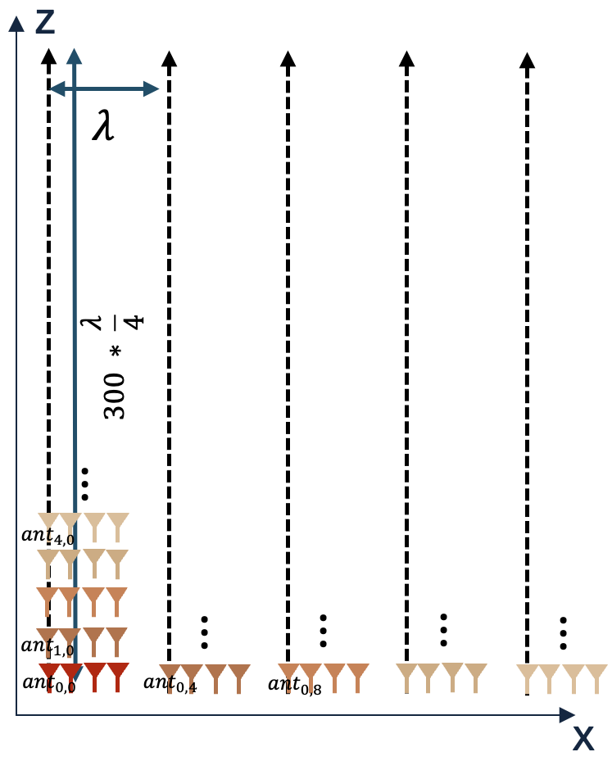
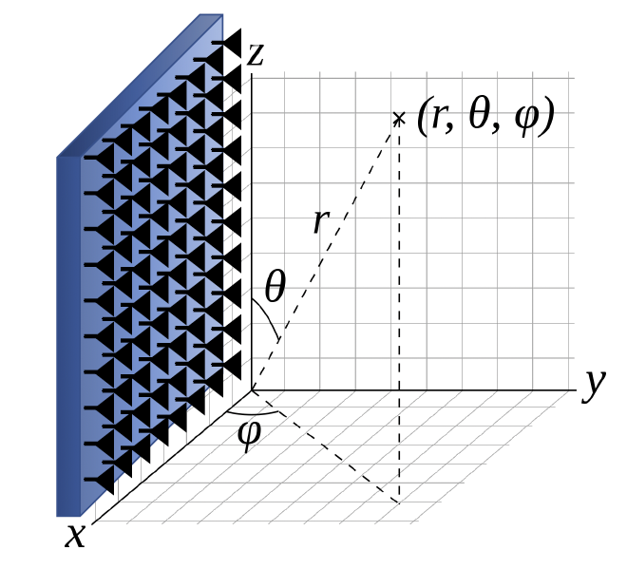
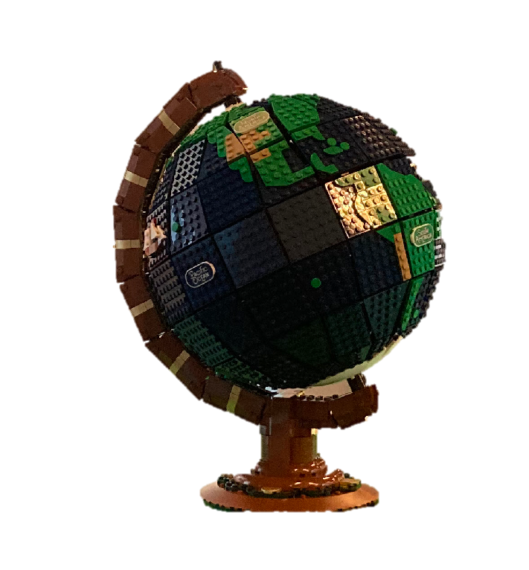
Antenna Placement
Coorindate System
Object Being Imaged

