Slide 1
How Does the Lexical Analyzer Handle White Spaces and Comments?
Course: Principles of Compiler Design
Topic: Lexical Analysis
Student Name: HAILEMIKAEL TESHOME
Student ID:1411310

Slide 2
Introduction
Lexical Analysis is the first phase of a compiler
It converts source code into tokens
White spaces and comments do not affect program logic
The lexical analyzer must identify and ignore them
Proper handling improves compiler efficiency

Slide 3
Role of Lexical Analyzer
Reads source code character by character
Groups characters into tokens
Sends tokens to the syntax analyzer
Skips:
-White spaces
-Comments
Maintains:
-Line numbers (for error reporting)

Slide 4
What Are White Spaces?
White spaces include:
Spaces ( )
Tabs (\t)
New lines (\n)
Purpose:
Improve readability of code
Separate tokens (e.g., int x)
Key Point:
White spaces are not tokens in most languages

Slide 5
Handling White Spaces
Lexical analyzer detects white space characters
They are ignored and not passed to the parser
Line breaks are counted for error diagnostics
Example:
int a = 10;
Tokens produced:
int, a, =, 10, ;

Slide 6
What Are Comments?
Comments are non-executable text used for documentation
Types of Comments:
Single-line comment
// This is a comment
Multi-line comment
/* This is a multi-line comment */

Slide 7
Handling Comments
Lexar recognizes comment patterns
Skips all characters until:
  End of line
  Closing delimiter
Comments are not sent as tokens
Example:
x = 5; // assign value
Tokens:
x, =, 5, ;

Slide 8
Algorithm (Simplified Flow)
Step 1: Read next character
Step 2:
If white space → skip
If comment start → skip comment
Step 3: Identify valid token
Step 4: Send token to parser
📌 White spaces & comments are filtered out early

Slide 9
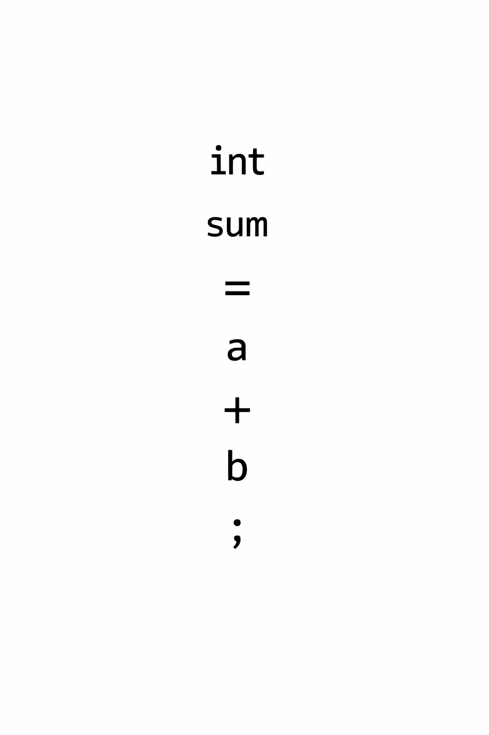
Practical Example (Code View)
Source Code:
int sum = a + b; /* addition*/

Slide 10
Why Is This Important?
Reduces parser complexity
Improves compiler performance
Prevents syntax errors caused by comments
Enables clean token stream
Essential for accurate error reporting

Slide 11
Real-World Application
Used in:
-GCC Compiler
-Clang
-Java Compiler (javac)
Tools like:
- Lex / Flex
IDEs rely on lexer rules for:
-Syntax highlighting
-Code formatting

Slide 12
Conclusion
Lexical analyzer ignores white spaces and comments
They do not affect program execution
Proper handling ensures:
-Clean token generation
-Efficient syntax analysis
This step is critical in compiler design

Slide 13
References
Aho, Lam, Sethi, Ullman – Compilers: Principles, Techniques & Tools
Alfred V. Aho – Lexical Analysis (Academic resources)
GeeksforGeeks – Compiler Design (Lexical Analysis section)

