Slide 3


Slide 12








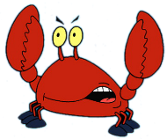
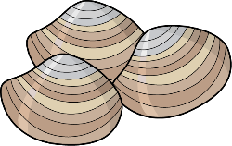






Slide 16
FLAPPY FISH

Slide 17
FLAPPY FISH

Slide 18

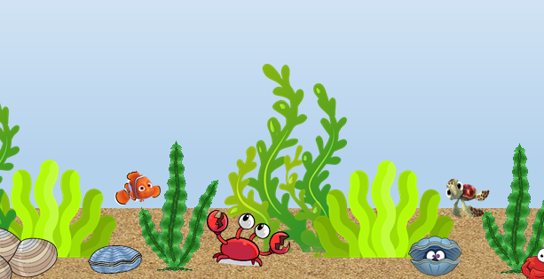
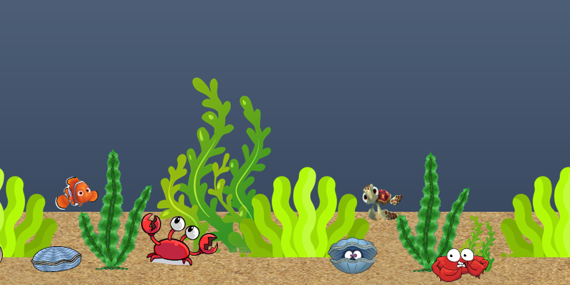
Jump : Press Space bar
Should not touch
Your fish
Shark
If you swim longer than 500 m, you can go to the level 2
Lv 1
Lv 2

Slide 19
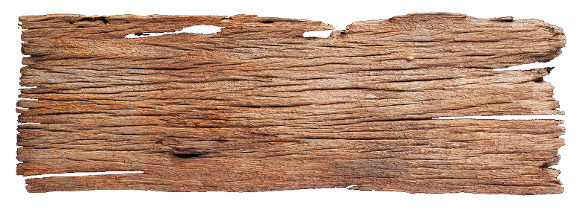

Slide 21
Made By
Hyerim Kim

Slide 22


