Slide 3


Slide 11








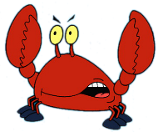
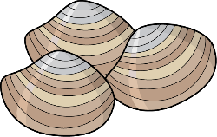






Slide 13
FLAPPY FISH

Slide 14
FLAPPY FISH

Slide 15
FLAPPY FISH

Slide 16
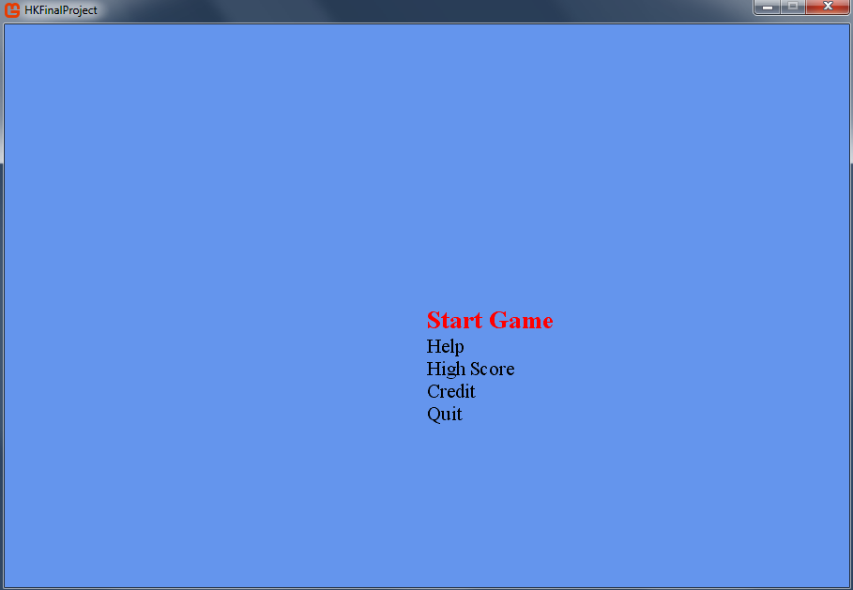
Flappy Fish

Slide 17

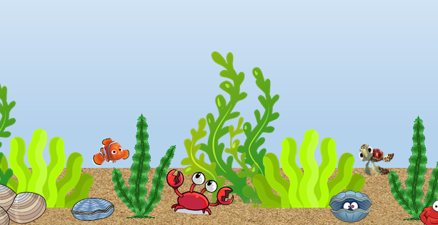
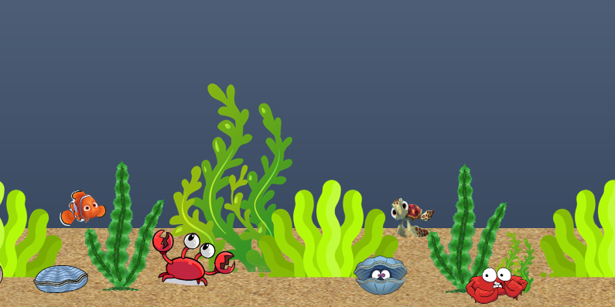
Jump : Press Space bar
Should not touch
Your fish
Shark
If you swim longer than 500 m, you can go to the level 2
Lv 1
Lv 2

Slide 18
GAME OVER
Please enter your name

Slide 19
Made By
Hyerim Kim

Slide 20

High Score

