Slide 3


Slide 11








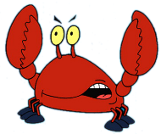
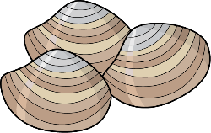






Slide 15
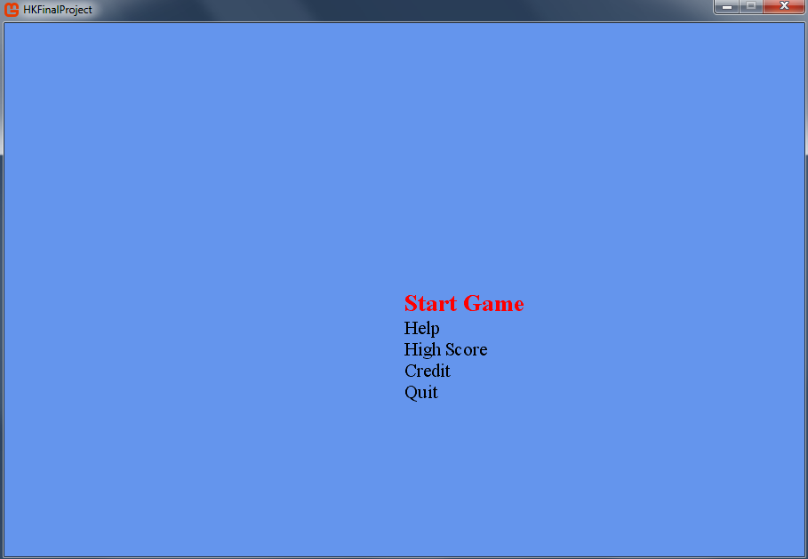
Flappy Fish

Slide 16

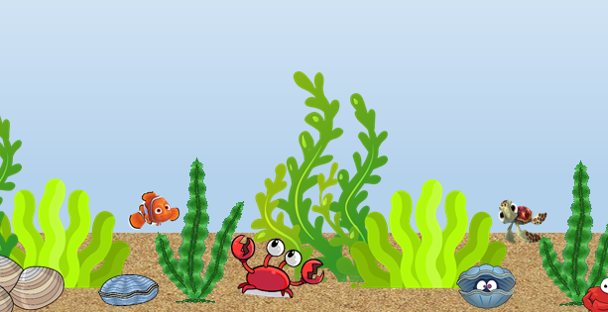
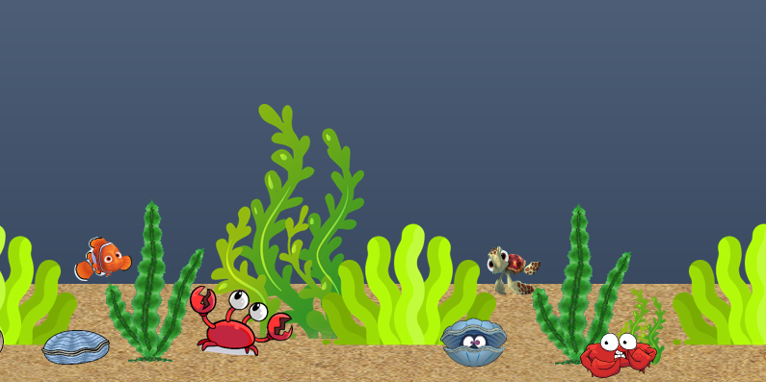
Jump : Press Space bar
Should not touch
Your fish
Shark
If you swim longer than 500 m, you can go to the level 2
Lv 1
Lv 2

Slide 17
Made By
Hyerim Kim

Slide 18

High Score

