Slide 1
Air Quality Prediction:
Developing Public Environmental Health Awareness
Hailey Birge, Maria Ramirez, Nicholas Lawson, Roberto Marquez

Slide 2
Project Overview
Relevance: Air quality is one of the most critical environmental components in public health as it affects every system in the human body.
The impact of air quality begins in utero and continues throughout our life span.
It is one of the leading factors in many diseases.
In addition to human welfare implications, air quality is also a key predictor of health in ecological systems.
Air quality is a determining factor in the health of every living creature in a region, and the ability to classify air quality using environmental metrics is paramount in keeping the public informed.
Purpose: To develop a user-friendly interface powered by a model that will generate a prediction on air quality when provided with 9 parameters:
Temperature, Humidity, PM2.5 (fine particulate matter), PM10 (coarse particulate matter), NO2, SO2, CO, Proximity to Industrial Areas, and Population Density.

Slide 3
Phase 1: Preparing the data
About the dataset:
Kaggle dataset, originally derived from World Health Organization and World Bank Data
5000 samples from various regions
Features: 9 major influencers of air quality
Target variable: Air Quality
Classes:
Good (0),
Moderate (1),
Poor (2),
Hazardous (3)
Pre-processing:
Confirmed no missing values
Checked class distribution
Scaled features
Used quartile transformer to normalize skewed features
Split data into features and target arrays

Slide 4
Phase 2: Creating and testing models
Three models were chosen to be tested based on their ability to handle multi-classes:
Random Forest
Combines decision trees for a more accurate prediction
k-Nearest Neighbors
Works by assigning the class most common among the k-nearest neighbors
Neural Network
Works well with complex relationships between features

Slide 5
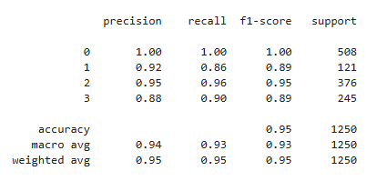
Random Forest Model Analysis: Classification Report
This model performed very well overall with an accuracy score of 0.95. The model also yielded excellent precision and recall in the "Good" class and above 0.85 for those scores in all other classes.

Slide 6
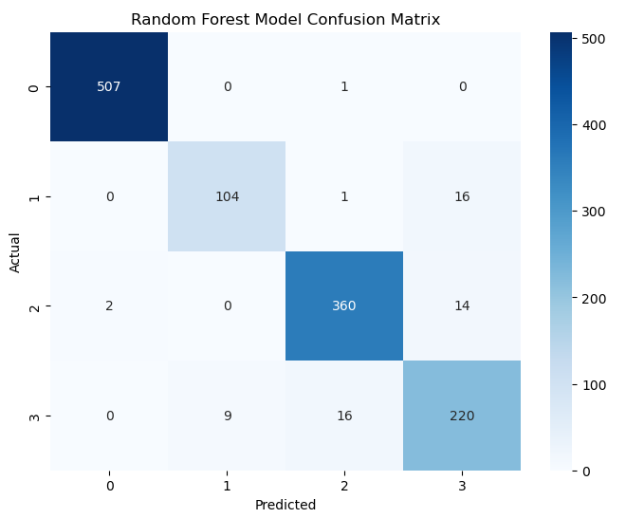
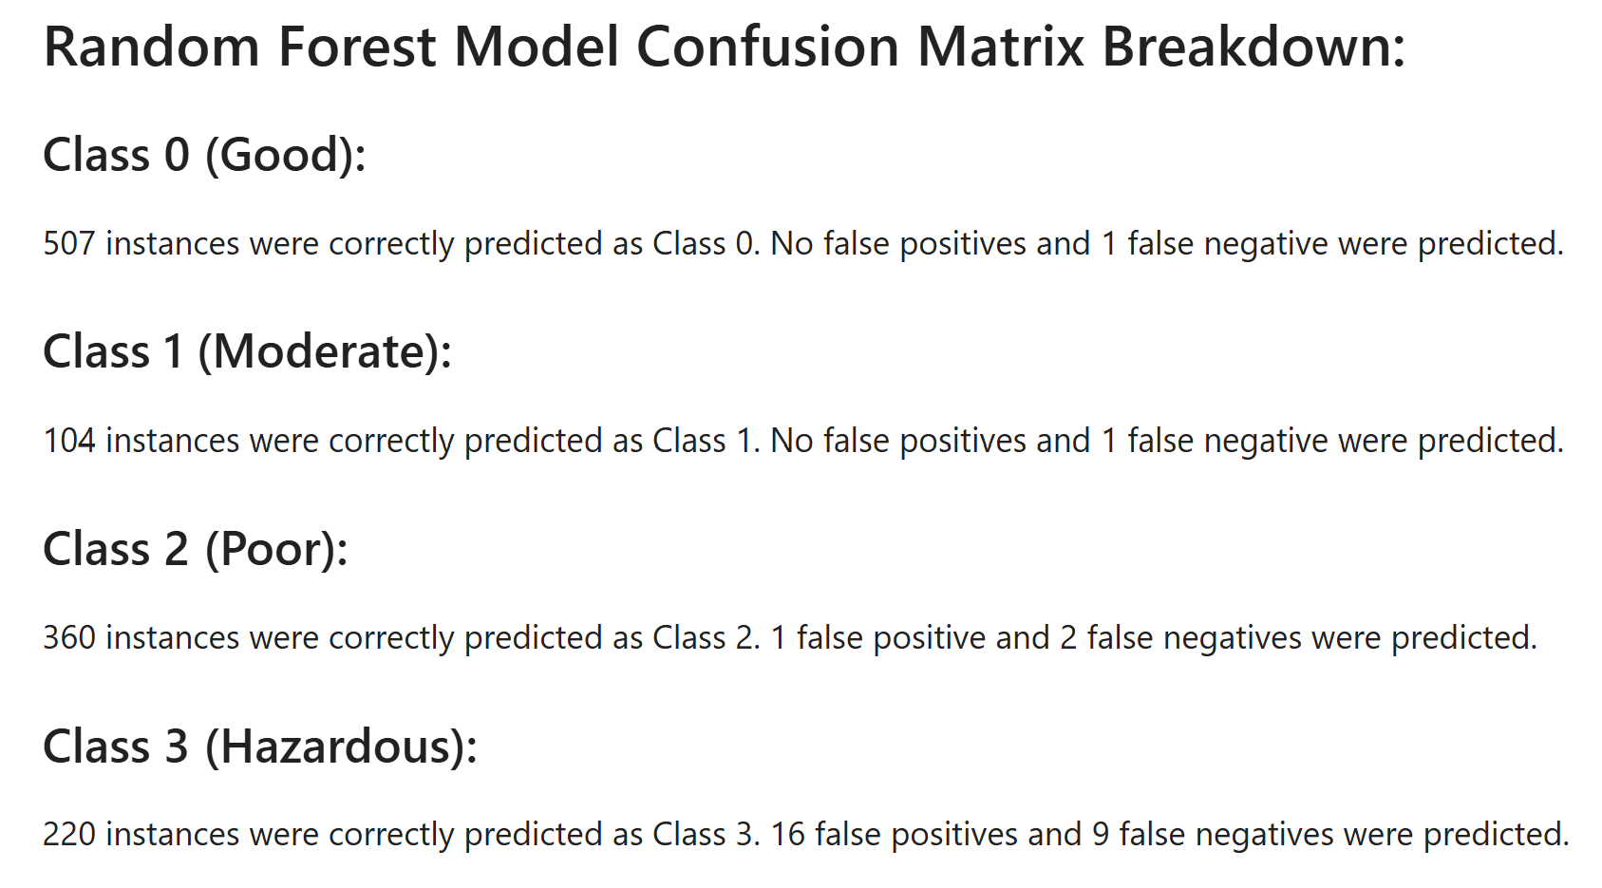
Random Forest Model Analysis: Confusion Matrix
The confusion matrix also provides evidence of this model's predictive ability. The class with the least accuracy was the "Hazardous" class, though there were a greater number of false positives than false negatives. This is preferred as it is more dangerous to public health to predict that the air quality is better than it actually is.

Slide 7
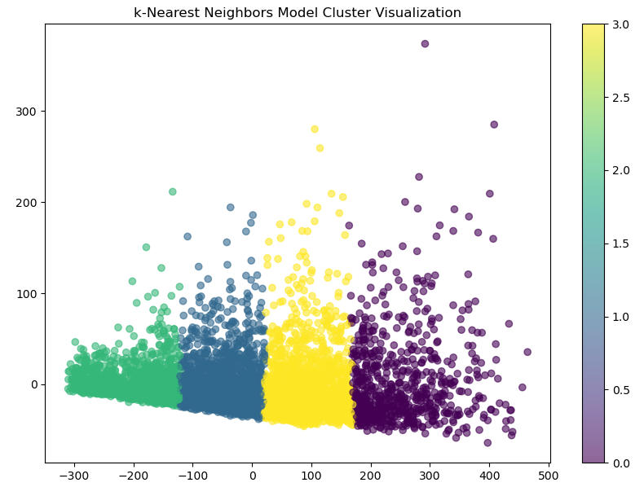
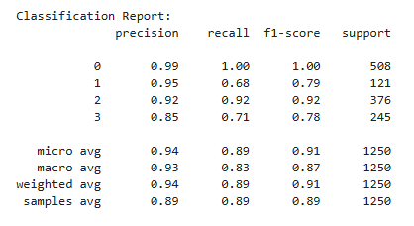
k-Nearest Neighbors Model Analysis: Classification Report and Clusters Visualization
This model also yielded a high accuracy score of 0.94. However, there is a drop in recall for both the "Moderate" and "Hazardous" classes, indicating that the model may be identifying less true positives there. This may be problematic as false negatives in those classes could lead to public misinformation on air quality. The model visualization of the clusters shows good separation.

Slide 8
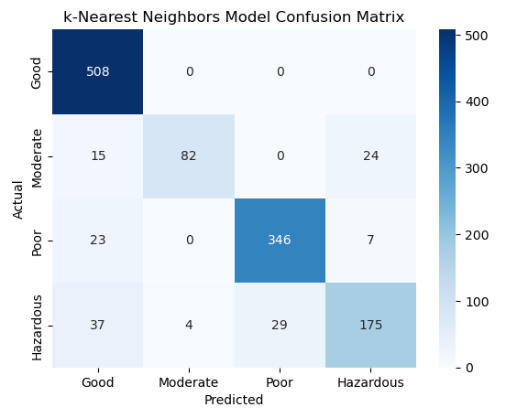
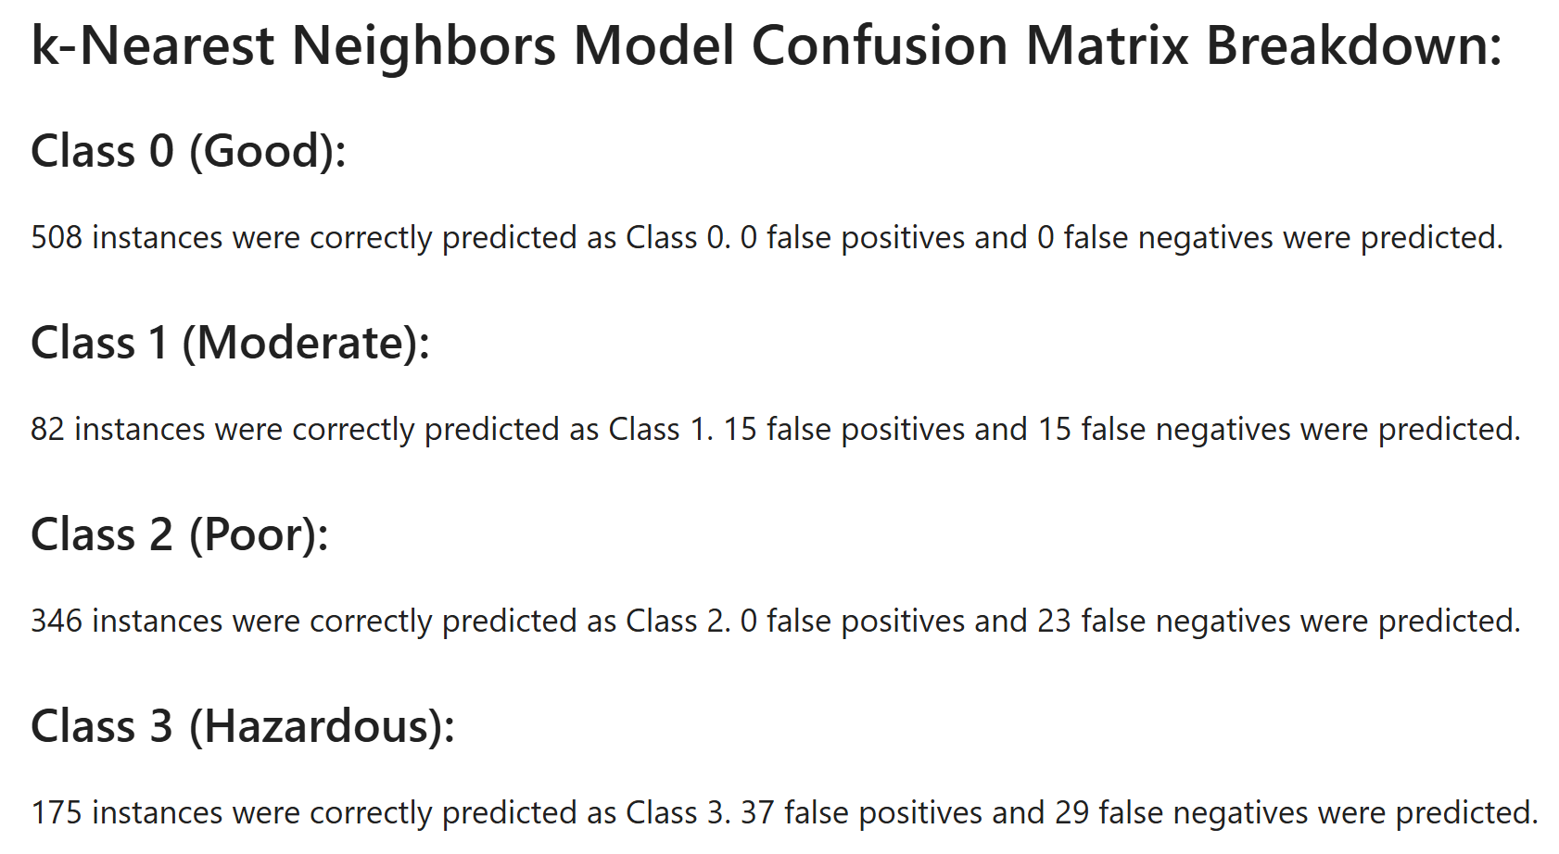
k-Nearest Neighbors Model Analysis: Confusion Matrix
The confusion matrix shows that the model yielded a higher number of false negatives for all classes except "Good". This is not ideal as false negatives will be costly in a real world scenario.

Slide 9
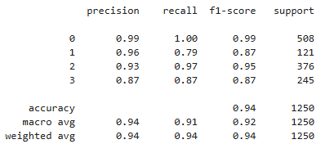
Neural Network Model Analysis: Classification Report
A simple 3 layer Sequential model was created with L2 regularization to account for overfitting and softmax activation to accommodate our 4 classes. Random seeds were set to ensure random numbers generated will be the same so results can be replicated.
This model performed very well, with an accuracy score of 0.94 and great precision and recall scores across all classes.

Slide 10
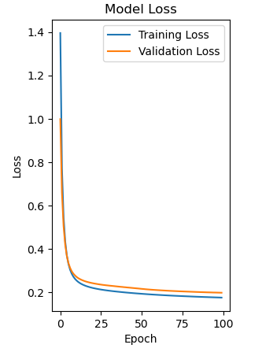
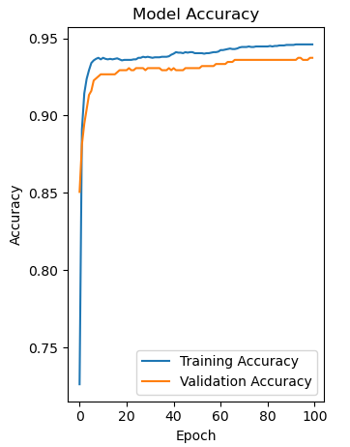
Neural Network Model Analysis: Loss and Accuracy Plots
The plots showing the relationships between training and validation accuracy and loss support the evidence that this is a strong model. Following a steep initial drop, both training loss and validation loss steadily decrease over epochs, indicating that the model is learning from the training data. The reverse is true for accuracy over epochs, indicating the model's improvement in classifying the training data.
The high accuracy score, consistency across classes in precision and recall, and the information revealed by the loss and accuracy plots make this the model of choice to power our air quality prediction app.

Slide 11
Phase 3: Developing the Air Quality Prediction App
The neural network model was saved as a .keras file and the scaler for the model was saved as a .pkl file and loaded into the flask app
Sliding scales for the user to manipulate were created within the associated HTML and JS files
The model analyzes the user’s input and the “Predict” button yields a prediction based on the classes (Good, Moderate, Poor and Hazardous).
The significance of this application is that it provides an accessible, user friendly interface in which to submit metrics from the region of interest and receive a prediction with good accuracy on air quality. This provides the public with relevant information to help inform decisions and spread awareness.

