Slide 1
Impact of Foreign Aid on Developing Countries in Africa
Hailey Birge & Maria Ramirez

Slide 2
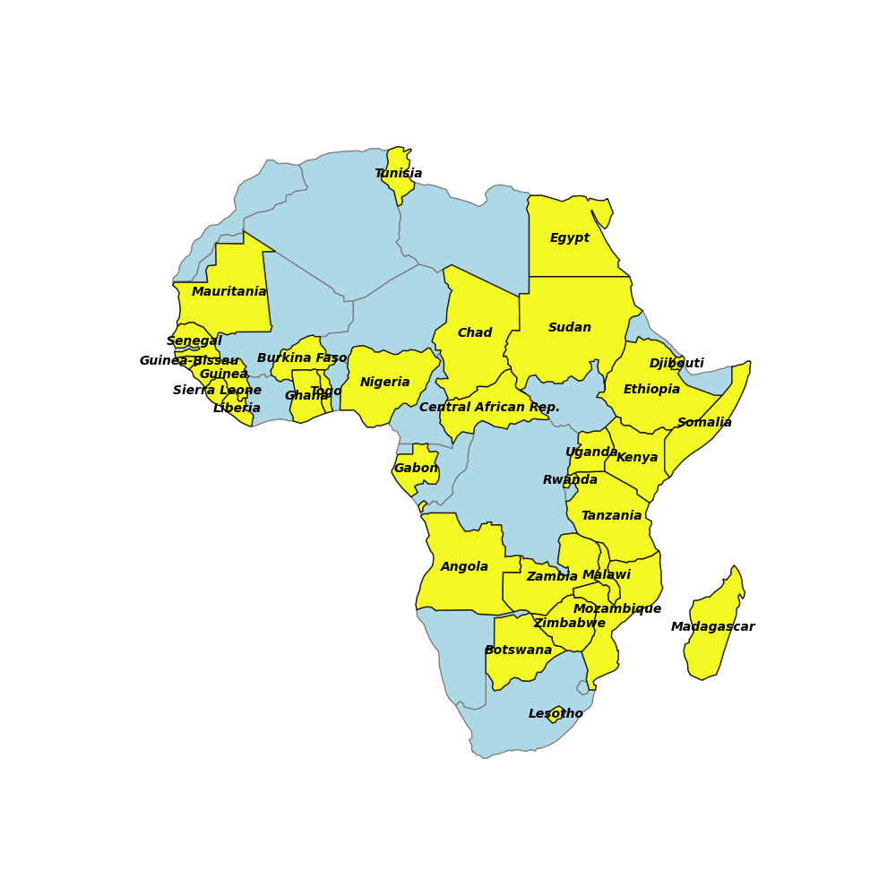
A total of 32 African countries were included in the analysis.
The data spans from the year 2000 to 2022.
Notes:
We included 32 African countries in the analysis, those are shown in yellow on the map.
The data spans a little over 20 years, from 2000 to 2022.

Slide 3
Research Questions
Hypotheses
How is foreign aid distributed in these developing countries?
Is there a relationship between foreign aid and mortality?
Is foreign aid dependent on population distribution?
Foreign aid is predominantly provided to those countries with low national income.
There is a negative correlation between foreign aid and mortality.
Countries with higher populations will receive more foreign aid.
Notes:
We set out to answer three questions

Slide 4
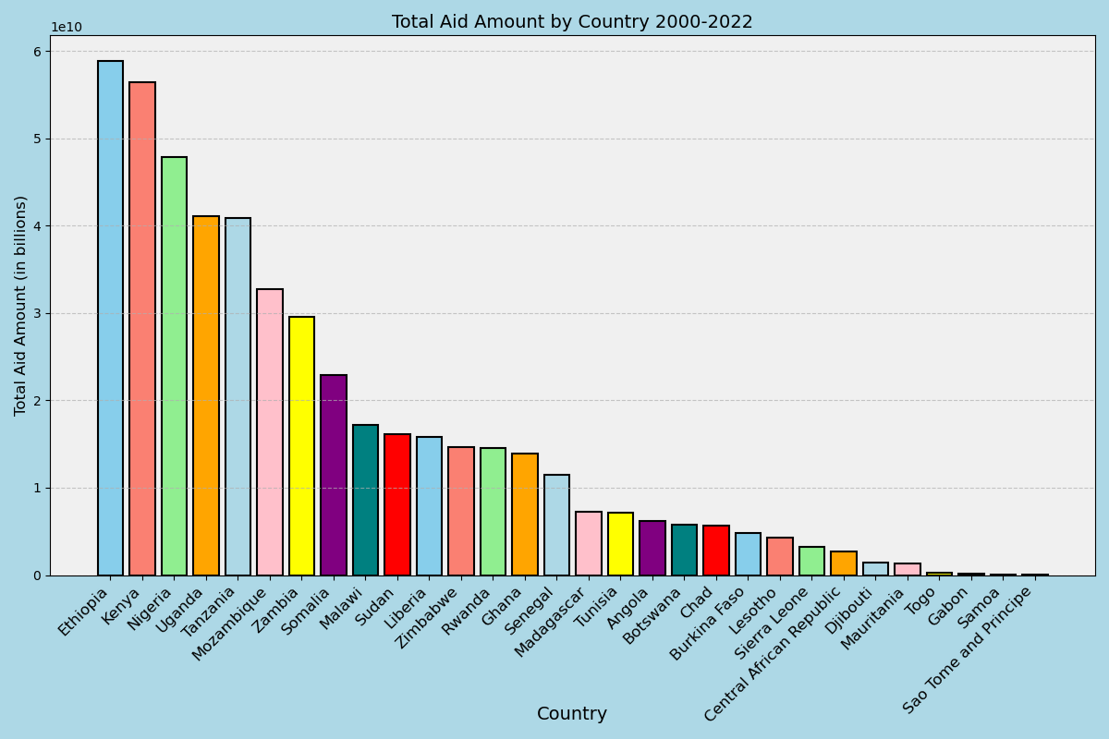
Notes:
Current amount and constant amount were provided in the dataset, we went with constant amount because it accounts for inflation, so it holds up over time.
Predictably, the countries receiving the most aid are classified as low or lower middle income, but we do have a few lower income countries towards the other end of the spectrum receiving a minimal amount of aid.
There are many types of aid and determining factors around who receives it, this is just one aspect.

Slide 5
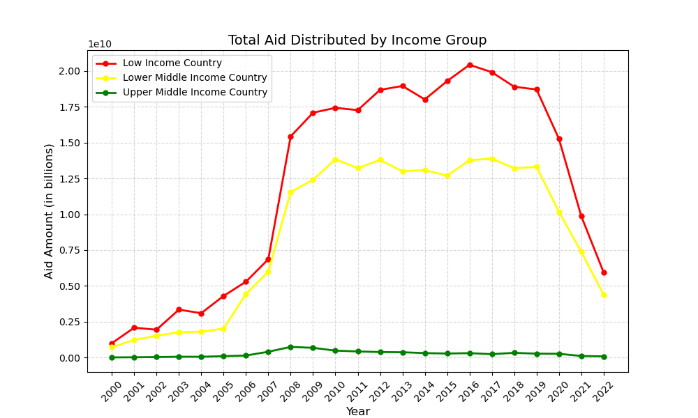
Notes:
This plot shows aid in billions distributed over the years by income group.
We see what we would probably expect to see, with the lowest income group receiving the most aid and the highest income group the least.
The most noteworthy aspect of this plot is the spike in aid between 2006-2008, even the highest income group saw a small increase.
This was the time period when the U.S. had a massive increase in the foreign aid budget.

Slide 6
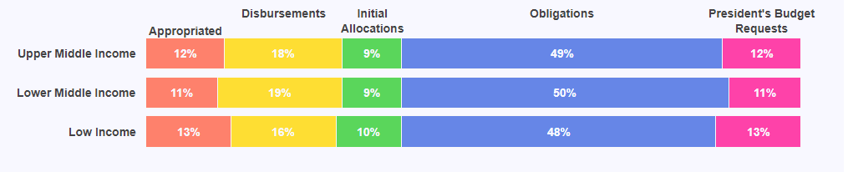
Transaction type summary by income group
Appropriated aid is collected through taxes and other sources.
Obligations are agreements to provide future payment.
Disbursements are measured in amount of money actually provided.
President's Budget Requests is the amount the government allots for foreign aid yearly.
Initial Allocations are issued in anticipation of demand.
Notes:
There were five types of aid transactions included in the data. Appropriated aid… Obligations are like a pledge.
This shows how foreign aid is distributed is a horizontal bar chart that shows transaction type by income group.
The chart shows that half of all transactions were obligations, or agreements to provide future payments, and the smallest percentage of transactions were classified as initial allocations.
We can also see that there’s a pretty even distribution of transaction type across income groups.

Slide 7
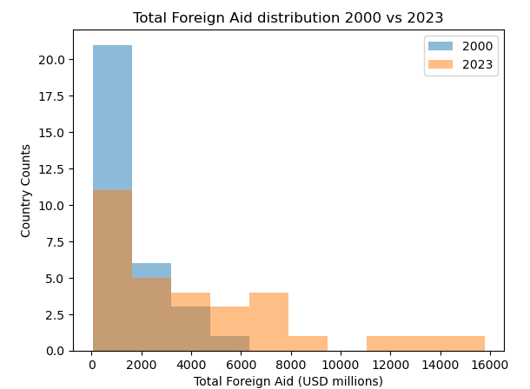
Foreign Aid Distribution by Country 2000 vs 2022 comparison

Slide 8
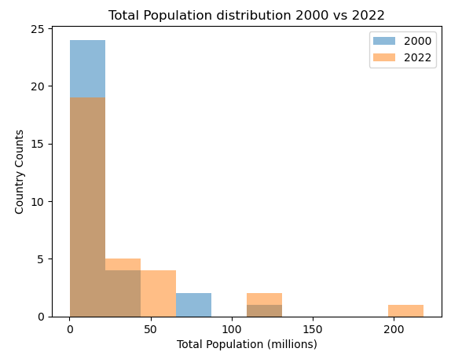
Population Distribution 2000 vs 2022 comparison

Slide 9
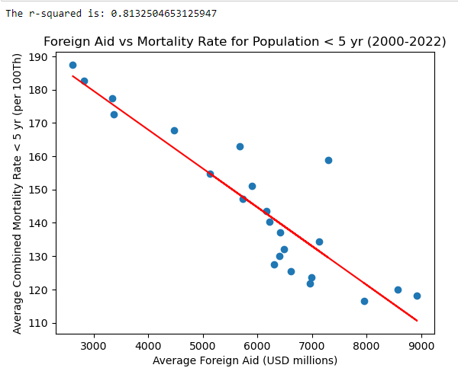
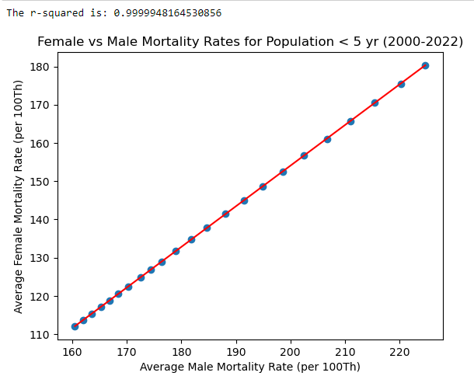
Linear Regression

Slide 10
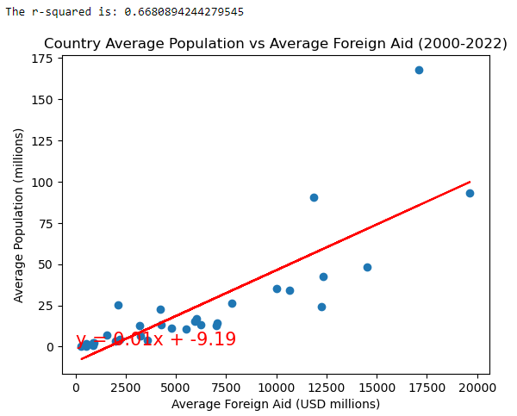
Linear Regression

Slide 11
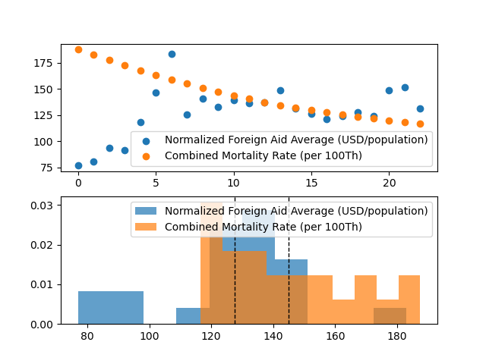
t-Test Comparison: Mortality Rate vs Foreign Aid
Does Foreign Aid have an impact on the mortality rate for population under 5 years old?
Alternate Hypothesis: Foreign aid contributions will help reduce the mortality rate for the population under 5 years old.
Null Hypothesis: Foreign aid contributions will NOT help reduce the mortality rate for the population under 5 years old.
t-Test Result = -2.540892782599118
P-value = 0.014691394219051454
P-value < 0.05
We can conclude that there is evidence to reject the null hypothesis.

Slide 12
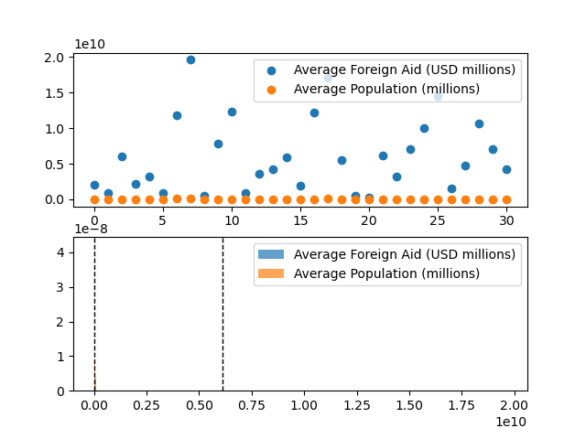
t-Test Comparison: Foreign Aid Contribution vs Population
Does Foreign Aid have an impact on the mortality rate for population under 5 years old?
Alternate Hypothesis: Foreign aid contributions will help reduce the mortality rate for the population under 5 years old.
Null Hypothesis: Foreign aid contributions will NOT help reduce the mortality rate for the population under 5 years old.
t-Test Result = -2.540892782599118
P-value = 0.014691394219051454
P-value < 0.05
We can conclude that there is evidence to reject the null hypothesis.

Slide 13
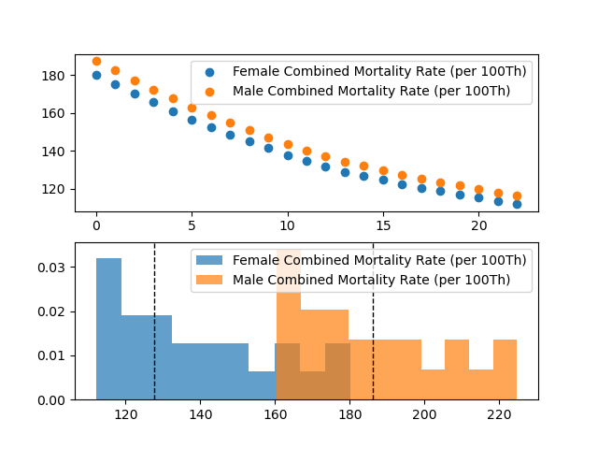
t-Test Comparison: Female vs Male Mortality Rates
Is there a difference between the Female and Male mortality rates for population under 5 years old?
Alternate Hypothesis: There is a significant difference between the Female and Male mortality rates for population under 5 years old.
Null Hypothesis: There is NOT a significant difference between the Female and Male mortality rates for population under 5 years old.
t-Test Result = -7.736177685637445
P-value = 9.908678073477023e-10
P-value < 0.05
We can conclude that there is evidence to reject the null hypothesis.

