Slide 1
Zoo Animal Multi-Class Classification Using CART
and Random Trees Models
DATA 450L-111
Brittany Mross, Hailey Tyler, Michelle Montevago

Slide 2
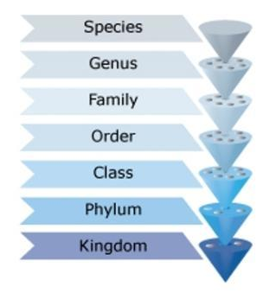
Animal Classification
“Despite existing for hundreds of years, the science of classification is far from dead. Classification of many species, old and new, continues to be hotly disputed as scientists find new information or interpret facts in new ways.” [1]
Animal classification is subjectively defined by scientists
Application of data mining techniques to make this classification easier and more consistent
New species can be classified based on previous data
Data analysts have created many models to attempt to classify animals using images
Kumar and Divya [2] created models to automatically classify animals using KNN, neural network, and symbolic classifier
Best accuracy rate: 92.5%
Notes:
+classification is subjective to scientists
+apply data mining to make this classification easier and classify new animals based on previous established categories
+

Slide 3
Animal Classification
Accuracy may be better when using feature lists in the form of flag variables
Birds: feathers, fly, lay eggs, etc.
Using data mining techniques can let scientists avoid having to decide whether a feature of an animal category is absolutely necessary for membership, or is only a frequent characteristic
e.g., Does a bird have to lay eggs to be a bird?
Our model uses data to classify animals into seven basic categories (correspond to classes) to test this methodology
Notes:
+classification is subjective to scientists
+apply data mining to make this classification easier and classify new animals based on previous established categories
+

Slide 4
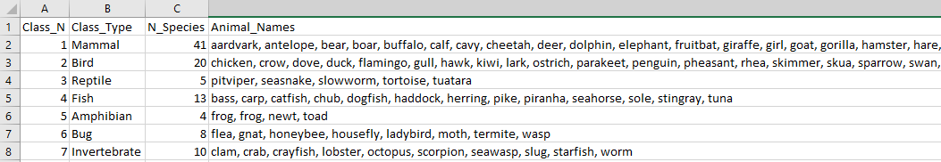
Dataset
Zoo Animal Classification from Kaggle [1]
101 cases
16 variables: hair, feathers, eggs, milk, airborne, aquatic, predator, toothed, backbone, breathes, fins, legs, tail, and catsize
Our goal was to build a multi-class classification model that would classify a species as one of seven categories based on their features:
7 categories: mammal, bird, reptile, fish, amphibian, bug, or invertebrate
Notes:
+variables-flag,one continuous
categories---multi class and

Slide 5
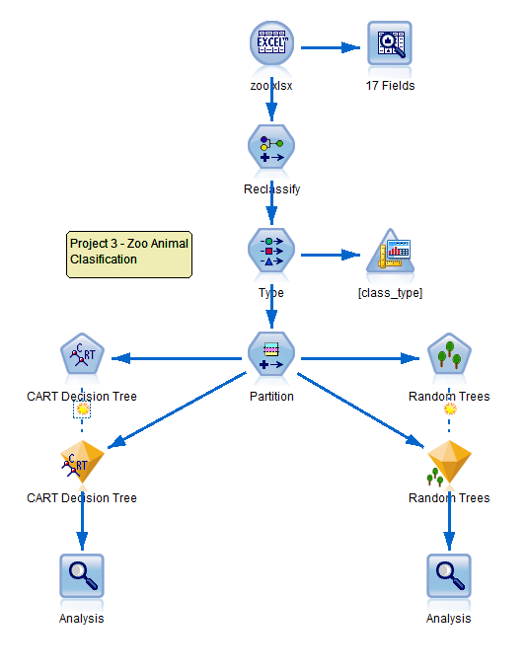
Overview of Method
Multi-class, single-label classification
CART Model
Random Trees Model
We used random forest classification to provide a model as accurate as possible without overfitting the data
Created 50 DT models and reports the “majority vote”

Slide 6
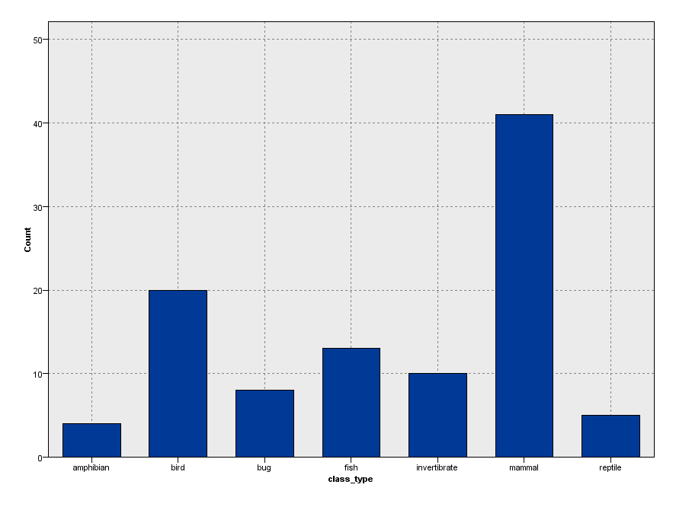
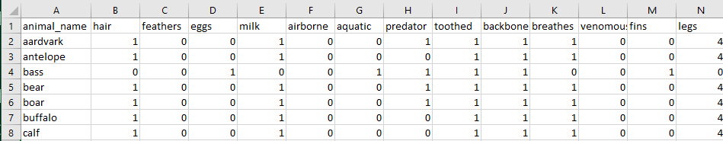
Data Preprocessing & Exploration
Data Audit showed 100% of fields and records are complete
We reclassified the class type variables to be the class names instead of numbers
(e.g., 1 = “mammal”)
No normalization of the data since they are flag variables
Frequency distribution of class types

Slide 7
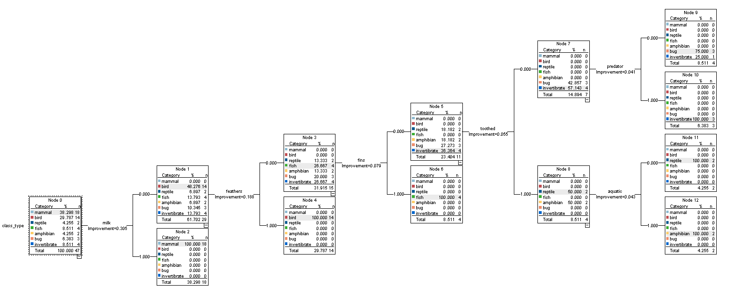
CART Decision Tree

Slide 8
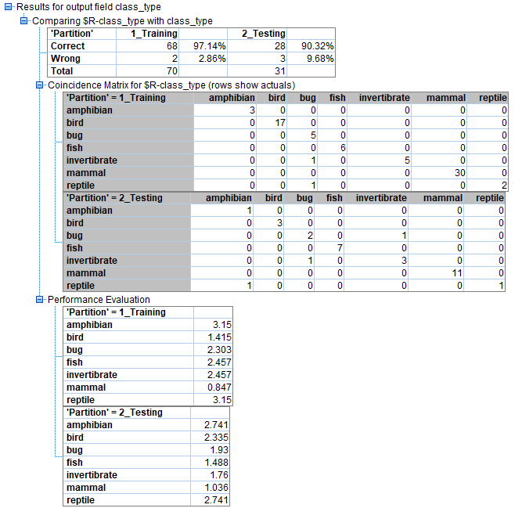
CART Accuracy
Accuracy
Training | 0.9714
Testing | 0.9032

Slide 9
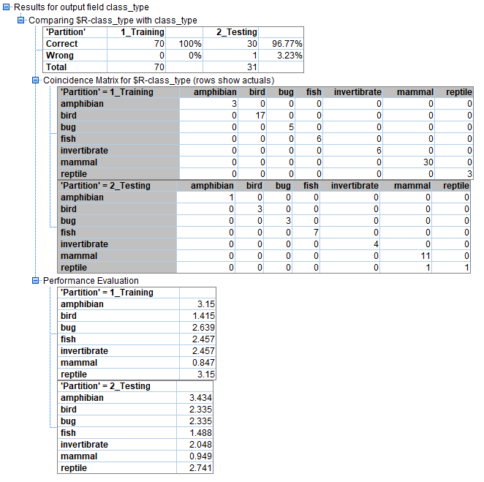
Random Trees
Model
The Random Trees node creates an ensemble model that consists of multiple decision trees.
It is a tree-based classification and prediction method that is built on classification and regression tree methodology.
As opposed to our CART Tree, Random Trees uses bagging and creates bootstrap samples to form component models which form the entire ensemble model. Additionally, at the split of each tree, only a sampling of the input fields is considered for the impurity measure. [5]

Slide 10
Predictive Performance Metrics for Random Forest
 | Accuracy | Precision | Recall | Specificity | F-Measure | Hamming Loss
Training | 1 | 1 | 1 | 1 | 1 | 0
Testing | .9677 | .9881 | .9287 | .9932 | .9575 | .0092
The higher the value of accuracy, precision, recall, specificity, and F-Measure, the better the performance of the learning algorithm.
A Hamming Loss of zero implies a perfect model. [6]

Slide 11
Discussion
The Random Trees model was more accurate than the CART model, as predicted
Improvements and future research
More data would make the models more accurate
The animal categories should be more specific (e.g., genus, family) for the model to be practically useful to scientists
Due to the high accuracy of our model, we believe that Random Trees is an appropriate algorithm to utilize in animal classification
Misclassification Rate
Model | Training | Testing
Random Trees | 0/70 = 0% | 1/31= 3.23%
CART | 2/70 = 2.86% | 3/31 = 9.68%

Slide 12
References
[1] “Classification system,” Science Learning Hub, 03-Sep-2018. [Online]. Available: https://www.sciencelearn.org.nz/resources/1438-classification-system.
[2] Y. H. Sharath Kumar and C. D. Divya, “Feature Selection Approach in Animal Classification,” Signal & Image Processing, vol. 5, no. 4, Aug. 2014.
[3] UCI Machine Learning, Zoo Animal Classification, 2016. [Online]. Available: https://www.kaggle.com/uciml/zoo-animal-classification.
[4] A. Ruiz, “Random Trees algorithm in SPSS Modeler 17.1,” SPSS Predictive Analytics, 12-Oct-2015. [Online]. Available: https://developer.ibm.com/predictiveanalytics/2015/10/11/random-trees-algorithm-in-spss-modeler-17-1/.
[5] “Random Trees node,” IBM Knowledge Center. [Online]. Available: https://www.ibm.com/support/knowledgecenter/en/SS3RA7_17.1.0/modeler_mainhelp_client_ddita/clementine/rf_general.html. [Accessed: May-2019].
[6] M. S. Sorower, “A Literature Survey on Algorithms for Multi-label Learning,” 2010. [Online]. Available: https://pdfs.semanticscholar.org/6b56/91db1e3a79af5e3c136d2dd322016a687a0b.pdf

Slide 13
Questions?

