Slide 1
Final Project
Pavel Petrov

Slide 2
Introduction to the topic (Chapter 2)

Slide 3
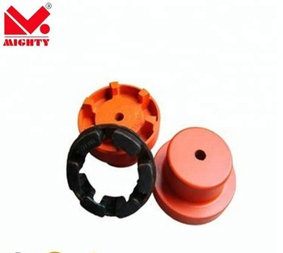
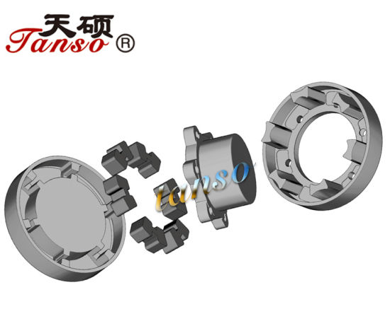
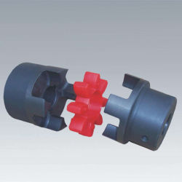
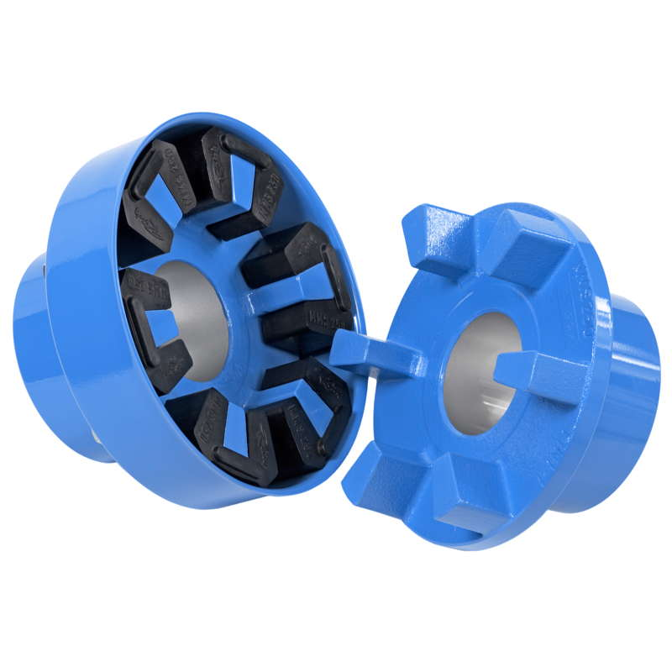
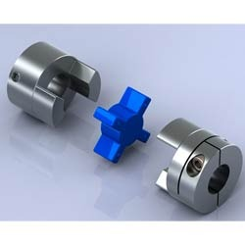
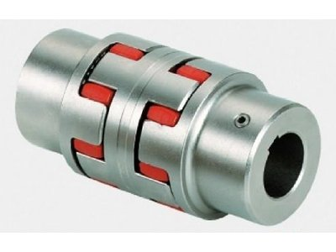
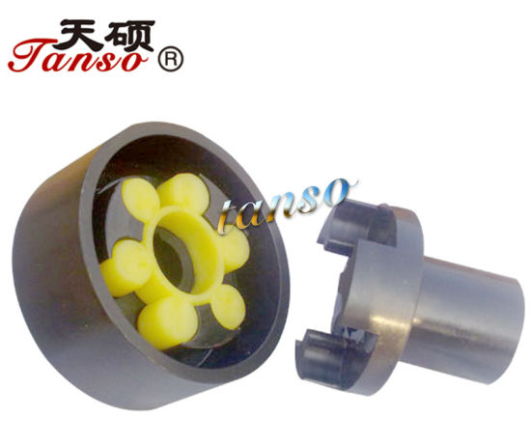
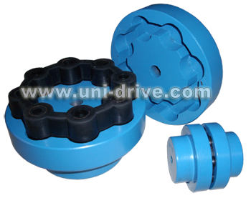
Flexible elastic jaw coupling
Different types of elastic coupling
https://en.wikipedia.org/wiki/Jaw_coupling

Slide 4
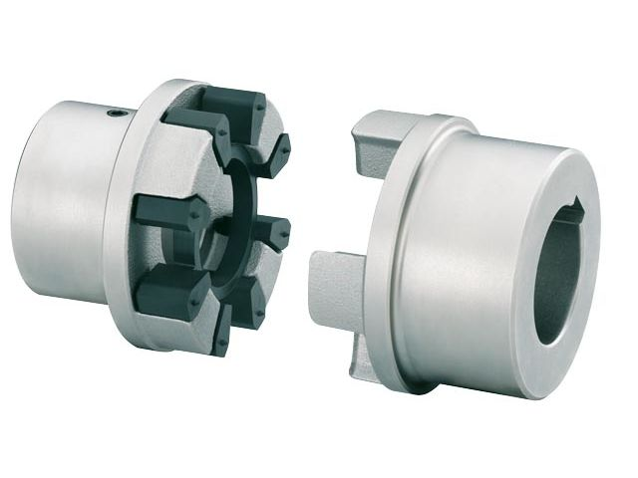
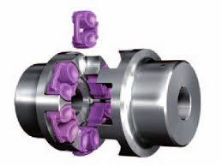
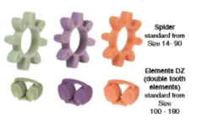
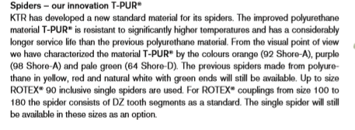
Flexible elastic jaw coupling
BIPEX semi-elastic coupling
Elastic coupling
Vote
Principle: Universal semi-elastic coupling of the slot type. Very compact, it works with a reduced torsional game. Application areas : Mechanical construction, especially for high-speed.
Different types of elastic coupling

Slide 5
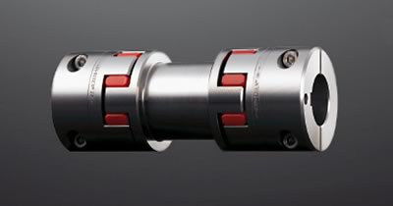
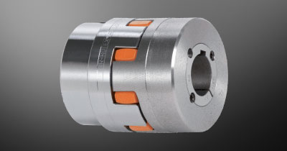
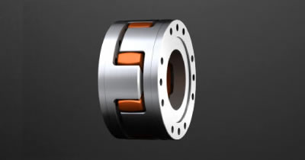
Topic description
Flexible elastic jaw couplings are characterized by small dimensions, low weight and low mass moments of inertia yet transmit high torques. Running quality and service life of the coupling are improved by accurate all-over machining. Their application is ideal for transmitting torque while damping torsional vibrations and absorbing shocks produced by the uneven operation of certain prime movers.
Problem: to improve the elastic element (spider); made it cheaper and easy to produce as well as easy to install

Slide 6
Patents for your system (Chapter 3)

Slide 7
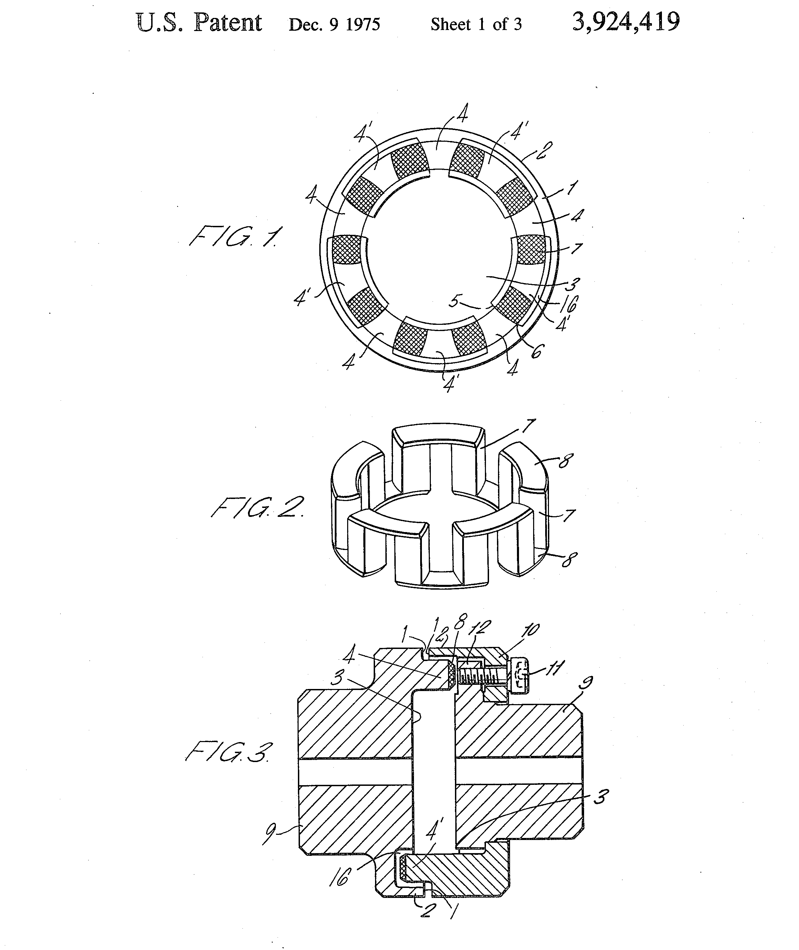
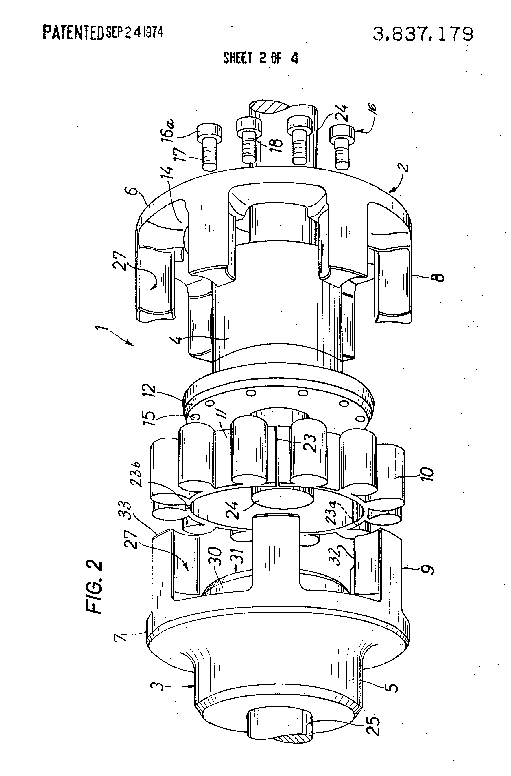
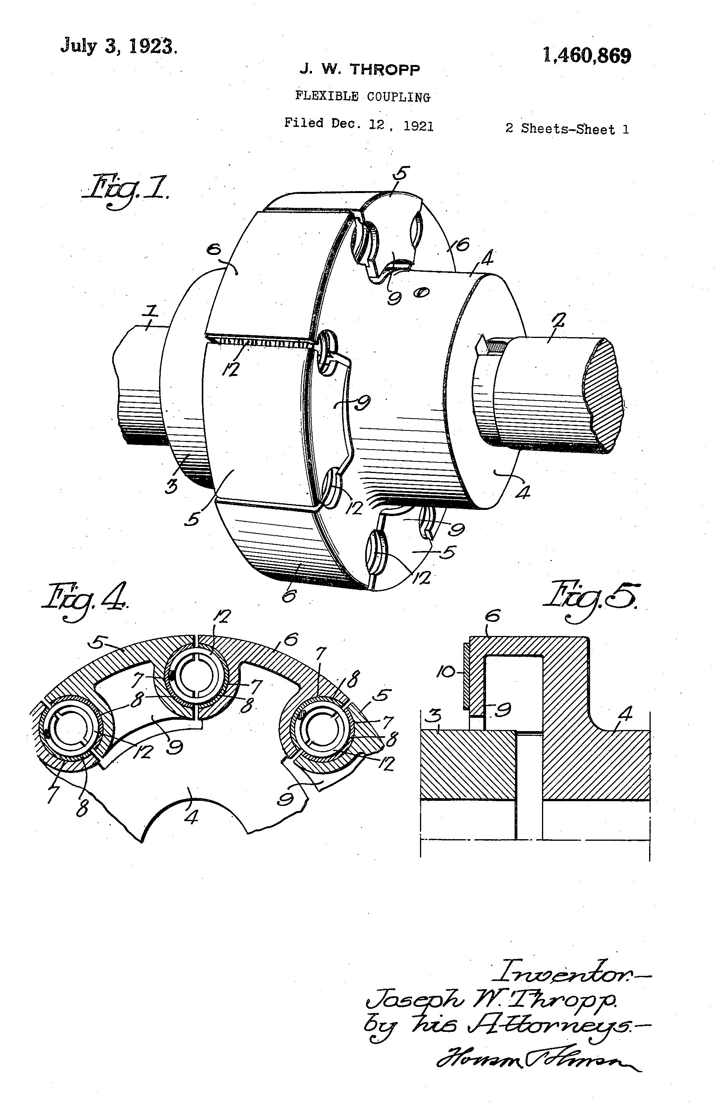
Patents’ search: Flexible elastic jaw coupling
Flexible jaw clutch coupling
Flexible coupling
Flexible coupling
Inventor Harald H Barth
Original Assignee Harald H Barth
Priority date 1972-06-12
Inventor Harald H Barth
Original Assignee Harald H Barth
Priority date 1972-03-10
Inventor Joseph W Thropp
Original Assignee Joseph W Thropp
Priority date 1921-12-12

Slide 8
Function of the system (Chapter 4)

Slide 9
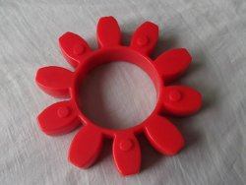
Flexible elastic jaw coupling
Components: elastic spider, hub
Interaction: compensate, connect, minimize, damp
Parameter: misalignment, amplitude of vibration, overload
1. Elastic spider compensates the angular misalignment of the driven shaft
2. Elastic spider connects two shafts
3. Elastic spider minimizes shock to a servomotor
metallic hubs
elastic spider

Slide 10
Function Oriented Search (Chapter 5)

Slide 11
Flexible elastic jaw coupling
Function: to compensate the misalignment of the shaft
Generalisation: to keep the system in balance, to pass the torque without loss, the tooth of the elastic spider should be save as much as possible
Leading area: gear box or gear in an automotive construction
Adoptation: the elastic spider interacts with the hubs through the toothing;
metallic hubs
elastic spider

Slide 12
Applying of biomimetrics to the system (Chapter 6)

Slide 13


Flexible elastic jaw coupling
Spider web
with dew
drops
Spider web
“…spider webs owe their superior performance not just to the ultimate strength of the silk thread, but also from its nonlinear response to stress and its alignment within the geometry of the web. The silk nanocrystals are a stacked arrangement with each layer dialed in a different direction. They are held together by weak hydrogen bonds that act together in the stack to resist external force.” (Zygote Quarterly)
Source: https://asknature.org/strategy/web-absorbs-impacts/#.XEjllfZuLIU
metallic hubs
elastic spider

Slide 14
Ideal Final Result for the system (Chapter 7)

Slide 15
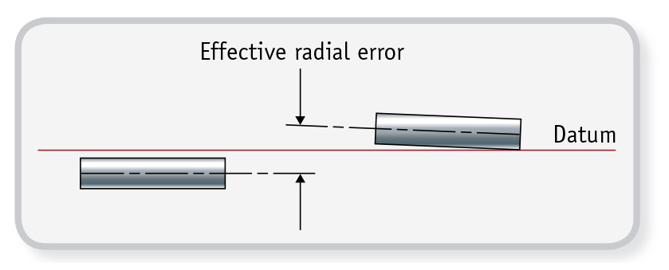
Variant 1:
Requirements:
The choice of couplings available to today’s engineers can be daunting, but follow the guidelines and it will be arrived at the optimum coupling for the particular application.
Does the coupling provide adequate misalignment protection?
Can it transmit the load torque?
Do I need axial motion or axial stiffness?
Can it sustain the required speed of rotation?
Will it fit within the available space envelope?
Can it operate at the designated ambient temperature?
Does it provide torsional stiffness required for positional accuracy?
Does it provide electrical isolation between the shafts?
Will it have the required life expectancy?
metallic hubs
Source: https://www.huco.com/design-guide/selecting-ideal-coupling
effective radial error

Slide 16
Variant 1:
Requirements:
The choice of couplings available to today’s engineers can be daunting, but follow the guidelines and it will be arrived at the optimum coupling for the particular application.
Does the coupling provide adequate misalignment protection?
Can it transmit the load torque?
Do I need axial motion or axial stiffness?
Can it sustain the required speed of rotation?
Will it fit within the available space envelope?
Can it operate at the designated ambient temperature?
Does it provide torsional stiffness required for positional accuracy?
Does it provide electrical isolation between the shafts?
Will it have the required life expectancy?
metallic hubs
Source: https://www.huco.com/design-guide/selecting-ideal-coupling
spider as double tooth element

Slide 17
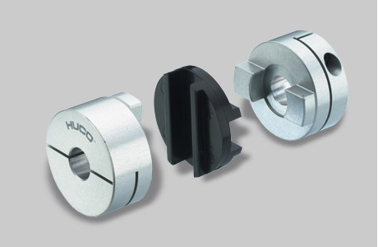
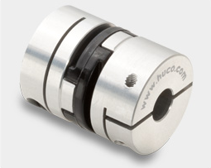
Variant 2:
Requirements:
The choice of couplings available to today’s engineers can be daunting, but follow the guidelines and it will be arrived at the optimum coupling for the particular application.
Does the coupling provide adequate misalignment protection?
Can it transmit the load torque?
Do I need axial motion or axial stiffness?
Can it sustain the required speed of rotation?
Will it fit within the available space envelope?
Can it operate at the designated ambient temperature?
Does it provide torsional stiffness required for positional accuracy?
Does it provide electrical isolation between the shafts?
Will it have the required life expectancy?
metallic hubs
“Oldham” coupling
Source: https://www.huco.com/design-guide/selecting-ideal-coupling

Slide 18
Ideal Final Result
classical spider
spider as double tooth element*
spider as a disc*
To modify the spider:
It is needed to reduce its cost
It is needed to simplify the shape of the spider
It is needed to simplify the technology of its production
The results of the modification:
+ reduction in cost of spider
+ simplification of the spider’s shape
The results of the modification:
+ more simple spider’s shape
+ more functionality
Spider function is to transfer the torque as well as to compensate the misalignments of the shafts
Source*: https://www.huco.com/design-guide/selecting-ideal-coupling
https://www.ach.nu/wp-content/uploads/2017/07/rotex_en.pdf

Slide 19
Contradictions for your system (Chapter 8)

Slide 20
Flexible elastic jaw coupling
Function of coupling:
to transmit the torque between the drive and driven machine
to compensate for angular, parallel and axial shaft misalignments within defined ranges
to damp the vibrations caused by unbalance of the shafts
Object: elastic element (spider)
Hub material: Aluminium (Al), Cast Iron (GG/GGG), Sintered Steel (Si), Steel (St)
Spider material: elastomeric of various degrees of shore hardness; sensitive to temperature and humidity; with resistance against hydrolysis (can be used in tropical conditions), non-abrasive, has a high self-damping effect and is also resistant to oil and ozone; can be used with temperatures ranging from -40 °C to +120 °C.
Maximum shaft diameters of 145 mm can be accommodated with maximum torques up to 15,000 Nm and maximum speeds of 19,000 rpm.
metallic hubs
elastic spider

Slide 21
Flexible elastic jaw coupling
Object: elastic element (spider)
Requirements (more strictly):
A. particular requirements of the application
the weight of the coupling;
coupling’s mass moments of inertia;
the avoidance of vibrations caused by unbalance;
B. economic requirements also have to be taken into account
time and work effort for the installation;
maintenance intensity;
cost for replacement;
cost of the elastic spider.
Source:
https://www.jbj.co.uk/spider-couplings.html#Application-service-factors-for-the-Spidex-coupling
https://info.ringfeder.com/engineers-blog/couplings-smart-engineering-considers-technical-and-economic-requirements
metallic hubs
elastic spider

Slide 22
Flexible elastic jaw coupling
Contradiction:
High degree of shore hardness
Shore hardness of elastomeric material of the spider
Application available for high torque and humidity requirements
Application available for high torque requirements
metallic hubs
Low degree of shore hardness
elastic spider

Slide 23
TESE for your system (Chapter 9)

Slide 24
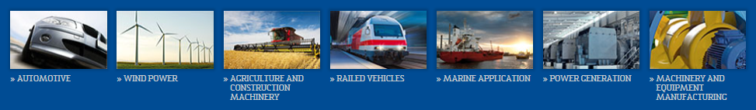
Flexible elastic jaw coupling: S-curve trend
Power drive:
- CNC machines
- Rolling mills
- River and navy vessels
- Diesel and electric locomotives
- Drilling machines
- Pumping units
- Road construction vehicles
Fields of application

Slide 25
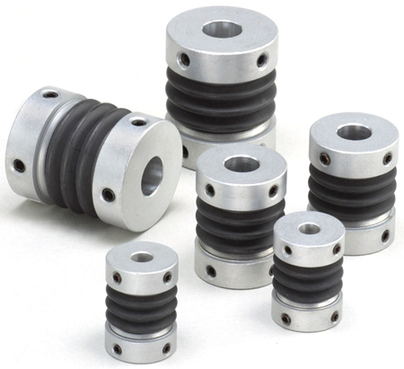
Flexible elastic jaw coupling: dynamisation trend
robust
(optimal)
adaptive
self-adaptive
https://
www.mikipulley-us.com/
bellows-couplings
initial
(patented in 1921)

