Slide 1
Final Report of CS30A7381SS Systematic Creativity and TRIZ basics Online

Slide 2
CONTENT
1. Introduction to your topic (Chapter 2)
2. Patents for your system (Chapter 3)
3. Function of your system (Chapter 4)
4. Function Oriented Search (Chapter 5)
5. Applying of Biomimetics to your system (Chapter 6)
6. Ideal Final Result for your system (Chapter 7)
7. Contradictions for your system (Chapter 8)
8. TESE for your system (Chapter 9)

Slide 3
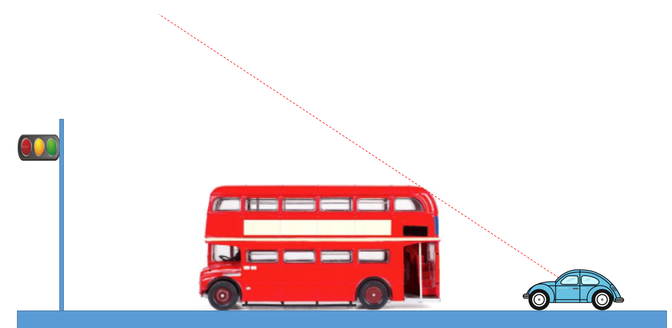
1.Introduction to your topic
In driving, large vehicles in front often block the rear cars.
I want to design a system to solve the problem that the car can not see the signal lamp because the large vehicle blocks the rear vehicle.

Slide 4
2.Patents for your system
First, identify the keywords.The key point is the improvement of traffic lights, so I search for traffic lights.
The keywords are vehicles，traffic lights or signal lights，
The results are in the next slide.

Slide 5
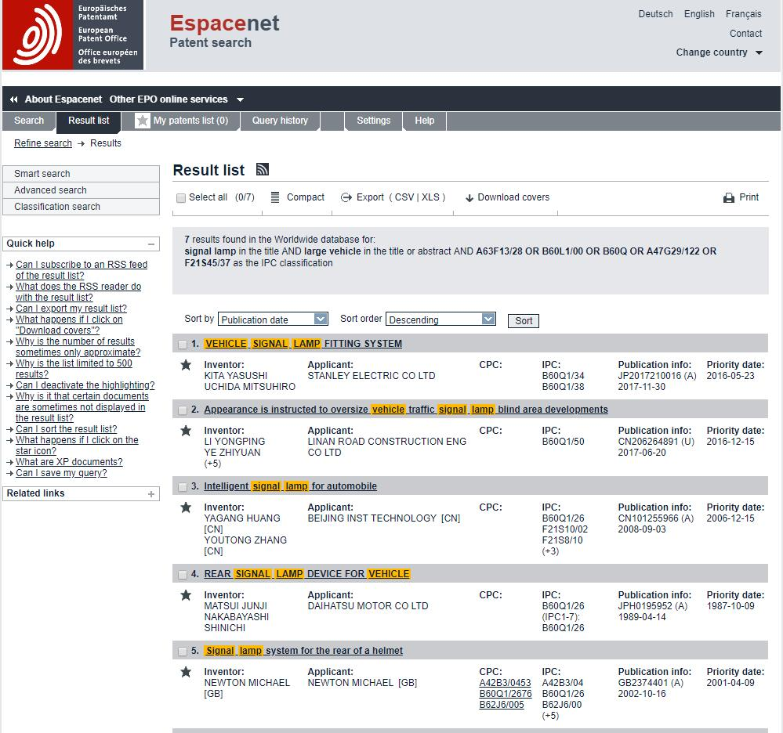

Slide 6
3.Function of your system
large vehicle
lamp pole
shelter
brace
provide information
block
car
supply electricity
electric power system
Signal lamp
provide information
produce
traffic information
signal light
output
The function of the system is to provide traffic information so that cars and large vehicles can pass through the crossroad normally.

Slide 7
4.Function Oriented Search
The main function of this system is to provide traffic information. Generally,its function is to produce a kind of information.
The functional effects found have Electromagnetic- Induction,Fluorescence,Piezoelectric Effect and so on.

Slide 8
5. Applying of Biomimetics to your system (Chapter 6)
Many animals have very conspicuous colors, and some animals disguise themselves.
Maybe when the signal light is red, it should have more bright colors, but other times it doesn't show colors.

Slide 9
6. Ideal Final Result for your system (Chapter 7)
This system should have a variety of ways to prompt traffic information,Specifically, traffic information can be conveyed through the network.Besides,it should have more visible signal lights.And we can also make improvements on the car.

Slide 10
7. Contradictions for your system (Chapter 8)
We have the Technology Contradiction:
When increasing the diversity of signals, it will increase the difficulty of manufacturing.
We have the Physical Contradiction:
We need large vehicles high enough to transport more goods. We need large vehicles not high to provide a better view.

Slide 11
8. TESE for your system (Chapter 9)
Ideality Trend; Transition to the Super System
Use network to provide real-time traffic information to drivers at all crossroads.

