Slide 1
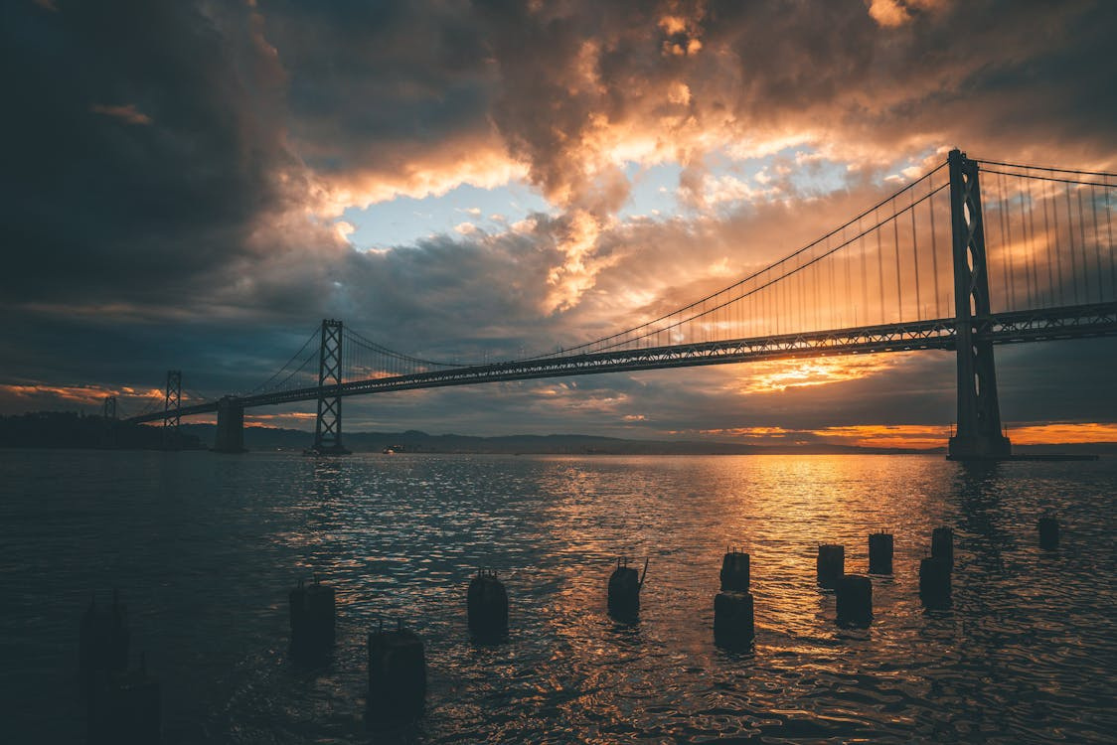
Đề Tài Incredible Bridge
BẢO VỆ ĐỒ ÁN KÌ 1
Incredible Bridge

Slide 2
OUR TEAM
Leader
Member
Bùi Hải Long
Ngô Quang Minh

Slide 3

Part I
PROJECT INTRODUCTION
The Bridge is a bridge magazine website, said to compile the world's most incredible bridges, both old and new. Here readers will not only find images of bridges but also history, artifacts, and many other aspects about bridges.
The Incredible Bridge

Slide 4






Technology

Slide 5
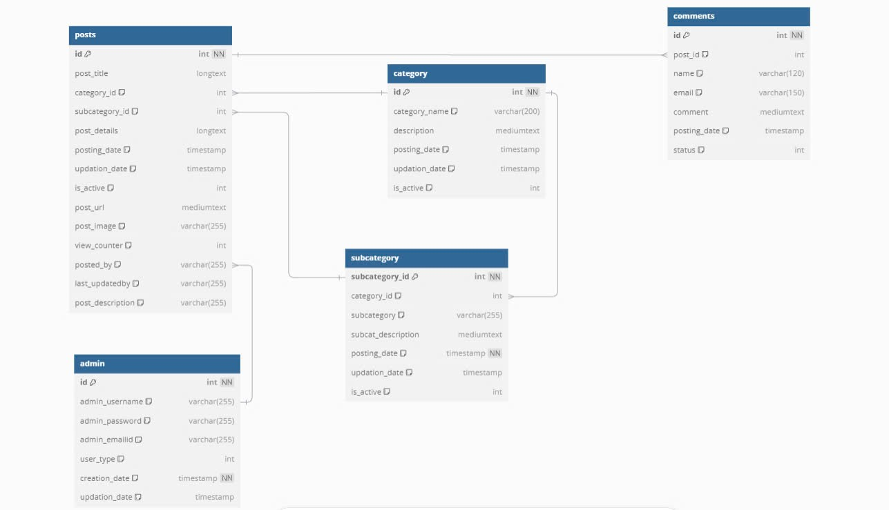
database

Slide 6
demo product

