Slide 1
Hack for Humanity 2026: Misinformation & Disinformation
Fakt (факт)
Это правда?
Is this true?
A community Telegram bot to dispel political misinformation targeting Uzbek elderly
Вот что говорит ваша махалля и проверенные источники.
Here’s what your mahalla and trusted sources say.
Sayid Achilov, Hailey Coval, August Gilmartin, Tiger Li, Kevin Zhu

Slide 2
Mission
Dispelling Russian political misinformation targeting elderly Telegram users in Uzbekistan by enabling community members to create custom information-checking Telegram bots

Slide 3
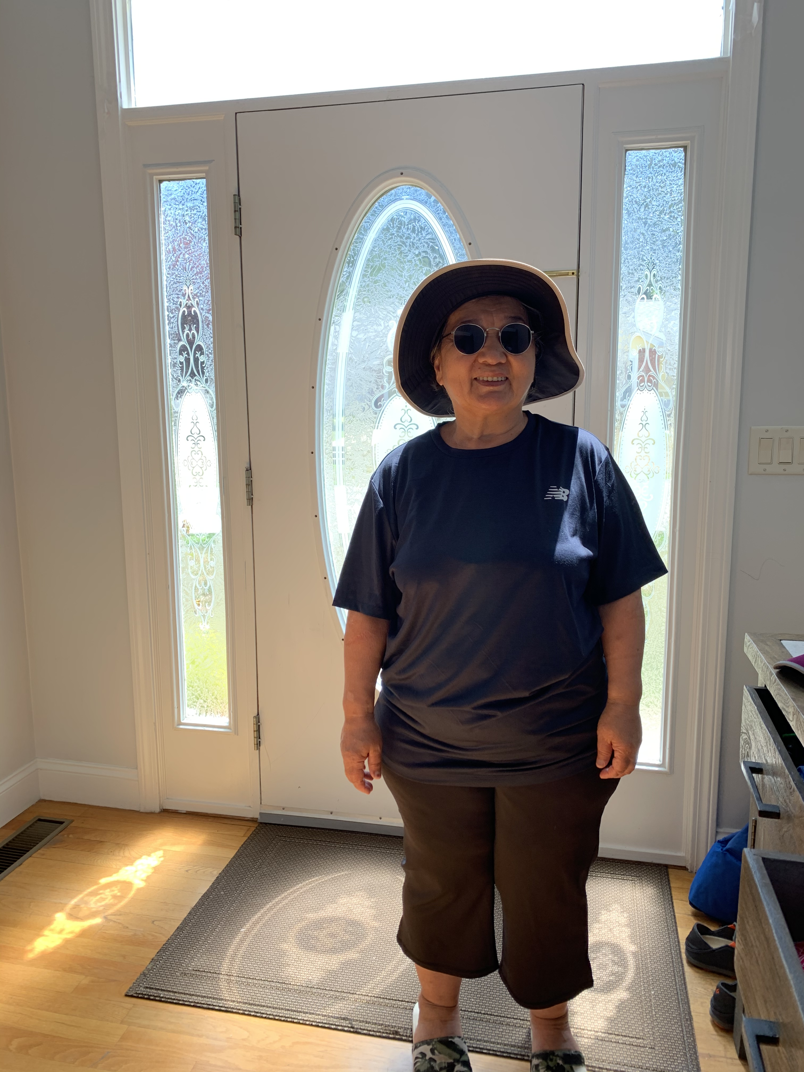
Sayid’s Grandmother
74 years old
Семья · Family
8 участников · 8 members
Uses Telegram as primary source of news
Forwards texts into the Achilov group chat
Переслано · Forwarded
Перешлите, пока не удалили! Запад рушится, только с Россией Узбекистан будет в безопасности.
Forward before it’s deleted! The West is collapsing; only with Russia will Uzbekistan be safe.
71.2%
of Uzbeks use Telegram more than WhatsApp¹
51.6%
Said Telegram was their leading news source²
Это правда?
Is this true?
46.6%
Said fake news is the most pressing problem¹
Illustrative example
¹ Central Asia Barometer, Dec. 27, 2023
² National Study on Media Consumption in Uzbekistan, Nov. 3, 2026
3 European External Action Service, Nov. 2, 2026
Notes:
Sources:
https://ca-barometer.org/en/publications/which-messaging-apps-are-popular-in-uzbekistan-kyrgyzstan-and-Kazakhstan
https://daryo.uz/en/2026/11/03/telegram-ranks-as-top-news-source-in-uzbekistan-study-shows/
https://www.lovguiden.dk/en/det-offentlige/eu-udenrigstjenesten/2026-11-02-uzbekistan-telegram-is-top-news-source-but-tv-enjoys-most-public-trust

Slide 4
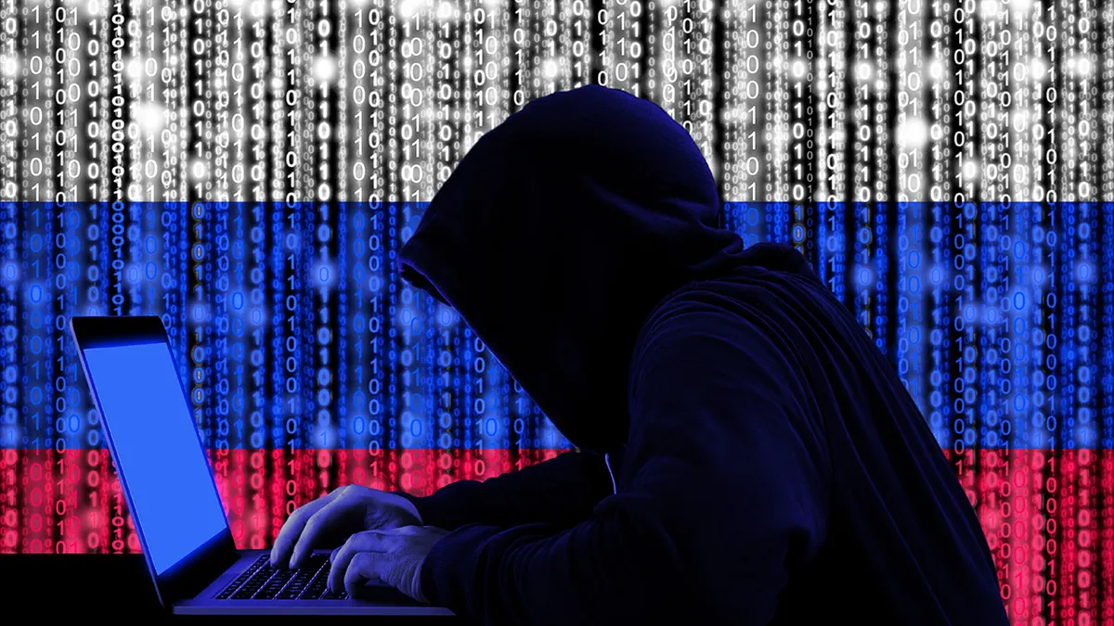
The Problem
Russia is flooding Uzbek Telegram with political disinformation, and older users are the most likely to believe and forward it
Propagandic Claims
Manufactured Consent
Bots and agents flood Telegram channels with coordinated misinformation
E.g. “Western power is collapsing”
  523 instances & 5.9M views on Telegram in Uzbekistan alone¹
Volume and range of activity from these accounts create a sense of consensus
No balancing voices from the other perspective
Attempts to convince citizens that what is “consensus” online is also “agreed” offline
Older Populations Targeted
Pro-Russian views in Central Asia track with older age, TV and Russian-media habits, and Soviet nostalgia²
Russian-language chain messages (“forward before it’s deleted!”) spread through family group chats
¹ ENC & Internews CARAVAN Project, Apr. 2026
² Re:Russia, Aug. 3, 2024
Notes:
Sources:
https://eualive.net/new-report-reveals-scale-of-kremlins-information-warfare-in-central-asia/
https://re-russia.net/en/review/698/

Slide 5
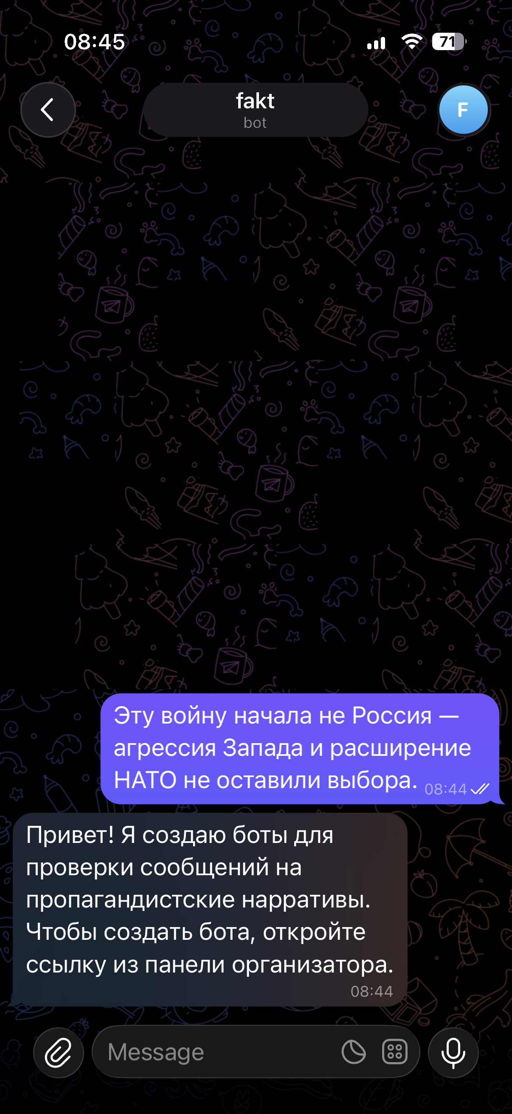
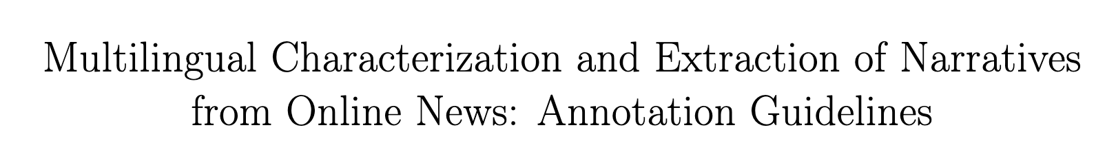
Our Solution: Fakt
Fakt empowers local, trusted communities to create custom information-checking Telegram bots
Telegram Native
Community Centered
Multiple Sources
Integrated directly with Telegram’s system
Not a website like factchecknet.uz
Mahallas: existing trusted neighborhood committees
Not creating individual echo chambers
Communities choose which sources and organizations’ views appear in chat
Official sources ground the custom AI responses
2025 classification technique we intend to integrate

Slide 6
getfakt.vercel.app
Demo created in collaboration with genAI

Slide 7



Partnerships
MJDC
Kun.uz
Internews
Uzbek NGO working on media literacy and journalism training; help bring Fakt to Uzbek communities.
Uzbekistan’s most-followed news outlet on Telegram; collaborate to share fact-checks and promote Fakt.
Has researched media literacy in Uzbekistan; train volunteers and run listening sessions with families.
Most importantly: local mahallas

Slide 8
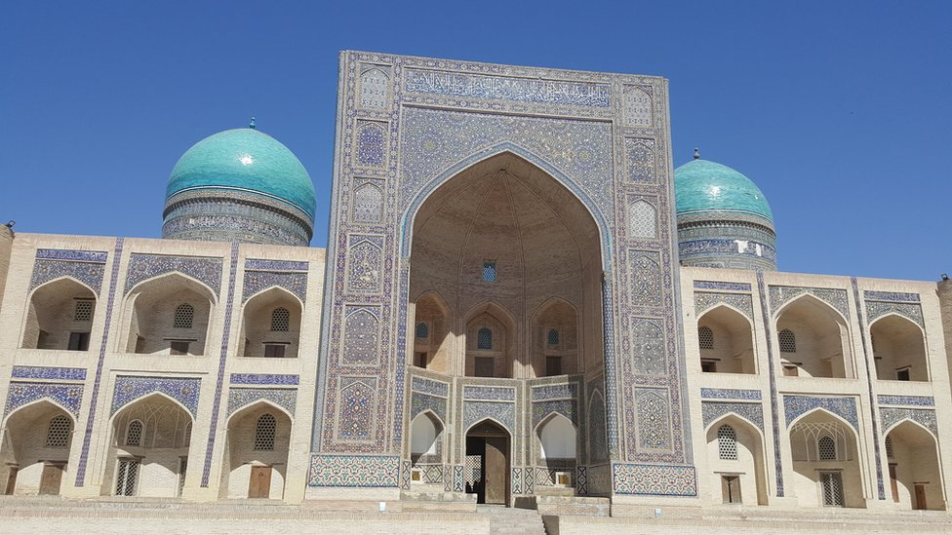
For the Future / Cost Projections
Reach younger Uzbeks next: add Uzbek in Latin script, not just Russian
Expand to Kazakhstan, Kyrgyzstan and Tajikistan, which share the same Russian-language Telegram spaces
Bring Fakt to diaspora families in the US, like the Uzbek community in Brooklyn
Pilot: 3 months
Month 1: listening sessions with families and 2–3 community leaders
Month 2: bots set up with partner sources, train 20 volunteer installers
Month 3: launch, collect feedback, add Uzbek
$3,000 budget (estimates)
Translation and native-speaker review: $900
Volunteer training and stipends: $900
Listening sessions and testing: $600
Hosting and AI usage: $300
Contingency: $300

