Slide 1
Foreign Exchange Directionality Prediction
Prediction of AUD/USD direction
Hailun Zhu
ID: hailunz
Notes:
My project aims to predict AUD/USD directions in the Foreign exchange market.

Slide 2
Project Purpose
Problem statement
The foreign exchange market (FOREX) is a global decentralized market for the trading of currencies.
The market is changing rapidly. It is hard to predict its trend.
We use machine learning techniques to predict AUD/USD directions in FOREX market.
Value proposition if solution found
Find pattern and trend of AUD/USD direction in the market
Help traders to make decision and earn money.
Notes:
The foreign exchange market is changing rapidly, thus predicting the trend of the market is a great challenge. If we could predict the approximate trend or pattern of it then we could help traders to make decision as well as earn money.

Slide 3
Analytic Approach
Description of methodology
Data preparation:
Time window: 1hr
Data source: 2013~2015
Data set size:
Total : 15266 rows (Randomly select training and test data)
80% Training data set size: 12212 rows
20% Test data set size: 3054 rows
Notes:
I preprocess the raw data. First I aggregate them based on their timestamp to get one-hour data and then get the corresponding features. Then I transfer the features to a binary feature vector so that feature values can only be 1 or 0. And I randomly separate the data set to training and test data set.

Slide 4
Analytic Approach
Description of methodology
Data preparation:
Feature vector used: (binary)
Features | Description
bidRange | bidMax - bidMin
bidAverage | Average bid price
spread | (ask - bid)/bid
self direction | AUD/USD current bid – previous bid
EUR/USD direction | EUD/USD current bid – previous bid
GBP/USD direction | GBP/USD current bid – previous bid
Label | AUD/USD next bid – current bid
Notes:
Here is the features that I used. The first three are features based on bid and ask prices. The last three are based on current direction of the predict currency and relative currency pairs, including EUR/USD, GBP/USD.

Slide 5
Analytic Approach
Description of methodology
Classifiers:
Decision tree
Random forest
Gradient-Boosted Trees (GBTs)
Others
Notes:
Basically I used three different methodologies to train model and make the prediction

Slide 6
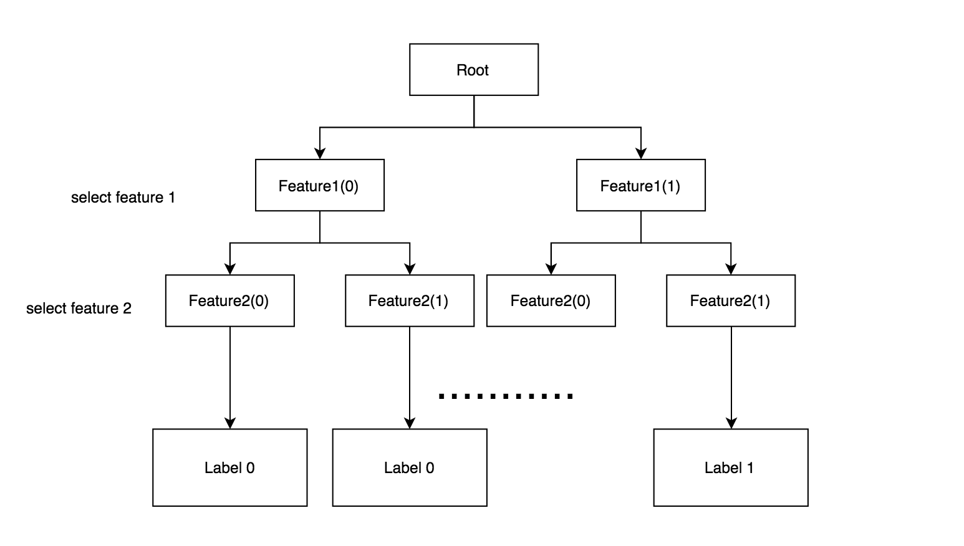
Analytic Approach
Description of methodology
Classifiers:
Decision tree
Notes:
For each layer of the decision tree, I choose to use the feature that could give more information. At the lowest level, the path from the root to the label gives a feature vector and a label. Then by passing a feature vector to the decision tree you could finally get a label. 0 indicates decrease and 1 indicates increase.

Slide 7
Analytic Approach
Description of methodology
Classifiers(estimators):
Decision tree
Random forest
combine many decision trees in order to reduce the risk of overfitting.
Number of the trees : N = 5;
Number of the features: featureNum = 3, total 6 features. I choose ceiling √6 = 3.
Gradient-Boosted Trees (GBTs)
GBTs iteratively train decision trees in order to minimize a loss function.
Others
Logistic Regression, etc.
Notes:
I also tried more complicated models, which are Random Forest and Gradient-Boosted Trees. They both use decision tree as a base model.

Slide 8
Analytic Approach
Description of methodology
Transformers: (Provided by Spark)
PCA:
PCA is a statistical procedure that uses an orthogonal transformation to convert a set of observations of possibly correlated variables into a set of values of linearly uncorrelated variables called principal components.
Project 6-dimensional feature vectors into 3-dimensional principal components
Notes:
I also tried another transformer to transform the data. PCA could project 6-dimensional feature vectors into 3-dimensional principal components. Thus instead of 6 features I also tested feature vector with 3 features.

Slide 9
Analytic Approach
Description of methodology
Programming techniques:
Hadoop Mapreduce Java
Scala, Spark, Spark MLLIb
Cassandra (for data storage)
Notes:
Here are the programming techniques that I used.

Slide 10
Analytic Approach
Description of the final approach utilized to generate the best results
Random Forest with 5 trees, using Spark
Notes:
The best result is gained by using Random Forest with 5 trees.

Slide 11
Results
Classifier |  | Precision
Decision Tree |  | 56.48%
Random Forest (simple) |  | 57.56%
Random Forest (MapReduce) |  | 57.24%
Random Forest (Spark) | 5 trees | 57.66% (best)
 | 10 trees | 57.56%
 | 20 trees | 57.56%
GBT | 3 interations | 56.64%
 | 10 interations | 56.35%
Logistic Regression |  | 52.03%
Logistic Regression with PCA |  | 52.02%
Notes:
As can be seen from this table, the best result I got is of 57.66% precision. The logistic regression got the worst result and its recall is also skew. Thus in this case, Random Forest is the best classifier so far.

Slide 12
Results
Summary
Random Forest with 5 trees got the best result:
Precision: 57.66%
Recall : 59.43%
When adding trees from 10 to 50 , the results are more stable.
Reason:
Compare to other classifiers, Random Forests can be less prone to overfitting.
Random Forests reduce variance by using more trees
Notes:
Here are other things that I found in my result. Increasing the number of trees in Random Forest, the results remain the same. The reason could be that when RF is small, every tree is very important to the final result. And some trees may have dominant influence to the final result. When increasing the number of trees, the effect of each tree is diminished. And the reason that Random Forest gained better result may be that Random Forests can be less prone to overfitting.

Slide 13
Error Analysis
Feature selections:
Some features have dominant effect, which influence the results more.
Some features are not independent, related to other features, thus provide redundant information.
Features I use are not enough, cannot fully reflect the trending pattern.
Binary features could generate more accuracy errors.
Notes:
The factors that could result in errors could be concluded into two aspects. One is feature selection. There are several reasons that could make the features not so distinguish and representable.

Slide 14
Error Analysis
Other factors:
The market is changing rapidly. Choosing one-hour time window is too large to be accurate.
The market could have dramatic changes due to reality factors like policy.
Notes:
The other is the reality factors. There are lots of factors that could influence the FOREX market. Thus the current state may not be enough to predict next state.

Slide 15
Actionable Information or Insights
Consult finance expert to extract better features.
Use smaller time window to predict.
Use parameters that could train a better model.
Use state-of-the-art programming techniques to implement the jobs in parallel.
Notes:
What we could learn from my project. First is to gain more domain knowledge. This is very important.
Second, we could use smaller time window. And we could tune parameters or use better models.
As for data processing, we could utilize other programming techniques to improve the efficiency.

Slide 16
Future Work
Utilizing the domain knowledge to extract more and better features.
Try other transformers and classifiers
Try other currency pairs, predict the trend and estimate the possible profit we could gain in the future.
Notes:
Here are some future work we could do. After we get better understanding of the domain knowledge, we could try different transformers and classifiers that suit our needs better. And we could get on to more sophisticated prediction tasks.

Slide 17
Supplemental Information
Tools and libraries:
Hadoop
Cassandra
Spark ML
Notes:
Here are some tools and libraries I used in my project.

