Slide 1
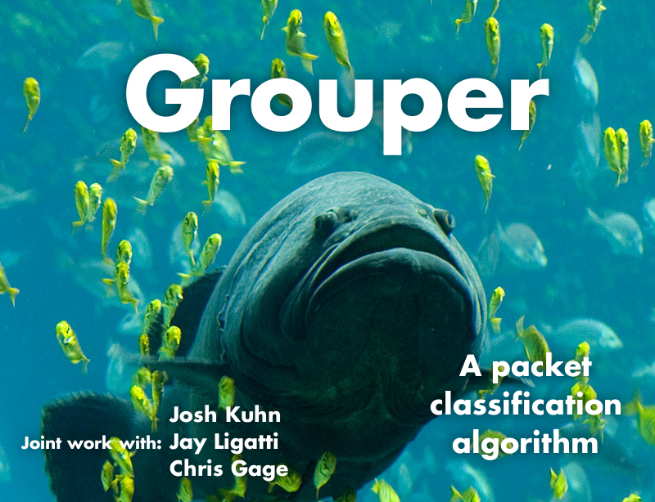
University of South Florida

Slide 2
Outline
Introduction
Related work on packet classification
Grouper
Performance Analysis
Empirical Evaluation
Conclusions

Slide 3
Introducing Grouper
A packet classification algorithm
Parameterized by the amount of memory available to it
Trades classification speed for memory efficiency
Obtains good performance under real-world memory constraints

Slide 4
Quick (Over|Re)view of Packet Classifiers
Takes in a list of rules, each specifying a class of packets matched by that rule
The rules are usually arranged by priority
Class | Source IP | Source Port
0 | 192.168.*.1 | 4567
1 | 4.4.4.[4-8] | [80 - 81]
2 | * | >=1024
3 | * | *

Slide 5
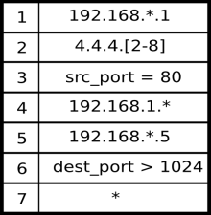
Packet Classifier’s Job
The classifier’s job is to input packets, and for every input, output the corresponding class number
Class 1
Packet
RULES
Class 2
Packet Classifier
…
Class N

Slide 6
Outline
Introduction
Related work on packet classification
Grouper
Performance Analysis
Empirical Evaluation
Conclusions & Future Work

Slide 7
Related Work: Range Rule Patterns
Existing software solutions (e.g., GEM) focus heavily on range and prefix pattern rules
Range rule: dest_port = [1024 – 65535]
Prefix rule: src_ip = 192.168.*
For many applications, these types of rules are not efficiently expressive
E.g., matching all odd-numbered 16-bit ports requires 65,535 range/prefix rules

Slide 8
Bitmask Patterns: More Efficiently Expressive than Range Patterns
Bitmask pattern to match all odd 16-bit ports:
Ternary mask, consisting of 0,1,or ? (don’t care)
???????????????1
A b-bit bitmask rule may require 2^{b}-1 range rules to express
On the other hand, Rottenstreich et al. recently showed that every b-bit range rule can be converted into b bitmask rules

Slide 9
Who Uses Bitmasks?
Some existing packet-classification solutions handle bitmask patterns
RFC (a software solution) handles them, but uses prohibitively large amounts of memory for large rule sets (> 6000 rules)
TCAMs (a hardware solution) are the de facto industry standard and use bitmask rules, but are expensive, special-purpose hardware with limited capacity for rules

Slide 10
Related Work: Regular Expression Patterns
Some software algorithms, such as ESAs XFAs and BDDs, can handle regular expression rules, which are even more efficiently expressive than bitmasks
Unfortunately, all of these algorithms suffer from worst-case exponential memory requirements and/or classification times

Slide 11
Outline
Introduction
Related work on packet classification
Grouper
Performance Analysis
Empirical Evaluation
Conclusions & Future Work

Slide 12
How Grouper Works: Grouping
Grouper is a software algorithm that handles bitmask rules
It works by partitioning the b packet bits our classifier cares about into approximately equal sized groups
b = 12
0
1
0
1
0
1
0
1
1
0
0
1
Group 0
Group 1
Group 2
Group 3

Slide 13
How Grouper Works: Lookup
Grouper uses the value of each of these groups to look up the set (expressed as a bitmap) of classes that match that group of bits
b = 12
0
1
0
1
0
1
0
1
1
0
0
1
Group 0
Group 1
Group 2
Group 3

Slide 14
How Grouper Works: Lookup
Grouper uses the value of each of these groups to look up the set (expressed as a bitmap) of classes that match that group of bits
Table for Group 0
1
0
1
1
0
1
0
= 2
0
1
0
1
0
0
1
1
0
0
1
1
1
0
1
1
1
1
0
1
0
1
0
1
0
0
0
1
1
0
1
1

Slide 15
How Grouper Works: Lookup
Grouper uses the value of each of these groups to look up the set (expressed as a bitmap) of classes that match that group of bits
Table for Group 1
0
1
0
1
Group 0
Group 1
1
0
1
1
Group 2
Group 3
0
1
0
1
0
1
0
0
1
1
0
1
1
0
0
1
0
1
1
1
0
0
1
1
1
1
0
0
0
0
1
1
1
1
1
1
1
0
0
1
1
0
1
1

Slide 16
How Grouper Works: Lookup
Grouper uses the value of each of these groups to look up the set (expressed as a bitmap) of classes that match that group of bits
Table for Group 2
Group 0
Group 1
Group 2
Group 3
0
1
0
1
0
1
0
1
1
1
0
1
0
1
0
1
1
0
0
1
0
0
0
1
0
1
1
1
0
1
1
0
1
1
1
1
1
1
1
1
0
1
0
0
0
1
1
1
0
1
0
1
1
0
0
0

Slide 17
How Grouper Works: Lookup
Grouper uses the value of each of these groups to look up the set (expressed as a bitmap) of classes that match that group of bits
Table for Group 3
Group 0
Group 1
Group 2
Group 3
0
1
0
1
0
1
0
1
1
1
0
1
0
1
0
1
1
0
0
1
1
1
1
1
0
0
1
1
0
1
1
1
0
0
1
0
1
0
1
0
1
1
1
1
1
1
1
1
1
1
0
1
0
1
0
1
1
0
1
0

Slide 18
How Grouper Works: Intersection
Then it takes the intersection (bitwise-AND) of all matching sets of rules to obtain the final matching class
0
1
0
1
&
0
1
1
1
&
1
1
1
1
&
1
1
0
1

Slide 19
How Grouper Works: Results
The final result is an n-length bitmap representing the set of all classes the input packet belongs to. We can either return the highest priority class that matches, or all matching classes. (Our implementation does the former).
0
1
0
1
Class 1 matches
Class # 0 1 2 3

Slide 20
Observation 1: Dimension Independence
Note that Grouper is “blind” to packet fields/dimensions
As far as Grouper is concerned, every packet is simply an array of bits
Groups do not necessarily correspond to packet fields.
Grouper doesn’t suffer from problems of other classification algorithms (e.g., geometric algorithms) whose performance is exponential in number of dimensions

Slide 21
Observation 2: Efficiency via Uniformity
Grouper guarantees that all groups will be roughly equal in size.
This uniformity prevents memory inefficiency from disproportionately large tables or time inefficiency from small tables.
Space Inefficient
Time Inefficient
Best Balance

Slide 22
Outline
Introduction
Related work on packet classification
Grouper
Performance Analysis
Empirical Evaluation
Conclusions & Future Work

Slide 23
Performance at the Extremes of Group Sizes
By controlling the size of the bit groupings, Grouper can trade memory for classification speed
0
1
0
1
0
0
1
1
Tables = 3
Mem = 40 bits

Slide 24
Performance at the Extremes of Group Sizes
By controlling the size of the bit groupings, Grouper can trade memory for classification speed
0
1
0
1
0
0
1
1
Tables = 4
Mem = 32 bits

Slide 25
Performance With All Bits in a Single Group
Having more bits per group implies larger lookup tables but less table lookups and less intersections: this is one extreme of the classification algorithm, using a single lookup table—large memory requirements but fast lookup time
0
1
0
1
0
0
1
1
256 entries

Slide 26
Performance with Each Bit in its Own Group
A single bit per group corresponds to the other extreme of the classification algorithm: linear search (analogous to walking through every combination of packet bits and rule/class numbers)
0
0
1
0
1
1
0
0
0
1
1
1
0
0
1
1

Slide 27



Grouper’s Performance in General (Running Time)
Grouper uses t lookup tables to classify b bits according to n rules/classes
Each lookup table maps either or of the b packet bits to an n-length bitmap representing the set of all classes those bits could possibly match
Classification time is [1 < t ≤ b]

Slide 28

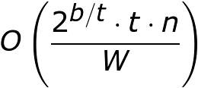
Grouper’s Performance in General (Memory Usage)
Grouper uses t tables, each with entries
Each entry is an n-length bitmap consuming O(n/W) machines words
(W is the word size in bits)
Total memory is therefore [1 < t ≤ b]

Slide 29
Outline
Introduction
Related work on packet classification
Grouper
Performance Analysis
Empirical Evaluation
Conclusions & Future Work

Slide 30
Implementation & Setup
Prototype in about 1,000 lines of C
Implemented for x86_64 processor
Experiments run on commodity Dell laptop, 2GHz Core 2 Duo, 4GB Ram
Tested on minimal install of Arch Linux

Slide 31
Values Tested
Tested relevant bit values (b) :
32, 104, 320 and 12,000
Tested number of rules (n):
100, 1K, 10K, 100K, 1 million
Didn’t test combination of b=12K and n=1M because it would require too much memory (minimum of 3GB and quickly increasing from there)

Slide 32
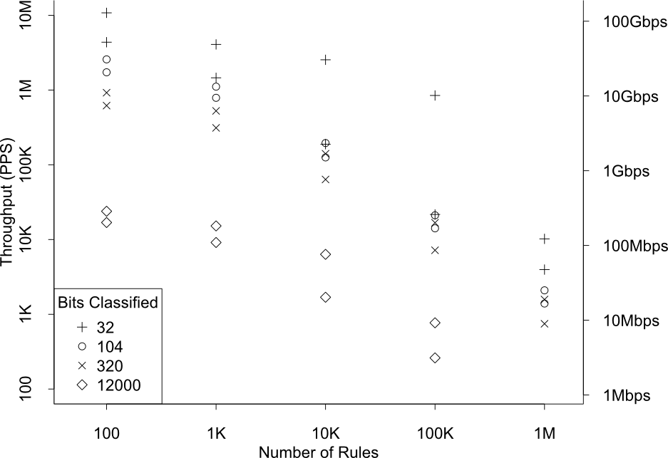
Max and Min Classifier Throughputs

Slide 33
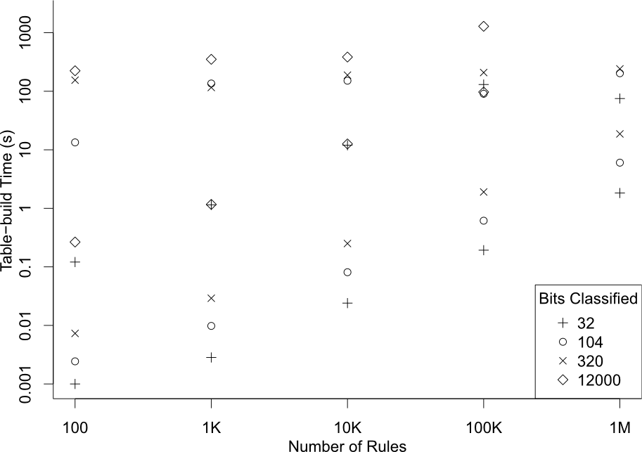
Max and Min Pre-Processing Time

Slide 34
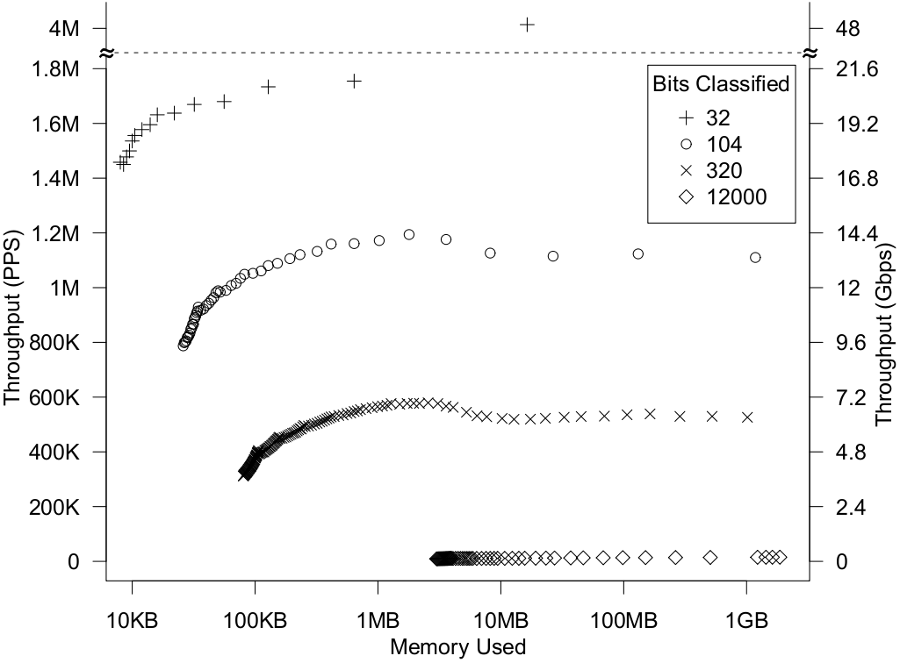
Throughputs for 1K Rules

Slide 35
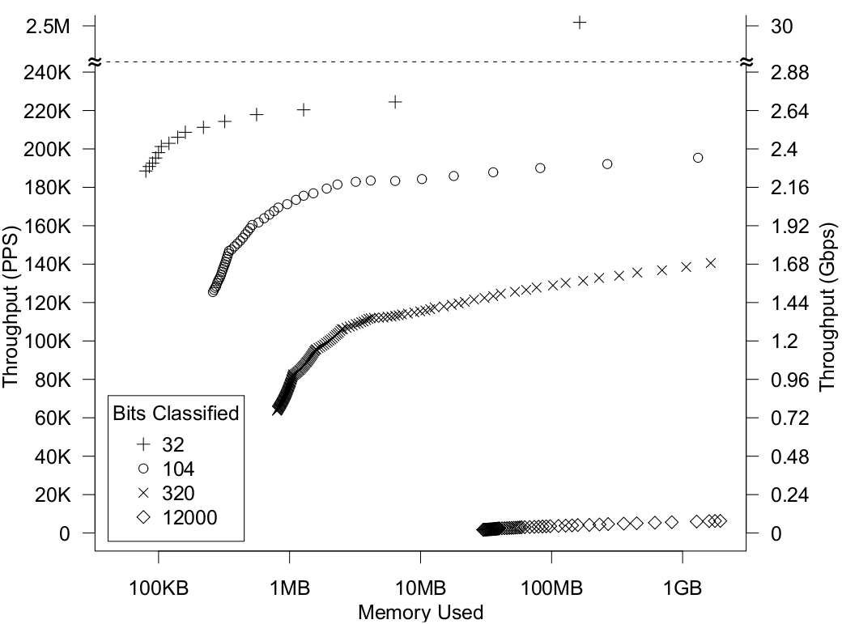
Throughputs for 10K Rules

Slide 36
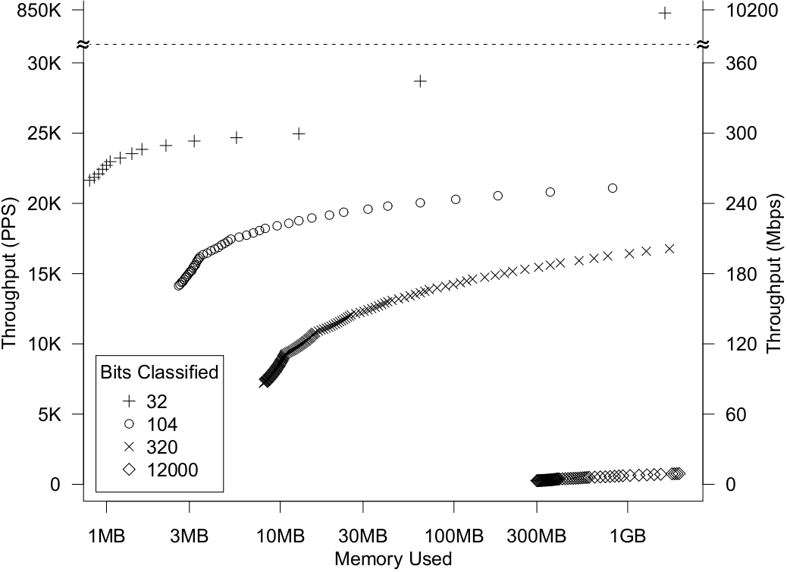
Throughputs for 100K Rules

Slide 37
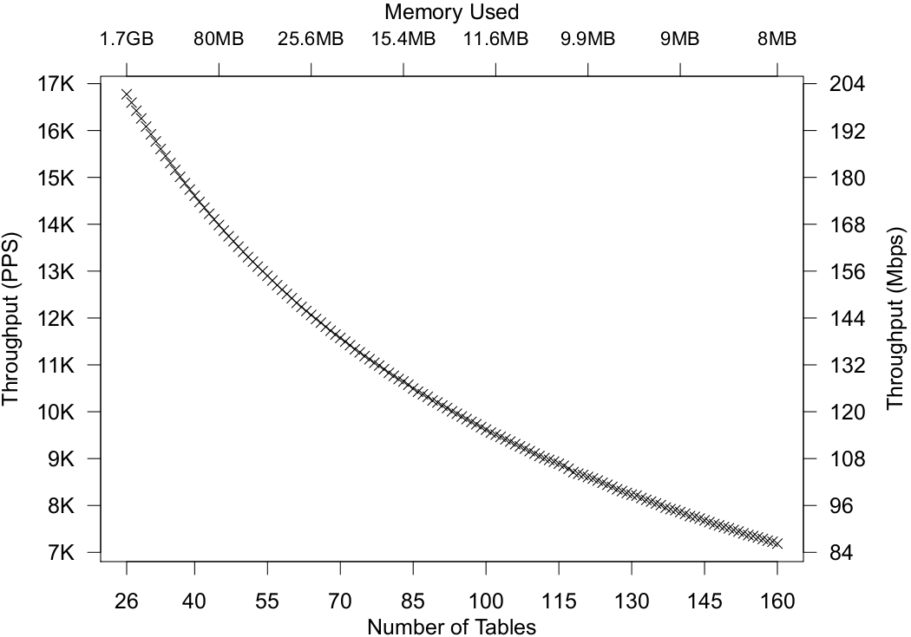
Throughputs for 320 bits Classified, 100K Rules

Slide 38
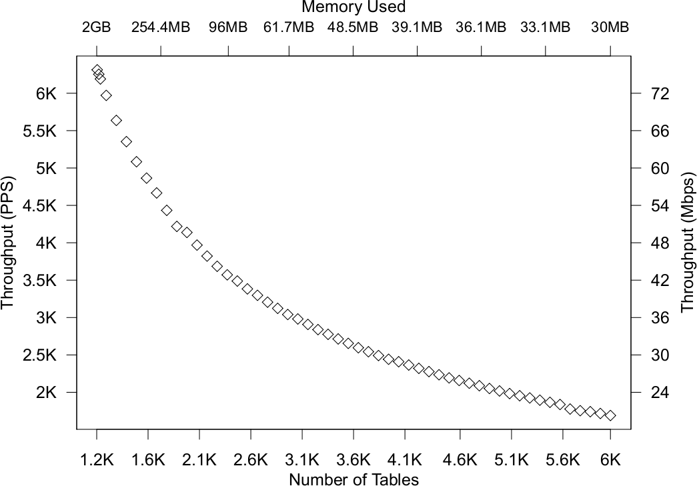
Throughputs for 12K Bits Classified,10K Rules

Slide 39
Outline
Introduction
Related work on packet classification
Grouper
Performance Analysis
Empirical Evaluation
Conclusions & Future Work

Slide 40
Summary
Grouper classifies packets according to arbitrary bitmask rules
Grouper can trade time for space efficiency as needed
Classification time: O(t ∙ n/W)
Memory use: O(2^{b/t} ∙ t ∙ n)
Grouper gets good performance even on commodity hardware and large rule sets
[1 < t ≤ b]

Slide 41
Future Work
We are extending Grouper to handle range patterns directly
This can be done both through expansion of range patterns to bitmask patterns, or through grouping all bits of the range into the same table
We are also extending Grouper to handle rule-set updates while it is running
This is an interesting challenge for an algorithm that relies heavily on precomputation

Slide 42
Thanks/Questions?

Slide 43
Extra Slides

Slide 44
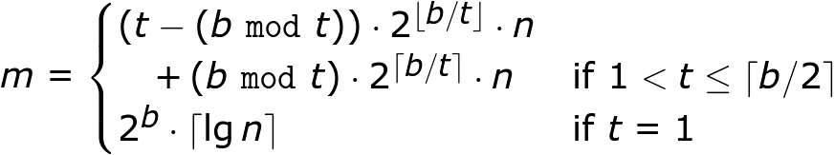
Exact Memory Usage
Grouper’s exact memory usage is given by

