Slide 1
Software Control Flow Integrity
Techniques, Proofs, & Security Applications
Jay Ligatti summer 2004 intern work with:
Úlfar Erlingsson and Martín Abadi

Slide 2
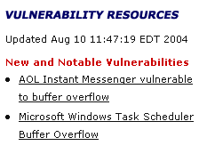
Motivation I:
Bad things happen
DoS
Weak authentication
Insecure defaults
Trojan horse
Back door
Particularly common: buffer overflows and machine-code injection attacks
Source: http://www.us-cert.gov

Slide 3
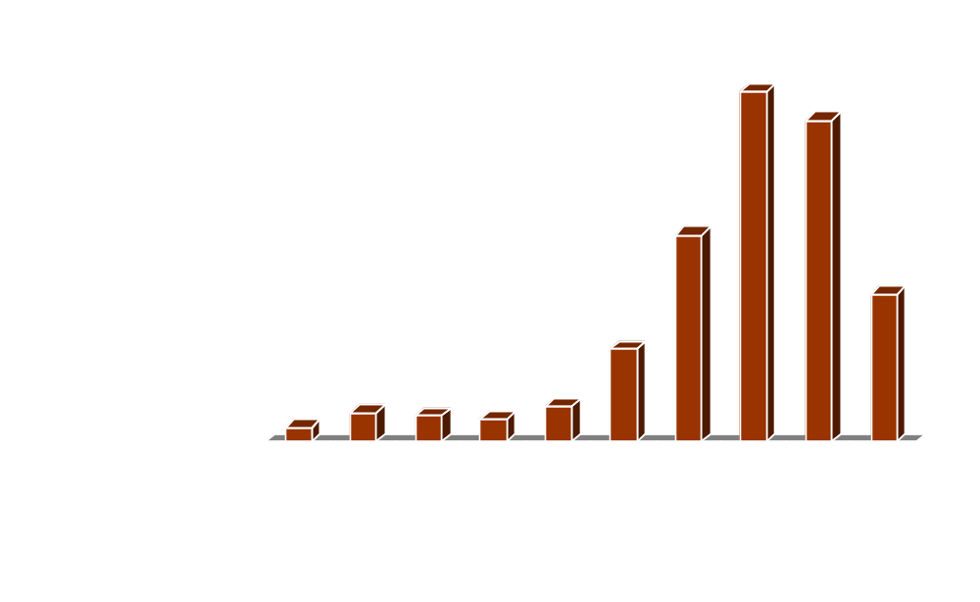
Motivation II:
Lots of bad things happen
**
(only Q1 and Q2 of 2004)
Source: http://www.cert.org/stats/cert_stats.html

Slide 4
Motivation III:
“Bad Thing” is usually UCIT
About 60% of CERT/CC advisories deal with Unauthorized Control Information Tampering [XKI03]
E.g.: Overflow buffer to overwrite return address
Other bugs can also divert control
Previous function’s
stack frame
Attack Code
Attack Code
Return address
Hijacked PC pointer
Local
Can be anything
Local
Buffer
Garbage
Notes:
UCIT not only types of bugs.
Other ways to do UCIT (format strings, heap corrupt, etc.) – would be nice to handle all of them.

Slide 5
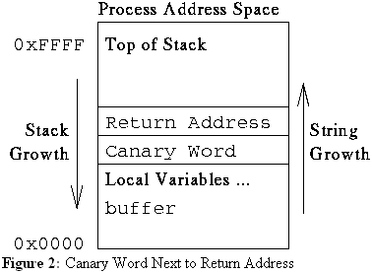
Motivation IV: Previous Work
Ambitious goals, Informal reasoning, Flawed results
StackGuard of Cowan et al. [CPM+98] (used in SP2)
“Programs compiled with StackGuard are safe from buffer overflow attack, regardless of the software engineering quality of the program.”
Why can’t an attacker
learn/guess the canary?
What about function args?
[CPM+98]
Notes:
Also: what about heap buffers?

Slide 6
This Research
Goal:
Provably correct mechanisms that prevent powerful attackers from succeeding
by protecting against all UCIT attacks
Part of new project: Gleipnir
…in Norse mythology, is a magic chord used to bind the monstrous wolf Fenrir, thinner than a silken ribbon yet stronger than the strongest chains of steel. These chains were crafted for the Norse gods by the dwarves from “the sound of a cat's footfall and the woman's beard and the mountain's roots and the bear's sinews and the fish's breath and bird's spittle.”
Notes:
What we can’t handle: non-UCIT attacks

Slide 7
Attack Model
Powerful Attacker: Can at any time arbitrarily overwrite any data memory and (most) registers
  Attacker cannot directly modify the PC
  Attacker cannot modify our reserved registers
  (in the handful of places where we need them)
Few Assumptions:
Data memory is Non-Executable *
Code memory is Non-Writable *
Also… currently limited to whole-program guarantees
(still figuring out how to do dynamic loading of DLLs)

Slide 8
Our Mechanism
F_{A}
F_{B}
nop IMM₁
if(*fp != nop IMM₁) halt
call fp
if(**esp != nop IMM₂) halt
return
nop IMM₂
CFG excerpt
A_{call}
B₁
NB: Need to ensure bit patterns for nops
appear nowhere else in code memory
A_{call+1}
B_{ret}

Slide 9
More Complex CFGs
Maybe statically all we know is that
F_{A} can call any int int function
CFG excerpt
A_{call}
B₁
F_{A}
C₁
F_{B}
succ(A_{call}) = {B₁, C₁}
nop IMM₁
if(*fp != nop IMM₁) halt
call fp
F_{C}
nop IMM₁
Construction: All targets of a computed jump must have
the same destination id (IMM) in their nop instruction

Slide 10
Imprecise Return Information
Q: What if F_{B} can return
to many functions ?
CFG excerpt
F_{A}
A_{call+1}
A: Imprecise CFG
B_{ret}
D_{call+1}
call F_{B}
F_{B}
nop IMM₂
succ(B_{ret}) = {A_{call+1}, D_{call+1}}
CFG Integrity:
Changes to the
PC are only to
valid successor
PCs, per succ().
F_{D}
if(**esp != nop IMM₂) halt
return
call F_{B}
nop IMM₂
Notes:
Even for a very imprecise CFG, where the succ set of every jump instruction is the entry point of every basic block, CFG integrity implies that basic blocks are only entered from the top.

Slide 11
No “Zig-Zag” Imprecision
Solution I: Allow the imprecision
Solution II: Duplicate code
to remove zig-zags
CFG excerpt
CFG excerpt
A_{call}
B₁
A_{call}
B₁
C₁
C_{1A}
E_{call}
E_{call}
C_{1E}

Slide 12
Security Proof Outline
Define machine code semantics
Model a powerful attacker
Define instrumentation algorithm
Prove security theorem

Slide 13
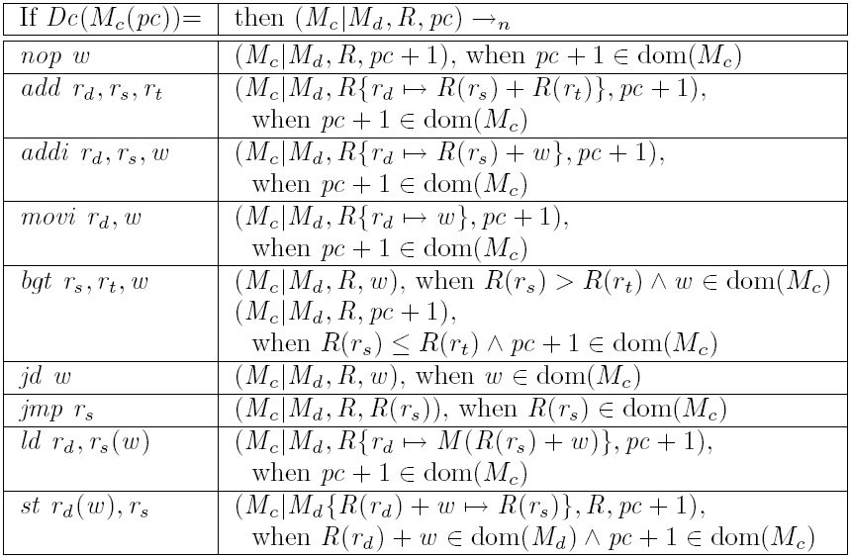




Security Proof I:
Semantics
“Normal” steps:
(an extension of [HST+02])
Attack step:
General steps:

Slide 14
Security Proof II:
Instrumentation Algorithm
Insert new illegal instruction at the end of code memory
For all computed jump destinations d
with destination id X, insert “nop X” before d
Change every jmp r_{s} into:
addi r₀, r_{s}, 0
ld r₁, r₀[0]
movi r₂, IMM_{X}
bgt r₁, r₂, HALT
bgt r₂, r₁, HALT
jmp r₀
Where IMM_{X} is the bit pattern that decodes into “nop X”
s.t. X is the destination id of all targets of the jmp r_{s} instruction.

Slide 15
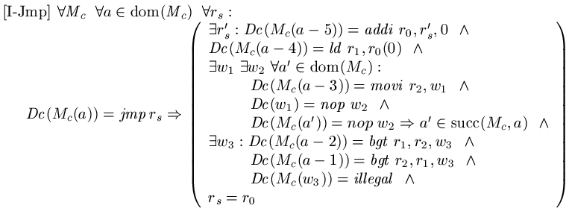
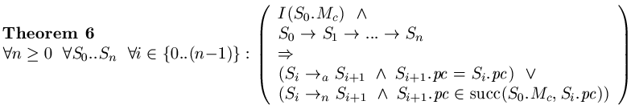
Security Proof III:
Properties
Instrumentation algorithm immediately leads to constraints on code memory, e.g.:
Using such constraints + the semantics,

Slide 16
SMAC Extensions
In general, our CFG integrity property implies uncircumventable sandboxing (i.e., safety checks inserted by instrumentation before instruction X will always be executed before reaching X).
Can remove NX data and NW code assumptions from language (can do SFI and more!):
NX data
addi r₀, r_{s}, 0
bgt r₀, max(dom(M_{C})), HALT
bgt min(dom(M_{C})), r₀, HALT
[checks from orig. algorithm]
jmp r₀
NW code
addi r₀, r_{d}, 0
bgt r₀, max(dom(M_{D})) - w, HALT
bgt min(dom(M_{D})) - w, r₀, HALT
st r₀(w), r_{s}
Notes:
Even with most-general succ() graph, we get enough guarantees to do uncircumventable sandboxing.

Slide 17
Runtime Precision Increase
Can use SMAC to increase precision
Set up protected memory for dynamic information and query it before jumps
E.g., returns from functions
  When A calls B, B should return to A not D
  Maintain return-address stack untouchable by original program
Notes:
Also mention this is frequent idea: have extra stack memory
Has been proposed in hardware schemes, etc.
Or schemes where you cannot guarantee that memory isn’t corrupted

Slide 18
Efficient Implementation ?
Should be fast (make good use of caches):
  Checks & IDs same locality as code
  Static pressure on unified caches and top-level iCache
  Dynamic pressure on top-level dTLB and dCache
How to do checks on x86
  Can implement NOPs using x86 prefetching etc.
  Alternatively add 32-bit id and SKIP over it
How to get CFG and how to instrument?
  Use magic of MSR Vulcan and PDB files

Slide 19
Microbenchmarks
Program calls pointer to “null function” repeatedly
Preliminary x86 instrumentation sequences
Normalized Overheads
 | PIII | P4
NOP IMM | Forward 11% Return 11% Both 33% | Forward 55% Return 54% Both 111%
SKIP IMM | Forward 11% Return 221% Both 276% | Forward 19% Return 181% Both 195%
PIII = XP SP2, Safe Mode w/CMD, Mobile Pentium III, 1.2GHz
P4 = XP SP2, Safe Mode w/CMD, Pentium 4, no HT, 2.4GHz

Slide 20
Future Work
Practical issues:
  Real-world implementation & testing
  Dynamically loaded code
  Partial instrumentation
Formal work:
  Finish proof of security for extended instrumentation
  Proofs of transparency (semantic equivalence) of instrumented code
  Move to proof for x86 code

Slide 21
References
[CPM+98] Cowan, Pu, Maier, Walpole, Bakke, Beattie, Grier, Wagle, Zhang, Hinton. StackGuard: Automatic adaptive detection and prevention of buffer-overflow attacks. In Proc. of the 7th Unsenix Security Symposium, 1998.
[HST+02] Hamid, Shao, Trifonov, Monnier, Ni. A Syntactic Approach to Foundational Proof-Carrying Code. Technical Report YALEU/DCS/TR-1224, Yale Univ., 2002.
[XKI03] Xu, Kalbarczyk, Iyer. Transparent runtime randomization. In Proc. of the Symposium on Reliable and Distributed Systems, 2003.

Slide 22
End

