Slide 1
Policy Enforcement via Program Monitoring
Jay Ligatti (Princeton); joint work with:
Lujo Bauer (CMU), David Walker (Princeton)

Slide 2
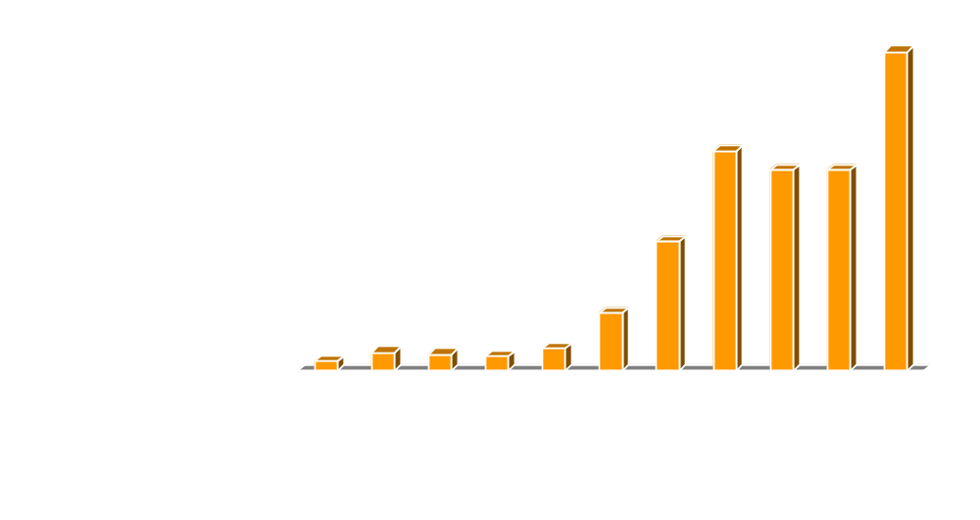
Problem
Software often behaves unexpectedly
  Bugs
  Malicious design (malware)
[ http://www.cert.org/stats/ ]

Slide 3
A Protection Mechanism
Run-time program monitors
  Ensure that software dynamically adheres to constraints specified by a security policy
Untrusted
Target
Program
Monitor
Executing
System
Open(f,“w”)
Open(f,“w”)
is OK
Open(f,“w”)
Notes:
Interpose between untrusted code and the system executing the untrusted code
Make sure only legal code gets executed

Slide 4
Common Monitor Examples
File access control
Firewalls
Resource monitors
Stack inspection
Applet sandboxing
Bounds checks on input values
Security logging
Displaying security warnings
Operating systems and virtual machines
…

Slide 5
Policies Become More Complex
As software becomes more sophisticated
  Multi-user and networked systems
  Electronic commerce
  Medical databases (HIPAA)
As we tighten overly relaxed policies
  Insecure default configurations disallowed
  Downloading .exe files requires warning
As we relax overly tight policies
  All applets sandboxed (JDK 1.0) vs.
  only unsigned applets sandboxed (JDK 1.1)

Slide 6
Research Questions
Given:
  The prevalence and usefulness of monitors
  The need to enforce increasingly complex policies
Which of the policies can monitors enforce?
  Want to know when and when not to use monitors
How can we conveniently specify the complex policies that monitors can enforce?

Slide 7
Outline
Motivation and Goals
  Program monitors are commonly used, so…
  What are their enforcement powers?
  How can we cope with their complexity?
Delineating the enforceable policies
Conveniently specifying policies in practice
Conclusions

Slide 8
Delineating the Enforceable Policies
1. Define policies on systems
2. Define monitors and how they enforce policies
3. Analyze which policies monitors can enforce

Slide 9
Systems and Executions
System = a state machine that transitions states by executing actions
We specify a system according to the possibly countably infinite set of actions it can execute
  A = { logBegin(n), (log that ATM is about to dispense $n)
  dispense(n), (dispense $n)
  logEnd(n) (log that ATM just dispensed $n)
  }
Execution = possibly infinite sequence of actions
logBegin(80); logEnd(80)
  dispense(100); dispense(100); dispense(100); …
Notes:
Exe or “run of a program”

Slide 10
Execution Notation
On a system with action set A,
A* = set of all finite executions
A^{ω} = set of all infinite executions
A∞ = set of all executions
Prefix notation: s≤u (or u≥s)
  Means: s is a finite prefix of possibly infinite u
  Read: “s prefixes u” (or “u extends s”)

Slide 11
Policies
A policy P is a predicate on executions
Execution s satisfies policy P if and only if P(s)
  Termination: P(s) ⇔ s is finite
  Transactional: P(s) ⇔ s is a sequence of valid transactions
Terminology
  If P(s) then s is valid, or “good”
  If ¬P(s) then s is invalid, or “bad”
Notes:
In the literature, these are actually called properties

Slide 12
Safety and Liveness
[Lamport ’77; Alpern, Schneider ’85]
Two types of policies have been studied a lot
Safety: “Bad executions cannot be made good”
 ∀s∈A∞ : ¬P(s) ⇒ ∃s’≤s : ∀u≥s’ : ¬P(u)
  Access-control (cannot “undo” illegal accesses)
Liveness: “Finite executions can be made good”
∀s∈A* : ∃u≥s : P(u)
  Termination and nontermination

Slide 13
Delineating the Enforceable Policies
1. Define policies on systems
2. Define monitors and how they enforce policies
3. Analyze which policies monitors can enforce

Slide 14
Operation of Monitors: Accepting an OK Action
Untrusted
Target
Program
Monitor
Executing
System
Open(f,“w”)
Open(f,“w”)
is OK
Open(f,“w”)
Monitor inputs actions from target and
outputs actions to the executing system
Here, input action is safe to execute, so
monitor accepts it (makes it observable)

Slide 15
Operation of Monitors: Suppressing an Action
Untrusted
Target
Program
Monitor
Executing
System
Open(f,“w”)
Open(f,“w”)
is not OK
Input action is not safe to execute, so monitor suppresses it and allows target to continue executing

Slide 16
Operation of Monitors: Inserting an Action
Untrusted
Target
Program
Monitor
Executing
System
Open(f,“w”)
Open(f,“w”)
is not OK
Close(f,“w”)
Input action is not safe to execute, so monitor inserts another action, then reconsiders the original action

Slide 17
Modeling Monitors
[Ligatti, Bauer, Walker ’05]
Model a monitor that can accept, suppress, and insert actions as an edit automaton (Q,q₀,t)
  Q is finite or countably infinite set of states
  q₀ is initial state
  A complete, deterministic, and TM-decidable function
t : Q x A → Q x (A U {●})
current
state
input
(trigger)
action
new
state
action
to insert
suppress
trigger
action
Notes:
this transition function does not directly model the acceptance of an action.
accept an action by first inserting it into the output and then suppressing it from the input

Slide 18
Operational Semantics
Transition functions define how monitors behave on individual input actions
For the definition of enforcement, we will generalize and consider how monitors transform entire input executions
Monitors are execution transformers
Untrusted input
Valid output
a1;a2;a2;a3;…
a1;a2;a2;a4;…
Monitor

Slide 19
Operational Semantics Judgments
Desired judgment: (q₀,s) _{X} ⇓ u
  Automaton X starting in state q₀ transforms input sequence s into output sequence u
Build up to this judgment
  1. Single-step judgment (q,s) _{X} →^{u} (q’,s’)
  2. Multi-step judgment (q,s) _{X} ⇒^{u} (q’,s’)
  3. Transforms judgment (q₀,s) _{X} ⇓ u

Slide 20
Enforcing Policies
A monitor enforces a policy P when it is sound and transparent with respect to P
Soundness:
  Monitors’ outputs (observable executions) must be valid
Transparency:
  Monitors must not alter the semantics of valid inputs
  Conservative definition: on a valid input execution s,
  a monitor must output s
Notes:
Target can expect that if it behaves well, it’s actions will execute properly.

Slide 21
Enforcing Policies
Automaton X starting in q₀ enforces P on a system with action set A iff ∀s∈A∞: ∃u∈A∞:
1. (q₀,s) _{X} ⇓ u
2. P(u) [Soundness]
3. P(s) ⇒ (s=u) [Transparency]

Slide 22
Delineating the Enforceable Policies
1. Define policies on systems
2. Define monitors and how they enforce policies
3. Analyze which policies monitors can enforce

Slide 23
Enforcement Powers
Related Work
In previous work on monitors’ enforcement bounds, monitors only respond to dangerous actions by halting the target [Schneider ’00; Viswanathan ’00; Fong ’04]
Enforcing policy meant recognizing rather than transforming invalid executions
Result: monitors only enforce safety policies

Slide 24
Enforcing Properties with
Edit Automata
Modeling realistic ability to insert and suppress actions enables a powerful enforcement technique
  Suppress (feign execution of) potentially bad actions, and later, if the suppressed actions are found to be safe, re-insert them
Using this technique, monitors can sometimes enforce non-safety policies, contrary to earlier results and conjectures
Notes:
We will continue assuming all actions can be feigned (suppressed), although in practice not true
In practice, some actions cannot be feigned:
Actions requiring an outside system to execute
Time-dependent actions

Slide 25
Example: ATM Policy
ATM must log before and after dispensing cash
and may only log before and after dispensing cash
  Valid executions = (logBegin(n); dispense(n); logEnd(n))∞
Guarantees that the ATM software generates a proper
log whenever it dispenses cash
Notes:
Enforceable by an edit automaton

Slide 26
Example: ATM Policy
ATM must log before and after dispensing cash
and may only log before and after dispensing cash
  Valid executions = (logBegin(n); dispense(n); logEnd(n))∞
logBegin(n)
dispense(n)
(suppress)
(suppress)
init
begun(n)
dispensed(n)
logEnd(n)
insert: logBegin(n);dispense(n);logEnd(n)
Notes:
Assume all actions complete normally => useful bc log’ll include time stamps, can analyze when & how long dispensing took

Slide 27
Example: ATM Policy
ATM must log before and after dispensing cash
and may only log before and after dispensing cash
  Valid executions = (logBegin(n); dispense(n); logEnd(n))∞
Is not a safety policy:
logBegin(200) by itself is illegal but can be “made good”
Is not a liveness policy:
  dispense(200) cannot be “made good”

Slide 28
Enforceable Policies ≈ Renewal Policies
Theorem:
Except for a technical corner case, edit automata enforce exactly the set of reasonable infinite renewal policies
Renewal: “Infinite executions are good iff they are good infinitely often”
∀s∈A^{ω} : P(s) ⇔ {u≤s | P(u)} is an infinite set
Notes:
“exactly when”
Proof idea: suppression technique causes all valid prefixes, and only valid prefixes, of an input to be output, so…

Slide 29
Example: ATM Policy
ATM must log before and after dispensing cash
and may only log before and after dispensing cash
  Valid executions = (logBegin(n); dispense(n); logEnd(n))∞
This is a renewal policy:
  Valid infinite executions have infinitely many valid prefixes
  Invalid infinite executions have finitely many valid prefixes
    Some prefix with multiple of 3 actions ends with a bad transaction; all successive prefixes are invalid
Notes:
Enforceable by an edit automaton

Slide 30
Safety, Liveness, Renewal
All Policies
Renewal
1 File access control
2 Trivial
3 Eventually audits
4 ATM transactions
5 Termination
6 Termination +
File access control
Safety
Liveness
1
2
3
5
4
6
Notes:
Note about transactions

Slide 31
Outline
Motivation and Goals
  Program monitors are commonly used, so…
  What are their enforcement powers?
  How can we cope with their complexity?
Delineating the enforceable policies
Conveniently specifying policies in practice
Conclusions

Slide 32
Related Work: Specifying Monitor Policies
General monitoring systems
  Java-MaC [Lee, Kannan, Kim, Sokolsky, Viswanathan ’99]
  Naccio [Evans, Twyman ’99]
  Policy Enforcement Toolkit [Erlingsson, Schneider ’00]
  Aspect-oriented software systems [Kiczales, Hilsdale, Hugunin, Kersten, Palm, Griswold ’01; …]
  …
Language theory
  Semantics for AOPLs [Tucker, Krishnamurthi ’03; Walker, Zdancewic, Ligatti ’03; Wand, Kiczales, Dutchyn ’04; …]
Lack: Flexible methodology for decomposing complex policies into simpler modules
Notes:
Permit specification of complex policies but

Slide 33
Polymer Contributions
Polymer [Bauer, Ligatti, Walker ’05]
  Is a fully implemented language (with formal semantics) for specifying run-time policies on Java code
  Provides a methodology for conveniently specifying and generating complex monitors from simpler modules
Strategy
  Make all policies first-class and composeable
  So higher-order policies (superpolicies) can compose simpler policies (subpolicies)
Notes:
First class = treated like a reg val that that can be dynamically created, passed as an argument, and returned from a function.

Slide 34
Polymer Language Overview
Syntactically almost identical to Java source
Primary additions to Java
  Key abstractions for first-class actions, suggestions, and policies
  Programming discipline
  Composeable policy organization
Notes:
Next go through these key abstractions for actions, suggestions, and policies

Slide 35
First-class Actions
Action objects contain information about a method invocation
  Static method signature
  Dynamic calling object
  Dynamic parameters
Policies can analyze trigger actions
Policies can synthesize actions to insert

Slide 36
Action Patterns
For convenient analysis, action objects can be matched to patterns in aswitch statements
Wildcards can appear in action patterns
aswitch(a) {
case <void ex.ATM.logBegin(int amt)>: E;
…
}
<public void *.*.logBegin(..)>

Slide 37
First-class Suggestions
Policies return Suggestion objects to indicate how to handle trigger actions
  IrrSug: action is irrelevant
  OKSug: action is relevant but safe
  InsSug: defer judgment until after running and evaluating some auxiliary code
  ReplSug: replace action (which computes a return value) with another return value
  ExnSug: raise an exception to notify target that it is not allowed to execute this action
  HaltSug: disallow action and halt execution

Slide 38
First-class Suggestions
Suggestions implement the theoretical capabilities of monitors
  IrrSug
  OKSug
  InsSug
  ReplSug
  ExnSug
  HaltSug
Different ways to accept
Insert
Different ways to suppress

Slide 39
First-class Policies
Policies include state and several methods:
  query() suggests how to deal with trigger actions
  accept() performs bookkeeping before a suggestion is followed
  result() performs bookkeeping after an OK’d or inserted action returns a result
public abstract class Policy {
public abstract Sug query(Action a);
public void accept(Sug s) { };
public void result(Sug s, Object result,
boolean wasExnThn) { };
}

Slide 40
Compositional Policy Design
query() methods should be effect-free
  Superpolicies test reactions of subpolicies by calling their query() methods
  Superpolicies combine reactions in meaningful ways
  Policies cannot assume suggestions will be followed
Effects postponed for accept() and result()

Slide 41
A Simple Policy That Forbids Runtime.exec(..) methods
public class DisSysCalls extends Policy {
public Sug query(Action a) {
aswitch(a) {
case <* java.lang.Runtime.exec(..)>:
return new HaltSug(this, a);
}
return new IrrSug(this);
}
public void accept(Sug s) {
if(s.isHalt()) {
System.err.println(“Illegal exec method called”);
System.err.println(“About to halt target.”);
}
}
}

Slide 42
Another Example: public class ATMPolicy extends Policy
public Suggestion query(Action a) {
if(isInsert) return new IrrSug( );
aswitch(a) {
case <void ex.ATM.logBegin(int n)>:
if(transState==0)
return new ReplSug(null, a);
else return new HaltSug(a);
case <void ex.ATM.dispense(int n)>:
if(transState==1 && amt==n)
return new ReplSug(null, a);
else return new HaltSug(a);
case <void ex.ATM.logEnd(int n)>:
if(transState==2 && amt==n)
return new OKSug(a);
else return new HaltSug(a);
default:
if(transState>0) return new HaltSug(a);
else return new IrrSug( );
}
}
private boolean isInsert = false;
private int transState = 0;
private int amt = 0;
public void accept(Sug s) {
aswitch(s.getTrigger( )) {
case <void ex.ATM.dispense(int n)>:
transState = 2; break;
case <void ex.ATM.logBegin(int n)>:
transState = 1; amt = n;
}
if(s.isOK( )) {
isInsert = true;
ex.ATM.logBegin(amt);
ex.ATM.dispense(amt);
isInsert = false;
transState = 0;
amt = 0;
}
}
Notes:
If exn in logBegin, propagate out => good because no dispense anyway
If exn in dispense, ok because no logEnd
If exn in logEnd, would want to catch and try re-logging

Slide 43
Policy Combinators
Polymer provides library of generic superpolicies (combinators)
Policy writers are free to create new combinators
Standard form:
public class Conjunction extends Policy {
private Policy p1, p2;
public Conjunction(Policy p1, Policy p2) {
this.p1 = p1; this.p2 = p2;
}
public Sug query(Action a) {
Sug s1 = p1.query(a), s2 = p2.query(a);
//return the conjunction of s1 and s2
…

Slide 44
Conjunctive Combinator
Apply several policies at once, first making any insertions suggested by subpolicies
When no subpolicy suggests an insertion, obey most restrictive subpolicy suggestion
Replace(v1)
Replace(v2)
Irrelevant
OK
Exception
Halt
Replace(v3)
…
Least restrictive
Most restrictive
Policy netPoly = new Conjunction(new FirewallPoly(),
new LogSocketsPoly(), new WarnB4DownloadPoly());

Slide 45
Selector Combinators
Make some initial choice about which subpolicy to enforce and forget about the other subpolicies
IsClientSigned: Enforce first subpolicy if and only if target is cryptographically signed
Policy sandboxUnsigned = new IsClientSigned(
new TrivialPolicy(), new SandboxPolicy());

Slide 46
Unary Combinators
Perform some extra operations while enforcing a single subpolicy
Audit: Obey sole subpolicy but also log all actions seen and suggestions made
AutoUpdate: Obey sole subpolicy but also intermittently check for subpolicy updates
Notes:
Audit: Obey sole subpolicy but also log all actions seen and suggestions made

Slide 47
Case Study
Polymer policy for email clients that use the JavaMail API
  Approx. 1800 lines of Polymer code, available at
  http://www.cs.princeton.edu/sip/projects/polymer
Tested on Pooka [http://www.suberic.net/pooka]
  Approx. 50K lines of Java code + libraries
  (Java standard libraries, JavaMail, JavaBeans Activation Framework, JavaHelp, The Knife mbox provider, Kunststoff Look and Feel, and ICE JNI library)

Slide 48
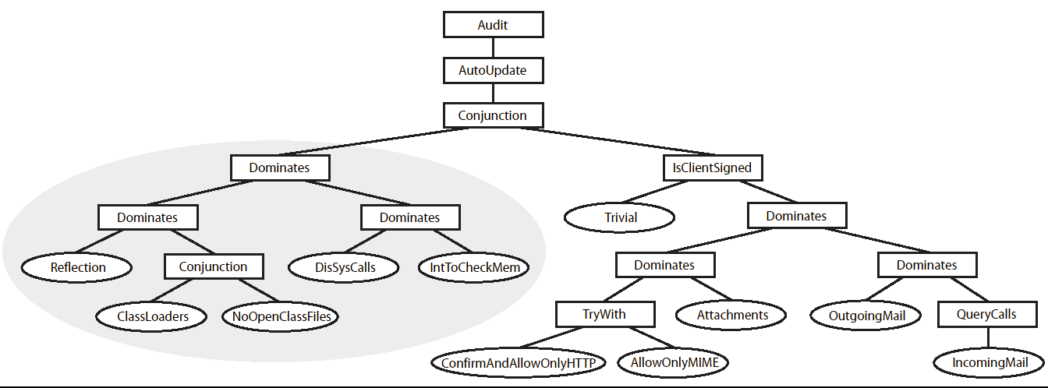
Email Policy Hierarchy
Related policy concerns are modularized
  Easier to create the policy
    Modules are reusable
    Modules can be written in isolation
  Easier to understand the policy

Slide 49
Outline
Motivation and Goals
  Program monitors are commonly used, so…
  What are their enforcement powers?
  How can we cope with their complexity?
Delineating the enforceable policies
Conveniently specifying policies in practice
Conclusions

Slide 50
Summary
Delineating the monitor-enforceable policies
  Shifted enforcement model to account for practical ability of security mechanisms to transform, rather than merely recognize, invalid executions
  Edit automata enforce all reasonable renewal properties, including some non-safety properties
A new approach to managing policy complexity in practice
  Build increasingly complex policies as compositions of simpler subpolicy modules
Notes:
Indeed, practical monitors can enforce some non-safety properties

Slide 51
Future Work I
Practical constraints on edit automata
  Add sets of unsuppressible (unfeignable) and uninsertable actions to model
  Fong ’04 showed that limiting automata space limits the policies enforceable… Are there useful policies that require super-polynomial monitoring time to enforce?
  Real-time policies: another resource bound?
Concurrency
  Executions as partial orders of actions
  Polymer support
How does monitoring compare with other mechanisms (e.g., program rewriting [Hamlen, Morrisett, Schneider ’03])?

Slide 52
Future Work II
Transactional policies
  Explore relationships with renewal properties and Polymer “policy commits”
Formally link edit automata with Polymer semantics
Combinator analysis
  Polymer allows general combinator specification, but which are the “right” combinators to use?
  How do we formalize combinators to show they are “right” in some sense [Krishnan ’05]?
Polymer GUI
  Tool for visualizing and specifying policy compositions and dynamic policy updates [Brown, Ryan ’06]

Slide 53
End
Special thanks to thesis committee:
  Andrew Appel, reader
  Boaz Barak, nonreader
  Ed Felten, nonreader
  Greg Morrisett, reader
  David Walker, adviser
Questions?

Slide 54
Extra Slides

Slide 55
Edit Automata Enforcement
(Lower Bound)
Theorem: ∀ policies P such that
1. P is a renewal property,
2. P(●), and
3. ∀s∈A* : P(s) is decidable,
∃ an edit automaton that enforces P.
Edit automata can enforce any
reasonable renewal policy

Slide 56
Edit Automata Enforcement
(Lower Bound)
Proof idea: Technique of suppressing actions until they are known to be safe causes every valid prefix, and only valid prefixes, of the input to be output
  Given a renewal policy P, construct an edit automaton X that uses this technique
  In all cases, X correctly enforces P
    If input s has finite length, X outputs longest valid prefix of s
    Else if ¬P(s), X outputs the longest valid (finite) prefix of s
    Else X outputs every prefix of s and only prefixes of s

Slide 57
Edit Automata Enforcement
(Precise Bounds)
Edit automata can only enforce policies where invalid infinite executions have finitely many valid prefixes
But in a “corner case,” edit automata can sometimes enforce policies where valid infinite executions have finitely many valid prefixes
Example
  P(s) iff s=a₁;a₁;a₁;…
  P is not a renewal policy
  Monitor enforces P by always entering an infinite loop to insert a₁;a₁;a₁;…

Slide 58
Edit Automata Enforcement
(Precise Bounds)
This non-renewal “corner case” requires automaton having input some invalid sequence s’ to decide:
  Only one extension s of s’ is valid
  s has infinite length
  How to compute the actions in s
Aside from this situation, edit automata enforce exactly the set of reasonable renewal policies

Slide 59
Polymer Tools
Policy compiler
  Converts centralized monitor policies written in the Polymer language into Java source code
  Then runs javac to compile the Java source
Bytecode instrumenter
  Adds calls to the monitor to the core Java libraries and to the untrusted target application
Total size = 30 core classes (approx. 2500 lines of Java) + JavaCC + Apache BCEL

Slide 60
Securing Targets in Polymer
Create a listing of all security-relevant methods (trigger actions)
Instrument trigger actions in core Java libraries
Write and compile security policy
Run target using instrumented libraries,
instrumenting target classes as they load

Slide 61
Securing Targets in Polymer
Original application
Target
…
…
Libraries
Secured application
Instrumented
target
…
…
Instrumented
libraries
Compiled policy

Slide 62
(Unoptimized) Polymer Performance
Instrument all Java core libraries = 107s = 3.7 ms per method
Typical class loading time = 12 ms
(vs. 6 ms with default class loader)
Monitored method call = 0.6 ms overhead
Policy code’s performance typically dominates cost

Slide 63
Precedence Combinators
Give one subpolicy precedence over another
Dominates: Obey first subpolicy if it considers the action relevant; otherwise obey whatever second subpolicy suggests
TryWith: Obey first subpolicy if and only if it returns an Irrelevant, OK, or Insertion suggestion

Slide 64
Formal Polymer Semantics
Precisely communicates language’s central workings
τ ::= Bool | ( τ ) | τ ref | τ₁→τ₂ | Act | Res | Sug | Poly
S;C├ e_{query}:Act→Sug
(F,M,v_{pol},(λx:τ.e)v)→_{β}(M,e[v/x])
S;C├ e_{acc}:(Act,Sug)→() S;C├ e_{res}:Res→()
S;C├ pol(e_{query},e_{acc},e_{res}):Poly
F_{i}∈F F_{i}=fun f(x:τ₁):τ₂{e}
(F,M,v_{pol},invk act(f,v))→_{β}(M,wrap(v_{pol},F_{i},v))
Theorem (Preservation): If ├ (F,M,e_{pol},e_{app}):τ and (F,M,e_{pol},e_{app})→(F,M,e’_{pol},e’_{app})
then ├ (F,M,e’_{pol},e’_{app}):τ
Theorem (Progress): If P=(F,M,e_{pol},e_{app}) and├ P:τ then either P is finished or
there exists a P’ such that P→P’
Notes:
Simply-typed lambda calculus with types for booleans, tuples, functions, references, policies, suggestions, actions (suspended function applications), and results

Slide 65
Single-step Semantics
We will specify execution of automaton X with a labeled operational semantics
First, we convert individual transitions into to a single-step judgment: (q,s) _{X} →^{u} (q’,s’)
  (q,s) is current state and input sequence
  (q’,s’) is state and input actions after the step
  u is a sequence of actions made observable during the transition

Slide 66
Single Step (Suppression)
Single-step rule for suppression:
If s=b;s’ & t(q,b)=(q’,●) then (q,s) _{X} →● (q’,s’)
Before transition
After transition
input
monitor
output
input
monitor
output
q
q’
…b;s’
…
…b;s’
…

Slide 67
Single Step (Insertion)
Single-step rule for insertion:
If s=b;s’ & t(q,b)=(q’,a) then (q,s) _{X} →ª (q’,s)
Before transition
After transition
input
monitor
output
input
monitor
output
q
q’
…b;s’
…
…b;s’
…;a

Slide 68
Multi-step Semantics
Multi-step judgment: (q,s) _{X} ⇒^{u} (q’,s’)
[Reflexive]
(q,s) _{X} ⇒ ● (q,s)
(q,s) _{X} →^{u} (q’’,s’’ )
(q’’,s’’ ) _{X} ⇒^{w} (q’,s’ )
[Transitive]
(q,s) _{X} ⇒^{u;w} (q’,s’ )

Slide 69
“Transforms” Definition
Definition: Automaton X = ( Q,q₀,t ) transforms input s∈A∞ into output u∈A∞ iff
1. ∀q’∈Q ∀s’∈A∞ ∀u’∈A* :
if (q₀,s) _{X} ⇒^{u’} (q’,s’) then u’ ≤ u
(On input s, X outputs only prefixes of u)
2. ∀u’≤u ∃q’∈Q ∃s’∈A∞ : (q₀,s) _{X} ⇒^{u’} (q’,s’)
(On input s, X outputs every prefix of u)
(q₀,s) _{X} ⇓ u

Slide 70
Decomposing the Example into Safety and Liveness
ATM must log before and after dispensing cash
and may only log before and after dispensing cash:
  Valid executions = (logBegin(n); dispense(n); logEnd(n))∞
P_{S}(s) ⇔ s matches one of:
  (logBegin(n);dispense(n);logEnd(n))*;logBegin(n)
  (logBegin(n);dispense(n);logEnd(n))*;logBegin(n);dispense(n)
  (logBegin(n);dispense(n);logEnd(n))∞
P_{L}(s) ⇔ s≠s’;logBegin(n) and s≠s’logBegin(n);dispense(n)

