Slide 1
New Research in Software Security
Jay Ligatti
University of South Florida

Slide 2
Outline
Motivating problems
Long-term goals
Recent and near-future work
  Modeling and analysis
  Monitor applications
  Policy tools

Slide 3
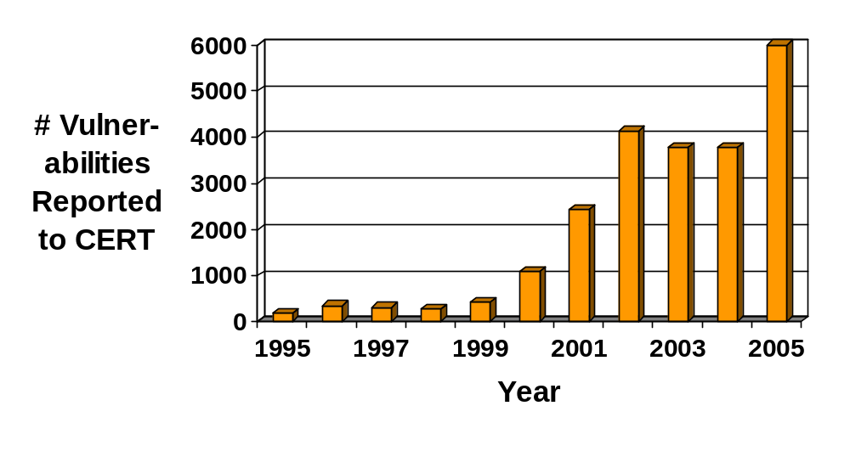
General Problem:
Software Insecurity
Vulnerability sources: bugs, malware
[ http://www.cert.org/stats/ ]

Slide 4
More Specific Problem:
Policy Complexity
Research has developed large body of policies for preventing vulnerabilities
  Authenticate before logging in, allow file write iff ACL has write permission, etc.
Unfortunately, policies are complex and grow more and more complex
  As software grows more sophisticated
  As new policies get combined with old
  As policies get refined in response to attacks and user feedback

Slide 5
Even More Specific Problem:
Managing Complex Policies
Policies are complex and grow more and more complex, so…
  Difficult to decide on policies to enforce
  Difficult to specify policies
  Difficult to know whether policies actually get enforced

Slide 6
Outline
Motivating problems
Long-term goals
Recent and near-future work
  Modeling and analysis
  Monitor applications
  Policy tools

Slide 7
Long-term Goals (1)
Problem
  Difficult to decide on policies to enforce
Research
  Which policies are useful to enforce in practice; what are enforcement costs?
Goal
  Pre-packaged, customizable policy library

Slide 8
Long-term Goals (2)
Problem
  Difficult to specify policies
Research
  How can we make specification easier and less error prone?
Goal
  Policy-specification languages, GUIs, etc.

Slide 9
Long-term Goals (3)
Problem
  Difficult to know whether policies actually get enforced
Research
  How to provide rigorous enforcement assurances?
Goal
  Verification tools that formally test whether existing mechanisms enforce required policies

Slide 10
Outline
Motivating problems
Long-term goals
Recent and near-future work
  Modeling and analysis (Goal 3: assurances)
  Monitor applications (Goal 1: useful policies)
  Policy tools (Goal 2: specification)

Slide 11
Recent Modeling Work [with Bauer and Walker]
Developed models of run-time program monitors
Monitors are enforcement mechanisms
Untrusted
Program
Program
Monitor
Executing
System
Open(f,“w”)
Open(f,“w”)
is OK
Open(f,“w”)
(based on monitor policy)

Slide 12
Enforcement Model
Provided precise definitions of systems, policies, monitors, and enforcement
Monitors modeled by infinite-state automata called edit automata
logBegin(n)
dispense(n)
(suppress)
(suppress)
init
begun(n)
dispensed(n)
logEnd(n)
insert: logBegin(n);dispense(n);logEnd(n)

Slide 13
Model Analysis
Also defined a new set of policies called infinite renewal properties
We showed:
∀s∈A^{ω} : P(s) ⇔ {u≤s | P(u)} is an infinite set
Edit automaton E
Renewal
Policy P
Proof that E enforces P

Slide 14
Surprising Result
Renewal properties include some policies thought unenforceable by monitors
  Monitors can enforce some nonsafety policies
Our understanding of policy enforcement capabilities is very primitive!

Slide 15
Near-future Modeling Research
Distributed monitors
  How to cooperate to enforce policies concurrently
  How to handle monitor failure/compromise
Distributed policies
  How do local policies compose into global policies?
  How can we synthesize global from locals?
  How can we analyze global to automatically generate locals?
Compare enforcement mechanisms’ capabilities
Analyze mechanisms’ time/space complexities

Slide 16
Notes
“Future” ideas are new
  Exciting! ☺
  Caveat: Some may be good, others bad
Opportunities for grad students
  I envision several of these “future” ideas leading to theses/dissertations.

Slide 17
Outline
Motivating problems
Long-term goals
Recent and near-future work
  Modeling and analysis (Goal 3: assurances)
  Monitor applications (Goal 1: useful policies)
  Policy tools (Goal 2: specification)

Slide 18
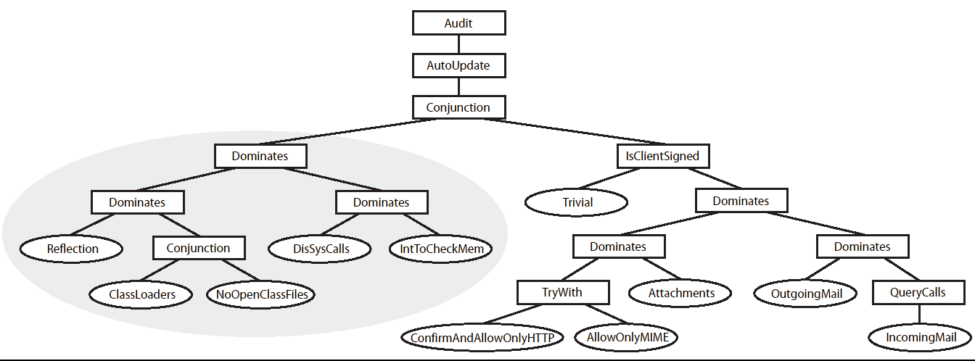
Applications of Monitors I
Monitors already heavily used for good
Additional uses to prevent recent attacks:
1) Sophisticated “sandbox” for email clients
[with Bauer and Walker]

Slide 19
Applications of Monitors II
Additional uses to prevent recent attacks:
2) Control-flow policy enforcement [with Abadi, Budiu, and Erlingsson]
Prevents control-flow tampering, which accounts for about 60% of attacks
[Xu, Kalbarczyk, Iyer ’03; Arora, Ravi, Raghunathan, Jha ’05]
F_{A}
F_{B}
nop IMM₁
if(*fp != nop IMM₁) halt
call fp
if(**esp != nop IMM₂) halt
nop IMM₂
return

Slide 20
Near-future Monitor-applications Research
Distributed monitors and policies
  Which policies would be really useful to enforce on distributed systems?
  Distributed-sensor policies?
Geography-based and RT policies
Medical database policies
  Privacy policies (HIPAA)
  Medical-alert policies to improve care

Slide 21
Outline
Motivating problems
Long-term goals
Recent and near-future work
  Modeling and analysis (Goal 3: assurances)
  Monitor applications (Goal 1: useful policies)
  Policy tools (Goal 2: specification)

Slide 22
Polymer [with Bauer and Walker]
A language for specifying complex run-time policies
An implemented tool for automatically generating code that’s secure w.r.t. to specified policies
public class DisSysCalls extends Policy {
public Sug query(Action a) {
aswitch(a) {
case <* java.lang.Runtime.exec(..)>:
return new HaltSug(this, a); }
return new IrrSug(this); }
public void accept(Sug s) {
if(s.isHalt()) {
System.err.println(“Illegal exec method called”);
System.err.println(“About to halt target.”); } }
}
Instrumented
targets
Instrumented
libraries
…
…
Compiled policies

Slide 23
Near-future Policy-tool Research
Specification languages for distributed policies
GUI-based tools for specifying, visualizing, and dynamically updating policies
  Sysadmins select and customize policies from expert-programmed library

Slide 24
Summary
I’m interested in all research related to security policies – theory and practice
  Design, analysis, synthesis, modeling, specification, implementation, management, enforcement, etc.
Recent work took first steps toward goals
  Useful policies, management tools, and assurances
Many (infinite) research steps remain!
  Help wanted ☺

Slide 25
End
I’m always happy to advise on security and programming languages research
If you have additional research ideas in these areas, please feel free to contact
Contact info:
Jay Ligatti, ENB 333, ligatti@cse.usf.edu

Slide 26
Questions?

