Slide 1
Coping with Runtime-Policy Complexity
Jay Ligatti, University of South Florida
Joint work with:
Lujo Bauer, Carnegie Mellon University CyLab
David Walker, Princeton University

Slide 2
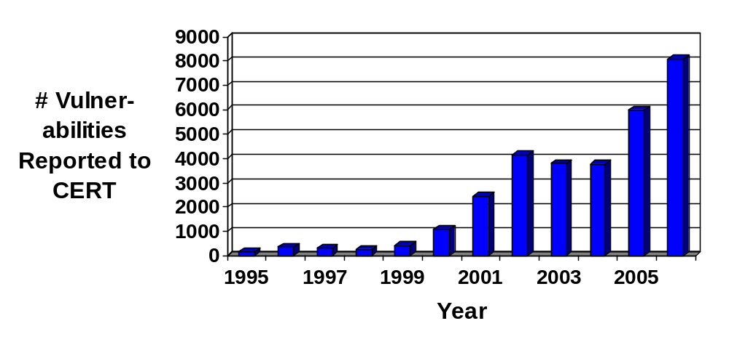
Problem
Software often behaves unexpectedly
  Bugs
  Malicious design (malware)
[ http://www.cert.org/stats ]

Slide 3
A Protection Mechanism
Run-time program monitors
  Ensure that software dynamically adheres to constraints specified by a security policy
Untrusted
Target
Program
Monitor
Executing
System
Open(f,“w”)
Open(f,“w”)
is OK
Open(f,“w”)

Slide 4
Common Monitor Examples
File access control
Firewalls
Resource monitors
Stack inspection
Applet sandboxing
Bounds checks on input values
Security logging
Displaying security warnings
Operating systems and virtual machines
…

Slide 5
Policies Become More Complex…
As software becomes more sophisticated
(i.e., enters new domains)
  Multi-user and networked systems
  Electronic commerce
  Medical databases (HIPAA, EU Data Protection Law)

Slide 6
Policies Become More Complex…
As software becomes more sophisticated
(i.e., enters new domains)
  Multi-user and networked systems
  Electronic commerce
  Medical databases (HIPAA, EU Data Protection Law)
As we tighten overly relaxed policies
  Insecure default configurations disallowed
  Downloading .doc files requires warning

Slide 7
Policies Become More Complex…
As software becomes more sophisticated
(i.e., enters new domains)
  Multi-user and networked systems
  Electronic commerce
  Medical databases (HIPAA, EU Data Protection Law)
As we tighten overly relaxed policies
  Insecure default configurations disallowed
  Downloading .doc files requires warning
As we relax overly tight policies
  All applets sandboxed (JDK 1.0) vs.
  only unsigned applets sandboxed (JDK 1.1)

Slide 8
Coping with Runtime-Policy Complexity: Research Questions
Given:
  The prevalence and usefulness of monitors
  The need to enforce increasingly complex policies
Which of the increasingly complex policies can we ever hope to enforce with monitors?
  At what point should we give up on runtime enforcement?
How can we simplify the task of specifying the complex policies that monitors can enforce?

Slide 9
Outline
Motivation and Goals
  Monitors are useful and policies are complex, so…
  What are monitors’ enforcement limits?
  How can we simplify complex-policy specification?
Delineating the enforceable policies
Conveniently specifying policies in practice
Conclusions

Slide 10
Delineating the Enforceable Policies
1. Define policies on systems
2. Define monitors and how they enforce policies
3. Analyze which policies monitors can enforce

Slide 11
Systems and Executions
System = a state machine that transitions states by executing actions
We specify a system according to the possibly countably infinite set of actions it can execute
  A = { logBegin(n), (log that ATM is about to dispense $n)
  dispense(n), (dispense $n)
  logEnd(n) (log that ATM just dispensed $n)
  }
Execution = possibly infinite sequence of actions
logBegin(80); logEnd(80)
  dispense(100); dispense(100); dispense(100); …

Slide 12
Execution Notation
On a system with action set A,
A* = set of all finite executions
A^{ω} = set of all infinite executions
A∞ = set of all executions
Prefix notation: s≤u (or u≥s)
  Means: s is a finite prefix of possibly infinite u
  Read: s prefixes u (or u extends s)

Slide 13
Policies
[Schneider ’00]
A policy P is a predicate on executions
Execution s satisfies policy P if and only if P (s)
  Termination: P (s) ⇔ s is finite
  Transactional: P (s) ⇔ s is a sequence of valid transactions
Terminology
  If P (s) then s is valid, or “good”
  If ¬P (s) then s is invalid, or “bad”
Notes:
In the literature, these are actually called properties

Slide 14
Safety and Liveness
[Lamport ’77; Alpern, Schneider ’85]
Two types of policies have been studied a lot
Safety: “Bad executions cannot be made good”
 ∀s∈A∞ : ¬P (s) ⇒ ∃s’≤s : ∀u≥s’ : ¬P (u)
  Access-control (cannot “undo” illegal accesses)
Liveness: “Finite executions can be made good”
∀s∈A* : ∃u≥s : P (u)
  Termination and nontermination

Slide 15
Delineating the Enforceable Policies
1. Define policies on systems
2. Define monitors and how they enforce policies
3. Analyze which policies monitors can enforce

Slide 16
Operation of Monitors: Accepting an OK Action
Untrusted
Target
Program
Monitor
Executing
System
Open(f,“w”)
Open(f,“w”)
is OK
Open(f,“w”)
Monitor inputs actions from target and
outputs actions to the executing system
Here, input action is safe to execute, so
monitor accepts it (makes it observable)

Slide 17
Operation of Monitors: Suppressing an Action
Untrusted
Target
Program
Monitor
Executing
System
Open(f,“w”)
Open(f,“w”)
is not OK
Input action is not safe to execute, so monitor suppresses it and allows target to continue executing

Slide 18
Operation of Monitors: Inserting an Action
Untrusted
Target
Program
Monitor
Executing
System
Open(f,“w”)
Open(f,“w”)
is not OK
Close(f,“w”)
Input action is not safe to execute, so monitor inserts another action, then reconsiders the original action

Slide 19
Modeling Monitors
[Ligatti, Bauer, Walker ’05]
Model a monitor that can accept, suppress, and insert actions as an edit automaton (Q,q₀,t)
  Q is finite or countably infinite set of states
  q₀ is initial state
  A complete, deterministic, and TM-decidable function
t : Q x A → Q x (A U {●})
current
state
input
(trigger)
action
new
state
action
to insert
suppress
trigger
action
Notes:
this transition function does not directly model the acceptance of an action.
accept an action by first inserting it into the output and then suppressing it from the input

Slide 20
Operational Semantics
Transition functions define how monitors behave on individual input actions
For the definition of enforcement, we will generalize and consider how monitors transform entire input executions
Monitors are execution transformers
Untrusted input
Valid output
a1;a2;a2;a3;…
a1;a2;a2;a4;…
Monitor

Slide 21
Enforcing Policies
[Ligatti, Bauer, Walker ’05]
A monitor enforces a policy P when it is sound and transparent with respect to P
Soundness:
  Monitors’ outputs (observable executions) must be valid
Transparency:
  Monitors must not alter the semantics of valid inputs
  Conservative definition: on any valid input execution s
  monitor must output s
Notes:
Target can expect that if it behaves well, its actions will execute properly.

Slide 22
Delineating the Enforceable Policies
1. Define policies on systems
2. Define monitors and how they enforce policies
3. Analyze which policies monitors can enforce

Slide 23
Enforcement Powers
Related Work
Previous work on monitors’ enforcement bounds only modeled monitors that accept actions and halt target [Schneider ’00; Viswanathan ’00; Hamlen, Morrisett, Schneider ’03; Fong ’04]
Enforcing policy meant recognizing rather than transforming executions
Result: monitors only enforce safety policies
  Once execution is recognized as bad, it stays bad

Slide 24
Enforcing Properties with
Edit Automata
Modeling realistic ability to insert and suppress actions enables a powerful enforcement technique
  Suppress (feign execution of) potentially bad actions, and later, if the suppressed actions are found to be safe, re-insert them
Using this technique, monitors can sometimes enforce non-safety policies, contrary to earlier results and conjectures
Notes:
We will continue assuming all actions can be feigned (suppressed), although in practice not true
In practice, some actions cannot be feigned:
Actions requiring an outside system to execute
Time-dependent actions

Slide 25
Example: ATM Policy
ATM must log before and after dispensing cash
and may only log before and after dispensing cash
  Valid executions = (logBegin(n); dispense(n); logEnd(n))∞
Guarantees that the ATM software generates a proper
log whenever it dispenses cash

Slide 26
Example: ATM Policy
ATM must log before and after dispensing cash
and may only log before and after dispensing cash
  Valid executions = (logBegin(n); dispense(n); logEnd(n))∞
logBegin(n)
dispense(n)
(suppress)
(suppress)
init
begun(n)
dispensed(n)
logEnd(n)
insert: logBegin(n);dispense(n);logEnd(n)

Slide 27
Example: ATM Policy
ATM must log before and after dispensing cash
and may only log before and after dispensing cash
  Valid executions = (logBegin(n); dispense(n); logEnd(n))∞
Is not a safety policy (safety=bad executions can’t be made good)
logBegin(200) by itself is illegal but can be “made good”
Is not a liveness policy (liveness=finite executions can be made good)
  dispense(200) cannot be “made good”

Slide 28
Enforceable Policies ≈ Renewal Policies
Theorem:
Except for a technical corner case, edit automata enforce exactly the set of reasonable infinite renewal policies
Renewal: “Infinite executions are good iff they are good infinitely often”
∀s∈A^{ω} : P(s) ⇔ {u≤s | P(u)} is an infinite set

Slide 29
Example: ATM Policy
ATM must log before and after dispensing cash
and may only log before and after dispensing cash
  Valid executions = (logBegin(n); dispense(n); logEnd(n))∞
This is a renewal policy:
  Valid infinite executions have infinitely many valid prefixes
  Invalid infinite executions have finitely many valid prefixes
    Some prefix with multiple of 3 actions ends with a bad transaction; all successive prefixes are invalid

Slide 30
Safety, Liveness, Renewal
All Policies
Renewal
1 File access control
2 Trivial
3 Eventually audits
4 ATM transactions
5 Termination
6 Termination +
File access control
Safety
Liveness
1
2
3
5
4
6

Slide 31
Outline
Motivation and Goals
  Monitors are useful and policies are complex, so…
  What are monitors’ enforcement limits?
  How can we simplify complex-policy specification?
Delineating the enforceable policies
Conveniently specifying policies in practice
Conclusions

Slide 32
Managing Policy Complexity via Centralization
Application with policy
scattered throughout
Application with
centralized policy
Policy contains:
- Security code
- When to run the
security code
Scattered policy is
hard to find, write
and reason about
Centralized policy is
easier to find, write,
and reason about

Slide 33
Related Work: Managing Policy Complexity via Centralization
General monitoring systems
  Java-MaC [Lee, Kannan, Kim, Sokolsky, Viswanathan ’99]
  Naccio [Evans, Twyman ’99]
  Diana [Sen, Vardhan, Agha, Rosu ’04]
  Policy Enforcement Toolkit [Erlingsson, Schneider ’00; Erlingsson ’03]
  Aspect-oriented software systems [Kiczales, Hilsdale, Hugunin, Kersten, Palm, Griswold ’01; …]
  …
Language theory
  Semantics for AOPLs [Tucker, Krishnamurthi ’03; Walker, Zdancewic, Ligatti ’03; Wand, Kiczales, Dutchyn ’04; …]
Automata theory
  Security automata [Schneider ’00; Ligatti, Bauer, Walker ’05]

Slide 34
Beyond Centralization: Composition
Policy centralization is not enough
  Need methodology for organizing a complex centralized policy
All of the cited efforts lack a flexible methodology for decomposing complex policies into simpler modules

Slide 35
Polymer Contributions
[Bauer, Ligatti, Walker ’05]
Polymer
  Is a fully implemented language for specifying run-time policies on Java code
  Provides a methodology for conveniently specifying and generating complex monitors from simpler modules
Strategy
  Make all policies first-class and composeable
  So higher-order policies (superpolicies) can compose simpler policies (subpolicies)

Slide 36
Polymer System: Practical Issues
Standard code-rewriting design
  Users specify Polymer policies, which get converted into Java bytecode
  A bytecode rewriter then inserts (weaves) the monitoring bytecode into application bytecode, so the monitor intercepts security-relevant methods
Nonstandard adherence to complete mediation
  Monitors intercept all security-relevant method calls/returns, even if the call is made from a library method or even a Polymer policy
  Increases Polymer’s expressiveness (more later)

Slide 37
Securing Targets in Polymer
Original application
Target
…
…
Libraries
Secured application
Instrumented
target
…
…
Instrumented
libraries
Compiled policy

Slide 38
Overview: Polymer Language
Syntactically almost identical to Java source
Primary additions to Java
  Key abstractions for first-class actions, suggestions, and policies
  Programming discipline
  Composeable policy organization

Slide 39
First-class Actions
Action objects contain information about a method invocation
  Static method signature
  Dynamic calling object
  Dynamic parameters
Policies can analyze trigger actions
Policies can synthesize actions to insert

Slide 40
Action Patterns
For convenient analysis, action objects can be matched to patterns in aswitch statements
Wildcards can appear in action patterns
aswitch(a) {
case <void ex.ATM.logBegin(int amt)>: E;
…
}
<public void *.*.logBegin(..)>

Slide 41
First-class Suggestions
Policies return Suggestion objects to indicate how to handle trigger actions
  IrrSug: action is irrelevant
  OKSug: action is relevant but safe
  InsSug: defer judgment until after running and evaluating some auxiliary code
  ReplSug: replace action (which computes a return value) with another return value
  ExnSug: raise an exception to notify target that it is not allowed to execute this action
  HaltSug: disallow action and halt execution

Slide 42
First-class Suggestions
Suggestions implement the theoretical capabilities of monitors
  IrrSug
  OKSug
  InsSug
  ReplSug
  ExnSug
  HaltSug
Different ways to accept
Insert
Different ways to suppress

Slide 43
First-class Policies
Policies include state and several methods:
  query() suggests how to deal with trigger actions
  accept() performs bookkeeping before a suggestion is followed
  result() performs bookkeeping after an OK’d or inserted action returns a result
public abstract class Policy {
public abstract Sug query(Action a);
public void accept(Sug s) { };
public void result(Sug s, Object result,
boolean wasExnThn) { };
}

Slide 44
Compositional Policy Design
Programming discipline: query() methods should be free of observable effects
  Superpolicies test reactions of subpolicies by calling their query() methods to get suggestions
  Superpolicies combine suggestions in meaningful ways
  Superpolicies may disobey subpolicy suggestions
  Policies cannot assume suggestions will be followed
Effects postponed for accept() and result()

Slide 45
A Simple Policy That Forbids Runtime.exec(..) methods
public class DisSysCalls extends Policy {
public Sug query(Action a) {
aswitch(a) {
case <* java.lang.Runtime.exec(..)>:
return new HaltSug(this, a);
}
return new IrrSug(this);
}
public void accept(Sug s) {
if(s.isHalt()) {
System.err.println(“Illegal method called”);
System.err.println(“About to halt target.”);
}
}
}

Slide 46
Another Example: public class ATMPolicy extends Policy
public Suggestion query(Action a) {
if(isInsert) return new IrrSug( );
aswitch(a) {
case <void ex.ATM.logBegin(int n)>:
if(transState==0)
return new ReplSug(null, a);
else return new HaltSug(a);
case <void ex.ATM.dispense(int n)>:
if(transState==1 && amt==n)
return new ReplSug(null, a);
else return new HaltSug(a);
case <void ex.ATM.logEnd(int n)>:
if(transState==2 && amt==n)
return new OKSug(a);
else return new HaltSug(a);
default:
if(transState>0) return new HaltSug(a);
else return new IrrSug( );
}
}
private boolean isInsert = false;
private int transState = 0;
private int amt = 0;
public void accept(Sug s) {
aswitch(s.getTrigger( )) {
case <void ex.ATM.dispense(int n)>:
transState = 2; break;
case <void ex.ATM.logBegin(int n)>:
transState = 1; amt = n;
}
if(s.isOK( )) {
isInsert = true;
ex.ATM.logBegin(amt);
ex.ATM.dispense(amt);
isInsert = false;
transState = 0;
amt = 0;
}
}

Slide 47
Policy Combinators
Polymer provides library of generic superpolicies (combinators)
Policy writers are free to create new combinators
Standard form:
public class Conjunction extends Policy {
private Policy p1, p2;
public Conjunction(Policy p1, Policy p2) {
this.p1 = p1; this.p2 = p2;
}
public Sug query(Action a) {
Sug s1 = p1.query(a), s2 = p2.query(a);
//return the conjunction of s1 and s2
…

Slide 48
Conjunctive Combinator
Apply several policies at once, first making any insertions suggested by subpolicies
When no subpolicy suggests an insertion, obey most restrictive subpolicy suggestion
Replace(v1)
Replace(v2)
Irrelevant
OK
Exception
Halt
Replace(v3)
…
Least restrictive
Most restrictive
Policy netPoly = new Conjunction(new FirewallPoly(),
new LogSocketsPoly(), new WarnB4DownloadPoly());
Notes:
Returns least upper bound of subpolicy suggestions

Slide 49
Selector Combinators
Make some initial choice about which subpolicy to enforce and forget about the other subpolicies
IsClientSigned: Enforce first subpolicy if and only if target is cryptographically signed
Policy sandboxUnsigned = new IsClientSigned(
new TrivialPolicy(), new SandboxPolicy());

Slide 50
Unary Combinators
Perform some extra operations while enforcing a single subpolicy
AutoUpdate: Obey sole subpolicy but also intermittently check for subpolicy updates
Audit: Obey sole subpolicy but also log all actions seen and suggestions made

Slide 51
Case Study I
Polymer policy for email clients that use the JavaMail API
  1539 lines of Polymer code, available at
  http://www.cs.princeton.edu/sip/projects/polymer
Tested on Pooka [http://www.suberic.net/pooka]
  Approx. 50K lines of Java code + libraries
  (Java standard libraries, JavaMail, JavaBeans Activation Framework, JavaHelp, The Knife mbox provider, Kunststoff Look and Feel, and ICE JNI library)

Slide 52
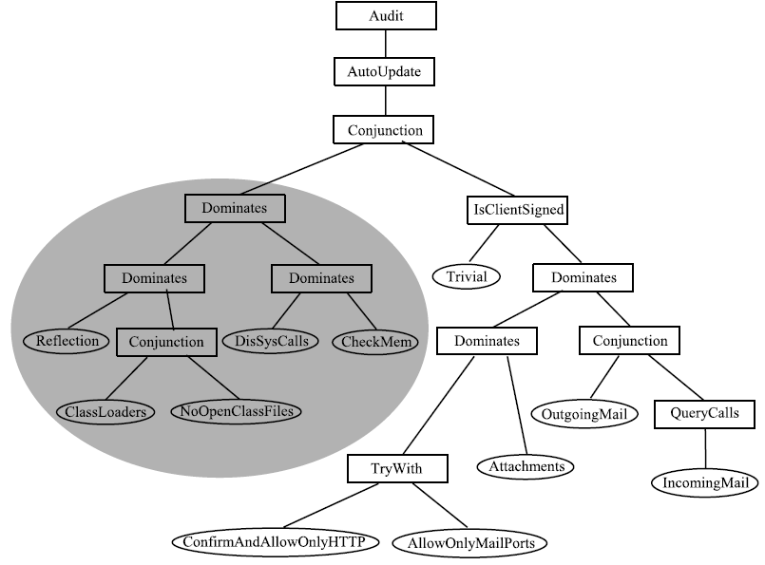
Email Policy Hierarchy
Related policy
concerns are
modularized =>
1) Easier to create the policy
- Modules are reusable
- Modules can be written in isolation
2) Easier to understand the policy
3) Easier to update the policy

Slide 53
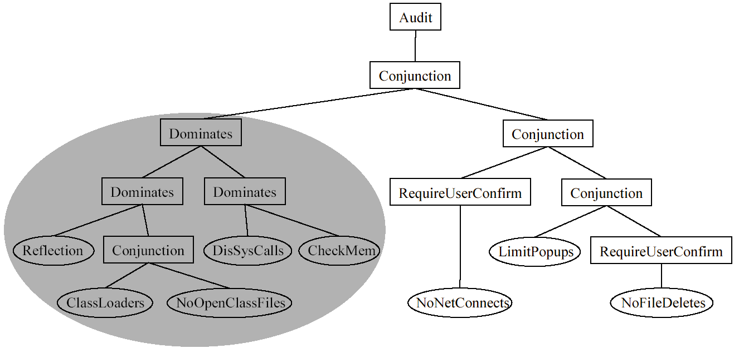
Case Study II
Polymer policy designed for text editors
  User must confirm all network connections and file deletions
  At most four windows can be popped up

Slide 54
Case Study II Notes
Good example of enabling flexible policy composition by suggesting effects
  NoNetConnects and NoFileDeletes policies return HaltSuggestions instead of directly halting execution
  Enables RequireUserConfirm to analyze and sometimes disobey its subpolicies’ suggestions

Slide 55
Case Study II Notes
In this example, complete mediation is required!
  LimitPopups policy needs to monitor all popups, even those invoked in the RequireUserConfirm policy
  Prevents malicious text editors from annoying users by spawning 100 threads, each of which deletes a file to trigger RequireUserConfirm into popping up a window
    (A confused-deputy attack)

Slide 56
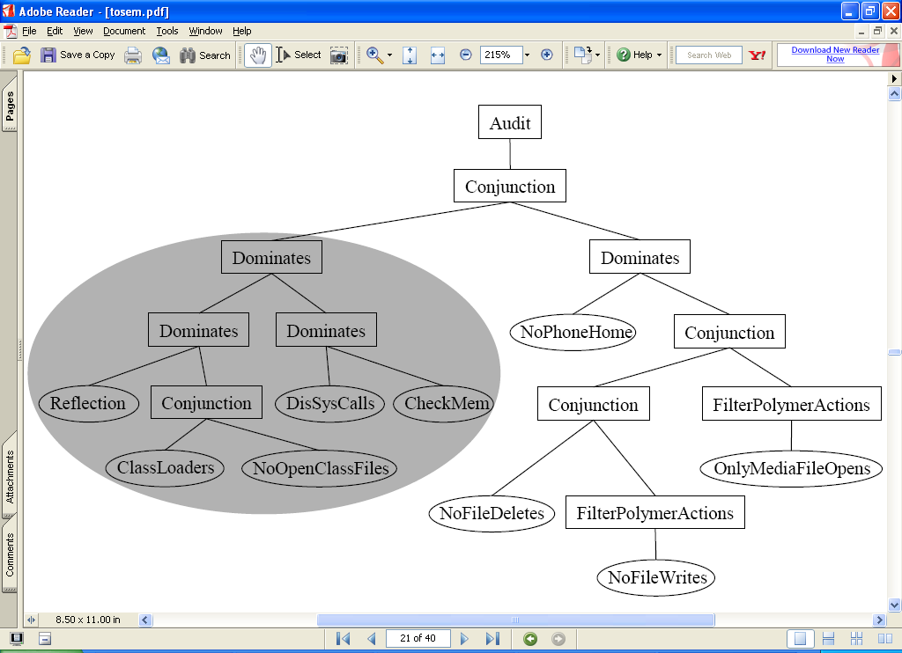
Case Study III
Polymer policy designed for media players
  Application may not “phone home” (i.e., connect to application provider)
  Application may not write to files, delete files, or open files with nonmedia type (e.g., executable files)

Slide 57
Case Study III Notes
In this example, we do not want complete mediation for some subpolicies!
  NoFileWrites and OnlyMediaFileOpens prevent opening and writing to nonmedia files, but the Audit policy does exactly that
We allow Polymer-invoked actions to execute unconditionally by using the FilterPolymerActions superpolicy
Price of expressive complete mediation:
  For every subpolicy S, have to consider whether to filter Polymer actions to S

Slide 58
Polymer Language Semantics
Formal semantics, rather than a particular Java implementation, serves as the precise, unambiguous, canonical definition of the policy-specification language
For simplicity, we have formalized the semantics in a simply-typed-lambda-calculus model
Full details in upcoming journal article…

Slide 59
Polymer Language Property I:
Type Safety
We have proven standard preservation and progress theorems
  Preservation: If P = (F,M,e_{pol},e_{app}) has type T and
  P->P’ then P’:T
  Progress: If P = (F,M,e_{pol},e_{app}):T then either P is in a finished state or there exists P’ such that P->P’
Particularly important result for monitor-based policy-specification languages
  Ensures that well-typed whole programs do not contain malicious applications that can tamper with monitors’ state or code

Slide 60
Polymer Language Property II:
Uncircumventability
Type safety also helps us prove the uncircumventability of monitoring code
(i.e., adherence to complete mediation)
Theorem: If P = (F,M,e_{pol},e_{app}) has type T and
P->*P’ and P’ = (F,M’,v_{pol},E[invk act(f,v)]) then
P’-> (F,M’,v_{pol},E’[v_{query}(act(f,v)])
Means: Well-typed programs, after evaluating the top-level policy value, always execute the top-level query method before any monitored method

Slide 61
Outline
Motivation and Goals
  Monitors are useful and policies are complex, so…
  What are monitors’ enforcement limits?
  How can we simplify complex-policy specification?
Delineating the enforceable policies
Conveniently specifying policies in practice
Conclusions

Slide 62
Summary
Long-term research goal:
Whenever possible, generate efficient and provably effective mechanisms to enforce conveniently specified policies
Results:
  Defined what it means for a monitor to enforce a policy
  Analyzed which of the increasingly complex policies that need to be enforced can be with monitors
  Made it easier to specify and generate complex monitors

Slide 63
Future Research Directions (Specification Technologies)
Develop languages for safely and easily specifying many types of policies
  Transactional policies
  Fault-tolerance policies
Create GUIs for visualizing and specifying policy compositions and dynamic policy updates

Slide 64
Future Research Directions
(Policy Analysis and Enforcement)
Generalize formal models for:
  Real-time policies
  Concurrency
  More “active” monitors
  (monitor triggers application, not vice versa)
Place resource bounds on mechanisms
Decompose general policies into practically enforceable static and dynamic policies

Slide 65
End
Thanks / Questions?

Slide 66
Extra Slides

Slide 67
Policy Details
RequireUserConfirm
  Suggests whatever subpolicy suggests, except suggests OK when
    Subpolicy suggests halting or raising exception
    User confirms in a popup window that action is safe
NoPhoneHome
  Restricts application from connecting to IP addresses assigned to application’s provider
    Obtains provider’s IP addresses through DNS search of provider’s name, as supplied in application’s signed JAR file or in a parameter to the policy’s constructor

Slide 68
Case-study-I Constraints
OutgoingMail
  logs all mail being sent
  pops up a window confirming email recipients
  back up messages by BCCing everything to polydemo@cs.princeton.edu
  Appends contact info to all mail
IncomingMail
  Logs all incoming mail
  Runs a spam filter
  Truncates long subject lines
  Warns before opening a message with an attachment

Slide 69
Precedence Combinators
Give one subpolicy precedence over another
Dominates: Obey first subpolicy if it considers the action relevant; otherwise obey whatever second subpolicy suggests
TryWith: Obey first subpolicy if and only if it returns an Irrelevant, OK, or Insertion suggestion

Slide 70
Implementation Numbers
Polymer size
  30 core classes (approx. 2500 lines of Java) + JavaCC + Apache BCEL
(Unoptimized) Performance
  Instrument all Java core libraries = 107s = 3.7 ms per method
  Typical class loading time = 12 ms
  (vs. 6 ms with default class loader)
  Monitored method call = 0.6 ms overhead
  Policy code’s performance typically dominates cost

Slide 71
Edit Automata Enforcement
(Lower Bound)
Theorem: ∀ policies P such that
1. P is a renewal policy,
2. P(●), and
3. ∀s∈A* : P(s) is decidable,
∃ an edit automaton that enforces P.
Edit automata can enforce any
reasonable renewal policy

Slide 72
Edit Automata Enforcement
(Lower Bound)
Proof idea: Technique of suppressing actions until they are known to be safe causes every valid prefix, and only valid prefixes, of the input to be output
  Given a renewal policy P, construct an edit automaton X that uses this technique
  In all cases, X correctly enforces P
    If input s has finite length, X outputs longest valid prefix of s
    Else if ¬P(s), X outputs the longest valid (finite) prefix of s
    Else if P(s), X outputs every prefix of s and only prefixes of s

Slide 73
“Transforms” Definition
Definition: Automaton X = ( Q,q₀,t ) transforms input s∈A∞ into output u∈A∞ iff
1. ∀q’∈Q ∀s’∈A∞ ∀u’∈A* :
if (q₀,s) _{X} ⇒^{u’} (q’,s’) then u’ ≤ u
(On input s, X outputs only prefixes of u)
2. ∀u’≤u ∃q’∈Q ∃s’∈A∞ : (q₀,s) _{X} ⇒^{u’} (q’,s’)
(On input s, X outputs every prefix of u)
(q₀,s) _{X} ⇓ u

Slide 74
Edit Automata Enforcement
Edit automata enforce exactly the set of reasonable renewal policies, except for a corner case that allows some valid infinite executions to have finitely many valid prefixes
Example
  P(s) iff s=a₁;a₁;a₁;…
  P is not a renewal policy
  Monitor enforces P by always entering an infinite loop to insert a₁;a₁;a₁;…

Slide 75
Edit Automata Enforcement
Enforcing an “almost renewal” policy requires automaton having input sequence s’ to decide:
  only one extension s of s’ is valid
  s has infinite length
  how to compute the actions in s
Aside from this situation, edit automata enforce exactly the set of renewal policies

Slide 76
Decomposing the Example into Safety and Liveness
ATM must log before and after dispensing cash
and may only log before and after dispensing cash:
  Valid executions = (logBegin(n); dispense(n); logEnd(n))∞
P_{S}(s) ⇔ s matches one of:
  (logBegin(n);dispense(n);logEnd(n))*;logBegin(n)
  (logBegin(n);dispense(n);logEnd(n))*;logBegin(n);dispense(n)
  (logBegin(n);dispense(n);logEnd(n))∞
P_{L}(s) ⇔ s≠s’;logBegin(n) and s≠s’;logBegin(n);dispense(n)

