Slide 1
Polymer: A Language and System for Specifying Complex, Modular Run-time Policies
Jay Ligatti, University of South Florida
Joint work with:
Lujo Bauer, Carnegie Mellon University
David Walker, Princeton University

Slide 2
Security Policy Enforcement
News flash:
Software sometimes does bad stuff
  Bugs
  Malicious design
One protection mechanism:
Run-time program monitoring
  Monitoring software interposes whenever an untrusted application is about to execute a security-relevant action

Slide 3
Program Monitoring
Monitors ensure that software dynamically adheres to constraints specified by a security policy
Practical examples
  Stack inspection, firewalls, network auditors, sandboxing, intrusion detection systems, …
Untrusted
Target
Program
Monitor
Executing
System
Open(f,“w”)
Open(f,“w”)
is OK
Open(f,“w”)

Slide 4
Security Policies Become More Complex…
As software becomes more sophisticated
(i.e., enters new domains)
  Multi-user and networked systems
  Electronic commerce
  Medical databases (HIPAA, EU Data Protection Law)

Slide 5
Security Policies Become More Complex…
As software becomes more sophisticated
(i.e., enters new domains)
  Multi-user and networked systems
  Electronic commerce
  Medical databases (HIPAA, EU Data Protection Law)
As we tighten overly relaxed policies
  Insecure default configurations disallowed
  Downloading .doc files requires warning

Slide 6
Security Policies Become More Complex…
As software becomes more sophisticated
(i.e., enters new domains)
  Multi-user and networked systems
  Electronic commerce
  Medical databases (HIPAA, EU Data Protection Law)
As we tighten overly relaxed policies
  Insecure default configurations disallowed
  Downloading .doc files requires warning
As we relax overly tight policies
  All applets sandboxed (JDK 1.0) vs.
  only unsigned applets sandboxed (JDK 1.1)

Slide 7
Managing Complexity via Centralization
Application with policy
scattered throughout
Application with
centralized policy
Policy contains:
- Security code
- When to run the
security code
Scattered policy is
hard to find and
reason about
Centralized policy is
easier to find and
reason about

Slide 8
Related Work: Managing Policy Complexity via Centralization
General monitoring systems
  Java-MaC [Lee, Kannan, Kim, Sokolsky, Viswanathan ‘99]
  Naccio [Evans, Twyman ’99]
  Policy Enforcement Toolkit [Erlingsson, Schneider ’00]
  Aspect-oriented software systems [Kiczales, Hilsdale, Hugunin, Kersten, Palm, Griswold ’01; …]
  …
Language theory
  Semantics for AOPLs [Tucker, Krishnamurthi ’03; Walker, Zdancewic, Ligatti ’03; Wand, Kiczales, Dutchyn ’04; …]
Automata theory
  Security automata [Schneider ’00; Ligatti, Bauer, Walker ’05]

Slide 9
Beyond Centralization: Composition
Policy centralization is not enough
  Need methodology for organizing a complex centralized policy
All of the cited efforts lack a flexible methodology for decomposing complex policies into simpler modules

Slide 10
Polymer Contributions
Polymer
  Is a fully implemented language (with formal semantics) for specifying run-time policies on Java code
  Provides a methodology for conveniently specifying and generating complex monitors from simpler modules
Strategy
  Make all policies first-class and composeable
  So higher-order policies (superpolicies) can compose simpler policies (subpolicies)

Slide 11
Outline
Motivation and goal
  Ease specification of run-time policies
Polymer system
Polymer language
  First-class actions, suggestions, policies
  Policy examples
Case study
Formal Polymer language
Conclusion

Slide 12
Polymer System Tools
Policy compiler
  Converts monitor policies written in the Polymer language into Java source code
  Then runs javac to compile the Java source
Bytecode instrumenter
  Inserts calls to the monitor at the right places in:
    The core Java libraries
    The untrusted (target) application

Slide 13
Securing Targets in Polymer
Original application
Target
…
…
Libraries
Secured application
Instrumented
target
…
…
Instrumented
libraries
Compiled policy

Slide 14
Securing Targets in Polymer
Create a listing of all security-relevant methods (trigger actions)
Instrument trigger actions in core Java libraries
Write and compile security policy
Run target using instrumented libraries,
instrumenting target classes as they load (with a custom class loader)

Slide 15
Outline
Motivation and goal
  Ease specification of run-time policies
Polymer system
Polymer language
  First-class actions, suggestions, policies
  Policy examples
Case study
Formal Polymer language
Conclusion

Slide 16
Polymer Language Overview
Syntactically almost identical to Java source
Primary additions to Java
  Key abstractions for first-class actions, suggestions, and policies
  Programming discipline
  Composeable policy organization

Slide 17
First-class Actions
Action objects contain information about a method invocation
  Static method signature
  Dynamic calling object
  Dynamic parameters
Policies can analyze trigger actions
Policies can synthesize actions to insert

Slide 18
Action Patterns
For convenient analysis, action objects can be matched to patterns in aswitch statements
Wildcards can appear in action patterns
aswitch(a) {
case <void System.exit(int status)>: E;
…
}
<public void java.io.*.<init>(int i, …)>

Slide 19
First-class Suggestions
Policies return Suggestion objects to indicate how to handle trigger actions
  IrrSug: action is irrelevant
  OKSug: action is relevant but safe
  InsSug: defer judgment until after running and evaluating some auxiliary code
  ReplSug: replace action (which computes a return value) with another return value
  ExnSug: raise an exception to notify target that it is not allowed to execute this action
  HaltSug: disallow action and halt execution

Slide 20
First-class Policies
Policies include state and several methods:
  query() suggests how to deal with trigger actions
  accept() performs bookkeeping before a suggestion is followed
  result() performs bookkeeping after an OK’d or inserted action returns a result
public abstract class Policy {
public abstract Sug query(Action a);
public void accept(Sug s) { };
public void result(Sug s, Object result,
boolean wasExnThn) { };
}

Slide 21
Compositional Policy Design
query() methods should be effect-free
  Superpolicies test reactions of subpolicies by calling their query() methods
  Superpolicies combine reactions in meaningful ways
  Policies cannot assume suggestions will be followed
Effects postponed for accept() and result()

Slide 22
A Simple Policy That Forbids Runtime.exec(..) methods
public class DisSysCalls extends Policy {
public Sug query(Action a) {
aswitch(a) {
case <* java.lang.Runtime.exec(..)>:
return new HaltSug(this, a);
}
return new IrrSug(this);
}
public void accept(Sug s) {
if(s.isHalt()) {
System.err.println(“Illegal method called”);
System.err.println(“About to halt target.”);
}
}
}

Slide 23
Policy Combinators
Polymer provides library of generic superpolicies (combinators)
Policy writers are free to create new combinators
Standard form:
public class Conjunction extends Policy {
private Policy p1, p2;
public Conjunction(Policy p1, Policy p2) {
this.p1 = p1; this.p2 = p2;
}
public Sug query(Action a) {
Sug s1 = p1.query(a), s2 = p2.query(a);
//return the conjunction of s1 and s2
…

Slide 24
Conjunctive Combinator
Apply several policies at once, first making any insertions suggested by subpolicies
When no subpolicy suggests an insertion, obey most restrictive subpolicy suggestion
Replace(v1)
Replace(v2)
Irrelevant
OK
Exception
Halt
Replace(v3)
…
Least restrictive
Most restrictive
Policy netPoly = new Conjunction(new FirewallPoly(),
new LogSocketsPoly(), new WarnB4DownloadPoly());

Slide 25
Selector Combinators
Make some initial choice about which subpolicy to enforce and forget about the other subpolicies
IsClientSigned: Enforce first subpolicy if and only if target is cryptographically signed
Policy sandboxUnsigned = new IsClientSigned(
new TrivialPolicy(), new SandboxPolicy());

Slide 26
Unary Combinators
Perform some extra operations while enforcing a single subpolicy
AutoUpdate: Obey sole subpolicy but also intermittently check for subpolicy updates
Notes:
Audit: Obey sole subpolicy but also log all actions seen and suggestions made

Slide 27
Outline
Motivation and goal
  Ease specification of run-time policies
Polymer system
Polymer language
  First-class actions, suggestions, policies
  Policy examples
Case study
Formal Polymer language
Conclusion

Slide 28
Case Study
Polymer policy for email clients that use the JavaMail API
  Approx. 1800 lines of Polymer code, available at
  http://www.cs.princeton.edu/sip/projects/polymer
Tested on Pooka [http://www.suberic.net/pooka]
  Approx. 50K lines of Java code + libraries
  (Java standard libraries, JavaMail, JavaBeans Activation Framework, JavaHelp, The Knife mbox provider, Kunststoff Look and Feel, and ICE JNI library)

Slide 29
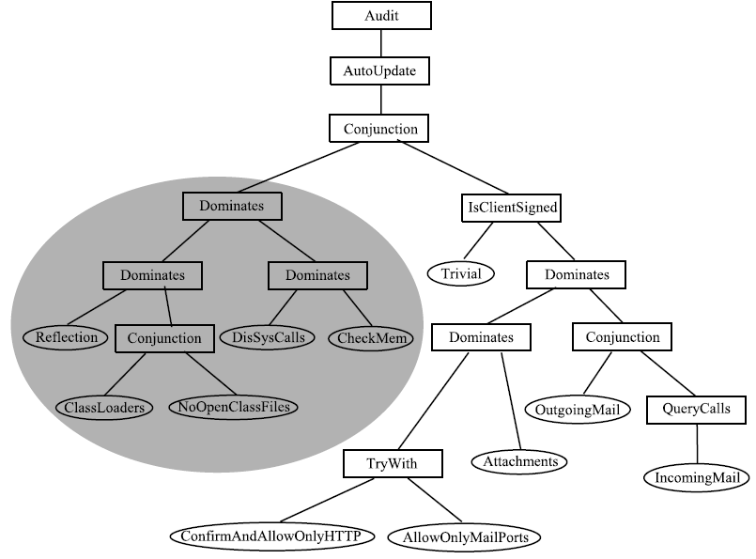
Email Policy Hierarchy
Related policy
concerns are
modularized =>
1) Easier to create the policy
- Modules are reusable
- Modules can be written in isolation
2) Easier to understand the policy
3) Easier to update the policy

Slide 30
Outline
Motivation and goal
  Ease specification of run-time policies
Polymer system
Polymer language
  First-class actions, suggestions, policies
  Policy examples
Case study
Formal Polymer language
Conclusion

Slide 31
Formal Semantics
Motivation
  Unambiguously communicate central workings of language and highlight their simplicity
Style
  Lambda calculus, rather than class-based calculus (again, for simplicity)

Slide 32
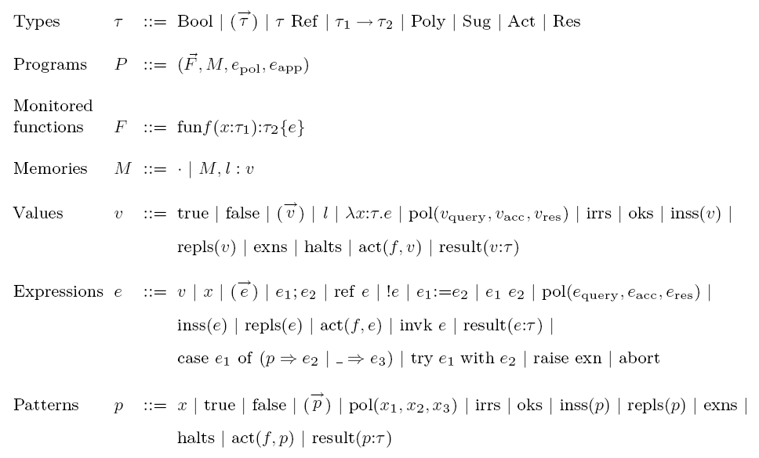
Syntax

Slide 33
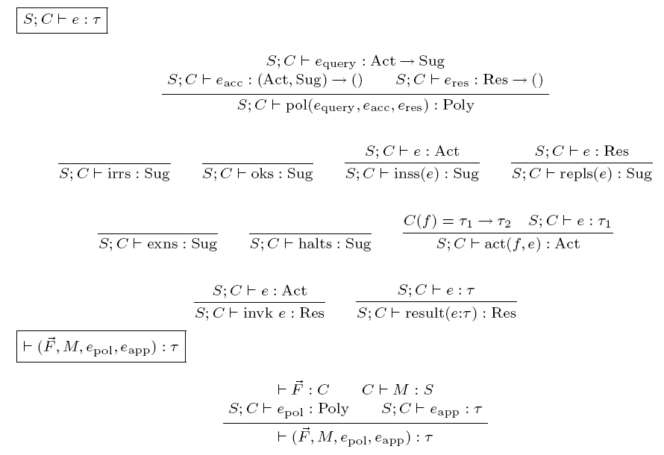
Static Semantics

Slide 34
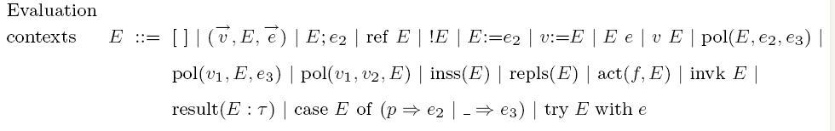
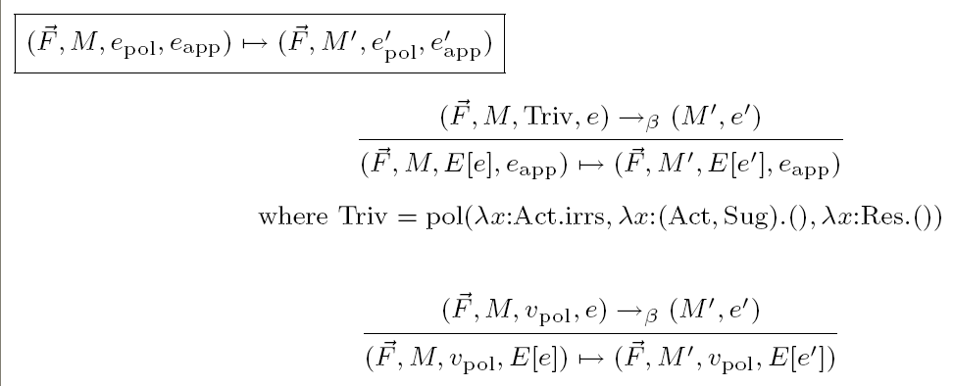
Dynamic Semantics I

Slide 35
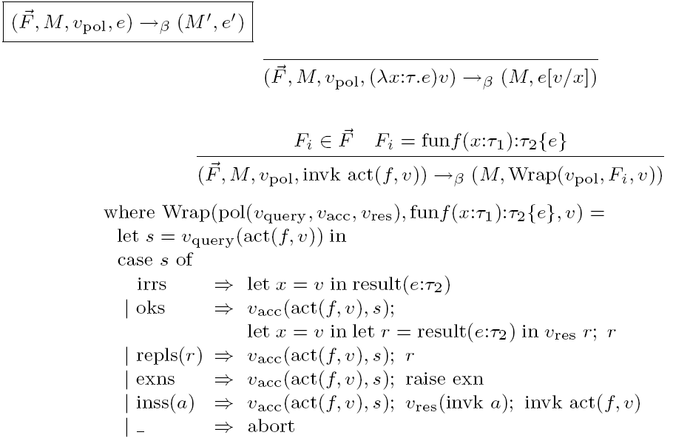
Dynamic Semantics II

Slide 36
Type Safety
Particularly important for monitor-based policy-specification languages
  Application expressions in well-typed programs cannot:
    circumvent monitor checks (complete mediation)
    tamper with monitor code or state
Straightforward proof
  Context weakening, Typing inversion, Canonical Forms, Substitution, Preservation, Progress

Slide 37
Outline
Motivation and goal
  Ease specification of run-time policies
Polymer system
Polymer language
  First-class actions, suggestions, policies
  Policy examples
Case study
Formal Polymer language
Conclusion

Slide 38
Summary
An approach to managing policy complexity:
  Design policies for composition
  Complex policies can be decomposed into simpler subpolicies
Enabling the approach
  First-class actions, suggestions, and policies
  Policy organization (effectless query methods and effectful bookkeeping methods)
Implemented end-to-end system
  Library of useful combinators
  Case study policy hierarchy

Slide 39
Current Work: Improving
Specification Convenience
Effectful query methods
  Writing effectless query methods is tedious
  Algorithm seems to exist for compiling an effectful-query policy into an effectless-query policy
Polymer GUI
  Policies written at too low of level for many users
  GUI would allow safe policy specification, visualization, and update by selection from a library of prepackaged policies

Slide 40
More Information
Source code and example policies:
http://www.cs.princeton.edu/sip/projects/polymer
Papers:
  Composing security policies with Polymer
  (PLDI 2005)
  Composing expressive run-time security policies (journal article in submission)

Slide 41
End
Thanks / Questions?

Slide 42
Implementation Numbers
Polymer size
  30 core classes (approx. 2500 lines of Java) + JavaCC + Apache BCEL
(Unoptimized) Performance
  Instrument all Java core libraries = 107s = 3.7 ms per method
  Typical class loading time = 12 ms
  (vs. 6 ms with default class loader)
  Monitored method call = 0.6 ms overhead
  Policy code’s performance typically dominates cost

Slide 43
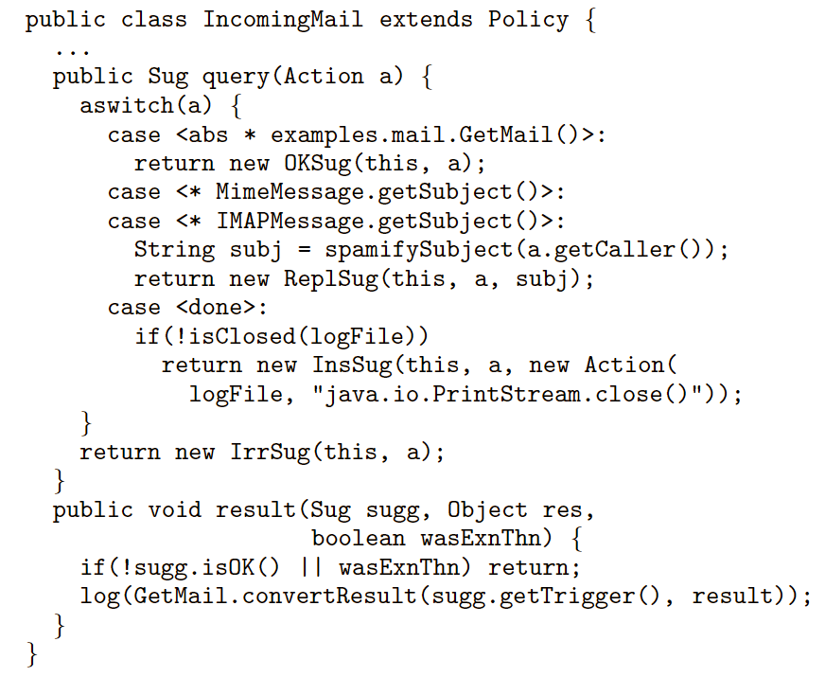
Another Example
(logs incoming email and prepends “SPAM:” to subject
lines on messages flagged by a spam filter)

