Slide 1
Composing Security Policies with Polymer
Jay Ligatti (Princeton); joint work with:
Lujo Bauer (CMU), David Walker (Princeton)

Slide 2
Security Policy Enforcement
News flash:
Software sometimes does bad stuff
  Bugs
  Malicious design
One mitigation is run-time monitoring
  Ensure that software adheres to run-time constraints specified by a security policy
  Stack inspection, access control lists, applet sandboxing, firewalls, resource monitors, …

Slide 3
Policies Become More Complex
As software becomes more sophisticated
  Multi-user and networked systems
  Electronic commerce
  Medical databases (HIPAA)
As we tighten overly relaxed policies
  Insecure default configurations disallowed
  Downloading .doc files requires warning
As we relax overly tight policies
  All applets sandboxed (JDK 1.0) vs.
  only unsigned applets sandboxed (JDK 1.1)

Slide 4
Managing Complexity via Centralization
Application with policy
scattered throughout
Application with
centralized policy
Policy contains:
- Security code
- When to run the
security code
Scattered policy is
hard to find and
reason about
Centralized policy is
easier to find and
reason about

Slide 5
Beyond Centralization: Composition
Policy centralization is not enough
  Need methodology for organizing a complex centralized policy
Polymer provides a flexible methodology for decomposing complex policies into simpler modules
  Policies are first-class and organized for composition
  Higher-order policies (superpolicies) can compose simpler policies (subpolicies)

Slide 6
Related Work
General monitoring systems (with centralized policies)
  Java-MaC [Lee, Kannan, Kim, Sokolsky, Viswanathan ‘99]
  Naccio [Evans, Twyman ’99]
  Policy Enforcement Toolkit [Erlingsson, Schneider ’00]
  Aspect-oriented software systems [Kiczales, Hilsdale, Hugunin, Kersten, Palm, Griswold ’01; …]
  …
Language theory
  Semantics for AOPLs [Tucker, Krishnamurthi ’03; Walker, Zdancewic, Ligatti ’03; Wand, Kiczales, Dutchyn ’04; …]
Automata theory
  Security automata [Schneider ’00; Ligatti, Bauer, Walker ’05]

Slide 7
Outline
Motivation and goal
  Ease specification of run-time policies
Polymer system
Polymer language
  First-class actions, suggestions, policies
  Policy examples
Case study
Summary

Slide 8
Polymer Tools
Policy compiler
  Converts monitor policies written in the Polymer language into Java source code
  Then runs javac to compile the Java source
Bytecode instrumenter
  Adds calls to the monitor to the core Java libraries and to the untrusted (target) application
Total size = 30 core classes (approx. 2500 lines of Java) + JavaCC + Apache BCEL

Slide 9
Securing Targets in Polymer
Create a listing of all security-relevant methods (trigger actions)
Instrument trigger actions in core Java libraries
Write and compile security policy
Run target using instrumented libraries,
instrumenting target classes as they load

Slide 10
Securing Targets in Polymer
Original application
Target
…
…
Libraries
Secured application
Instrumented
target
…
…
Instrumented
libraries
Compiled policy

Slide 11
Outline
Motivation and goal
  Ease specification of run-time policies
Polymer system
Polymer language
  First-class actions, suggestions, policies
  Policy examples
Case study
Summary

Slide 12
First-class Actions
Action objects contain information about a method invocation
  Static method signature
  Dynamic calling object
  Dynamic parameters
Policies can analyze actions about to be executed by the target
Policies can synthesize actions to invoke on behalf of the target

Slide 13
Action Patterns
Action objects can be matched to patterns in aswitch statements
Wildcards can appear in action patterns
aswitch(a) {
case <void System.exit(int status)>: E;
…
}
<public void java.io.*.<init>(int i, …)>

Slide 14
First-class Suggestions
Policies return Suggestion objects to indicate how to handle trigger actions
  IrrSug: action is irrelevant
  OKSug: action is relevant but safe
  InsSug: defer judgment until after running and evaluating some auxiliary code
  ReplSug: replace action (which computes a return value) with another return value
  ExnSug: raise an exception to notify target that it is not allowed to execute this action
  HaltSug: disallow action and halt execution

Slide 15
First-class Policies
Policies include state and several methods:
  query() suggests how to deal with trigger actions
  accept() performs bookkeeping before a suggestion is followed
  result() performs bookkeeping after an OK’d or inserted action returns a result
public abstract class Policy {
public abstract Sug query(Action a);
public void accept(Sug s) { };
public void result(Sug s, Object result,
boolean wasExnThn) { };
}

Slide 16
Compositional Policy Design
query() methods should be effect-free
  Superpolicies test reactions of subpolicies by calling their query() methods
  Superpolicies combine reactions in meaningful ways
  Policies cannot assume suggestions will be followed
Effects postponed for accept() and result()

Slide 17
A Simple Policy That Forbids Runtime.exec(..) methods
public class DisSysCalls extends Policy {
public Sug query(Action a) {
aswitch(a) {
case <* java.lang.Runtime.exec(..)>:
return new HaltSug(this, a);
}
return new IrrSug(this);
}
public void accept(Sug s) {
if(s.isHalt()) {
System.err.println(“Illegal exec method called”);
System.err.println(“About to halt target.”);
}
}
}

Slide 18
Policy Combinators
Polymer provides library of generic superpolicies (combinators)
Policy writers are free to create new combinators
Standard form:
public class Conjunction extends Policy {
private Policy p1, p2;
public Conjunction(Policy p1, Policy p2) {
this.p1 = p1; this.p2 = p2;
}
public Sug query(Action a) {
Sug s1 = p1.query(a), s2 = p2.query(a);
//return the conjunction of s1 and s2
…

Slide 19
Policy Combinator I: Conjunction
Apply several policies at once, first making any insertions suggested by subpolicies
When no subpolicy suggests an insertion, obey most restrictive subpolicy suggestion
Replace(v1)
Replace(v2)
Irrelevant
OK
Exception
Halt
Replace(v3)
…
Least restrictive
Most restrictive

Slide 20
Policy Combinator II: Selector
Make some initial choice about which subpolicy to enforce and forget about the other subpolicies
IsClientSigned: Enforce first subpolicy if and only if target is cryptographically signed
Policy sandboxUnsigned = new IsClientSigned(
new TrivialPolicy(), new SandboxPolicy());

Slide 21
Policy Combinator III: Precedence
Give one subpolicy precedence over another
Dominates: Obey first subpolicy if it considers the action relevant; otherwise obey whatever second subpolicy suggests
TryWith: Obey first subpolicy if and only if it returns an Irrelevant, OK, or Insertion suggestion

Slide 22
Policy Combinator IV:
Single-policy Modifier
Perform some extra operations while enforcing a single subpolicy
Audit: Obey sole subpolicy but also log all actions seen and suggestions made
AutoUpdate: Obey sole subpolicy but also intermittently check for subpolicy updates

Slide 23
Outline
Motivation and goal
  Ease specification of run-time policies
Polymer system
Polymer language
  First-class actions, suggestions, policies
  Policy examples
Case study
Summary

Slide 24
Case Study
Polymer policy for email clients that use the JavaMail API
  Approx. 1800 lines of Polymer code
Tested on Pooka [http://www.suberic.net/pooka]
  Approx. 50K lines of Java code + libraries
  (Java standard libraries, JavaMail, JavaBeans Activation Framework, JavaHelp, The Knife mbox provider, Kunststoff Look and Feel, and ICE JNI library)

Slide 25
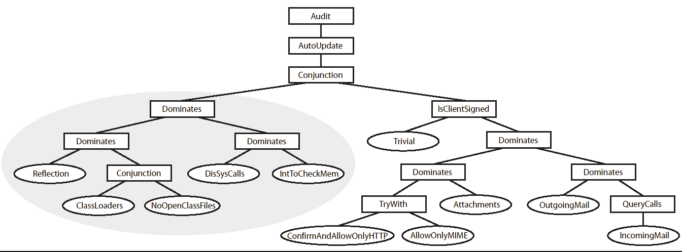
Email Policy Hierarchy
Related policy concerns are modularized
  Easier to create the policy
    Modules are reusable
    Modules can be written in isolation
  Easier to understand the policy

Slide 26
Outline
Motivation and goal
  Ease specification of run-time policies
Polymer system
Polymer language
  First-class actions, suggestions, policies
  Policy examples
Case study
Summary

Slide 27
Summary
A new approach to managing policy complexity:
  Design policies for composition
  Complex policies can be decomposed into simpler subpolicies
Enabling the approach
  First-class actions, suggestions, and policies
  Policy organization (effectless query methods and effectful bookkeeping methods)
Implemented end-to-end system
  Library of useful combinators
  Case study policy hierarchy

Slide 28
More Information
Language and system details, including a sound formal semantics for the language:
PLDI ’05 proceedings
Full source code and example policies:
http://www.cs.princeton.edu/sip/projects/polymer

Slide 29
End
Thanks / Questions

Slide 30
(Unoptimized) Performance
Instrument all Java core libraries = 107s = 3.7 ms per method
Typical class loading time = 12 ms
(vs. 6 ms with default class loader)
Monitored method call = 0.6 ms overhead
Policy code’s performance typically dominates cost

Slide 31
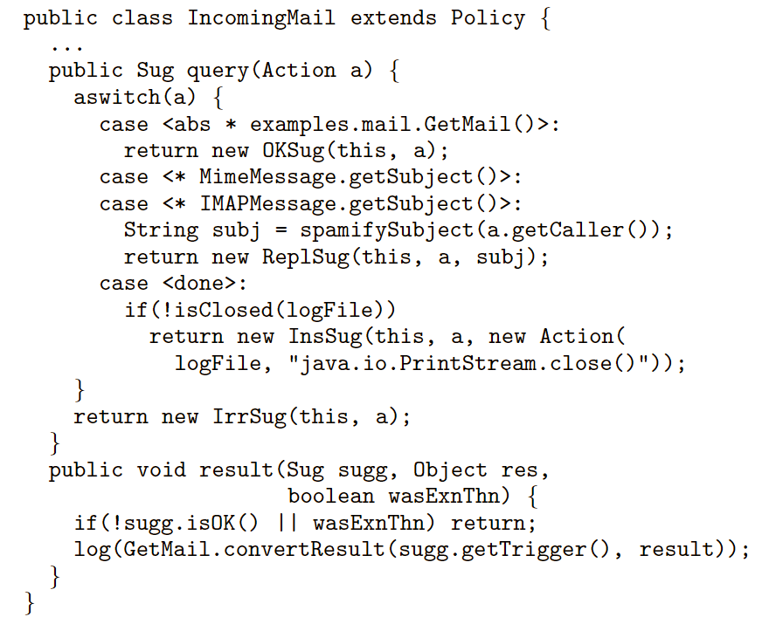
Another Example
(logs incoming email and prepends “SPAM:” to
subject lines on messages flagged by a spam filter)

