Slide 1
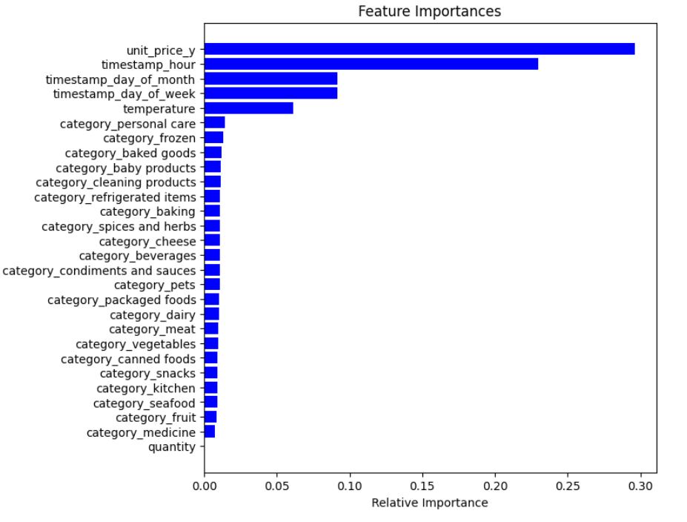
RESULTS
RELATIVE IMPORTANCE OF FEATURES
‘unit price’ is the most important feature
‘timestamp’ is also an important feature
‘category’ is not an important feature.
FOR BETTER MODEL ACCURACY:
MORE DATA IS REQUIRED-the accuracy of the model
is approximately 27% which is very less ,hence more
data feeding to the model is required.
As the data are taken from IOT of temperature sensors---> ANOTHER IMPORTANT FEATURE ‘TEMPERATURE’

