Slide 1
ANNUAL TECHNOLOGY KPI 2026
Rust → WebAssembly
Running native-speed code in the browser: measured against JavaScript and a C# (.NET) server
Research • Advantages & disadvantages • Working demo • Code sample
Notes:
Opening. This deck is my evidence for the yearly KPI: master one new technology beyond the skill standard, understand its pros and cons, and show it with slides, a demo and code. I chose Rust compiled to WebAssembly.

Slide 2
The KPI and how this work answers it
Continuously research and master a new technology each year
The KPI
My choice this year: Rust + WebAssembly
Master at least one new technology beyond the skill standard, every year.
Understand its advantages and disadvantages clearly.
Develop personal skills; prove it with slides, a demo, code and a blog post.
Outside my daily stack (C# / .NET / JavaScript).
Directly relevant: heavy file and image work today runs on servers.
Question to answer: when is it worth moving that work into the browser?
Expected outputs
✔ Slides
✔ Demo
✔ Code sample
○ Blog post
this deck
split-screen app + recorded video
rust-core, web-ui, dotnet-api
planned next
Rust → WebAssembly | Annual new-technology KPI 2026
2
Notes:
Map each KPI expectation to a deliverable. Blog post is the remaining item and is honest to call out as planned.

Slide 3
What is Rust + WebAssembly?
A compiled, memory-safe language running in a sandbox next to JavaScript
Rust source
wasm-pack
.wasm module
Web Worker
lib.rs, about 235 lines
serde, csv, calamine
wasm-bindgen generates
JS glue + TypeScript types
539 KB, no wasm-opt yet
compiled in 30 ms
Calls Rust from JS;
UI thread stays free
■ Near-native speed: predictable performance, no garbage collector, SIMD-friendly code.
■ Memory safety: Rust's ownership model prevents whole classes of bugs without a runtime.
■ Runs on the client: data can be processed locally; nothing needs to be uploaded.
■ Portable: the same Rust crate can also target servers, edge runtimes and WASI.
Rust → WebAssembly | Annual new-technology KPI 2026
3
Notes:
Explain the toolchain once: Rust compiles to a .wasm binary, wasm-bindgen creates the JavaScript bindings, and we call it from a Web Worker so the UI never freezes.

Slide 4
The demo: one workload, three engines
Same algorithms and validation rules everywhere; the UI checks the outputs match
JavaScript
C# / .NET 10 API
Rust → WASM
Traditional (browser)
Traditional (server)
New (browser)
Runs in a Web Worker
CSV only (no xlsx parser)
Hand-written filters
Minimal API, SkiaSharp, ClosedXML
Upload → process → download
Server-Timing header
Runs in a Web Worker
calamine + csv crates
Nothing leaves the device
Workloads
■ Image filters: grayscale, blur, sharpen, edge detection on a 12 MP image.
■ Data validation: 100,000-row CSV and XLSX (ids, emails, amounts, dates), with an error report.
Rust → WebAssembly | Annual new-technology KPI 2026
4
Notes:
Three engines, same inputs. JS and WASM both run in Web Workers. The server path includes upload and download, which is the real cost a user waits for.

Slide 5
How the comparison stays fair
A benchmark is only useful if the reader can trust it
■ Same rules: integer algorithms and identical validation; an output-match check runs on every comparison.
■ Workers for both: JS and WASM run off the main thread, so neither blocks the UI.
■ Warm-up + median: 1 warm-up run and N timed runs; the median is reported.
■ Honest WASM cost: timings include the JS ↔ WASM copy of input and output.
■ Init shown separately: WASM load + compile took 30 ms once, not part of per-run timing.
■ Server split: Server-Timing separates compute from network, so Total is what the user waits.
Test environment
Local machine, headless Chromium
API on localhost (network cost is a floor)
Real internet latency would favour WASM even more
Reproducible
Recorder script: docs/demo-recording
Metrics saved to results.json
Deck is generated from those numbers
Rust → WebAssembly | Annual new-technology KPI 2026
5
Notes:
Be upfront about methodology and its limits. Numbers will vary by machine, so I record them by script rather than by hand.

Slide 6
Results: measured end-to-end time
What the user waits (lower is better). 12 MP blur image and 100,000-row files
Scenario | Compared with | Traditional | Rust → WASM | Speed-up
Image blur, 12 MP | vs JavaScript | 7.69 s | 6.92 s | 1.1× faster
Image blur, 12 MP | vs C# server | 14.90 s | 6.75 s | 2.2× faster
CSV validate, 100k rows | vs JavaScript | 147 ms | 61 ms | 2.4× faster
CSV validate, 100k rows | vs C# server | 424 ms | 67 ms | 6.3× faster
XLSX validate, 100k rows | vs C# server | 3.98 s | 1.12 s | 3.6× faster
Median of 3 timed runs after 1 warm-up. Results are from a single machine; expect different absolute numbers elsewhere (range here: 1.1× to 6.3×).
Rust → WebAssembly | Annual new-technology KPI 2026
6
Notes:
Read the table honestly: WASM wins everywhere, but the margin ranges widely. Against JavaScript on image blur the gain is modest; against the server, where upload and download count, the gain is largest.

Slide 7
Where WASM wins big, and where it doesn't
End-to-end speed-up of Rust/WASM over the traditional approach
Biggest gains
Server comparisons: no upload, no download, no round trip.
Smaller gains
Versus tuned JavaScript on pure compute (image blur).
Takeaway
WASM is not magic; the architecture matters as much as the language.
Rust → WebAssembly | Annual new-technology KPI 2026
7
Notes:
The honest story: WASM is faster in every scenario, but the biggest wins come from removing the network, not just from the faster compute.

Slide 8
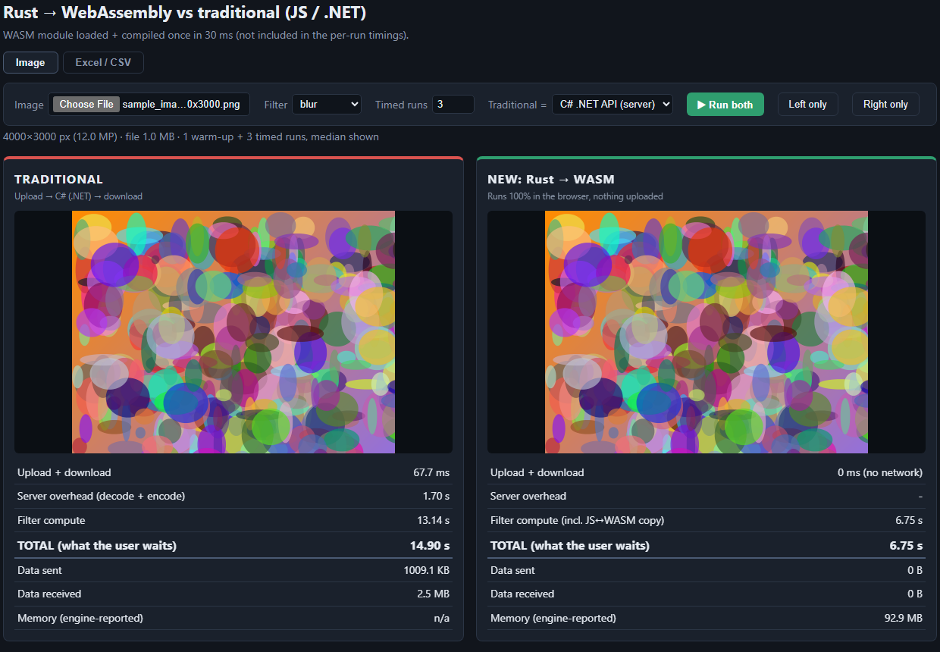
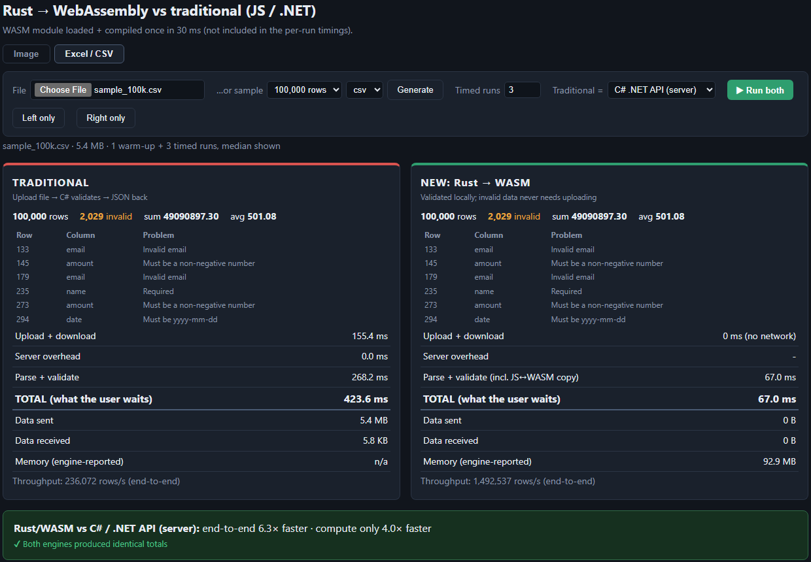
Live demo: split screen, same input
Traditional on the left, Rust → WASM on the right, with metrics for each side
Image blur: C# server vs Rust/WASM
CSV validation: C# server vs Rust/WASM
■ Metrics per side: upload/download, compute, total, data sent/received, memory.
■ Correctness first: output-match and identical-totals checks confirm both engines agree.
Rust → WebAssembly | Annual new-technology KPI 2026
8
Notes:
Walk through the screen: left panel is the traditional approach, right panel is Rust/WASM. The banner states the speed-up and the match check proves the answers are identical.

Slide 9
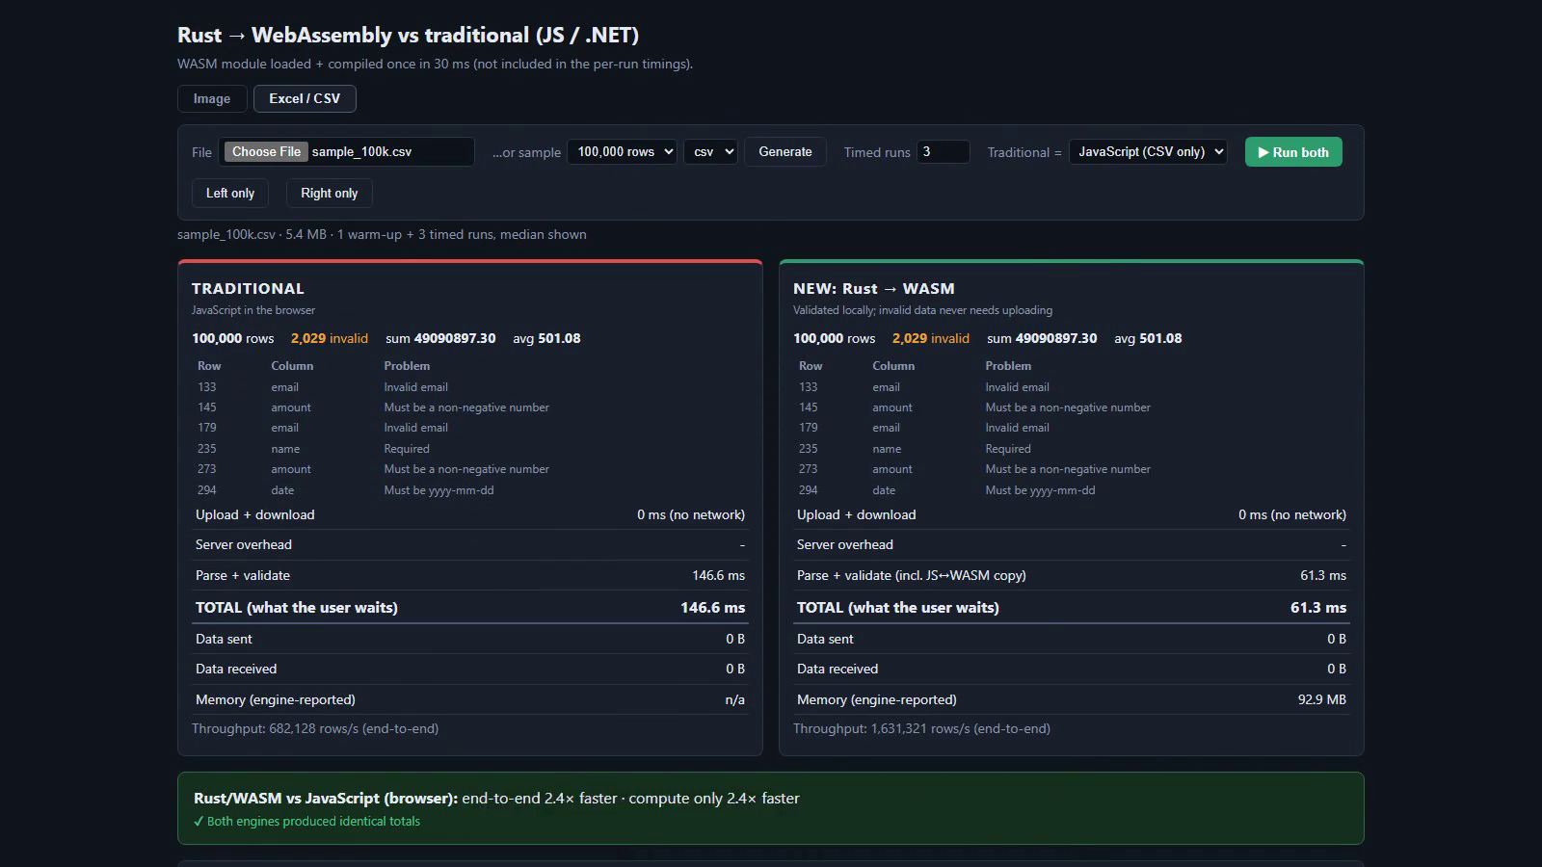
Demo video
About 4 minutes: image filter, CSV and XLSX validation (docs/demo.mp4)
Click to play. If playback is unavailable, open docs/demo.mp4 directly.
Rust → WebAssembly | Annual new-technology KPI 2026
9
Notes:
Play the recorded demo. It was captured by a script so the run is repeatable.

Slide 10
Advantages
What Rust + WebAssembly gave me in this project
Faster
Private by design
Cheaper to run
1.1× to 6.3× end-to-end in this demo; the largest gains versus the server.
Files are processed on the device; sensitive data never needs uploading.
Compute moves to the user's machine, so server cost and load drop.
Reuse and safety
Works offline
Responsive UI
One Rust crate with strong typing; memory safety without a garbage collector.
No server round trip once the page and module are loaded.
Web Workers keep the interface smooth while heavy work runs.
Rust → WebAssembly | Annual new-technology KPI 2026
10
Notes:
Lead with the advantages that are measurable (speed) and architectural (privacy, cost, offline).

Slide 11
Disadvantages and limits
The honest side of the comparison
Steep learning curve
Heavier toolchain
Boundary cost
Ownership and lifetimes take time; slower to write than JS or C#.
Needs Rust, wasm-pack and a build step; CI is more complex.
Data is copied between JS and WASM; tiny tasks may not benefit.
Bundle size
Harder debugging
Not always a win
539 KB module here (wasm-opt not yet applied); extra download on first load.
Browser tooling for WASM is improving but trails JS.
Tuned JS is competitive on simple work; gain was only 1.1× on image blur.
Rust → WebAssembly | Annual new-technology KPI 2026
11
Notes:
Be candid. Other demo-specific limits: JS has no xlsx parser, hand-rolled CSV split ignores newlines in quoted fields, performance.memory is Chrome-only, and image decode time is not included in any engine's timing.

Slide 12
When to use it, and when not to
A simple decision guide
Good fit
Poor fit
■ CPU-heavy work in the browser (image, audio, parsing, crypto).
■ Large files where upload time dominates.
■ Privacy-sensitive data that should stay local.
■ Sharing one core library across web, server and CLI.
■ Simple DOM or UI logic; JavaScript is the right tool.
■ Small inputs where the JS ↔ WASM copy dominates.
■ Teams with no Rust skills and tight deadlines.
■ Work that needs server-side data or central auditing.
Rust → WebAssembly | Annual new-technology KPI 2026
12
Notes:
My recommendation: use WASM for isolated, CPU-heavy, data-local tasks, and keep everything else in JavaScript or on the server.

Slide 13
Skills developed
Personal growth beyond the current skill standard
Rust fundamentals
WebAssembly toolchain
Ownership, error handling, crates (serde, csv, calamine).
wasm-pack, wasm-bindgen, Web Workers, JS ↔ WASM boundaries.
Benchmarking
Full-stack comparison
Fair methodology, warm-ups, medians, output-match checks.
React + Vite UI, .NET 10 minimal API, Swagger, scripted automation.
KPI evidence: slides ✔ demo ✔ code sample ✔ blog post (next)
Rust → WebAssembly | Annual new-technology KPI 2026
13
Notes:
Close the loop to the KPI: list the skills gained and the evidence produced.

Slide 14
Next steps
■ Publish the blog post with the methodology and results.
■ Apply wasm-opt and measure the bundle-size and speed gain.
■ Try SIMD and multi-threading for the image filters.
■ Pilot WASM on one real internal workload with heavy client-side files.
Questions?
Notes:
Close with the follow-up plan and open for questions.

