Slide 1
ANNUAL TECHNOLOGY KPI 2026
Rust → WebAssembly
Running native-speed code in the browser: measured against JavaScript and a C# (.NET) server
Research • Advantages & disadvantages • Working demo • Code sample
Notes:
Opening. This deck is my evidence for the yearly KPI: master one new technology beyond the skill standard, understand its pros and cons, and show it with slides, a demo and code. I chose Rust compiled to WebAssembly.

Slide 2
The problem: why not just handle it the traditional way?
Context: heavy file and image work in web apps today, and where it hurts
How it is usually done: the work goes to a server
User's browser
Upload
Server
Download
Picks a photo, CSV or Excel file
File travels over the network
Decode, process, encode, validate
Result travels back to the user
Where it hurts
Network wait
Server cost
Privacy risk
JavaScript has limits
Large files must be uploaded and the result downloaded before the user sees anything. Slow links make it worse.
Every user's CPU-heavy job runs on your servers, so cost and scaling effort grow with usage.
Sensitive files leave the user's device just to be validated or resized.
Fine for UI logic, but CPU-heavy loops are slower, and some formats (e.g. xlsx) lack good libraries.
The question: can Rust compiled to WebAssembly run this work inside the browser, remove the round trip, and still be fast?
Rust → WebAssembly
2
Notes:
Context before the technology. Today, heavy work such as image processing or validating a 100,000-row CSV or Excel file is usually sent to a server: upload, process, download. That costs waiting time, server capacity and, for sensitive files, privacy. Plain JavaScript in the browser avoids the trip but is slower for CPU-heavy loops and lacks good parsers for some formats. This is why I looked at Rust compiled to WebAssembly, which the next slide explains. The rest of the deck measures whether it helps.

Slide 3
What is Rust + WebAssembly?
Write the heavy code in Rust, ship it to the browser as a small file that runs at near-native speed
Two ingredients, in plain words
Rust
WebAssembly (WASM)
Rust + WASM
A programming language
A file format browsers can run
Fast code, inside the browser
Very fast, like C or C++, but it prevents whole classes of memory bugs. Used where speed and safety both matter.
A compact, ready-to-run binary that every modern browser runs in a safe sandbox, right next to JavaScript.
Compile Rust into a .wasm file; JavaScript loads it and calls it like a normal function.
How it works, step by step
1
Write
2
Compile
3
Load
4
Run
The logic (resize an image, validate a CSV) is written once in Rust: about 235 lines here.
A build tool turns it into one .wasm file: 539 KB, compiled by the browser in 30 ms.
The web page downloads the file and loads it in the background, so the screen never freezes.
JavaScript hands the file to Rust and gets the result back. Nothing is uploaded to a server.
In one line: JavaScript still runs the page; Rust + WASM is the fast engine it hands the heavy jobs to, so the work stays on the user's device.
Rust → WebAssembly
3
Notes:
Keep it simple. Rust is a fast, memory-safe programming language. WebAssembly is a compact binary format that every modern browser can run safely next to JavaScript. Together: write the heavy logic once in Rust, compile it to a .wasm file (539 KB here, about 235 lines of Rust), load it in a Web Worker so the page never freezes, and call it from JavaScript. Tie it back to the previous slide: the work stays on the user's device, so there is no upload or download. Tooling names (wasm-pack, wasm-bindgen) can be mentioned verbally if asked.

Slide 4
The demo: one workload, three engines
Same algorithms and validation rules everywhere; the UI checks the outputs match
JavaScript
C# / .NET 10 API
Rust → WASM
Traditional (browser)
Traditional (server)
New (browser)
Runs in a Web Worker
CSV only (no xlsx parser)
Hand-written filters
Minimal API, SkiaSharp, ClosedXML
Upload → process → download
Server-Timing header
Runs in a Web Worker
calamine + csv crates
Nothing leaves the device
Workloads
■ Image filters: grayscale, blur, sharpen, edge detection on a 12 MP image.
■ Data validation: 100,000-row CSV and XLSX (ids, emails, amounts, dates), with an error report.
Rust → WebAssembly
4
Notes:
Three engines, same inputs. JS and WASM both run in Web Workers. The server path includes upload and download, which is the real cost a user waits for.

Slide 5
How the comparison stays fair
A benchmark is only useful if the reader can trust it
■ Same rules: integer algorithms and identical validation; an output-match check runs on every comparison.
■ Workers for both: JS and WASM run off the main thread, so neither blocks the UI.
■ Warm-up + median: 1 warm-up run and N timed runs; the median is reported.
■ Honest WASM cost: timings include the JS ↔ WASM copy of input and output.
■ Init shown separately: WASM load + compile took 30 ms once, not part of per-run timing.
■ Server split: Server-Timing separates compute from network, so Total is what the user waits.
Test environment
Local machine, headless Chromium
API on localhost (network cost is a floor)
Real internet latency would favour WASM even more
Reproducible
Recorder script: docs/demo-recording
Metrics saved to results.json
Deck is generated from those numbers
Rust → WebAssembly
5
Notes:
Be upfront about methodology and its limits. Numbers will vary by machine, so I record them by script rather than by hand.

Slide 6
Results: measured end-to-end time
What the user waits (lower is better). 12 MP blur image and 100,000-row files
Scenario | Compared with | Traditional | Rust → WASM | Speed-up
Image blur, 12 MP | vs JavaScript | 7.69 s | 6.92 s | 1.1× faster
Image blur, 12 MP | vs C# server | 14.90 s | 6.75 s | 2.2× faster
CSV validate, 100k rows | vs JavaScript | 147 ms | 61 ms | 2.4× faster
CSV validate, 100k rows | vs C# server | 424 ms | 67 ms | 6.3× faster
XLSX validate, 100k rows | vs C# server | 3.98 s | 1.12 s | 3.6× faster
Median of 3 timed runs after 1 warm-up. Results are from a single machine; expect different absolute numbers elsewhere (range here: 1.1× to 6.3×).
Rust → WebAssembly
6
Notes:
Read the table honestly: WASM wins everywhere, but the margin ranges widely. Against JavaScript on image blur the gain is modest; against the server, where upload and download count, the gain is largest.

Slide 7
Where WASM wins big, and where it doesn't
End-to-end speed-up of Rust/WASM over the traditional approach
Biggest gains
Server comparisons: no upload, no download, no round trip.
Smaller gains
Versus tuned JavaScript on pure compute (image blur).
Takeaway
WASM is not magic; the architecture matters as much as the language.
Rust → WebAssembly
7
Notes:
The honest story: WASM is faster in every scenario, but the biggest wins come from removing the network, not just from the faster compute.

Slide 8
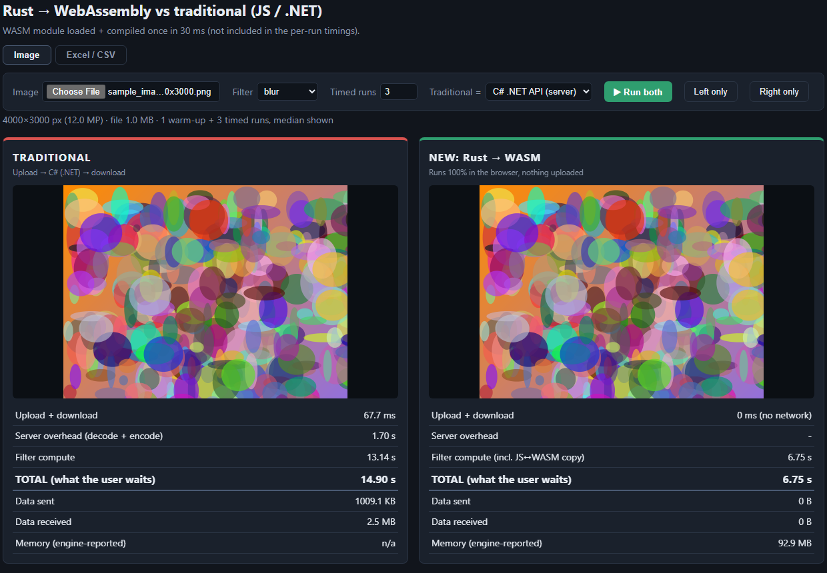
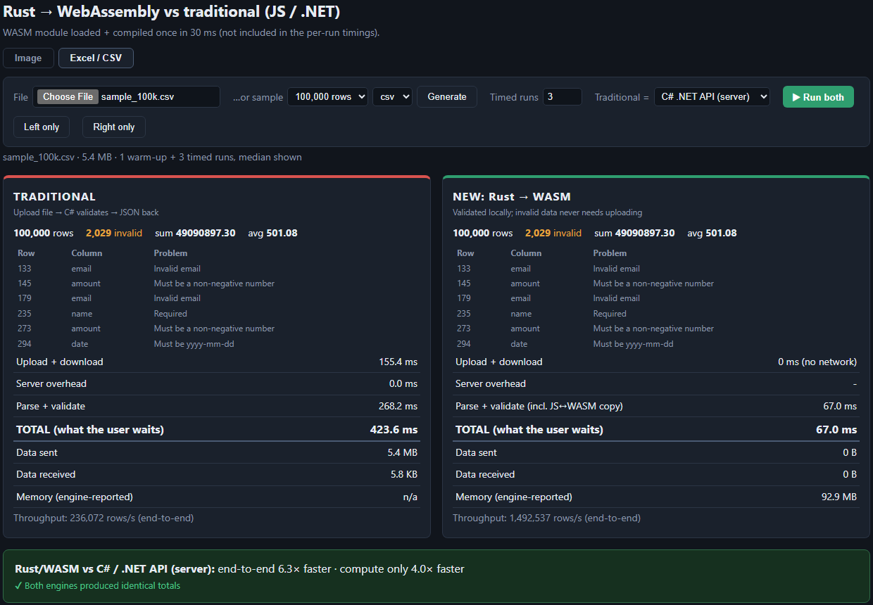
Live demo: split screen, same input
Traditional on the left, Rust → WASM on the right, with metrics for each side
Image blur: C# server vs Rust/WASM
CSV validation: C# server vs Rust/WASM
■ Metrics per side: upload/download, compute, total, data sent/received, memory.
■ Correctness first: output-match and identical-totals checks confirm both engines agree.
Rust → WebAssembly
8
Notes:
Walk through the screen: left panel is the traditional approach, right panel is Rust/WASM. The banner states the speed-up and the match check proves the answers are identical.

Slide 9
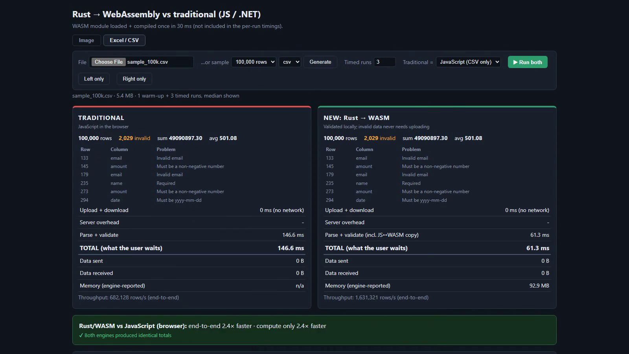
Demo video
About 4 minutes: image filter, CSV and XLSX validation (docs/demo.mp4)
Click to play. If playback is unavailable, open docs/demo.mp4 directly.
Rust → WebAssembly
9
Notes:
Play the recorded demo. It was captured by a script so the run is repeatable.

Slide 10
Advantages
What Rust + WebAssembly gave me in this project
Faster
Private by design
Cheaper to run
1.1× to 6.3× end-to-end in this demo; the largest gains versus the server.
Files are processed on the device; sensitive data never needs uploading.
Compute moves to the user's machine, so server cost and load drop.
Reuse and safety
Works offline
Responsive UI
One Rust crate with strong typing; memory safety without a garbage collector.
No server round trip once the page and module are loaded.
Web Workers keep the interface smooth while heavy work runs.
Rust → WebAssembly
10
Notes:
Lead with the advantages that are measurable (speed) and architectural (privacy, cost, offline).

Slide 11
Disadvantages and limits
The honest side of the comparison
Steep learning curve
Heavier toolchain
Boundary cost
Ownership and lifetimes take time; slower to write than JS or C#.
Needs Rust, wasm-pack and a build step; CI is more complex.
Data is copied between JS and WASM; tiny tasks may not benefit.
Bundle size
Harder debugging
Not always a win
539 KB module here (wasm-opt not yet applied); extra download on first load.
Browser tooling for WASM is improving but trails JS.
Tuned JS is competitive on simple work; gain was only 1.1× on image blur.
Rust → WebAssembly
11
Notes:
Be candid. Other demo-specific limits: JS has no xlsx parser, hand-rolled CSV split ignores newlines in quoted fields, performance.memory is Chrome-only, and image decode time is not included in any engine's timing.

Slide 12
When to use it, and when not to
A simple decision guide
Good fit
Poor fit
■ CPU-heavy work in the browser (image, audio, parsing, crypto).
■ Large files where upload time dominates.
■ Privacy-sensitive data that should stay local.
■ Sharing one core library across web, server and CLI.
■ Simple DOM or UI logic; JavaScript is the right tool.
■ Small inputs where the JS ↔ WASM copy dominates.
■ Teams with no Rust skills and tight deadlines.
■ Work that needs server-side data or central auditing.
Rust → WebAssembly
12
Notes:
My recommendation: use WASM for isolated, CPU-heavy, data-local tasks, and keep everything else in JavaScript or on the server.

Slide 13
Skills developed
Personal growth beyond the current skill standard
Rust fundamentals
WebAssembly toolchain
Ownership, error handling, crates (serde, csv, calamine).
wasm-pack, wasm-bindgen, Web Workers, JS ↔ WASM boundaries.
Benchmarking
Full-stack comparison
Fair methodology, warm-ups, medians, output-match checks.
React + Vite UI, .NET 10 minimal API, Swagger, scripted automation.
KPI evidence: slides ✔ demo ✔ code sample ✔ blog post (next)
Rust → WebAssembly
13
Notes:
Close the loop to the KPI: list the skills gained and the evidence produced.

Slide 14
Questions?
Notes:
Close with the follow-up plan and open for questions.

