Slide 1
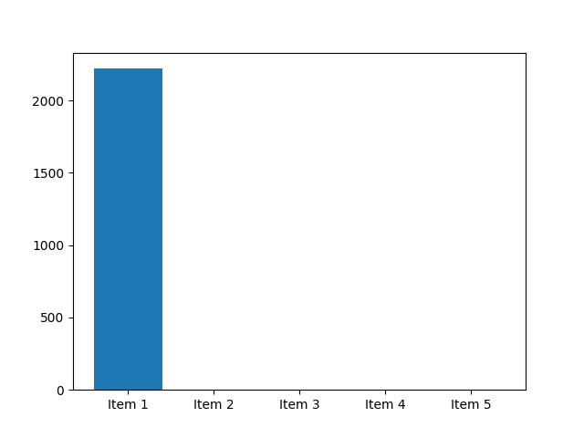
Key Insight 1
Modern Computing Systems Design (CSE 2221) 3rdSEMESTER –CSE (AIML, DS, IOT, CYSC)Chapter -3 : Processor Element ❖This chapter introduces the conceptual design and core functionality of a modern processor, focusing on the internal mechanisms that allow it to execute instructions, manage data, and communicate with the outside world.Chapter -3 : Processor Element The following topics will be covered in this chapter: ❖A simple processor ❖The instruction set ❖ Addressing modes ❖ Instruction categories ❖ Interrupt processing ❖ Input/output operationsChapter -3 : Processor Element ❖A Simple Processor Central Processing Unit (CPU)Chapter -3 : Processor Element ❖A Simple Processor ❖The fundamental architectural units common to almost all CPUs: ❑Control Unit : ▪Acts as the brain of the processor.
▪Decodes the instructions to determine the required operation.
▪Generates control signals to coordinate the ALU, registers, and other components to execute the instruction.

Slide 2
Key Insight 2
▪Manages the sequence of execution.Chapter -3 : Processor Element ❑Control Unit : Chapter -3 : Processor Element ❑Control Unit : ❖ Executing an Instruction: Chapter -3 : Processor Element ❑Arithmetic Logic Unit (ALU) : ▪The execution unit for all computational tasks.
▪Performs Arithmetic Operations (addition, subtraction, multiplication, division).
▪Performs Logical Operations (AND, OR, NOT, XOR).
Chapter -3 : Processor Element ❑ALU Unit : Example: ADC and SBC instructions Chapter -3 : Processor Element ❑Registers : ▪Small, ultra-fast storage locations located inside the CPU .

Slide 3
Key Insight 3
▪They hold data, addresses, and status information actively being used by the current instruction .
▪Types include general -purpose registers (for data manipulation), program counter (holds the address of the next instruction), and status/flag registers (reflect results of operations) .Chapter -3 : Processor Element ❑Registers : ❖RISC Architecture vs CISC Architecture : RISC CISC It stands for Reduced Instruction Set Computer.It stands for Complex Instruction Set Computer.
It is a microprocessor architecture that uses small instruction set of uniform length.This offers hundreds of instructions of different sizes to the users.
These simple instructions are executed in one clock cycle.This architecture has a set of special purpose circuits which help execute the instructions at a high speed.

Slide 4
Key Insight 4
These chips are relatively simple to design.

Slide 5
Key Insight 5
More numbers of registers Less number of registersChapter -3 : Processor Element ❑Registers : ❖RISC Architecture vs CISC Architecture : RISC CISC Most of the operations are based on registers which reduces the need to access memoryMost of the operations are memory based It has less number of instructions.
It has fixed -length encodings for instructions.
It has variable -length encodings of instructions.

Slide 6
Key Insight 6
The instructions interact with memory using complex addressing modes.
Separate LOAD/Store instructions are used to access memory operand.No Separate LOAD/STORE instructions are available Examples of RISC chips include ARM, RISC -VExamples of CISC include x86 ArchitectureChapter -3 : Processor Element ❑Addressing Modes: oThe way in which an operand is denoted in an instruction is known as addressing modes.
o Addressing modes are techniques used by the CPU to identify the location of the operand(s) needed for executing an instruction.

