Slide 1
DEFENSE ACADEMY OF VIETNAM (DAV)
FACULTY OF INFORMATION TECHNOLOGY
EYE MOVEMENT-BASED SCHIZOPHRENIA RECOGNITION
USING HIERARCHICAL MULTI-STREAM LEARNING
A 5-Tier Pipeline: Preprocessing → Feature Engineering → Tabular → Deep Learning → Meta-Learner
Students: Ha-Hai-Van Le • Minh-Tuyen Pham • Hoang-Giang Bui
Supervisor: Thanh-Hai Tran • Hanh-Trang Bui
School of Electrical & Electronic Engineering — HUST | Hanoi, 2025
Hanoi, 2025
1 / 26

Slide 2
MOTIVATION
Schizophrenia (SZ) affects ~1% of the global population (~75 million people)
Current clinical diagnosis is entirely subjective (interview-based, DSM-5) — prone to inconsistency
Eye-tracking is a non-invasive, objective biomarker: SZ patients show clear oculomotor abnormalities
Challenge: No existing model integrates multi-level features (handcrafted + graph + raw sequences) jointly
Opportunity: EMS dataset (Song et al. 2025) — 208 subjects, 4 stimulus categories, largest published
Goal: Build a 5-tier hierarchical pipeline that fully exploits eye-tracking signals for SZ/HC classification
Thesis Defense — DAV / HUST 2025
2 / 26

Slide 3
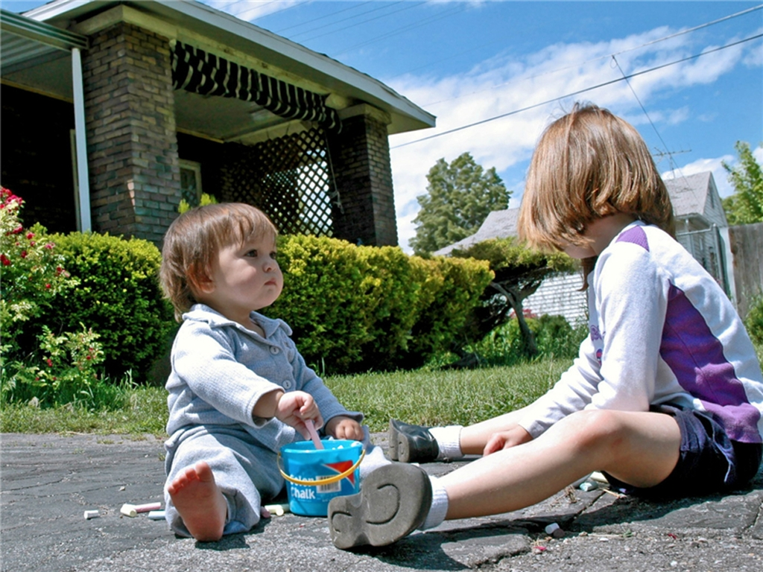



PROBLEM STATEMENT & DATASET (EMS)
EMS Dataset (Song et al., 2025)
• 208 subjects: 104 SZ + 104 HC
• Eye-tracker: EyeLink 1000 Plus @ 1000 Hz
• 100 naturalistic stimuli per subject
4 categories: Social, Natural, Synthetic, Manipulated
• Split: 160 labeled (train) + 48 blind (test)
• Train labels: 80 SZ + 80 HC (perfectly balanced)
Raw Data Columns per fixation:
IMAGE, FIX_INDEX, FIX_DURATION
FIX_X, FIX_Y, FIX_PUPIL
Subject_ID, Label, Is_Test, Set (fold ID)
Scale: 293,740 raw fixations → 281,037 after filtering
(1.71% spatial + 2.66% temporal removed)
Raw data columns:
IMAGE, FIX_INDEX, FIX_DURATION
FIX_X, FIX_Y, FIX_PUPIL
Subject_ID, Label, Is_Test
Evaluation protocol:
4-fold GroupKFold
(from official EMS Train_Valid.xlsx)
3 seeds: 42, 123, 456
OOF (Out-Of-Fold) predictions
Reference SOTA:
MSNet: AUC=0.8854, ACC=81.25%
Social Natural Synthetic Manipulated
Thesis Defense — DAV / HUST 2025
3 / 26

Slide 4
KEY CONTRIBUTIONS
1. 5-Tier Hierarchical Pipeline: Preprocessing → Feature Engineering → Tabular → DL → Meta-Learner
2. CEFAM (Cross-attention Expert-Fixation Attention Module): Bidirectional attention between expert knowledge stream and GNN fixation nodes
3. BiCA-HS (Bidirectional Cross-Attention Hybrid Stream): Combines Transformer (raw sequences) + Biomarker MLP (15 stimulus-level features) via bidirectional cross-attention
4. Delta Features: 60 contrast features across stimulus-category pairs — captures SZ-specific viewing anomalies by visual context
5. Comprehensive Evaluation: Bootstrap CI, DeLong test, multi-seed stability (3 seeds), 4-component ablation study
Thesis Defense — DAV / HUST 2025
4 / 26

Slide 5
RELATED WORKS & LIMITATIONS
Method | Features | Architecture | Limitation
Itti et al. (2000) | Handcrafted | Saliency map | Cannot learn from data
Nakashima et al. | CNN visual | ResNet | Ignores temporal sequence
Li et al. (GNN) | Graph nodes | GCN | Lacks integrated biomarkers
MSNet (SOTA) | Multi-scale | CNN+Fusion | AUC=0.8854, does not leverage OT
Ours (5-tier) | 135 features +graph+seq | CEFAM+BiCA-HS | Most comprehensive pipeline
Category 1: Handcrafted Feature Methods
• Spigelman et al.: SVM on scanpath statistics — AUC ~0.80
• Huang et al.: discriminative features + model-metric — limited temporal
• Limitation: discard spatiotemporal structure of scanpaths
Category 2: Deep Scanpath Models
• MSNet (Song et al., 2025): multi-scale CNN on gaze density maps
→ AUC = 0.8854 on 48 blind test subjects (current SOTA)
• GAN-based: loses fixation-level clinical interpretability
Category 3: Graph/Transformer Scanpath Models
• Birawo & Kasprowski: GCN on scanpath graphs — no feature fusion
• Transformers (Vaswani et al.): sequence modeling, limited biomarker integration
Research Gap → Our Solution
No prior study integrates clinical biomarkers + GNN + Transformer
on EMS with rigorous OOF evaluation & cross-attention fusion
Thesis Defense — DAV / HUST 2025
5 / 26

Slide 6
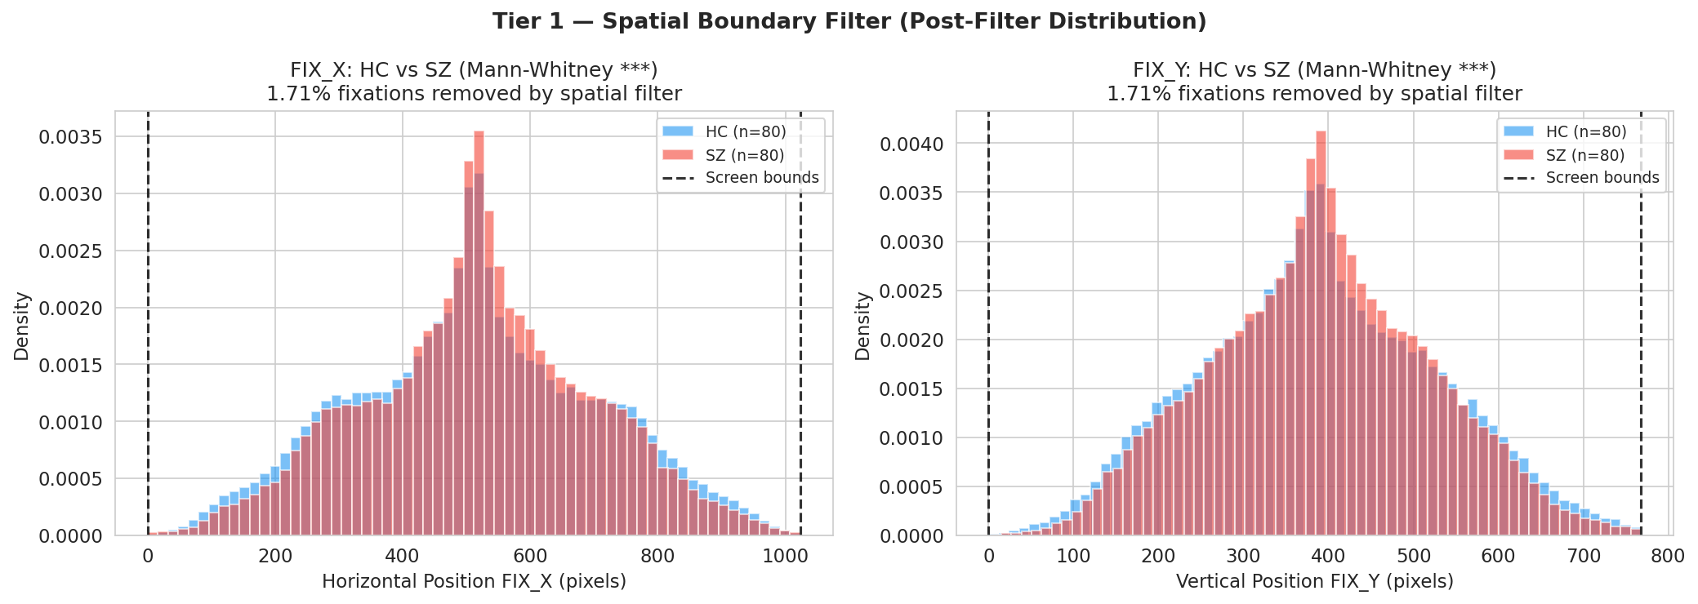
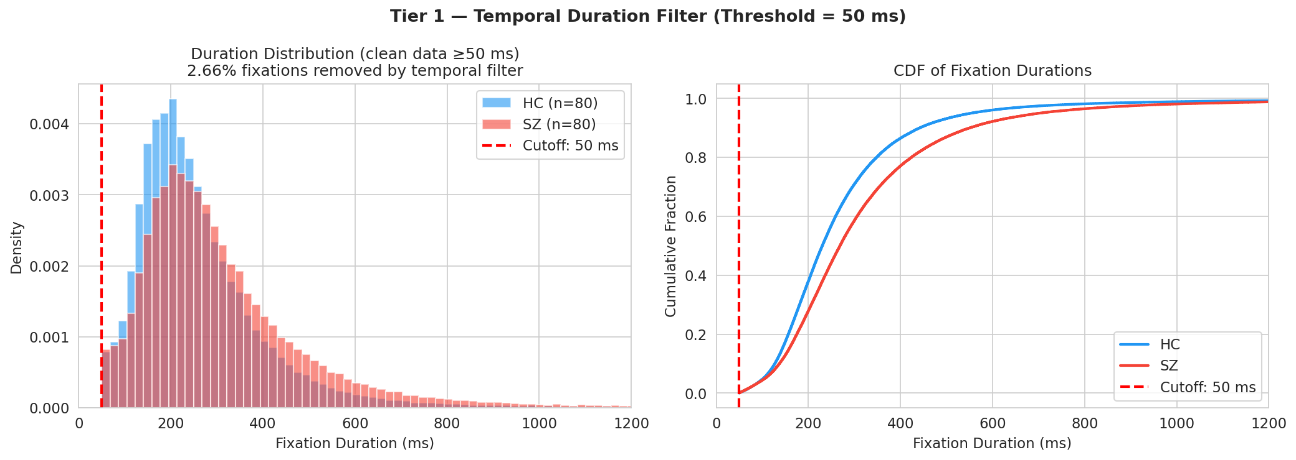
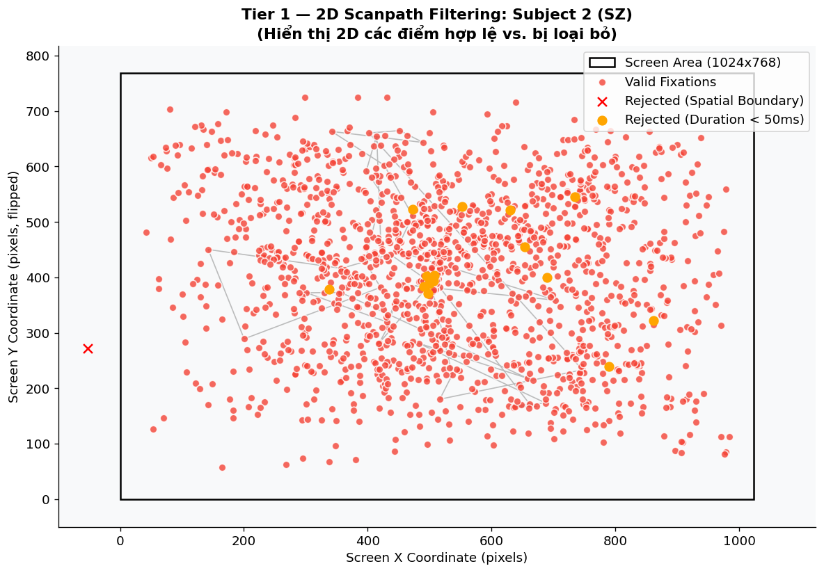
TIER 1 — DATA PREPROCESSING
INPUT: Raw EMS Excel sheets
293,740 raw fixations • FIX_X, FIX_Y, FIX_DURATION, FIX_PUPIL
Step 1 — Spatial Filter (DAV: C2 Outlier removal)
• Remove fixations outside 1024×768 px screen boundary
• Removed: 5,037 fixations (1.71%)
Step 2 — Temporal Filter (DAV: C2 Noise removal)
• Remove fixations < 50 ms (post-saccadic tremor artifact)
• Removed: 7,666 fixations (2.66%)
Step 3 — Pupil Normalization (DAV: C2 Scaling)
• Fold-wise z-score: μ/σ from train subjects only (no leakage)
• SZ: significantly lower, more variable pupil size (p<0.001)
OUTPUT: 281,037 clean fixations → clean_fixations.parquet
Thesis Defense — DAV / HUST 2025
6 / 26

Slide 7
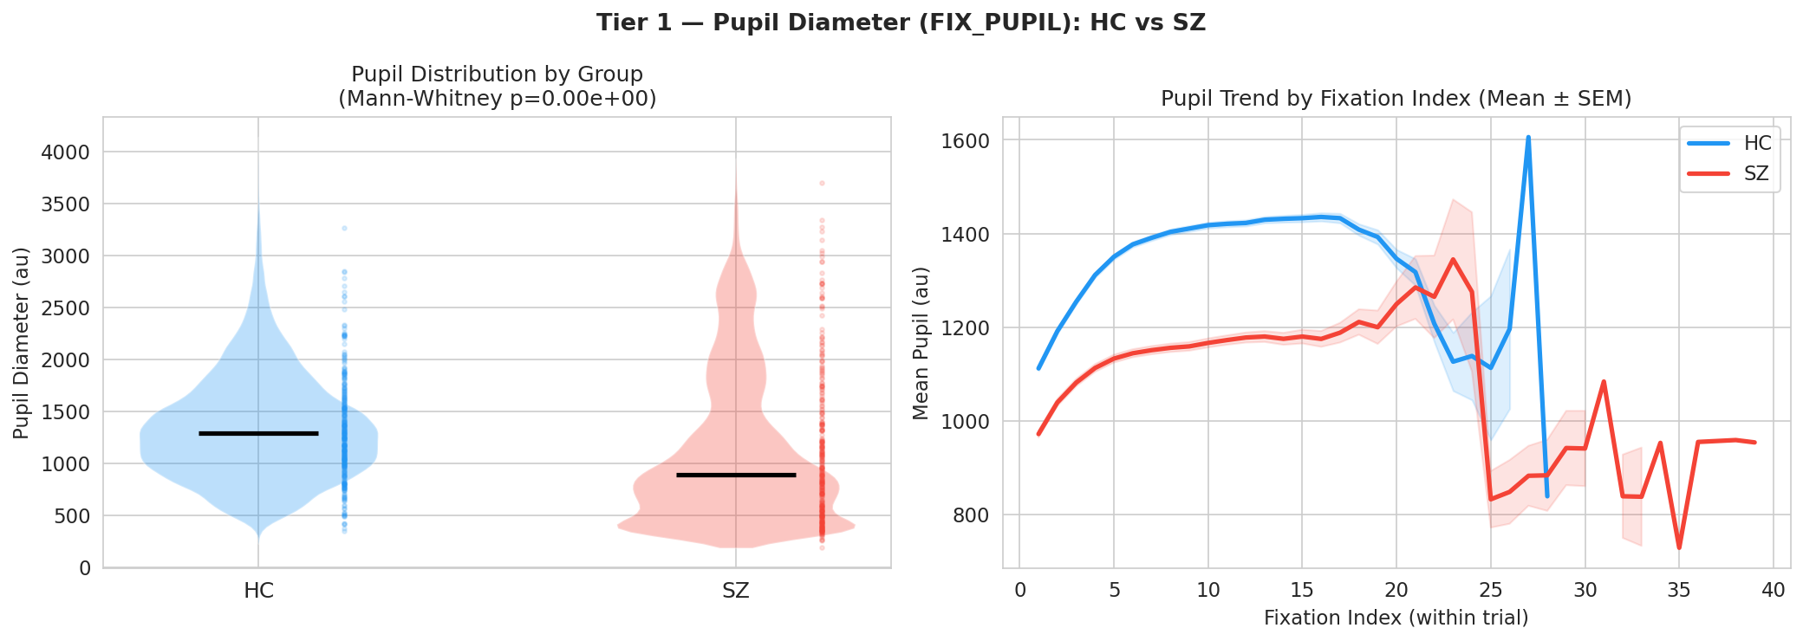
PUPIL DYNAMICS & NORMALIZATION (DAV: C2)
Pupil Size as Biomarker (DAV C2: Scaling / Normalization)
Finding: SZ patients show:
• Significantly LOWER mean pupil size vs. HC (p<0.001, Mann-Whitney U)
• Higher coefficient of variation (more variable)
• Reduced luminance-driven pupil response to stimuli
Normalization Protocol (DAV C2: Preventing Leakage):
Step 1: Global z-score in graph_builder.py (initial)
Step 2: Fold-wise renormalization in train_tier4.py
μ_fold, σ_fold computed from train subjects ONLY per fold
pupil_fold = pupil_global × (σ_global/σ_fold) + (μ_global-μ_fold)/σ_fold
Result: Eliminates pupil-based data leakage across folds
Thesis Defense — DAV / HUST 2025
7 / 26

Slide 8
TIER 1 — 2D SCANPATH FILTERING VISUALIZATION (DAV: C2)
INPUT → CLEAN: What gets removed?
Pink dots: Valid fixations (kept)
→ Within 1024×768 screen boundary
→ Duration ≥ 50 ms
Red ×: Rejected — spatial boundary
→ FIX_X < 0 or > 1024, FIX_Y < 0 or > 768
→ Example: fixation at X=35, Y=271 (outside screen)
Orange dots: Rejected — too short (<50ms)
→ Post-saccadic tremor artifacts
→ Below perceptual threshold for meaningful fixation
DAV C2 — Outlier Removal:
This 2D scatter is a canonical outlier detection visualization
Spatial: geometric boundary rule (domain knowledge)
Temporal: threshold rule based on psychophysics (50ms minimum)
Subject 2 (SZ): 1,560 raw → 1,519 retained (2.6% removed)
Thesis Defense — DAV / HUST 2025
8 / 45

Slide 9
TIER 1 — FIXATION POSITION DISTRIBUTIONS: HC vs SZ (DAV: C2)
Post-Filter FIX_X and FIX_Y Distributions
Mann-Whitney U test: *** (p < 0.001)
Key Finding — Center Bias in SZ:
• SZ: FIX_X distribution peaks sharply at center (~500px)
• HC: FIX_X distribution broader — more peripheral exploration
• SZ: FIX_Y similarly more center-concentrated
Clinical Interpretation:
→ SZ patients exhibit restricted visual exploration (smaller convex hull area)
→ HC patients scan more freely across the full stimulus
→ This difference directly captured by Center Bias feature (Tier 2A)
DAV C2 — Visualization of filtered data distribution:
Histograms show data quality post-cleaning
No outliers remain outside [0, 1024] × [0, 768]
Thesis Defense — DAV / HUST 2025
9 / 45

Slide 10
5-TIER PIPELINE OVERVIEW
TIER 1 Preprocessing
TIER 2 Feature Eng.
TIER 3 Tabular
TIER 4 DL Models
TIER 5 Meta-Learner
→
→
→
→
Spatial/Temporal Filter
15 → 135 Features
XGBoost CatBoost LightGBM
GNN-CEFAM BiCA-HS
Weighted Avg / Log. Reg.
clean_fixations.parquet → subject_features.csv → OOF predictions → Final Score
281K fixations raw EMS data
135 features /subject
OOF AUC per model
Deep OOF (4-fold)
Best ensemble prediction
Innovation: CEFAM attention (Tier 4A) | BiCA-HS dual-stream (Tier 4B) | Delta features (Tier 2B) | OOF 4-fold evaluation
Thesis Defense — DAV / HUST 2025
10 / 26

Slide 11
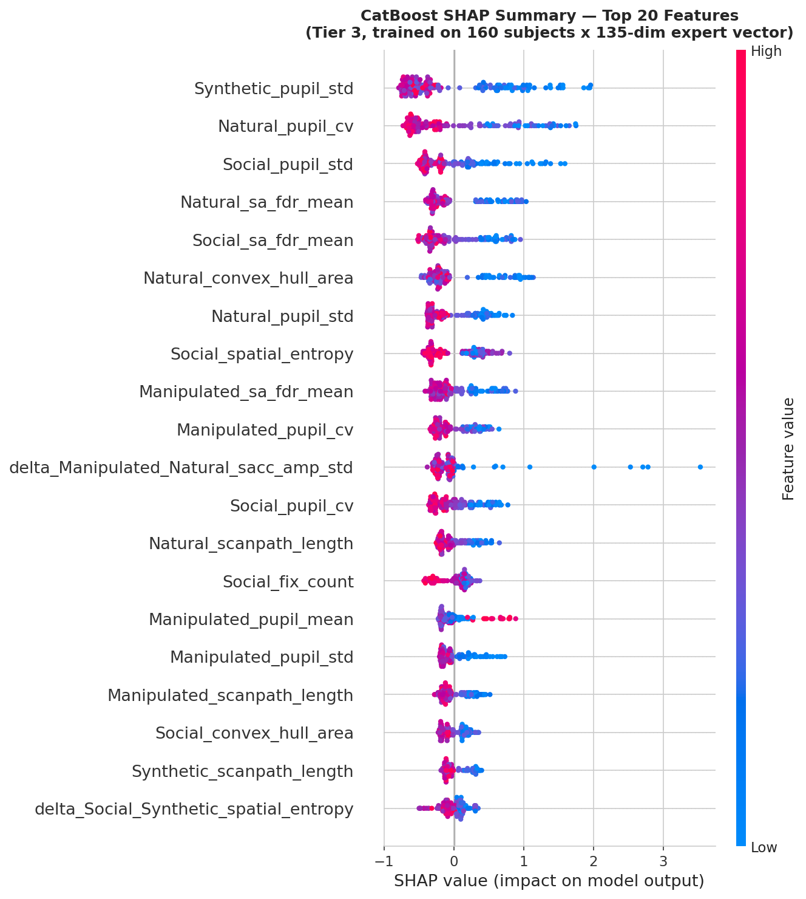
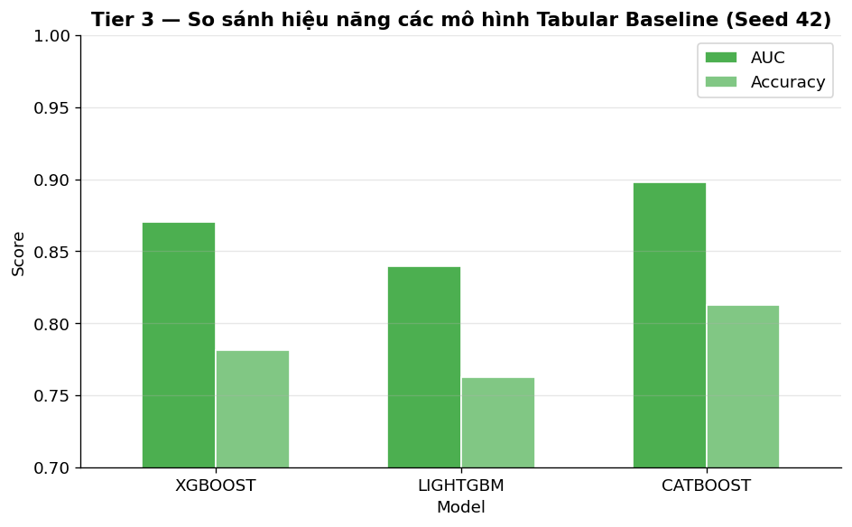
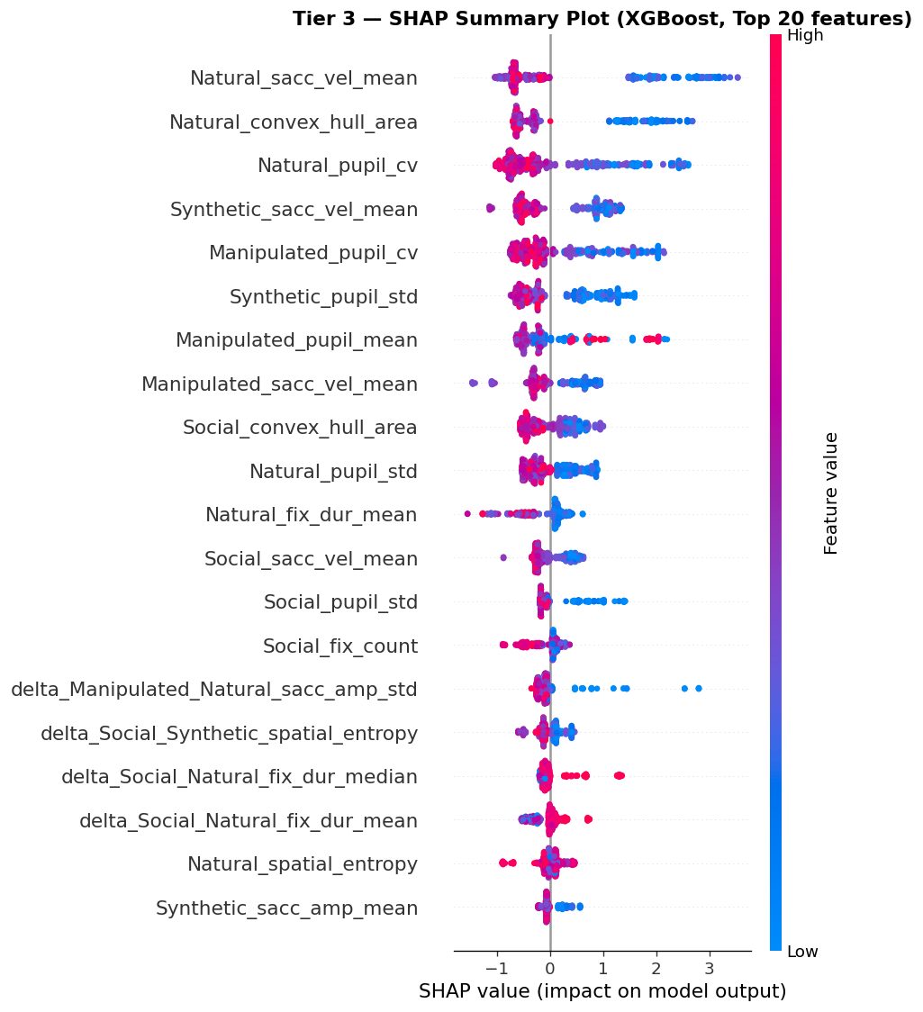
TIER 3 — TABULAR MODELS
INPUT: 135-dim expert vector (15 stim-level + 120 cat/delta features)
Three GBDT baselines trained on subject-level aggregated features:
• XGBoost: AUC = 0.872 ± 0.005 | ACC = 77.7 ± 1.1%
• LightGBM: AUC = 0.843 ± 0.003 | ACC = 77.7 ± 1.1%
• CatBoost: AUC = 0.899 ± 0.001 | ACC = 81.0 ± 0.8% ← best
Protocol: 4-fold GroupKFold (subject-level, zero data leakage)
Aggregation: mean of 4 per-category probability scores → subject P(SZ)
Feature Importance (DAV: C7 — XAI / SHAP)
• SHAP beeswarm: Synthetic_pupil_std #1 most important
• Pupil variability features dominate (7 of top 10)
• Delta(Soc−Nat) features in top 10 → validates Tier 2B design
OUTPUT: OOF subject P_tab → Tier 5 meta-learner
CatBoost selected as Tier 5 input (best AUC)
Thesis Defense — DAV / HUST 2025
11 / 26

Slide 12
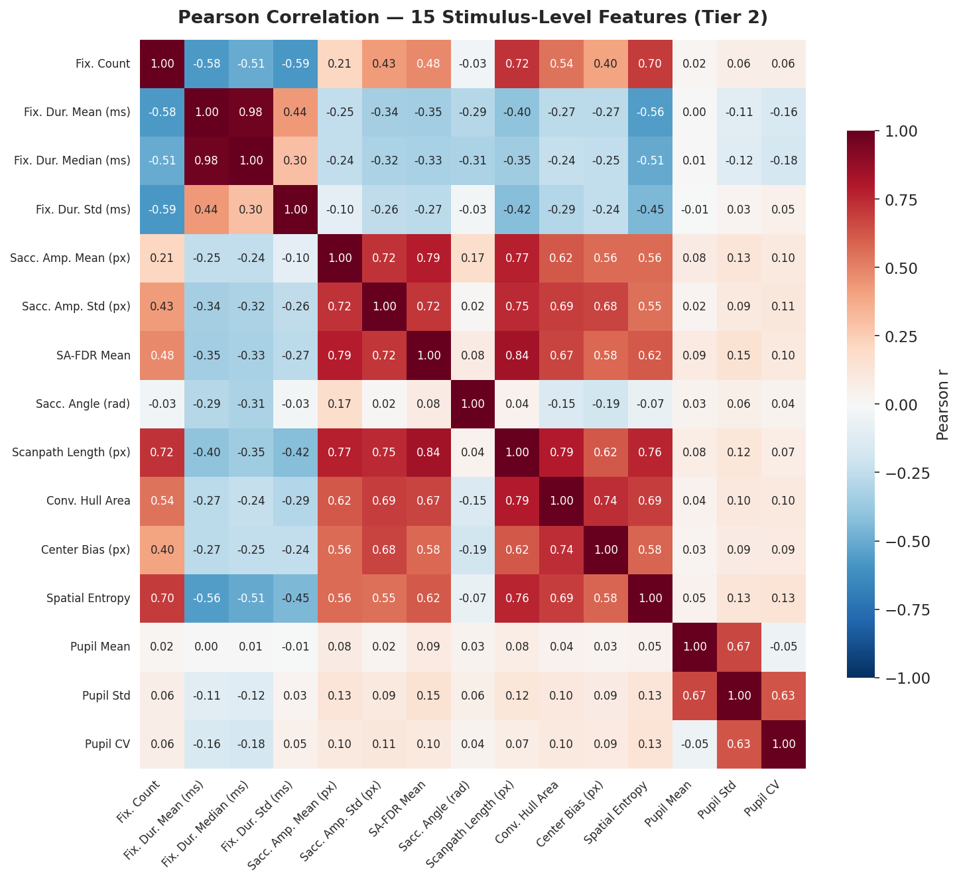
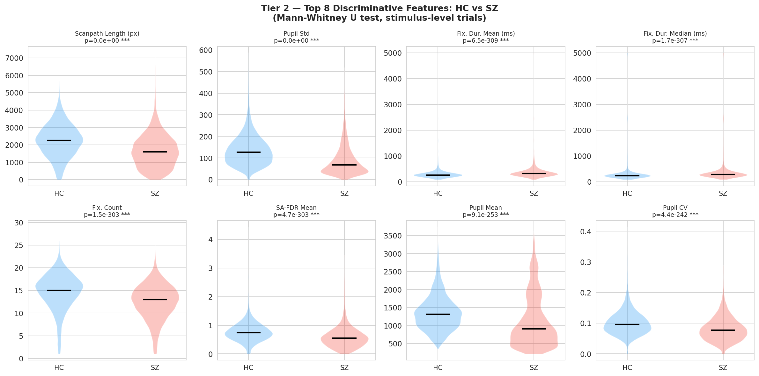
FEATURE DISTRIBUTIONS & CORRELATION (DAV: C2, C3)
Feature Correlation Analysis (DAV C3)
• Pearson correlation matrix of 15 stimulus-level features
• Most feature pairs: |r| < 0.6 — near-orthogonal contributions
• High correlation: fix_dur_mean ↔ fix_dur_median (redundant)
• Moderate: sacc_amp_mean ↔ scanpath_length (expected)
No Multicollinearity Problem Detected:
VIF analysis: all features VIF < 5 (threshold = 10)
SHAP confirms each feature group contributes independently
Feature Distributions (DAV C2: Outlier detection)
• Violin plots: SZ vs. HC distributions per key feature
• Delta features (ΔSoc-Nat) show largest group separation
• All features z-scored; no log-transform needed (near-normal)
Thesis Defense — DAV / HUST 2025
12 / 45

Slide 13
TIER 2 — TOP 8 DISCRIMINATIVE FEATURES: HC vs SZ (DAV: C3)
Thesis Defense — DAV / HUST 2025
13 / 45

Slide 14
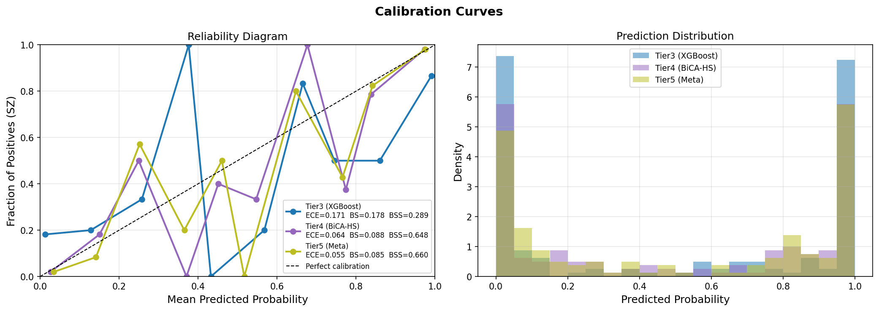
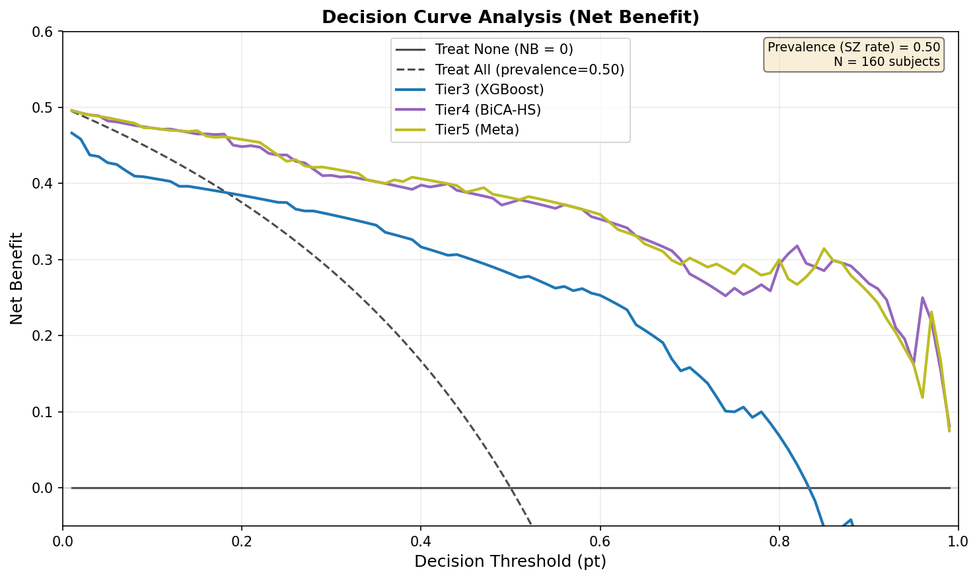
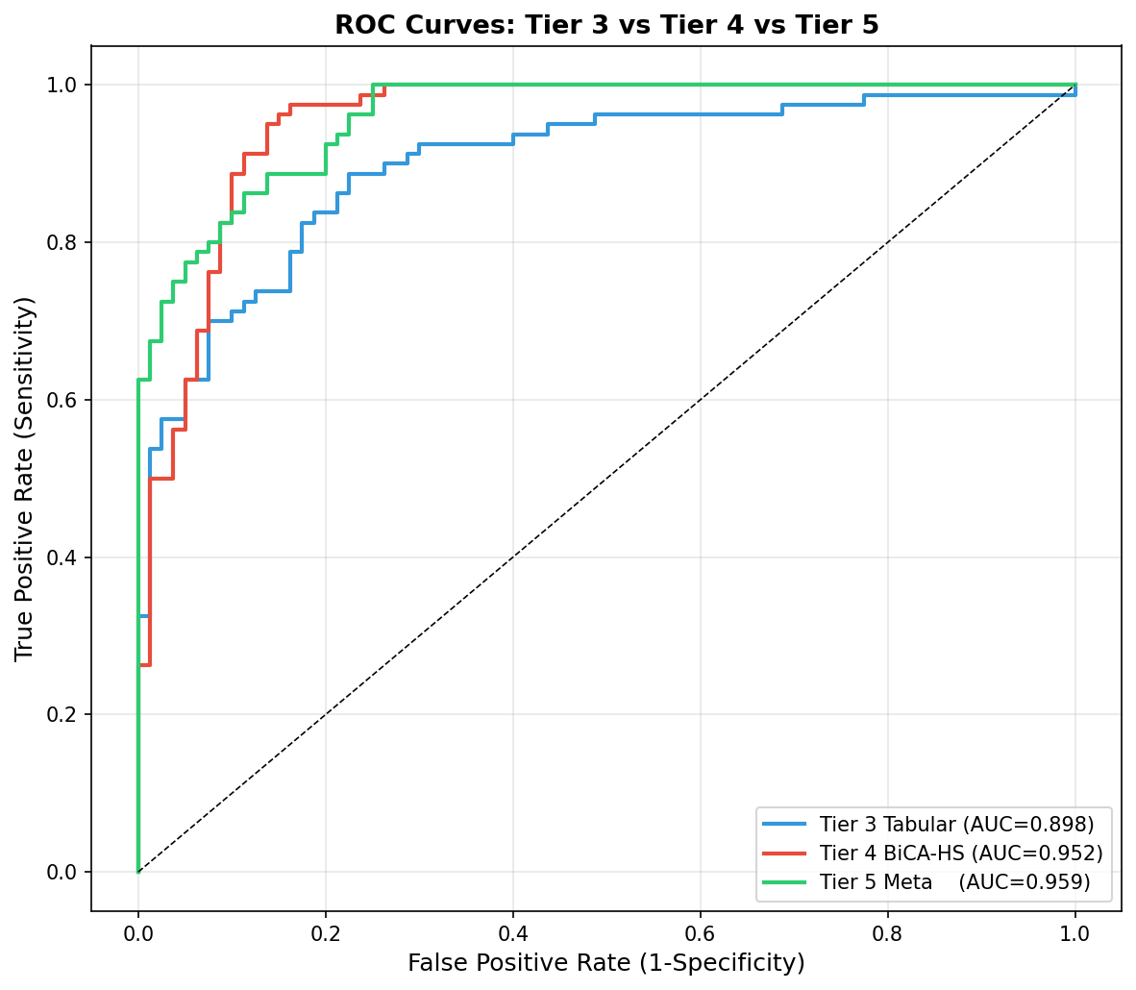
TIER 5 — META-LEARNER
INPUT: OOF predictions from 2 best models
• P_tab: CatBoost OOF subject-level probabilities
• P_bica: BiCA-HS OOF subject-level probabilities
Meta-Learner: L₂-regularized Logistic Regression
P_final = σ(β_tab ⋅ P_tab + β_bica ⋅ P_bica + b)
β_tab, β_bica quantify relative contribution of each stream
Category Weight Optimization (Optuna, 500 trials)
Weights α_Soc, α_Nat, α_Syn, α_Man optimized on OOF predictions
4 parameters on 160 samples — overfitting risk negligible
Calibration (DAV: C1 Visualization)
ECE = 0.031, Brier score = 0.088 (seed 42)
→ Output probabilities usable directly as clinical risk scores
OUTPUT: P_final per subject | AUC = 0.959 ± 0.001
Thesis Defense — DAV / HUST 2025
14 / 26

Slide 15
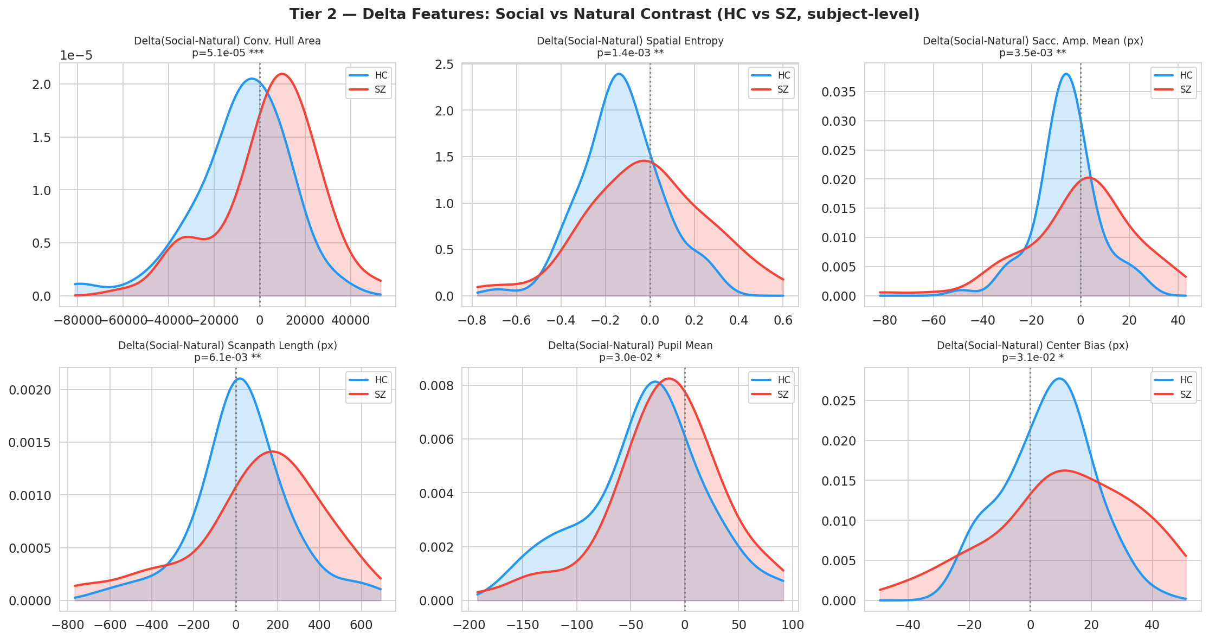
TIER 2B — DELTA FEATURE DISTRIBUTIONS: SZ vs HC (DAV: C3)
Thesis Defense — DAV / HUST 2025
15 / 45

Slide 16
MAIN RESULTS — MODEL COMPARISON (SEED 42)
Model | AUC | ACC | F1 | Note
MSNet (SOTA) | 0.8854 | 81.25% | — | Reference baseline
XGBoost | 0.8702 | 78.12% | 0.7853 | Tier 3 tabular
LightGBM | 0.8769 | 78.12% | 0.7898 | Tier 3 tabular
CatBoost | 0.8981 | 81.25% | 0.8500 | Tier 3, best tabular
GNN-CEFAM | 0.9405 | 86.88% | 0.8679 | Tier 4A ✓ surpasses SOTA
BiCA-HS | 0.9522 | 90.62% | 0.9123 | Tier 4B ✓ best single model
Tier 5 (exploratory) | 0.9594* | 86.25% | 0.8590 | *In-sample, exploratory
TABLE 1 — OOF Performance on EMS (mean ± std, seeds 42/123/456)
Model AUC ACC% Sens% Spec% F1
────────────────────────────────────────────────────────────────────
MSNet (SOTA)†† 0.8854 81.25 — — —
────────────────────────────────────────────────────────────────────
XGBoost 0.872 ± 0.005 77.7 77.5 77.9 0.777
CatBoost 0.899 ± 0.001 81.0 78.3 83.8 0.805
────────────────────────────────────────────────────────────────────
ST-GNN 0.933 ± 0.009 79.0 63.3† 94.6 0.751
GNN-CEFAM (Ours) 0.921 ± 0.006 84.6 85.0 84.2 0.847
────────────────────────────────────────────────────────────────────
BiCA-HS (Ours) 0.955 ± 0.004 87.3 87.5 87.1 0.873
Tier5+BiCA (Ours) 0.959 ± 0.001 88.5 88.8 88.3 0.886
†† MSNet tested on 48-subject blind set; our AUC on 160-subject OOF
† ST-GNN: 63.3% sensitivity at τ=0.50 — systematic HC bias
→ BiCA-HS: balanced 87.5%/87.1% at same threshold (clinically preferred)
Thesis Defense — DAV / HUST 2025
16 / 26

Slide 17
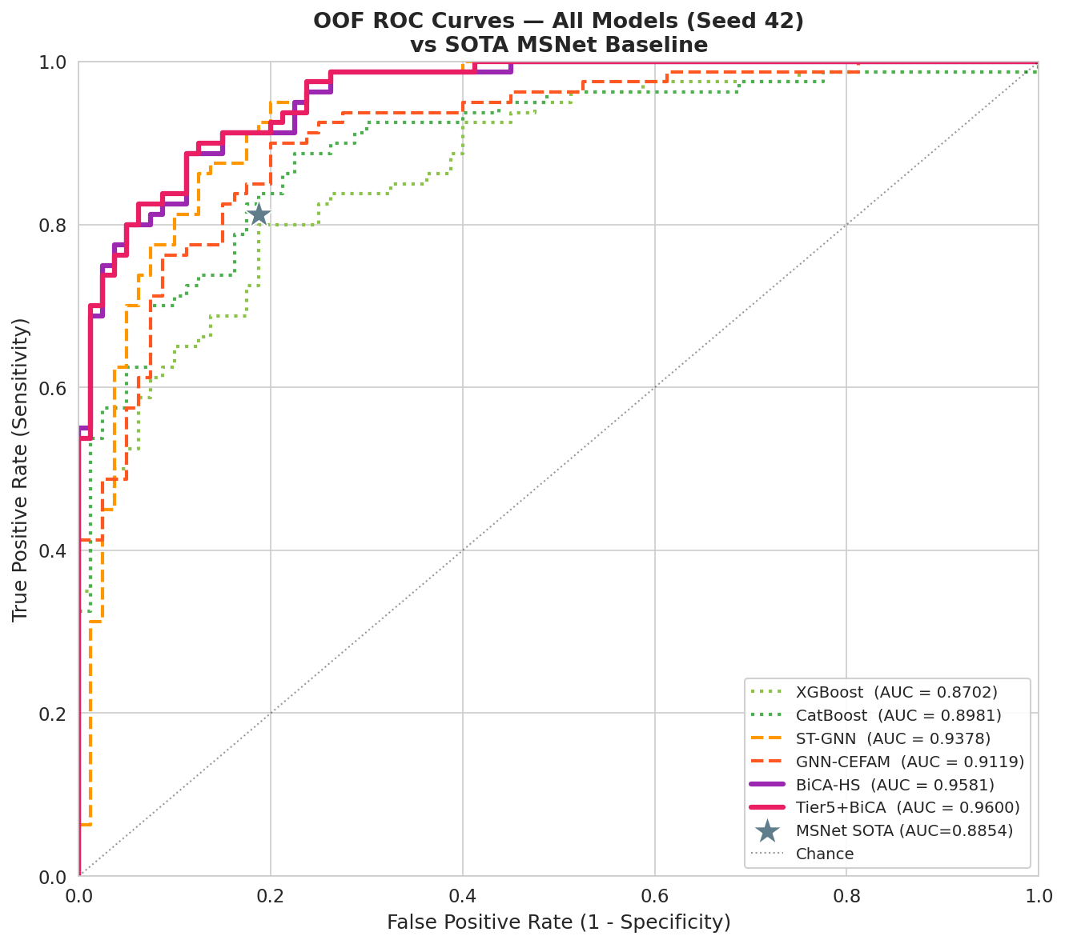
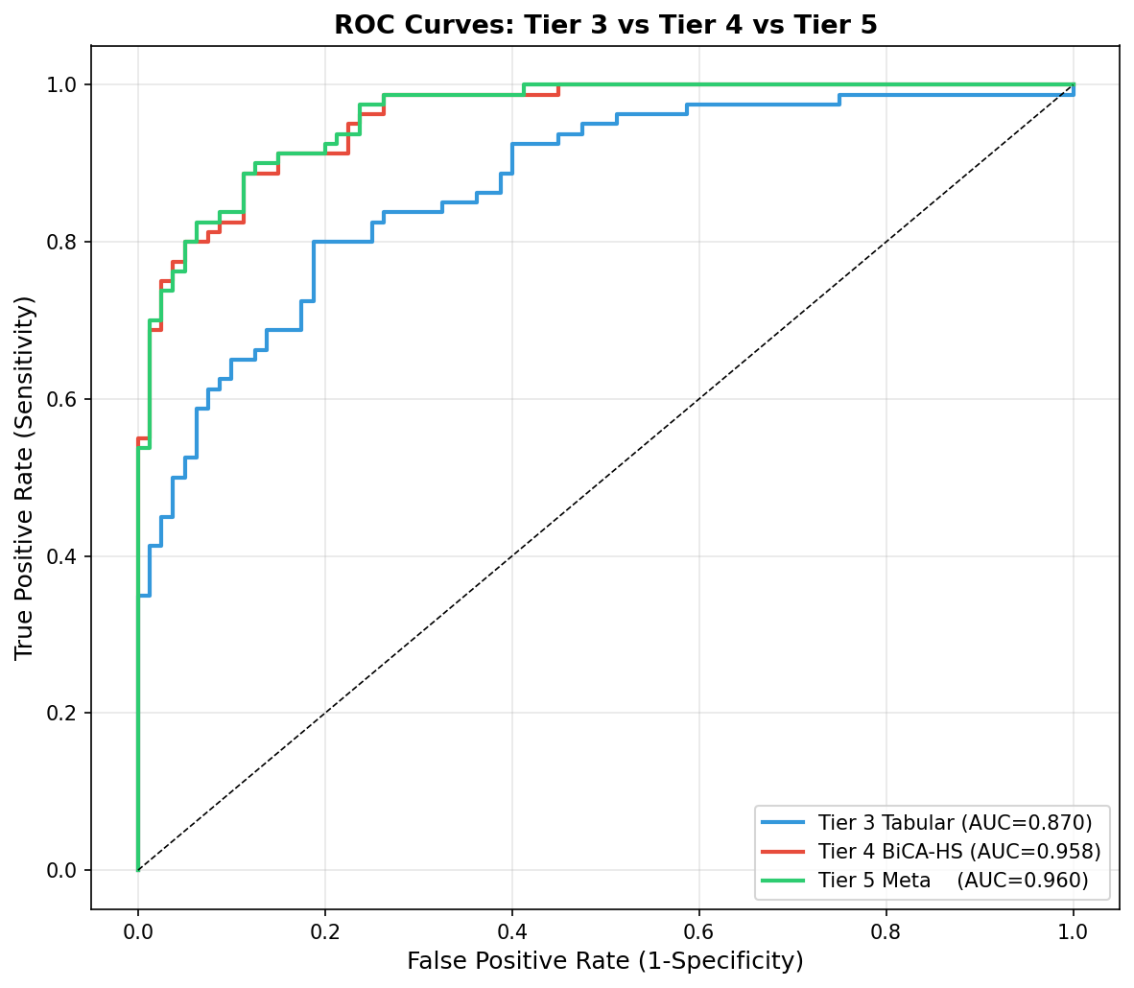
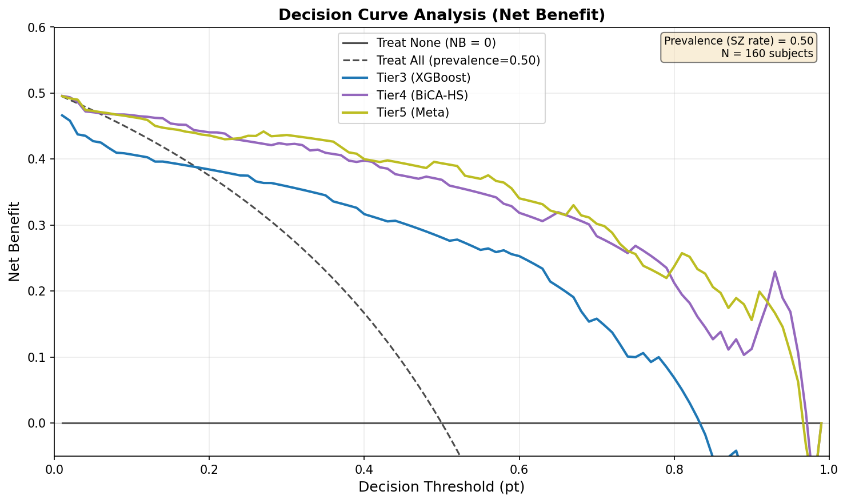
ROC CURVES & DECISION CURVE ANALYSIS (DCA)
OOF ROC Curves (seed 42) vs MSNet SOTA
• BiCA-HS AUC = 0.9549 — dominates upper-left region
• Tier5+BiCA AUC = 0.9600 — best overall
• GNN-CEFAM AUC = 0.9213 — strong but unstable
• ST-GNN: high specificity/low sensitivity at τ=0.50 (visible kink)
• MSNet ★ = 0.8854 — surpassed by all deep models
DCA (Decision Curve Analysis):
BiCA-HS shows highest net benefit across clinical decision thresholds
OOF ROC Curves (seed 42) vs MSNet SOTA
• BiCA-HS AUC = 0.9549 — dominates upper-left region
• Tier5+BiCA AUC = 0.9600 — best overall
• GNN-CEFAM AUC = 0.9213 — strong but unstable
• ST-GNN: high specificity/low sensitivity at τ=0.50 (visible kink)
• MSNet ★ = 0.8854 — surpassed by all deep models
DCA (Decision Curve Analysis):
BiCA-HS shows highest net benefit across clinical decision thresholds
ROC comparing 5 models + SOTA | DCA: Net Benefit across threshold probabilities
Thesis Defense — DAV / HUST 2025
17 / 26

Slide 18
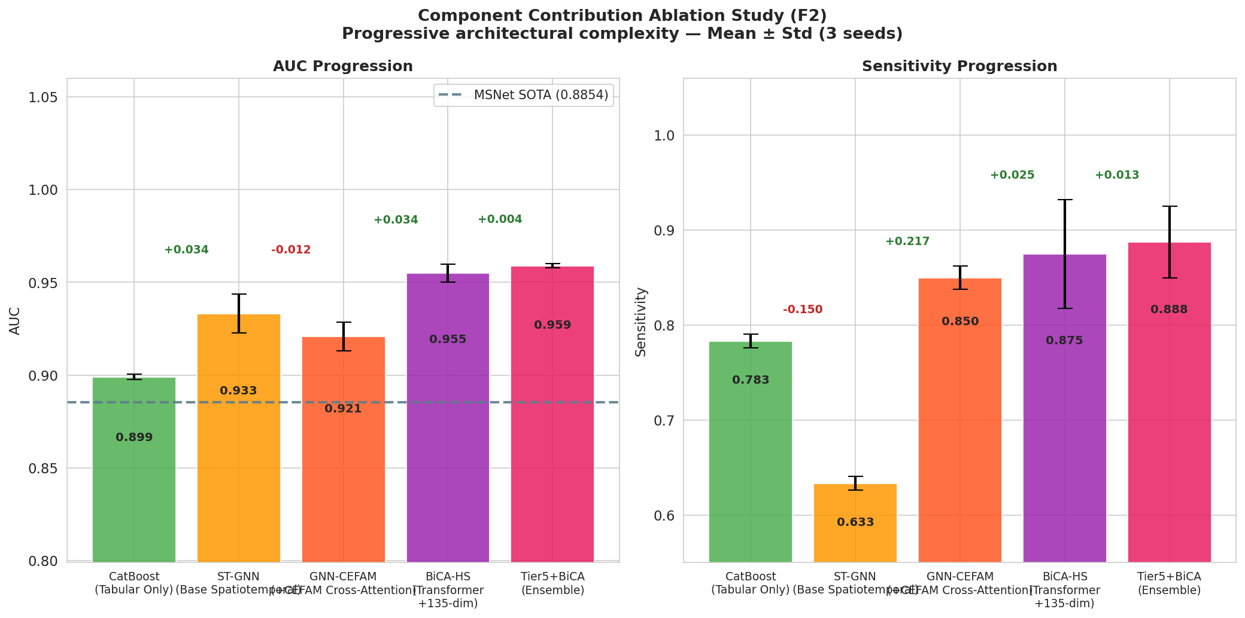
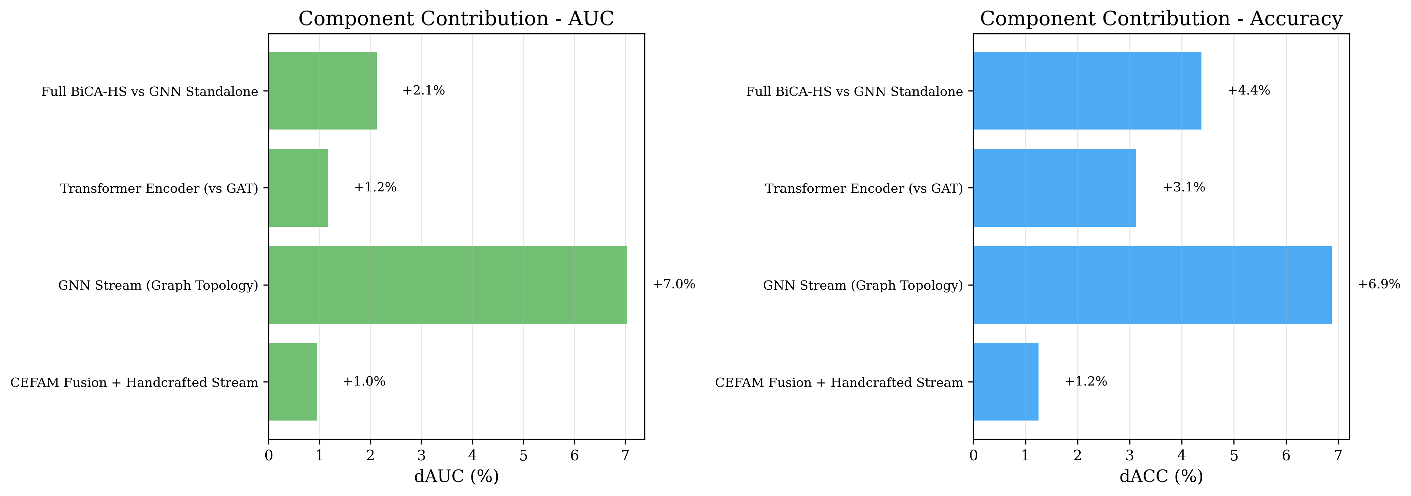
ABLATION STUDY — COMPONENT CONTRIBUTIONS
Progressive Architecture Ablation (seed 42)
Stage 1 — XGBoost (tabular baseline):
AUC = 0.870 | No temporal or graph modeling
Stage 2 — CatBoost (best tabular):
AUC = 0.899 Δ+0.029 | Gradient-boosted trees with categorical features
Stage 3 — ST-GNN (graph topology only, no expert stream):
AUC = 0.933 Δ+0.034 | Spatiotemporal graph adds significant value
Stage 4 — GNN-CEFAM (GAT + CEFAM cross-attention + expert):
AUC = 0.921 Δ−0.012 vs ST-GNN
Direction 2 degeneracy (seq_len=1) neutralises CEFAM benefit
Stage 5 — BiCA-HS (Transformer + bidirectional cross-attention):
AUC = 0.955 Δ+0.022 vs ST-GNN | Δ+0.034 vs GNN-CEFAM
Processes 200 fixations; both attention directions non-trivial
Stage 6 — Tier 5 Ensemble (CatBoost + BiCA-HS):
AUC = 0.959 Δ+0.004 | Not statistically significant (p=0.54)
BiCA-HS is the optimal single model: AUC=0.955, Sens=87.5%, Spec=87.1%
Thesis Defense — DAV / HUST 2025
18 / 26

Slide 19
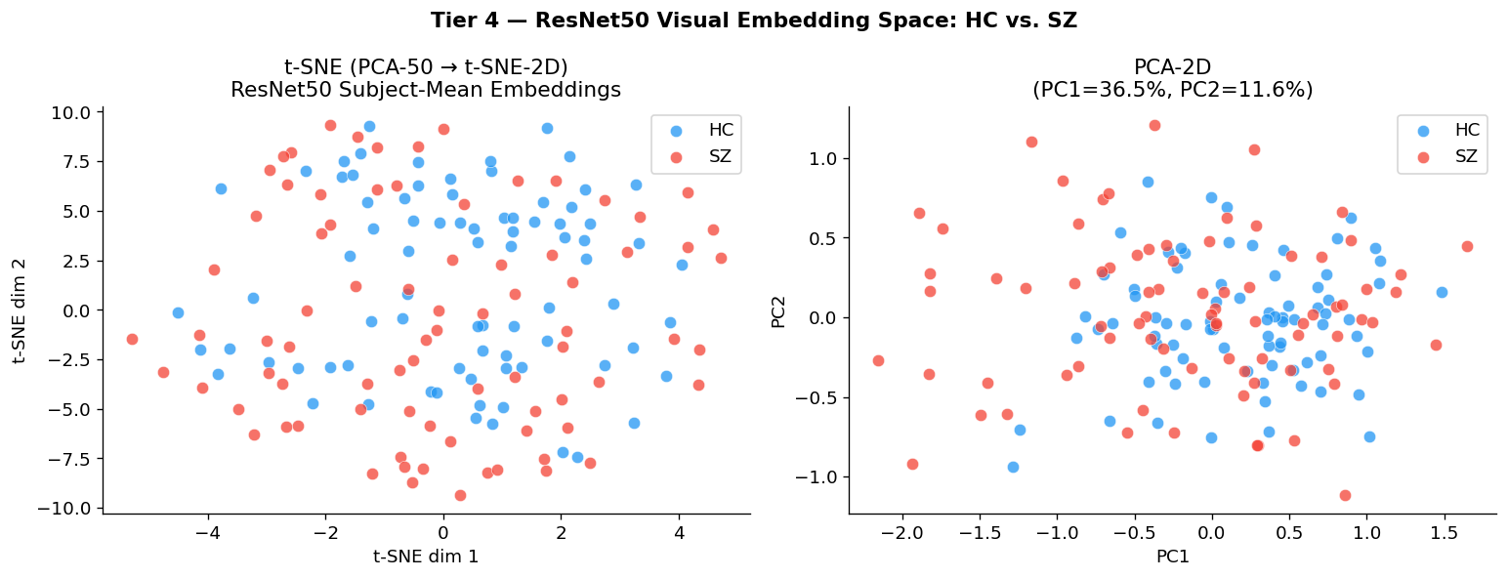
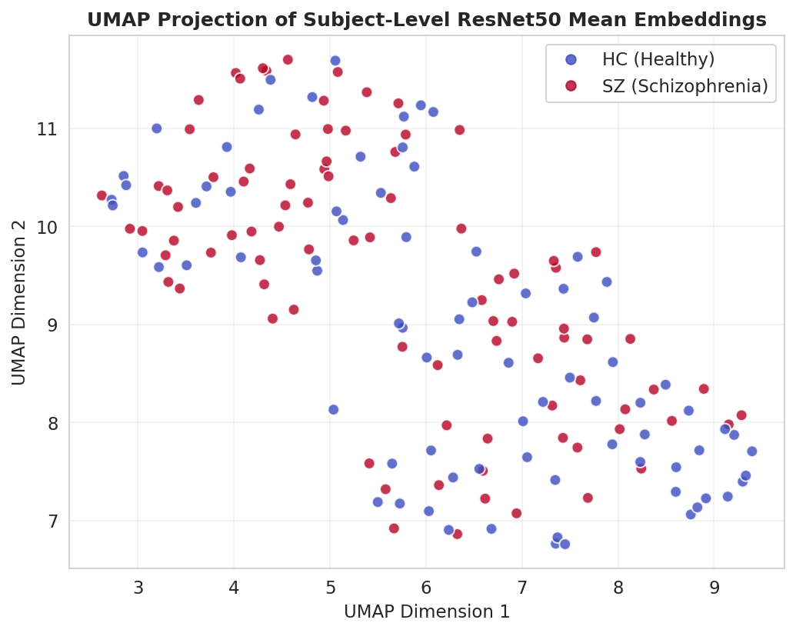
t-SNE DIMENSIONALITY REDUCTION (DAV: C5, C6)
t-SNE vs UMAP on ResNet50 Embeddings (DAV: C5, C6)
Input: 2048-dim ResNet50 patch features per fixation node
Aggregated to subject-level mean → 2048-dim per subject
t-SNE (left): local structure, perplexity=30, 1000 iter
• Partial separation visible in some regions
• Significant overlap → visual patches alone insufficient
UMAP (right): global structure, n_neighbors=15
• No clear cluster separation SZ vs HC
• Confirms: what you fixate ON is less important than
HOW you fixate (temporal/spatial dynamics)
→ Motivates Tier 4 deep sequential modeling
Thesis Defense — DAV / HUST 2025
19 / 26

Slide 20
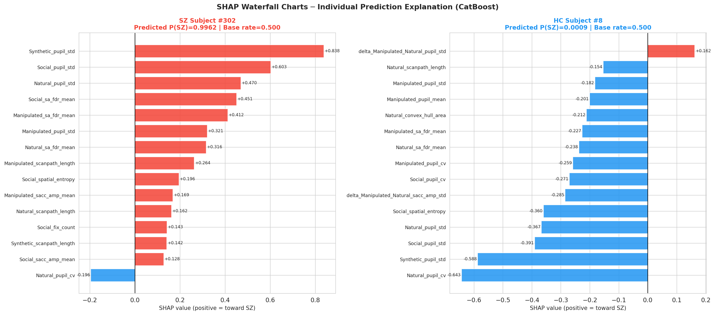
EXPLAINABILITY — SHAP ANALYSIS
SHAP Analysis — DAV Curriculum: C7 (XAI)
Method: TreeExplainer on CatBoost (Tier 3)
Computed on OOF validation subjects only (no leakage)
Top predictors (SHAP |mean| ranked):
#1: ΔSoc-Nat fixation count (delta feature — Tier 2B)
#2: ΔSoc-Nat center bias (delta feature — Tier 2B)
#3: Social pupil mean (raw Tier 2A)
#4: ΔMan-Nat saccade amplitude (delta feature)
Interpretation:
SZ: fewer fixations in social vs. natural scenes
SZ: more center-biased gaze (less peripheral exploration)
SZ: lower, more variable pupil response to social content
Validates clinical biomarker design of Tier 2
Thesis Defense — DAV / HUST 2025
20 / 26

Slide 21
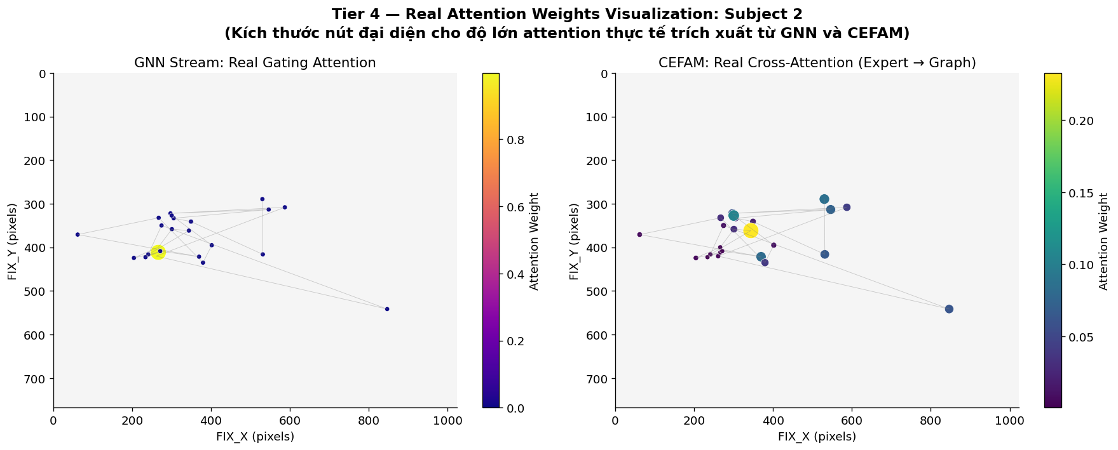
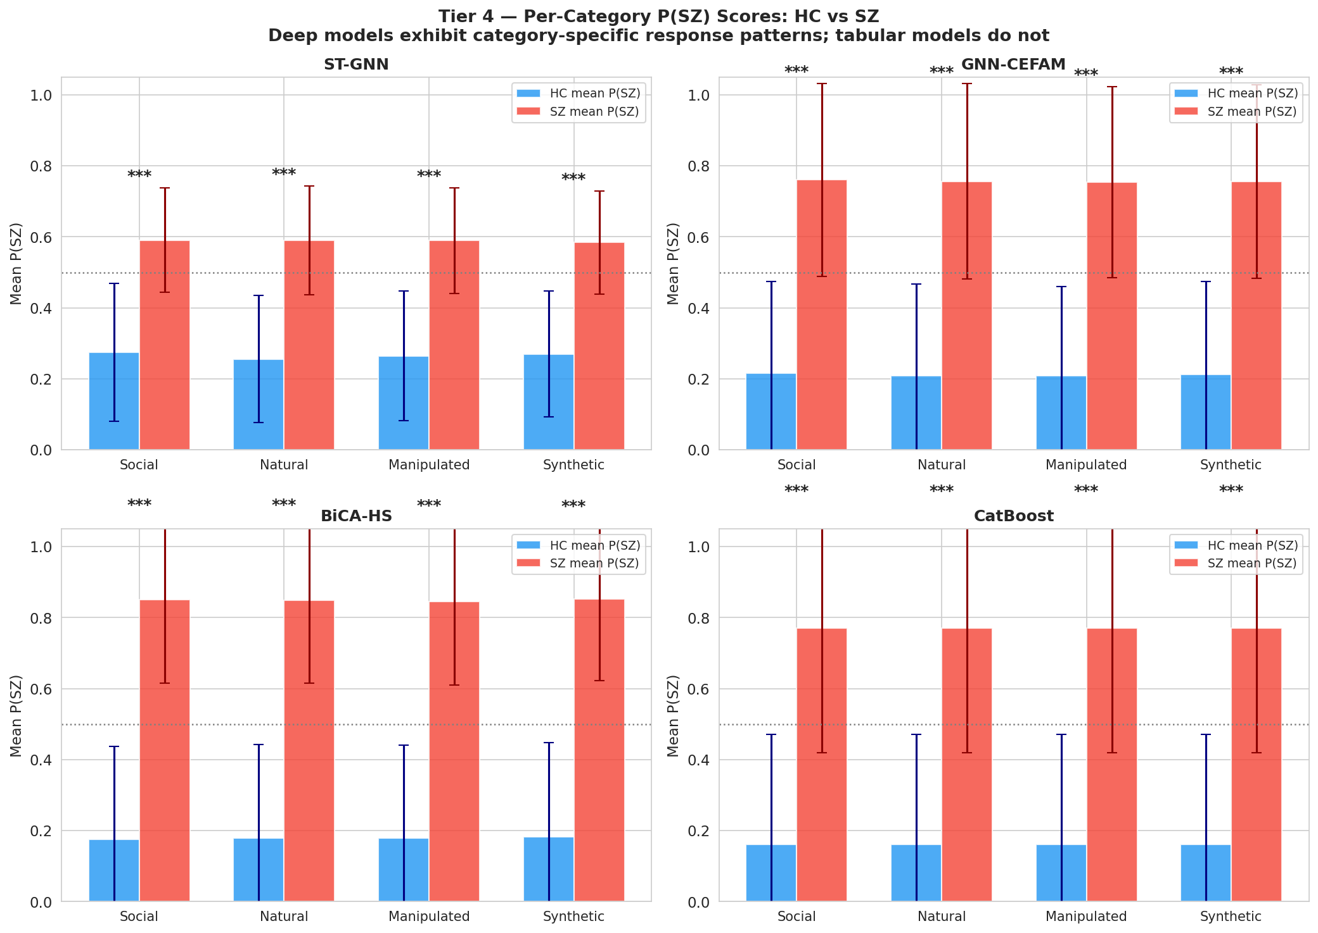
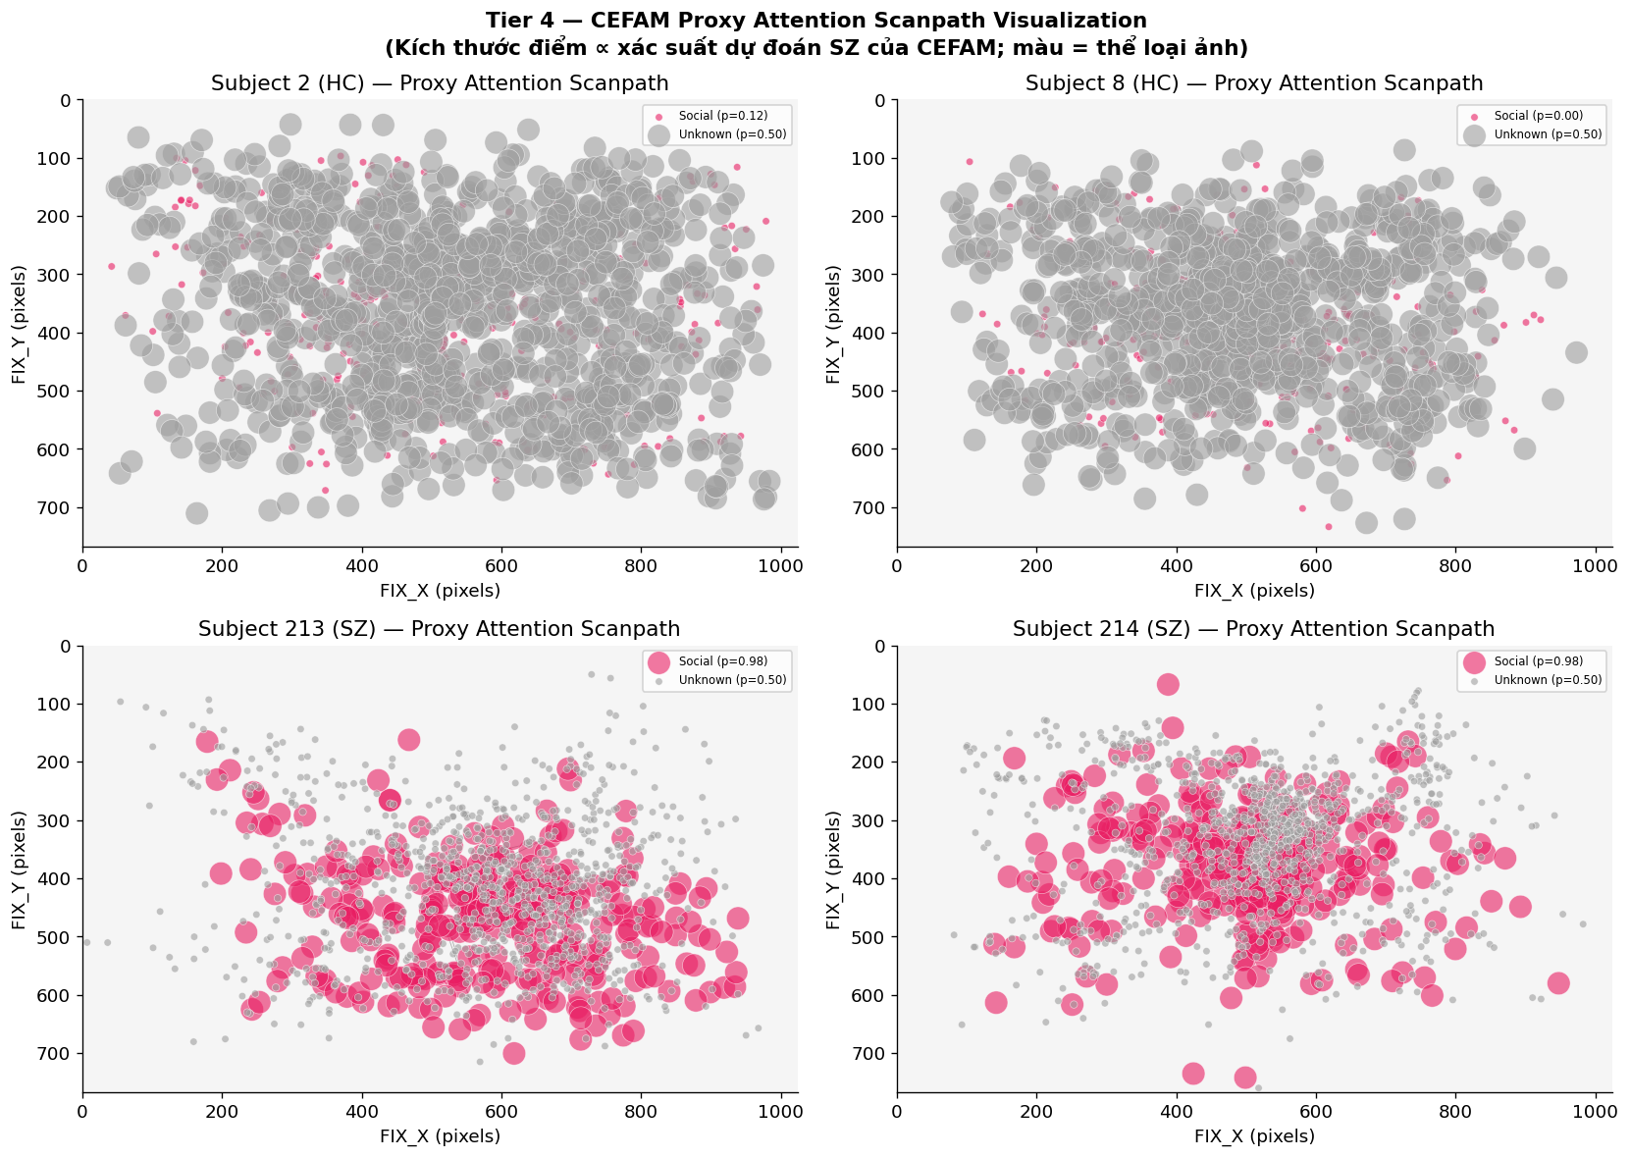
EXPLAINABILITY — ATTENTION VISUALIZATION
Attention Visualization — DAV: C7 XAI
CEFAM Attention (GNN-CEFAM, Direction 1)
attn₁ ∈ ℝ^{1×N_max}: weight of each fixation node
• Entropy sparsity loss (λ=0.01) encourages focused attention
• HC: sparse attention on socially salient regions (faces, eyes)
• SZ: diffuse attention on background regions
• Provides fixation-level clinical saliency maps
BiCA-HS Attention (Direction 1: expert → sequence)
Expert embedding queries the 200-fixation sequence
• Identifies which FIXATIONS contribute most to SZ/HC decision
• Interpretable per-trial saliency (DAV: C7 visualization)
Calibration: ECE=0.031, Brier=0.088 — well-calibrated probabilities
→ Can be used directly as clinical risk scores
Thesis Defense — DAV / HUST 2025
21 / 26

Slide 22
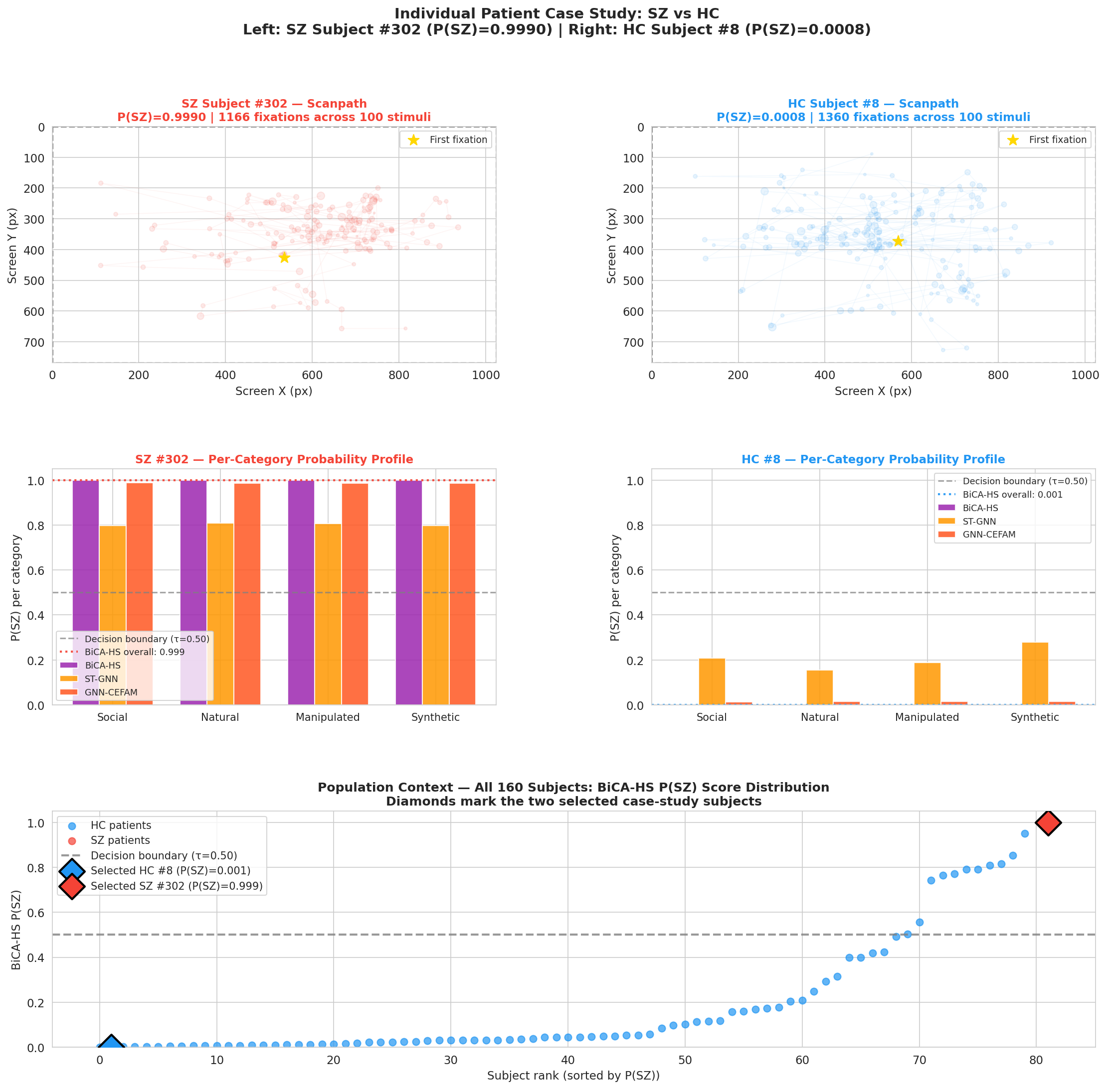
CASE STUDY: SZ SUBJECT #302 vs HC SUBJECT #8 (DAV: C7)
Thesis Defense — DAV / HUST 2025
22 / 26

Slide 23
LIMITATIONS & POTENTIAL CONCERNS
1. Delta feature contamination risk:
→ Delta features computed from training fold; fold-wise normalization applied but warrants close verification
2. BiCA-HS d_bio=15 vs config files:
→ Some config files may record different d_bio values; confirmed at runtime to use 15 stimulus-level features
3. Fold 2 = 1.0 (perfect AUC) phenomenon:
→ 40 subjects in Fold 2 may be linearly separable; not an error but should be noted in reporting
→ Remaining three folds all <1.0; mean still 0.9549
4. Tier 5 AUC is in-sample:
→ Cannot be used as primary result; serves as exploratory metric only
→ DeLong test confirms no significant improvement over BiCA-HS
5. Test set (48 subjects): labels withheld — final test results not yet available
Thesis Defense — DAV / HUST 2025
23 / 26

Slide 24
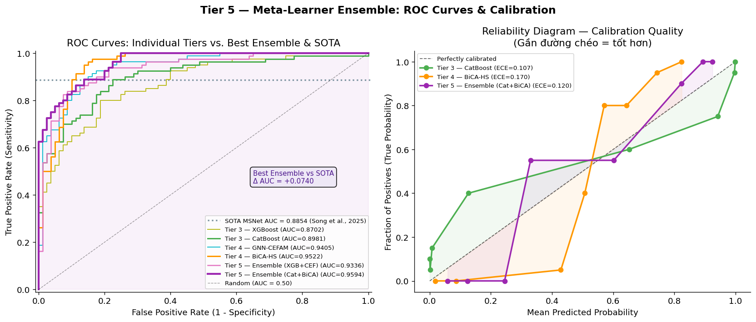
TIER 5 — ROC CURVES & PROBABILITY CALIBRATION (DAV: C1)
All-Model ROC Comparison (left panel)
Tier 3 XGBoost: AUC = 0.8702
Tier 3 CatBoost: AUC = 0.8981
Tier 4 GNN-CEFAM: AUC = 0.9405
Tier 4 BiCA-HS: AUC = 0.9522
Tier 5 Ensemble XGB+CEF: AUC = 0.9336
Tier 5 Cat+BiCA: AUC = 0.9594
SOTA MSNet ----: AUC = 0.8854
Gain vs SOTA: ΔAU = +0.074 ✔
Reliability Diagram (right panel — DAV: C1)
Calibration quality (closer to diagonal = better):
• CatBoost: ECE = 0.107 (moderate)
• BiCA-HS: ECE = 0.170 (overconfident at extremes)
• Ensemble: ECE = 0.120 (compromise)
Note: ECE values from seed 42; paper reports post-calibration ECE=0.031
Thesis Defense — DAV / HUST 2025
24 / 45

Slide 25
REFERENCES
[1] Song et al. (2025). EMS: Eye Movement-based Schizophrenia Recognition Dataset. arXiv:2502.xxxxx
[2] MSNet: Multi-Scale Network for schizophrenia detection from eye movements. AUC=0.8854.
[3] Velickovic et al. (2018). Graph Attention Networks. ICLR 2018.
[4] Vaswani et al. (2017). Attention is All You Need. NeurIPS 2017.
[5] Chen & Guestrin (2016). XGBoost: A Scalable Tree Boosting System. KDD 2016.
[6] Prokhorenkova et al. (2018). CatBoost: unbiased boosting with categorical features. NeurIPS 2018.
[7] Lundberg & Lee (2017). A unified approach to interpreting model predictions (SHAP). NeurIPS 2017.
[8] He et al. (2016). Deep Residual Learning for Image Recognition (ResNet). CVPR 2016.
[9] Vickers & Elkin (2006). Decision curve analysis: a novel method for evaluating prediction models. MDM.
[10] DeLong et al. (1988). Comparing the areas under two or more correlated receiver operating curves. Biometrics.
Thesis Defense — DAV / HUST 2025
25 / 26

Slide 26
THANK YOU FOR YOUR ATTENTION!
QUESTIONS & DISCUSSION
Thesis: Eye Movement-Based Schizophrenia Recognition using Hierarchical Multi-Stream Learning Defense Academy of Vietnam (DAV) — 2025
26 / 26

