Slide 1
Fall 2024 Seminar Projects

Slide 2
Course outline
Researchers will work on teams addressing some of the problems listed in this presentation
Progress reports will be given in 15- or 20-minute segments at weekly meetings
We’ll write up, post, and possibly even publish interesting results

Slide 3
James-Stein for Eigenvalues (JSE) shrinkage with long-only constraints
We have detailed results on how JSE improves eigenvectors and variance estimates of equality-constrained optima. Practical portfolio construction requires long-only and other inequality constraints. We will examine how the theory adapts to minimizing variance with mixed equality and inequality constraints, quantifying the improvement, if any, of JSE shrinkage methods.

Slide 4
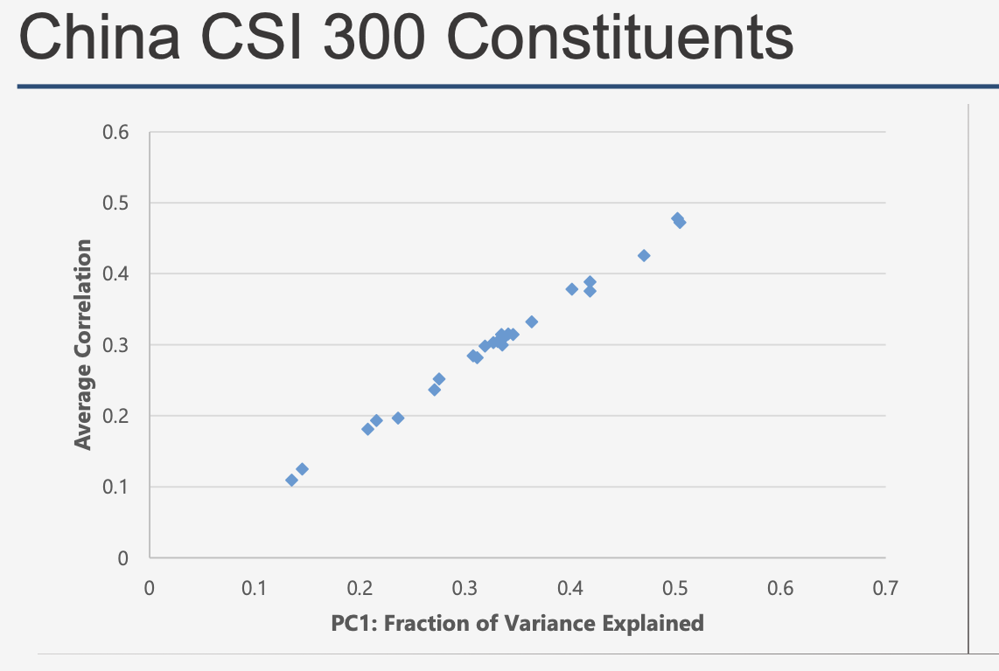
Spectral properties of sample return covariance matrices
Often based on data sets where the number of securities vastly exceeds the number of observations, these matrices exhibit distinctive empirical properties, such as:
A leading eigenvalue that scales linearly with the number of securities
A leading eigenvector whose entries have a (mostly) uniform sign
An approximately linear relationship between average pairwise correlation and fraction of variance explained by the leading eigenvector
In this project, we will expand our exploration of spectral properties in familiar data sets and look at some new ones.

Slide 5
Spectral properties of machine learning transition matrices
Neural network weight matrices fully capture the ability of a neural network to perform the task it was trained to perform. The collection of these matrices are in essence the "brain" of a neural net. In this project, we use spectral methods and random matrix theory to probe this neural structure to understand what makes it good or bad at performing a given task

Slide 6
Graphical models
Simulate different network structures, and use available methods to detect edges in graphs with/without assumptions about the true structure. Apply graphical model methods to models from other topics in this course, such as single-spike. Work with real data in domains where graphical models may be used, such as genomics, social sciences.

Slide 7
Empirical JSE
Real financial data has many features that push the limits of what even modern statistical methods can accomplish (e.g. heavy tails, heteroskedasticity, non-stationarity, etc). In this project we use historical US stock data to test the most advanced statistical techniques available on their ability to deal with uncertainty and hedge out as much financial risk as possible.

Slide 8
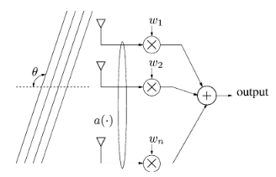
Beamforming – optimization in high dimension
Simulate low-dimensional beamforming data and implement a closed-form solution (Capon’s method). Use methods which are based on shrinkage of eigenvalues to improve the estimation. Simulate high-dimensional beamforming data and implement methods for optimization, including methods involving shrinkage estimation of eigenvectors.
Source: https://stanford.edu/~boyd/papers/pdf/rmvb.pdf

