Slide 1

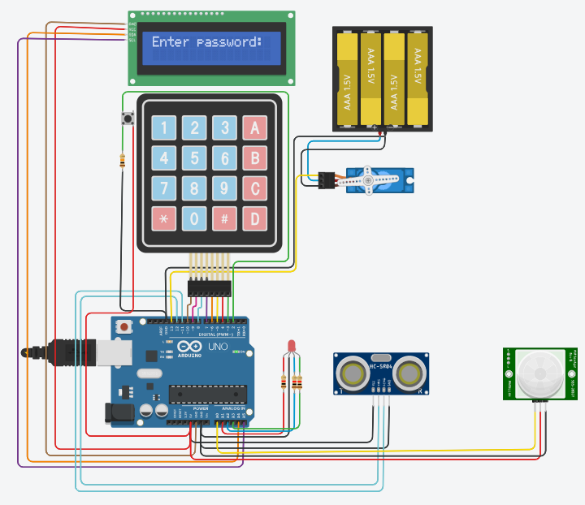
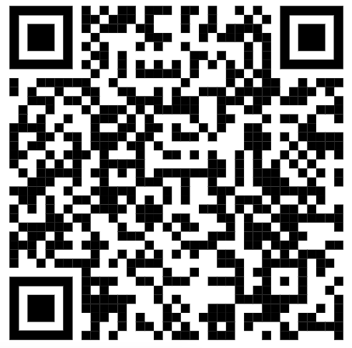
Embedded Software Development | Smart Security System Adi Malka, Haim Pinhasov 2024, semester B
Budnitski Vladi
Introduction
The system provides an advanced security solution by combining sensors and hardware for motion detection, distance measurement, and servo lock control. It ensures user safety by detecting break-ins or unauthorized entries, with visual feedback via LEDs and an LCD display. Users enter a password on a keypad, unlocking the servo-controlled lock if correct. Continuous monitoring of the environment enhances the security and reliability of the system, making it an effective way to secure premises.
System Design and Implementation
The security system integrates a microcontroller with a 4x4 keypad, ultrasonic sensor, PIR sensor, RGB LEDs, a servo motor, and an LCD display. Users enter a password on the keypad, shown on the LCD. The correct password unlocks the servo motor (green LED), while incorrect attempts blink the red LED. The system continuously monitors the ultrasonic and PIR sensors, logging motion or proximity events.
We wanted the LED to blink during code entry. Initially, using TIMER 1 caused crashes due to a conflict with INTERRUPT 0. To diagnose the issue, we isolated each component and discovered the conflict. Switching from TIMER 1 to TIMER 2 resolved the problem, allowing the LED to blink as intended. This combination of components and logic ensures effective monitoring and security of the premises.
Conclusion
We successfully developed a security system integrating sensors, actuators, and a microcontroller for effective access control and monitoring. We learned how to handle component conflicts, optimize sensor readings, and implement effective user feedback mechanisms.
Discussion
Future improvements could include:
1. Adding network connectivity for remote monitoring.
2. Using more advanced encryption for password protection.
3. Enhancing the system's scalability to support more sensors and larger areas.
4. Integrating an audio alert system.
5. Sending text messages if someone tries to access the door.
6. Add visualization of the data
Source Code
Scan the code to view the source code:

