Slide 1
BINDING AFFINITY
Nguyen Thi Hai Yen

Slide 2
AGENDA
01
02
03
04
Definition
Application
Measurement
Visualization

Slide 3
Definition
01
Drug-protein interaction
Target: A protein to which a given drug binds, resulting in an alteration of the normal function of the bound molecule and a desirable therapeutic effect. Drug targets are most commonly proteins such as enzymes, ion channels, and receptors, transporters.
Enzyme: A protein which catalyzes chemical reactions involving a given drug (substrate).
Ion channels: specialized proteins in the plasma membrane that provide a passageway through which charged ions can cross the plasma membrane down their electrochemical gradient.
Receptors: proteins, usually cell surface receptors.
Carrier: A secreted protein which binds to drugs, carrying them to cell transporters, where they are moved into the cell. Drug carriers may be used in drug design to increase the effectiveness of drug delivery to the target sites of pharmacological actions

Slide 4
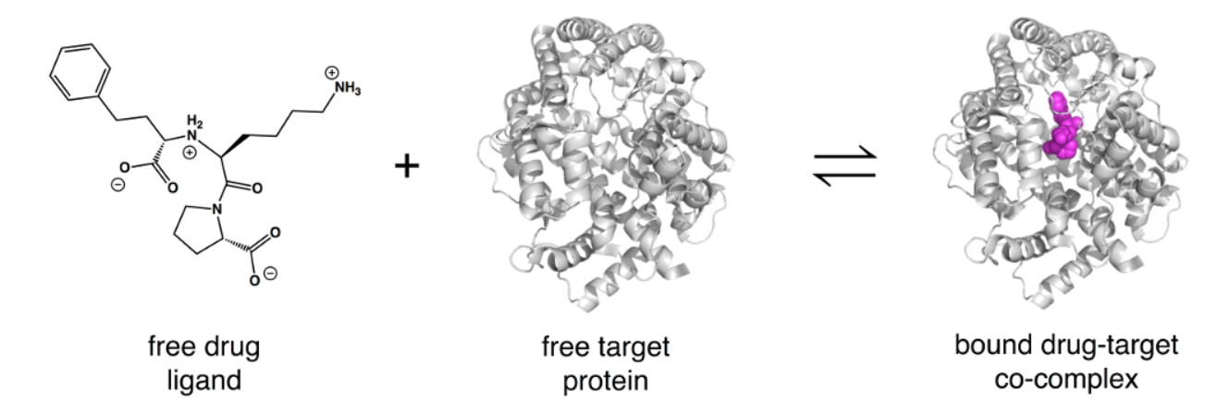
Definition
01
Protein-drug binding

Slide 5
Definition
01
Protein-drug binding affinity
The strength of the binding interaction between a single biomolecule (e.g. protein) to its ligand/binding partner (e.g. drug). Binding affinity is typically measured and reported by the equilibrium dissociation constant (K_{D}).
The smaller the K_{D} value, the greater the binding affinity of the ligand for its target and conversely.
Binding affinity is influenced by
non-covalent intermolecular interactions such as hydrogen bonding, electrostatic interactions, hydrophobic and Van der Waals forces between the two molecules
the presence of other molecules

Slide 6
Application
02
Understanding the binding affinity to substrates, inhibitors, and cofactors is key to the appreciation of the intermolecular interactions driving biological processes, structural biology, and structure-function relationships.
For drug discovery, binding affinity is measured to
rank order hits binding to the target => drug repositioning
help design drugs that bind their targets selectively and specifically => drug design, drug synthesis

Slide 7
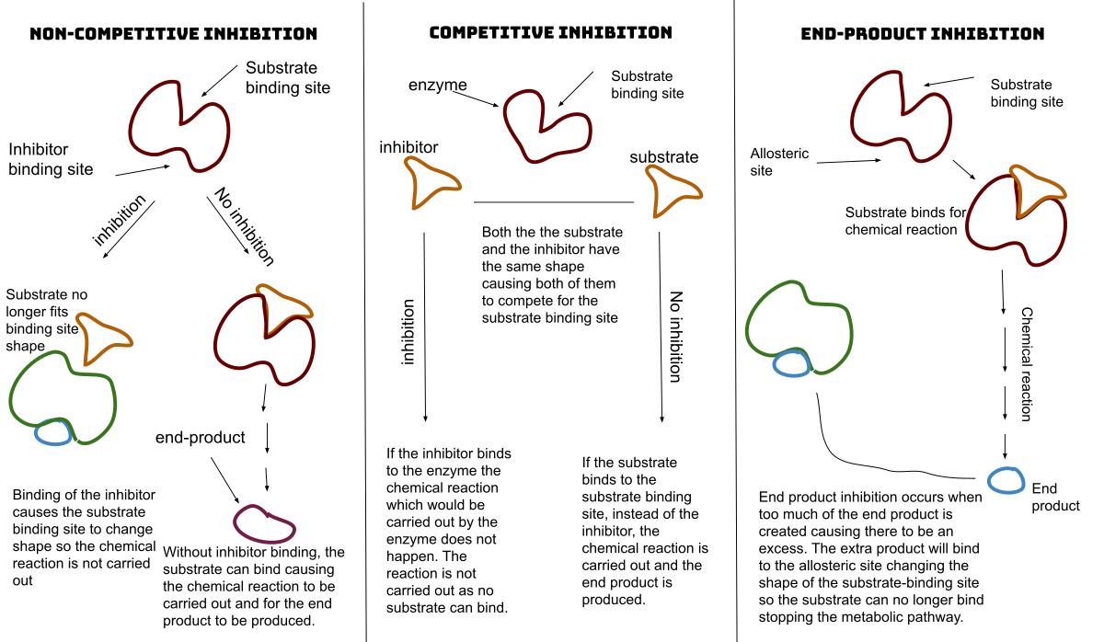
Application: Enzyme
02

Slide 8
Measurement
03
There are many ways to measure binding affinity and dissociation constants
ELISAs
gel-shift assays
pull-down assays
equilibrium dialysis
analytical ultracentrifugation
surface plasmon resonance
spectroscopic assays.

Slide 9
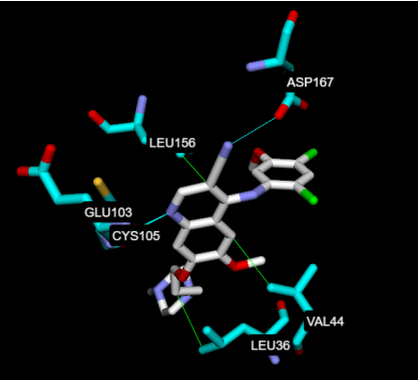
Visualization
04
Residue-ligand interaction between MST1 and Bosutinib predicted by blind docking.

Slide 10
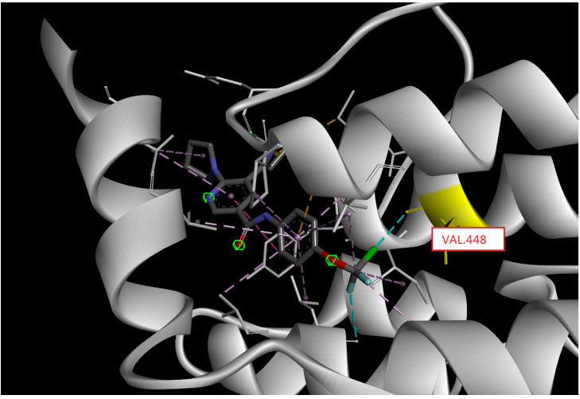
Visualization
04
Visualization of residue VAL.448 of protein ABL1-Asciminib (PDB 5MO4). The residue VAL.448 is the binding site of ABL1-Asciminib.

Slide 11
THANKS!
Do you have any questions?
haiyenzenny97a1@gmail.com

