Slide 1
Graph Embedding on Biomedical Networks: Methods, Applications and Evaluations
Authors: Xiang Yue et al
Github: https://github.com/xiangyue9607/BioNEV
Reporter: Cuong Vo

Slide 2
Introduction
Drug-Disease Association(DDA)
Drug-Drug interaction (DDI)
Protein-Protein interaction (PPI)
Goal: Utilizing Graph Embedding to learn low-dimensional node representations.
Biomedical link prediction
Tasks
Medical Term Semantic type Classification
Protein Function Prediction
Node classification tasks

Slide 3
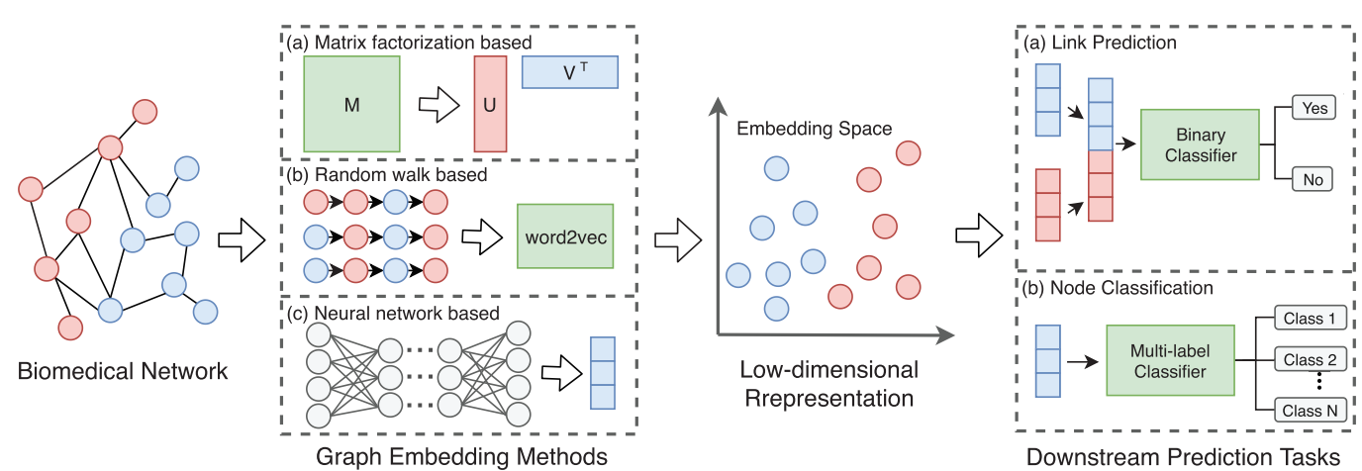
Introduction

Slide 4
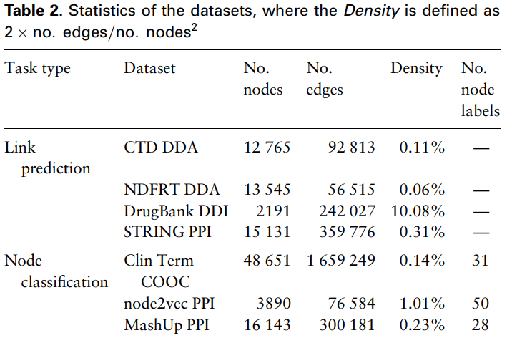
Datasets
Notes:
- The link prediction task can be formulated as: given a set of biomedical entities and their known interactions, we aim to predict other potential interactions between entities (The assumption behind these methods is that entities sharing similar biological features or graph features could have similar connections) - Protein function prediction - Given a medical term co-occurrence graph where terms and co-occurrence statistics have been extracted from clinical texts, classify the semantic types of medical terms

Slide 5
Graph Embedding Methods
Laplacian
SVD
GF
HOPE
GraRep
First-order proximity
MF-based
High-order proximity
Graph Embedding Methods
DeepWalk
Node2vec
struc2vec
Random Walk-based
LINE
SDNE
GAE
First and Second order proximity
Neural Network-based
Notes:
MF based: it aims to factorize a data matrix into lower dimensional matrices and still keep the manifold structure and topological properties hidden in the original data matrix.
Random Walk based: tries to learn word representations from sentences, random walk-based methods are developed to learn node representations by generating ‘node sequences’ through random walks in graphs.
NN based: such as multilayer perceptron (MLP), autoencoder, generative adversarial network (GAN) and graph convolutional network (GCN).

Slide 6
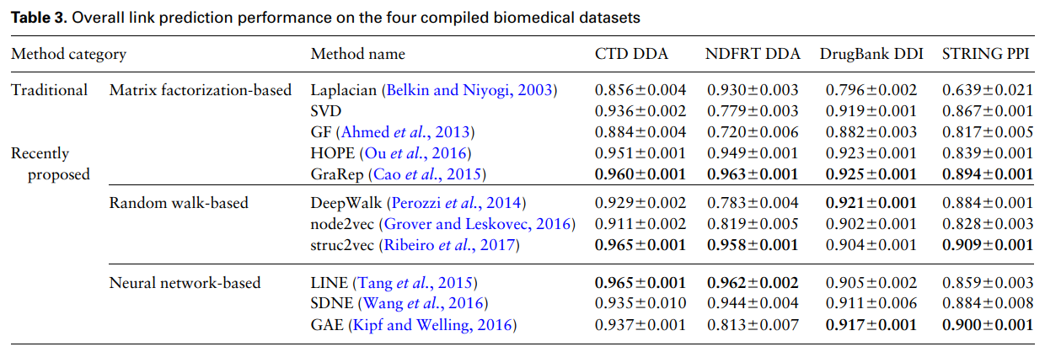
Results

Slide 7
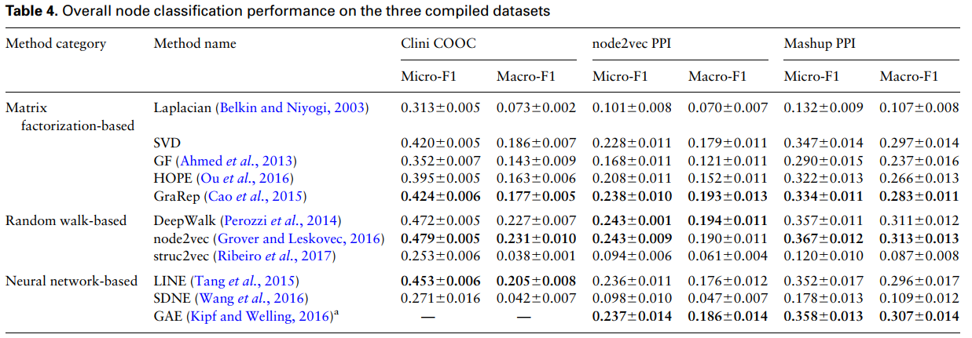
Results

Slide 8
Contributions
Providing an overview of different types of graph embedding methods, and three biomedical link prediction tasks and two node classification tasks.
Compile 7 benchmark datasets with 11 representative graph embedding methods. Discuss observations from extensive experiments and provide some insights and guidelines for how to choose embedding methods (including their hyper-parameter settings).
Developing an easy-to-use Python package with detailed instructions, BioNEV.

Slide 9
References
Xiang Yue. et al. (2020) Graph embedding on biomedical networks: methods, applications and evaluations. Bioinformatics, 36, 1241-1251.

