Slide 1
SGDTI and de novo Drug Design for specified Target
Nguyen Minh Son – Tran Tan Thanh – Vo Thanh Cuong

Slide 2
Content
Stacked GraphDTI
Generator

Slide 3
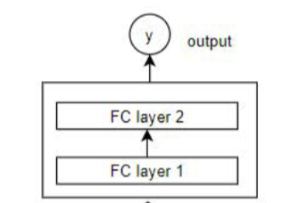
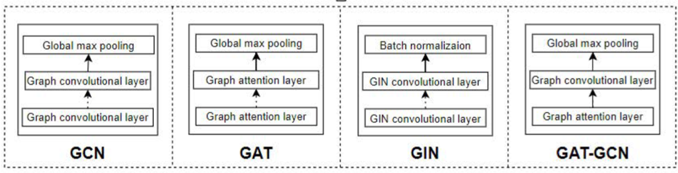

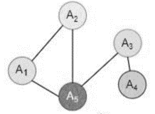
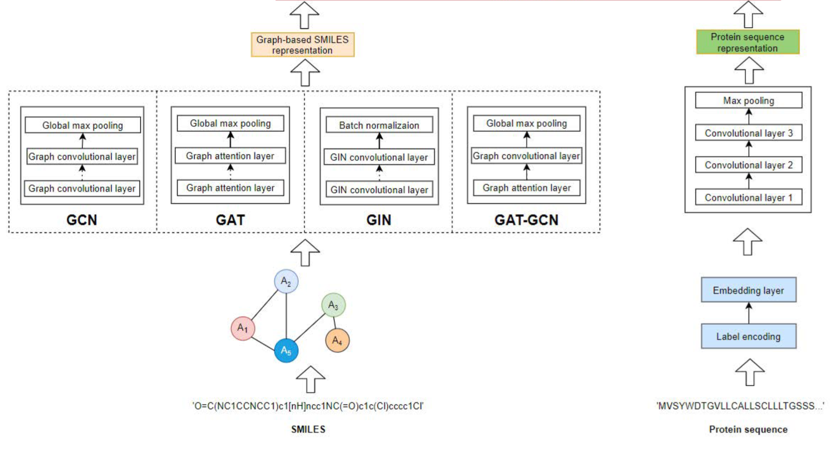
SG-DTI
Stacked Graph Drug-Target Interaction
Notes:
3

Slide 4
SG-DTI
Stacked Graph Drug-Target Interaction
Results from the original paper and Re-implement Graph-DTA (GIN, davis)
 | MSE Score Validation | CI Score Validation | MSE Score Test | CI Score Test
Original paper | x | x | 0.229 | 0.893
Reimplement Graph-DTA | 0.244 | 0.891 | 0.2588 | 0.8846
K-fold and Full dataset
Random Seed
Hyperparameter
Notes:
4

Slide 5
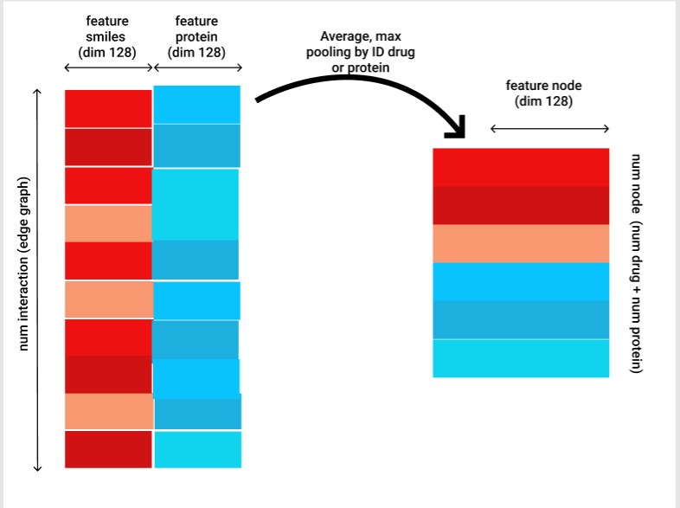
Graph interaction SMILES-Protein
Notes:
5

Slide 6
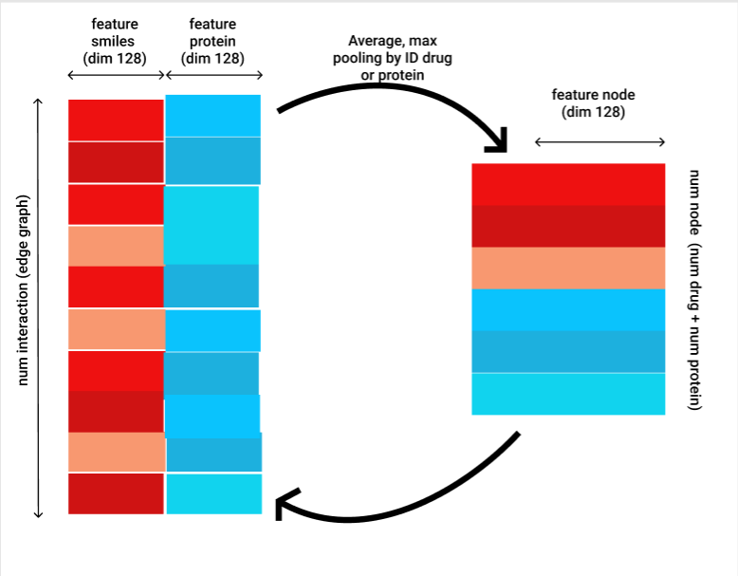
Graph interaction SMILES - Protein
?
Notes:
6

Slide 7
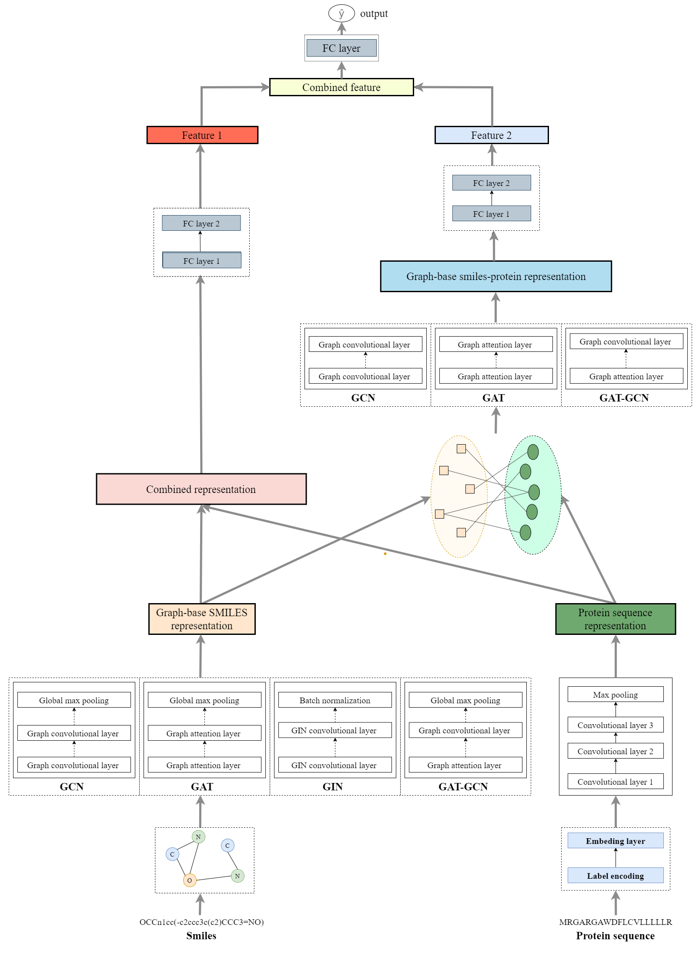
Stacked Graph Drug-Target
Interaction Model
Notes:
7

Slide 8
SG-DTI
Stacked Graph Drug-Target Interaction
Results from the Ours and Re-implement Graph-DTA (GCN, davis)
 | MSE Score Validation | CI Score Validation | MSE Score Test | CI Score Test
Original paper | x | x | 0.254 | 0.880
Reimplement Graph-DTA
Our | 0.279 | 0.873 | 0.295 | 0.873
Notes:
8

Slide 9
SG-DTI
Stacked Graph Drug-Target Interaction
Re-implemented model Training loss: 0.07-0.09
Our model Training loss: 0.04-0.05
Fighting with overfitting
Tuning Model
Lr-scheduler
Adding Regularization
Training full folds
Notes:
9

Slide 10
Our proposed model for specific target
SMILES
Graph Generator
SMILES
Embedding
(atom, relationship)
Predictor
Protein target
Reward

Slide 11
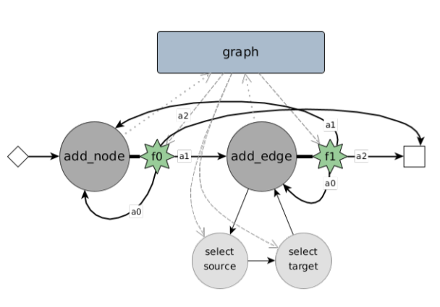
Generator proposed in the last report (Cannot use)
3 operations of graph construction:
Add nodes
Add edges
Remove edges
Input: Null Graph
Output: Graph

Slide 12
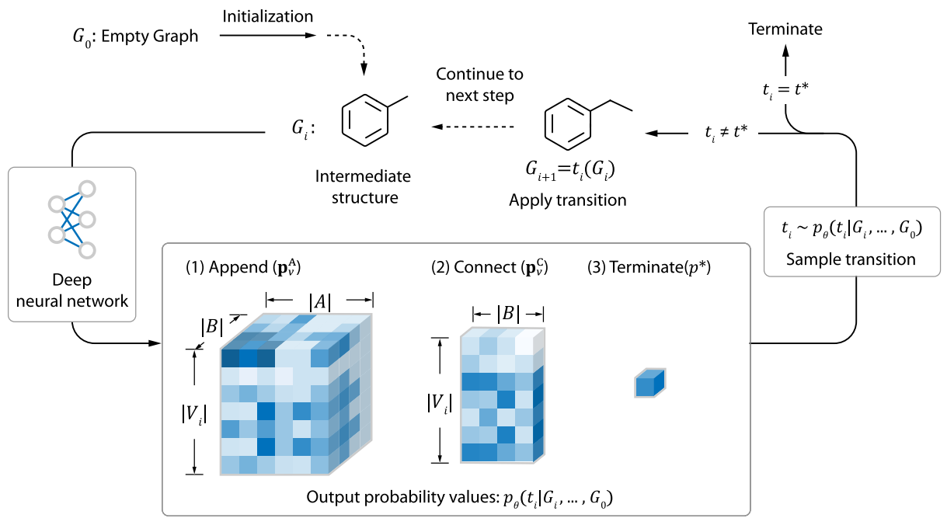
Graph Generator
Source: Multi-objective de novo drug design with conditional graph generative model (2018)
Status: Code refactor

Slide 13
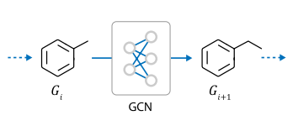
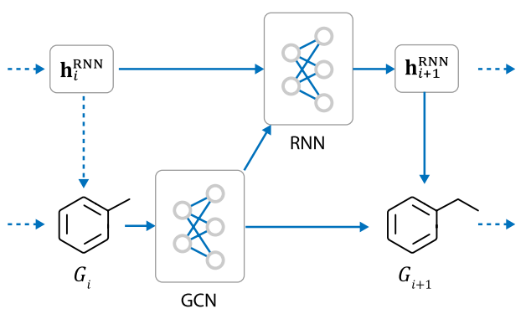
Graph Generator
How does the Deep Neural Net look like?

Slide 14
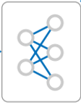

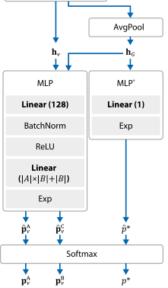

Graph Generator
GCN +MLP
GCN +MLP
RNN
Without RNN
With RNN

Slide 15
Graph Generator
GCN
RNN
Constrain c
With RNN + constrain

Slide 16
Graph Generator

Slide 17
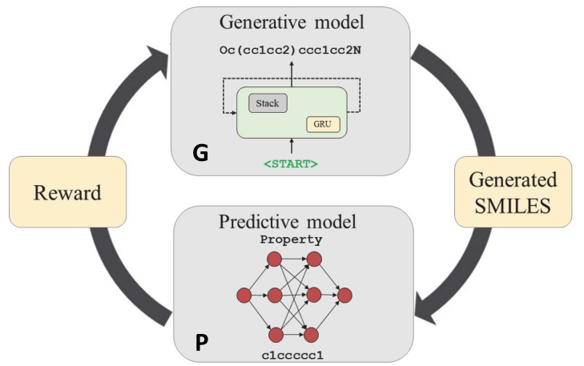
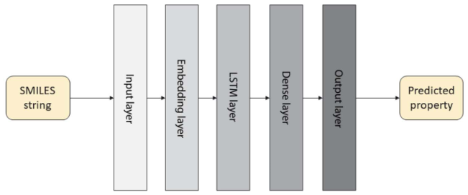
From the base idea of previous paper

Slide 18
Thanks for Listening!!!

