Slide 1

Google Maps API v2 for Android
ucu-ccs

Slide 2
Google Maps
Early Android mapping was done with Google Maps Android API V1 and the MapView control. This approach is now deprecated (Dec 2012)
ucu-ccs

Slide 3
Google Maps
The newer Google Maps Android API V2 allows the embedding and manipulations of maps into an Android activity through the classes:
SupportMapFragment
GoogleMap
ucu-ccs

Slide 4
XML
<fragment xmlns:android="http://schemas.android.com/apk/res/android" xmlns:tools="http://schemas.android.com/tools" android:layout_width="match_parent" android:layout_height="match_parent" android:id="@+id/map" tools:context=".MapsActivity" android:name="com.google.android.gms.maps.SupportMapFragment" />
ucu-ccs

Slide 5
Google Maps
The API is now distributed as part of the Google Play services SDK, which you can download with the Android SDK Manager.
ucu-ccs

Slide 6
Google Maps Features
The mapping API V2 offers features such as:
3D maps;
indoor, satellite, terrain, and hybrid maps;
vector-based tiles;
markers, overlays, and animated transitions.
ucu-ccs

Slide 7
Google Maps API V2
Google Maps Some features of the API V2 include:
A SupportMapFragment object adjusts map rendering to screens of various sizes.
A typical Android app need only to extend Activity instead of the MapActivity used in version 1.
The Maps API V2 uses vector tiles (smaller, and faster).
Caching is improved, so users will typically see a map without empty areas.
By tilting the user’s viewpoint maps can be displayed on 3D.
ucu-ccs

Slide 8
Google Maps API Key
In order to display Google Maps data in a SupportMapFragment, there are two preliminary operations:
You must register with the Google Maps Service and obtain a 40-characters Maps API Key (Visit: https://console.developers.google.com)
You must add to your SDK the Android-Google-Play-Services package (Use SDK Manager). The support files will be installed in the <android-sdk>/extras/google folder.
ucu-ccs

Slide 9
Hello Google Maps
Add the following statement to your onCreate method.
SupportMapFragment mapFragment = (SupportMapFragment) getSupportFragmentManager() .findFragmentById(R.id.map); mapFragment.getMapAsync(this)
ucu-ccs

Slide 10
AndroidManifest.xml
Add the following lines into your AndroidManifest.xml (insert them before the first <Activity> tag )
1 2 3 4 5 6 | <<meta-data android:name="com.google.android.geo.API_KEY" android:value="@string/google_maps_key" /> <meta-data android:name="com.google.android.gms.play_services" android:value="@integer/google_play_services_version"/>
ucu-ccs

Slide 11
Permission
Modify the app’s AndroidManifest.xml file with the following permissions and features requests:
<uses-permission android:name="android.permission.ACCESS_FINE_LOCATION" /> <uses-permission android:name="android.permission.INTERNET"/> <uses-permission android:name="android.permission.WRITE_EXTERNAL_STORAGE"/> <uses-permission android:name="android.permission.ACCESS_COARSE_LOCATION"/>
ucu-ccs

Slide 12
Dependencies
implementation 'com.google.android.gms:play-services:9.4.0‘
implementation 'com.google.android.gms:play-services-maps:9.4.0‘
ucu-ccs

Slide 13
Markers
Markers may define a custom image to show in place of the default icon. Defining an icon involves setting a number of properties that affect the visual behavior of the marker.
Markers support customization through the following properties:
ucu-ccs

Slide 14
Markers
.position (LatLang)
The LatLng value for the marker's position on the map. This is the only required property for a Marker object.
.alpha(1.0)
Sets the opacity of the marker. Defaults to 1.0. .title(“String”)
A string that's displayed in the info window when the user taps the marker.
ucu-ccs

Slide 15
.snippet(“String”)
Additional text that's displayed below the title.
.icon(Bitmap)
A bitmap that's displayed in place of the default marker image.
.draggable(boolean)
Set to true if you want to allow the user to move the marker. Defaults to false.
ucu-ccs

Slide 16
Adding Markers
Identify locations on the map. The default marker uses a standard icon, common to the Google Maps look and feel
Markers are objects of type Marker, and are added to the map with the
LatLng urdaneta = new LatLng(15.9758, 120.5707);
mMap.addMarker(new MarkerOptions()
.position(urdaneta));
ucu-ccs

Slide 17
Draggable Marker
You can reposition a marker once it’s been added to the map so long as its draggable property is set to true. Long press the marker to enable dragging. When you take your finger off the screen, the marker will remain in that position.
static final LatLng urdaneta= new
LatLng(15.9758, 120.5707);
mMap.addMarker(new MarkerOptions() .position(urdaneta) .draggable(true));
ucu-ccs

Slide 18
Customize the marker color
It's possible to customize the color of the default marker image by passing a BitmapDescriptor object to the icon() method. You can use a set of predefined colors in the BitmapDescriptorFactory object, or set a custom marker color with the BitmapDescriptorFactory.defaultMarker(
float hue) method. The hue is a value between 0 and 360, representing points on a color wheel.
ucu-ccs

Slide 19
static final LatLng urdaneta= new LatLng(15.9758, 120.5707); Marker marker = mMap.addMarker(new MarkerOptions() .position(urdaneta) .icon(BitmapDescriptorFactory
.defaultMarker(BitmapDescriptorFactory.HUE_AZURE)));
ucu-ccs

Slide 20
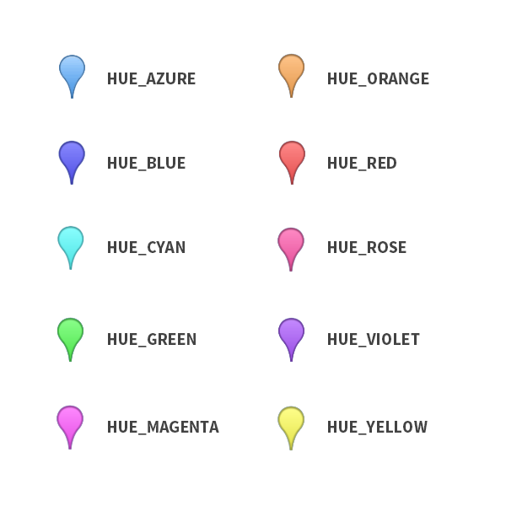
ucu-ccs

Slide 21
Customize a Marker
You can replace the default marker image with a custom marker image, often called an icon. Custom icons are always set as a BitmapDescriptor, and defined using one of four methods in the BitmapDescriptorFactory class.
ucu-ccs

Slide 22
Customize a Marker
fromAsset(String assetName)
Creates a custom marker using an image in the assets directory.
fromBitmap (Bitmap image)
Creates a custom marker from a Bitmap image.
fromFile (String path)
Creates a custom icon from a file at the specified path.
fromResource (int resourceId)
Creates a custom marker using an existing resource.
ucu-ccs

Slide 23
static final LatLng urdaneta= new LatLng(15.9758, 120.5707); Marker marker = mMap.addMarker(new MarkerOptions() .position(urdaneta) .icon(BitmapDescriptorFactory.fromResource(R.drawable.arrow)));
ucu-ccs

Slide 24
Marker Events
You can use an OnMarkerClickListener to listen for click events on the marker. To set this listener on the map, all
Map.setOnMarkerClickListener(new GoogleMap.OnMarkerClickListener() { });
ucu-ccs

Slide 25
Map Events
You can use an OnMapClickListener to listen for click events on the map. To set this listener on the map, all
Map.setOnMapClickListener(new GoogleMap.OnMapClickListener() {
});
ucu-ccs

