Slide 1
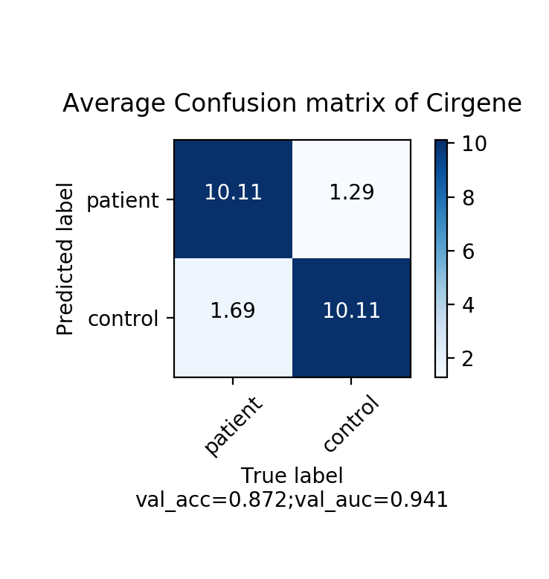
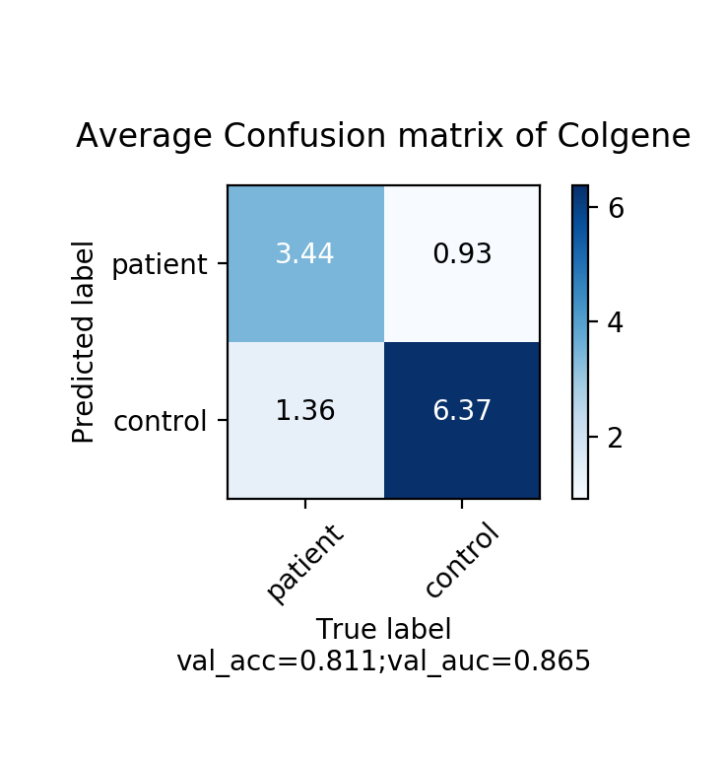
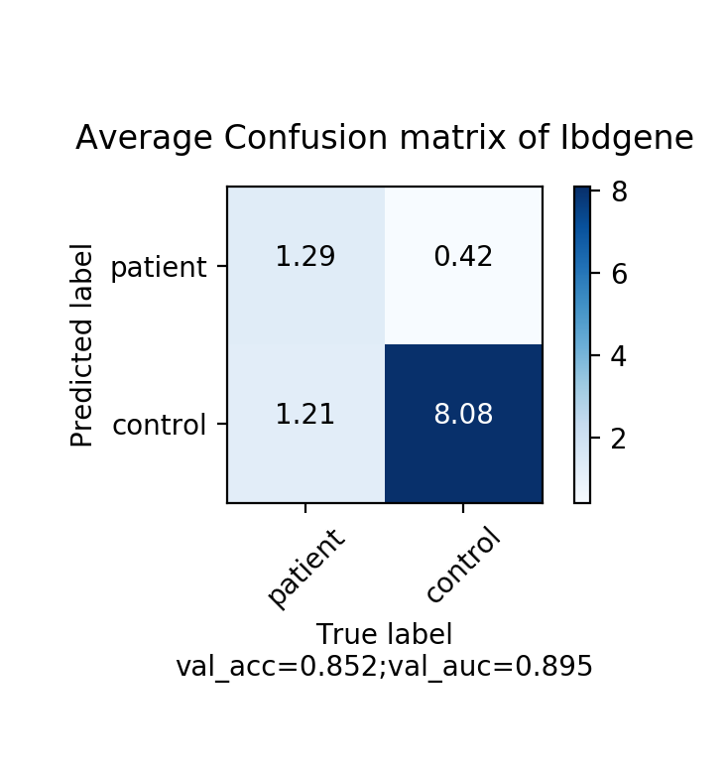
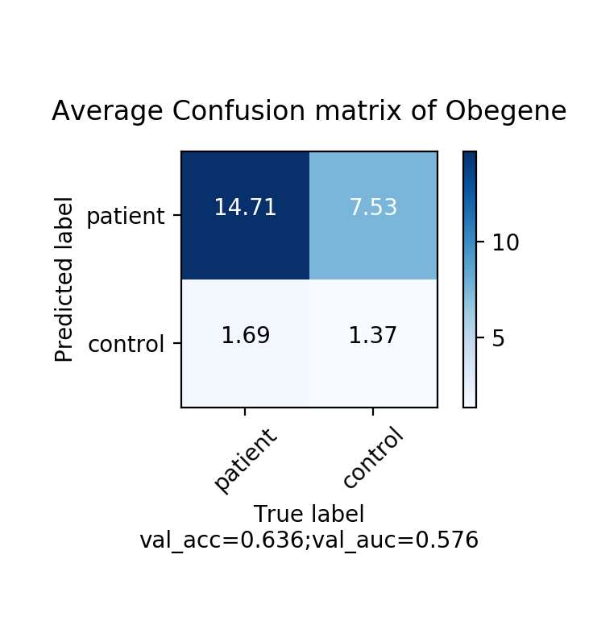
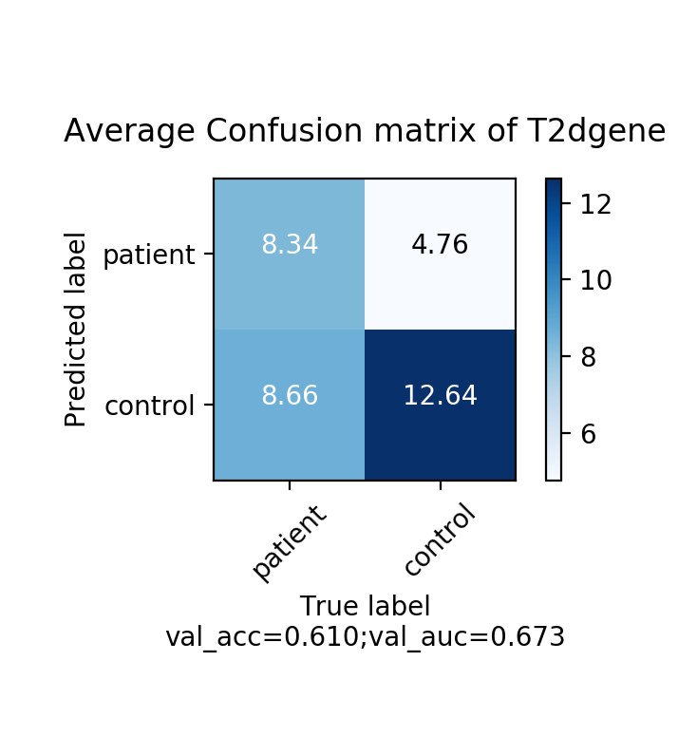
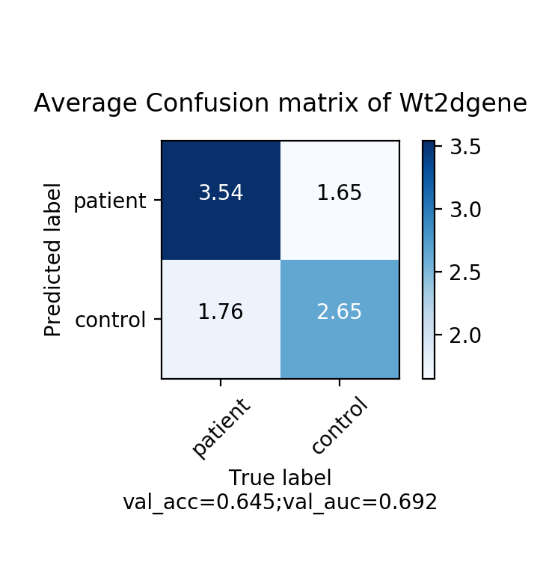

Slide 2

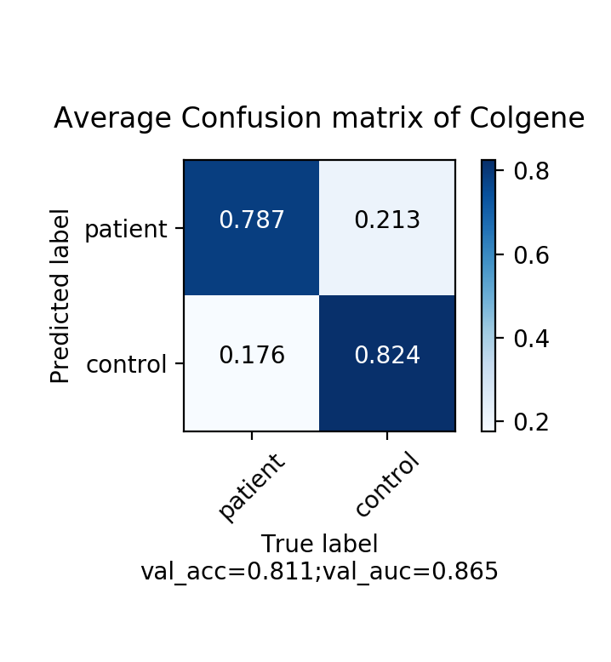

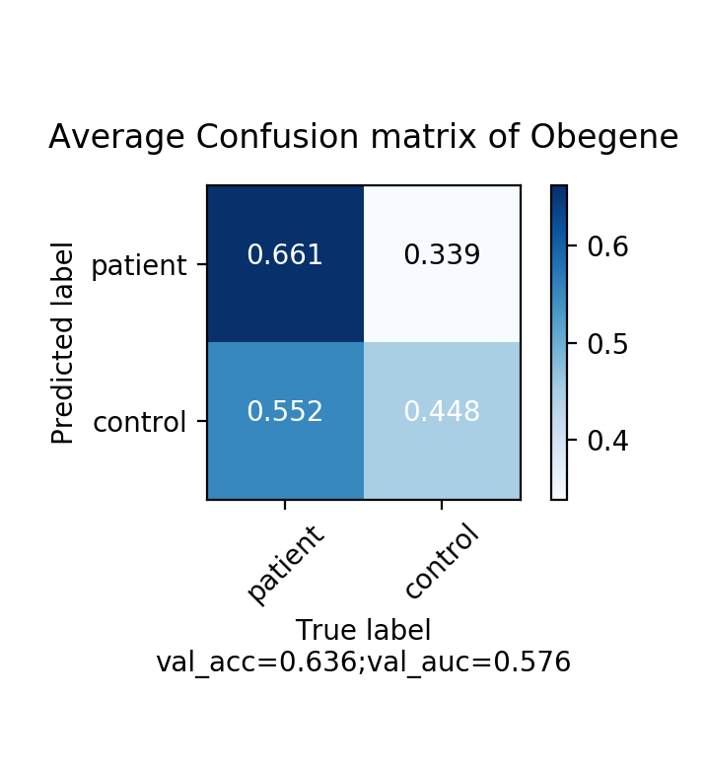
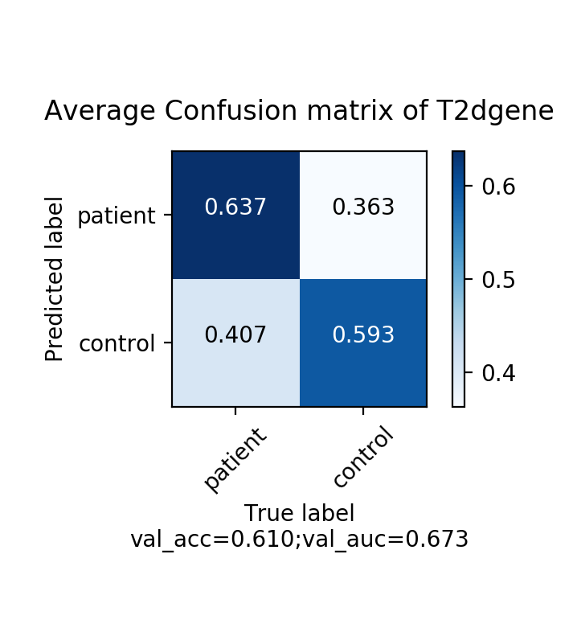
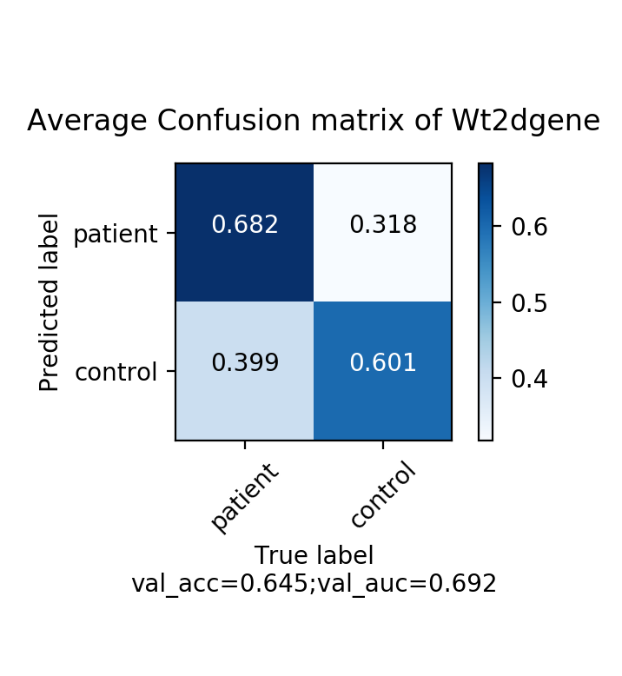

Slide 3
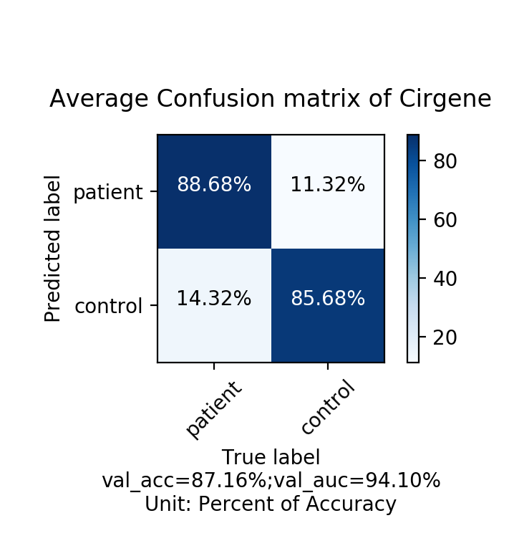
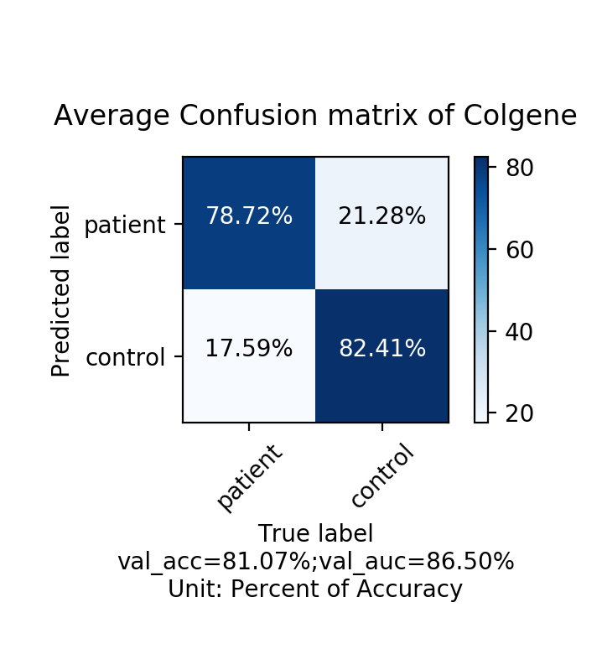
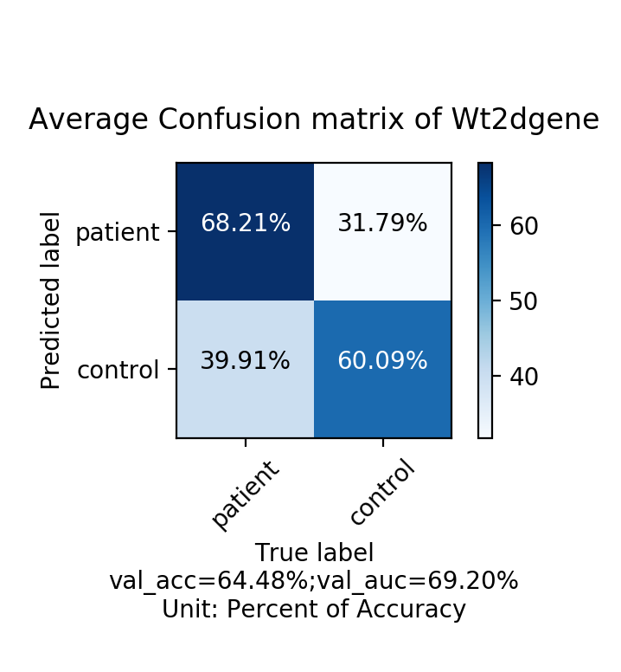
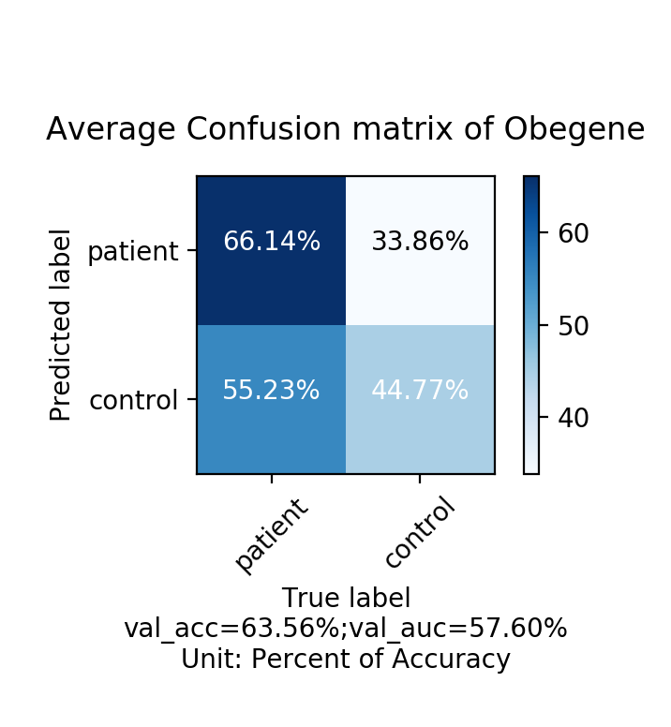
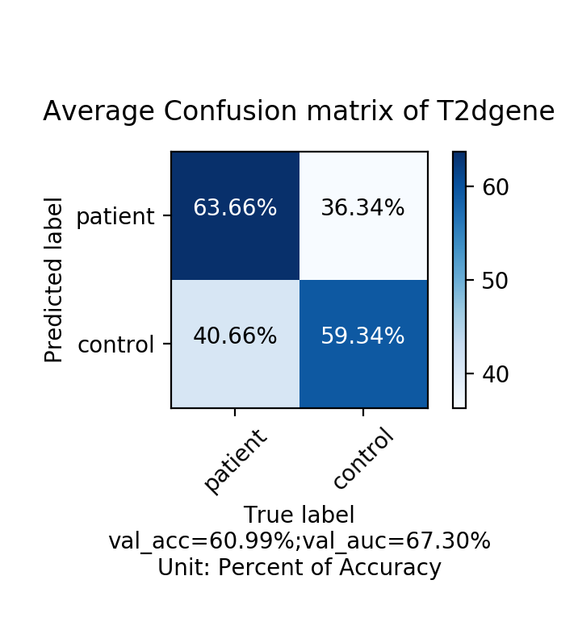


Slide 4
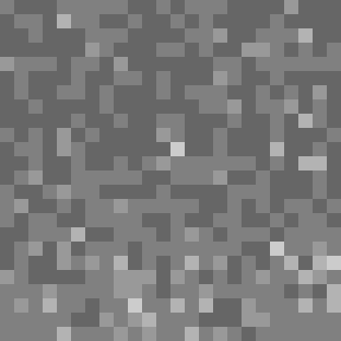
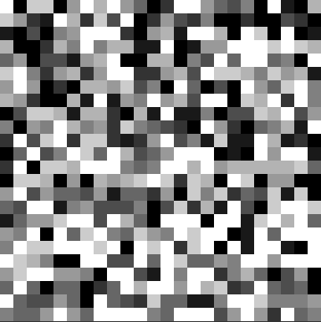
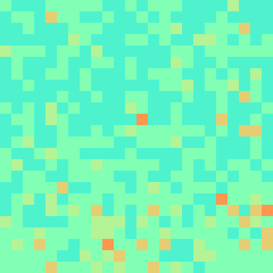
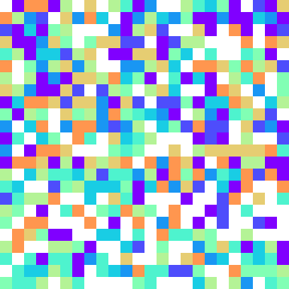

Slide 5
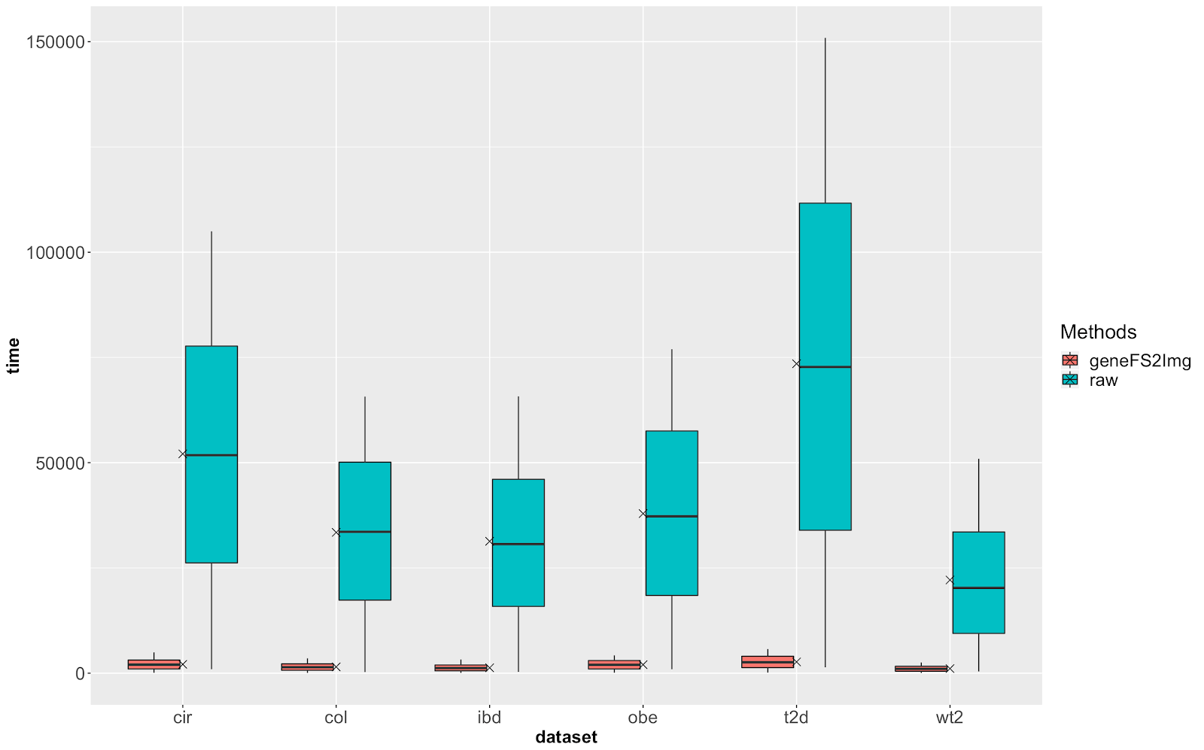
<fig-time-reduction>. A boxplot showing Total of run-time (in seconds) of FC model running various datasets comparing between raw data and data visualized by geneFS2Img

Slide 6
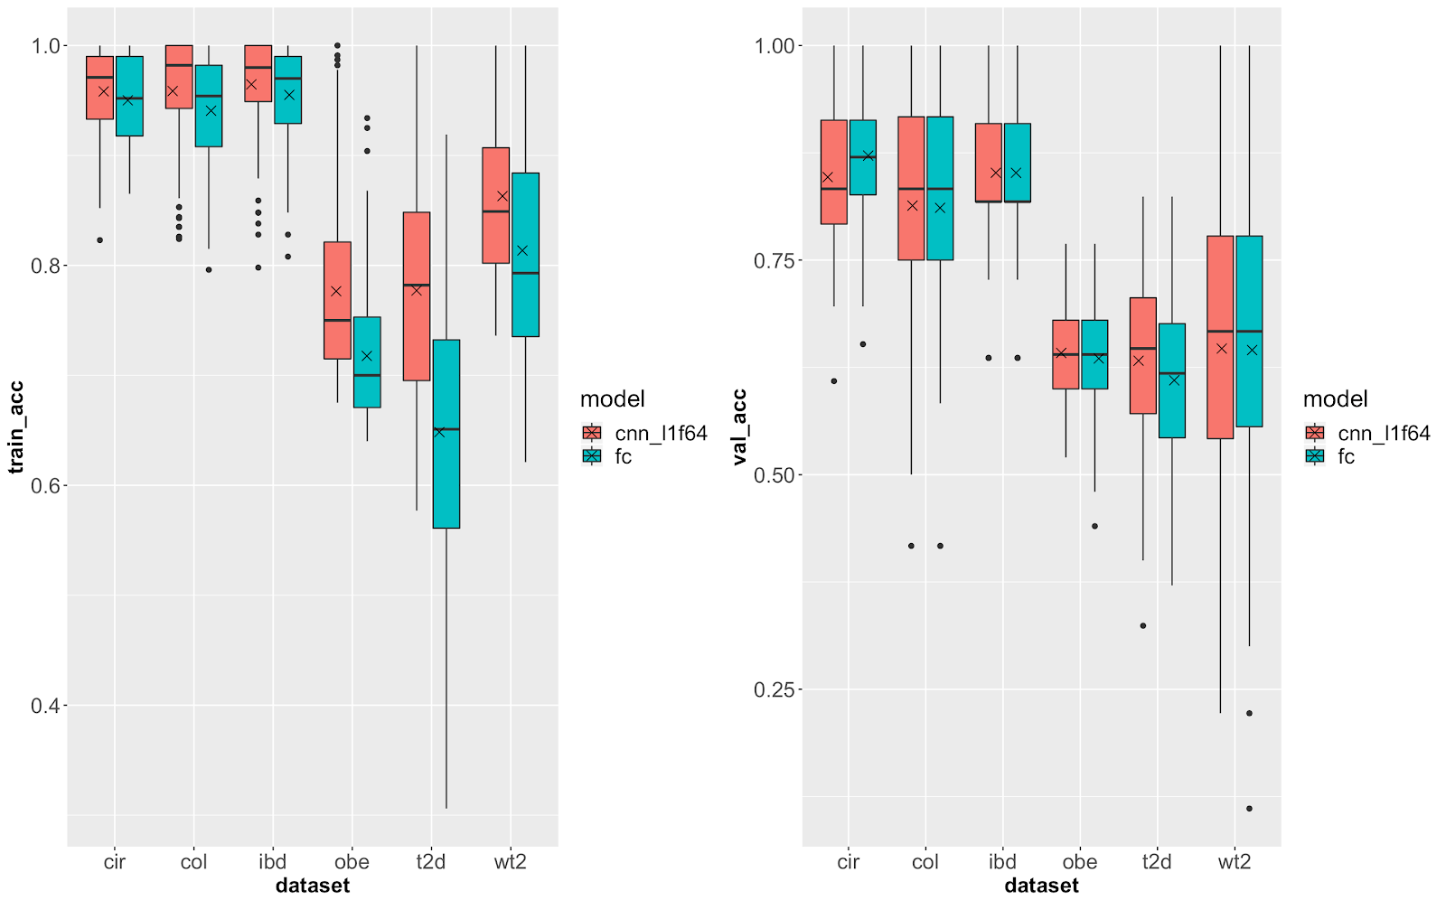
Fig <geneFS2Img-best-FC-CNN>. Performance Comparison in Average Accuracy when applying geneFS2Img approach using FC and CNN2D model on gene family datasets. The left chart shows the performance in training while the other exhibits the generalization (testing performance) of models

Slide 7
Method | CIR | COL | IBD | OBE | T2D | WT2 | AVG
PCA* [sota] | 0.547 | 0.604 | 0.775 | 0.648 | 0.514 | 0.540 | 0.605
RD_PRO*[sota] | 0.555 | 0.605 | 0.775 | 0.648 | 0.496 | 0.530 | 0.602
Raw [sota] | 0.761 | 0.628 | 0.775 | 0.648 | 0.655 | 0.620 | 0.681
Raw | 0.754 | 0.634 | 0.775 | 0.648 | 0.660 | 0.586 | 0.675
Our method (FC with gray image) | 0.872 | 0.811 | 0.852 | 0.635 | 0.610 | 0.645 | 0.738
Our method (FC with color image) | 0.855 | 0.785 | 0.852 | 0.624 | 0.619 | 0.635 | 0.728
Our method (CNN with gray image) | 0.847 | 0.813 | 0.852 | 0.642 | 0.633 | 0.647 | 0.739
Our method (CNN with color image) | 0.841 | 0.779 | 0.838 | 0.627 | 0.618 | 0.657 | 0.727

Slide 8
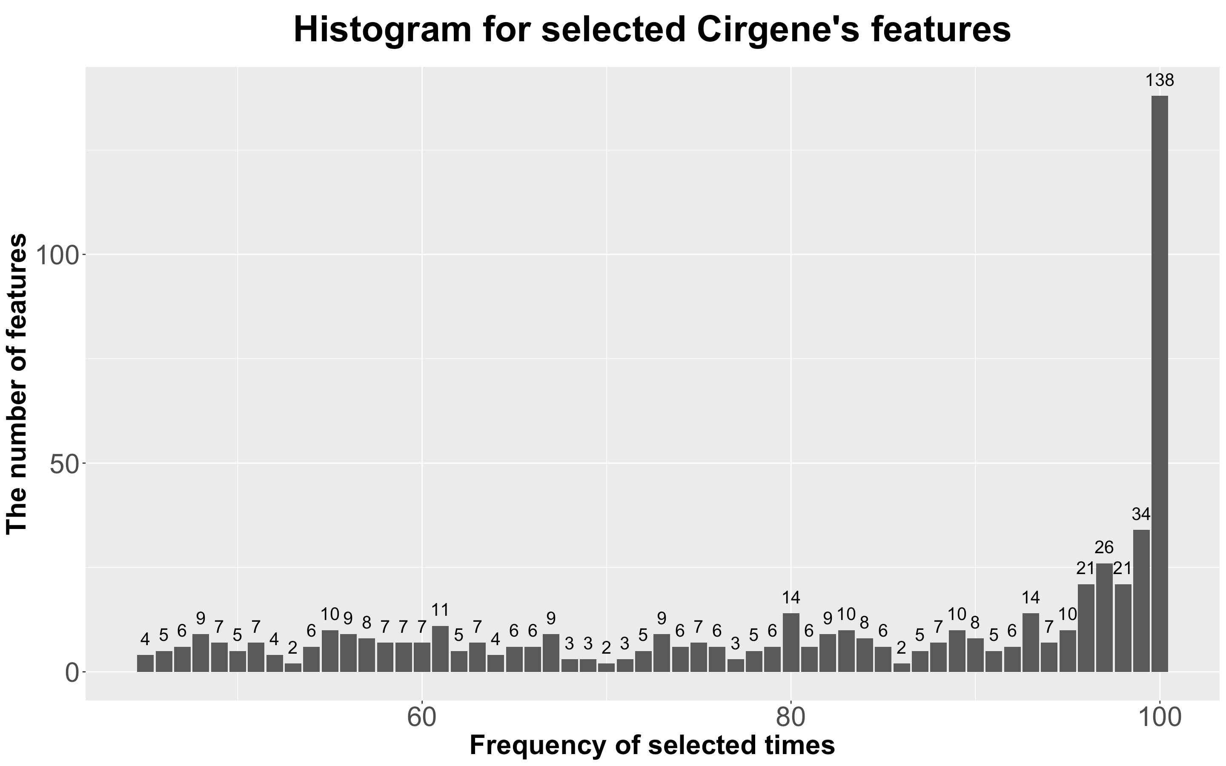
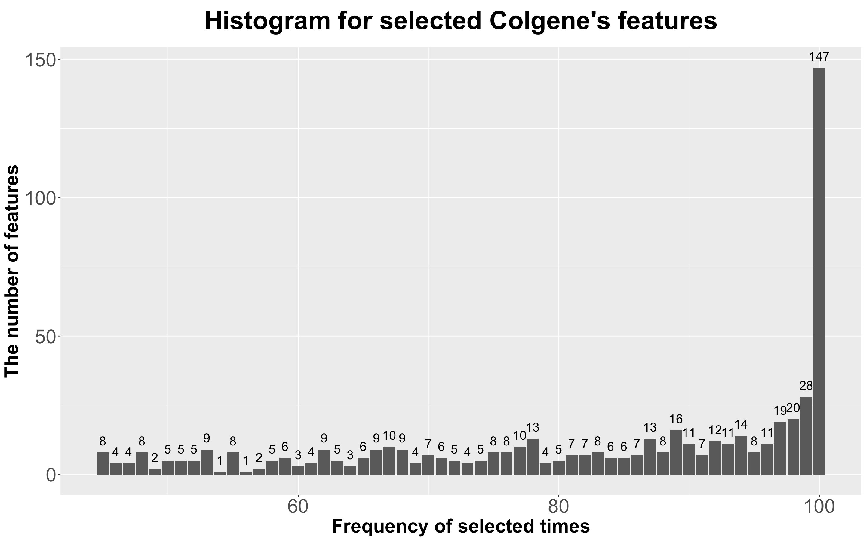

Slide 9
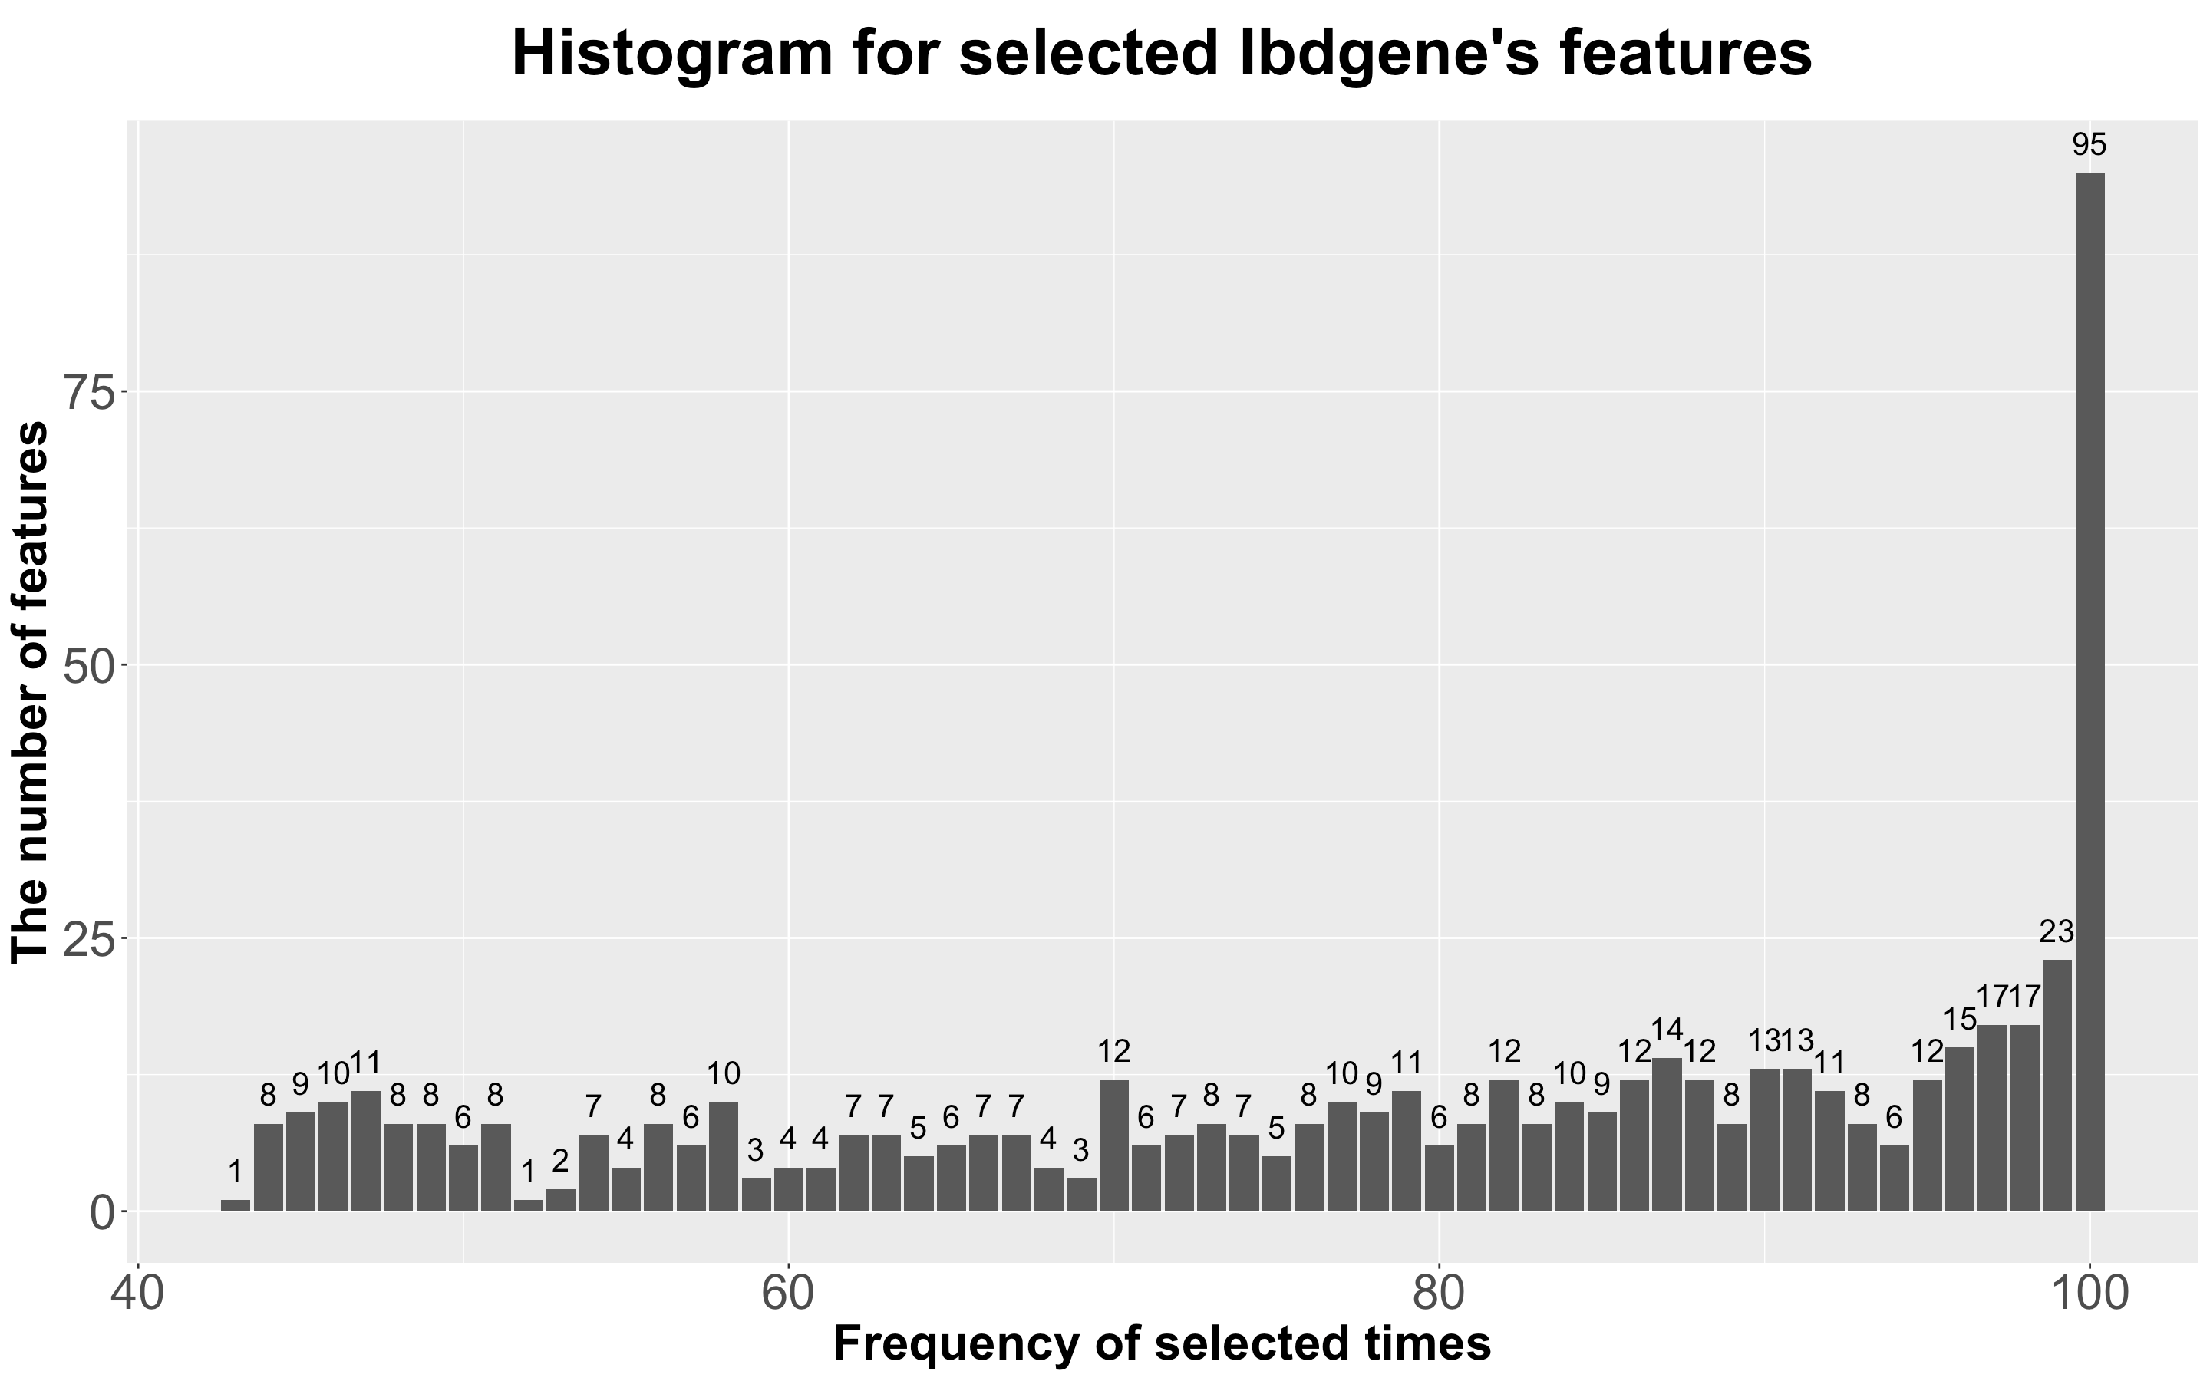
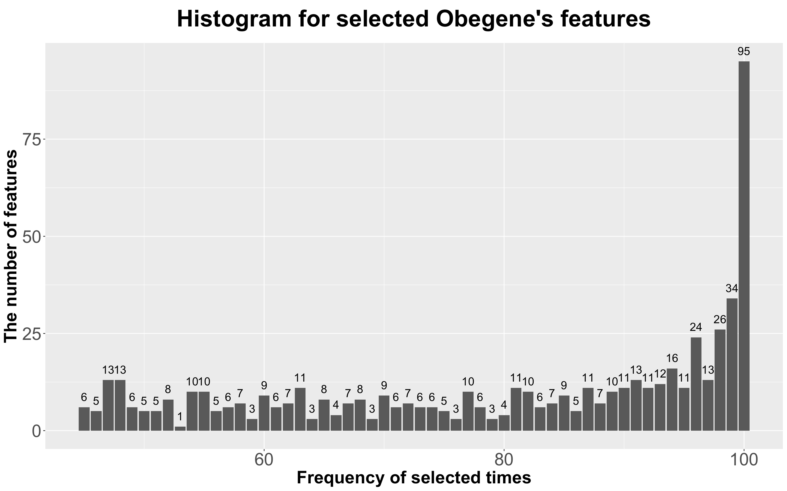

Slide 10
