Slide 1
Work flow

Slide 2
Architecture
Paper collection
@Zotero
Rubrics
Paper
@ arxiv.tex
Descriptor File
@arxiv.yaml
Extractor
Prompts
Responses
Score
Physicist
Evaluator
Prompt template@ prompt_template.md

Slide 3
Architecture
Extractor
Scoring
Paper@ arxiv.tex
Excerpt
Placeholders
@arxiv.yaml
Scores for reading
Human
Extractor LLM
Human
Relevance
Rubrics
Executor
Prompts
HF equations
Scores for execution
Execution LLM
Human
Rubrics
Prompt template@ prompt_template.md

Slide 4

Physicist
P_{i}
: i-th prompt
: Solver LLM
$$\sum_{k=1}^{i}{ }$$
S_{i}
P_{i}
R_{i}
R_{i}
: i-th response
: Summarizer LLM
Naïve way
Summarization way (due to max token)
Round 1
P₁
Solver
P₁
Solver
P₁
R₁
P₁
R₁
Summarizer
Round 2
P₁
R₁
P₂
S₁
P₂
P₁
R₁
P₂
R₂
S₁
P₂
R₂
Round 3
P₁
R₁
P₂
R₁
P₃
S₂
P₃
R₃
R₃
Final
results
P₁
R₁
P₂
R₂
P₃
R₃
Final results
P₁
R₁
P₂
R₂
P₃
R₃
However, this naïve way can easily exceed the maximal token that GPT4 can support.

Slide 5
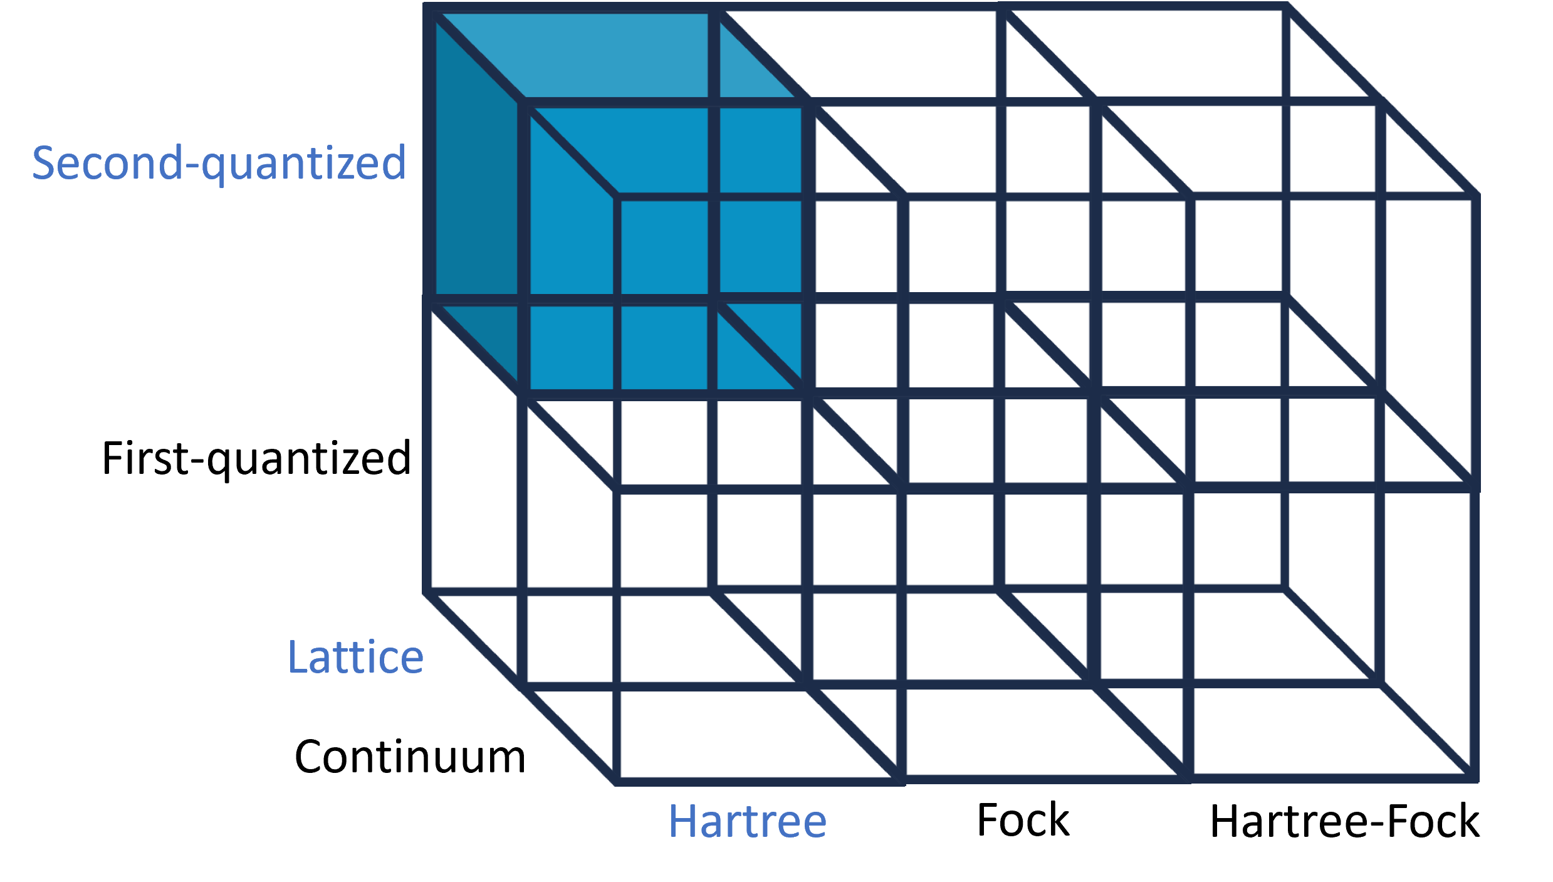
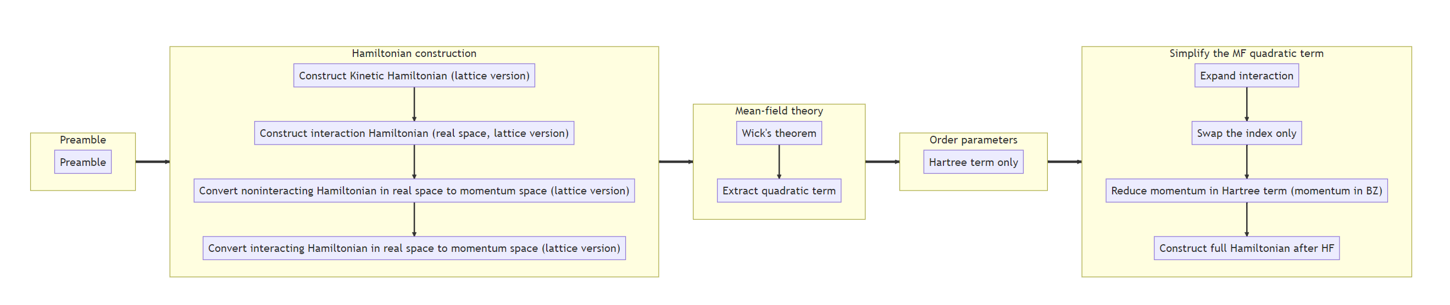
Extractor

Slide 6
Evaluator

