Slide 1
Work flow

Slide 2
Architecture
Paper collection
@Zotero
Rubrics
Paper
@ arxiv.tex
Descriptor File
@arxiv.yaml
Extractor
Prompts
Responses
Score
Physicist
Evaluator
Prompt template@ prompt_template.md

Slide 3
(a)
Scoring
Physics logic: 1
Math derivation: 2
...
Template Task i:
The Hamiltonian of {system} is ...
Human
①
③
Prompts
Task i:
The Hamiltonian of free fermion is ...
②
Output
The Hamiltonian of free fermion is $H=\sum_k\frac{k^2}{2m} c_k^\dag c_k$ ...
Execution LLM
Placeholders
system: free fermion
...
①
④
Rectifying
$H=\frac{1}{N_k}\sum_k\frac{k^2}{2m} c_k^\dag c_k$ ...
Human
⑤
Feed to next task

Slide 4
① Button Press
Project-specific information
system: free fermion
...
Standardize prompt template
STEP 1 Task i:
The Hamiltonian of {system} is ...
Human
Scoring
Physics logic: 1
Math derivation: 2
...
Human
Prompt 1
Task i:
The Hamiltonian of free fermion is ...
Output
The Hamiltonian of free fermion is $H=\sum_k\frac{k^2}{2m} c_k^\dag c_k$ ...
Rectifying
$H=\frac{1}{N_k}\sum_k\frac{k^2}{2m} c_k^\dag c_k$ ...
Execution LLM
Correct output STEP 1
② Conveyor Belt
Output STEP i
Template STEP i+1
…

Slide 5
Template Task i:
The Hamiltonian of {system} is ...
(b)
①
③
Scoring
Score: 2
Paper
\title{Title}
\begin{document}
...
\end{document}
①
Steps Task 1: ...
Task 2: ...
Task 3: ...
Task i
Task i:
The Hamiltonian of {system} is ...
Human
Human
Prompt
Given the following excerpt, fill the placeholders in the template. EXECERPT:
In this paper, we study the free fermion problem ... TEMPLATE:
The Hamiltonian of {system} is ...
⑤
④
Output
The Hamiltonian of free fermion is ...
②
Extractor LLM
②
Excerpt
In this paper, we study the free fermion problem ...
③
Formatting & Rectifying
System : free fermion
...
Human
⑥
Human

Slide 6
Template for
STEP i + blanks
Step i:
The Hamiltonian of {system} is ...
Human
Scoring
Score: 2
HF Framework Step 1: ...
Step 2: ...
Step 3: ...
Start with STEP i
Prompt
Given the following excerpt, fill the placeholders in the template. EXECERPT:
In this paper, we study the free fermion problem ... TEMPLATE:
The Hamiltonian of {system} is ...
Human
Output prompt for STEP i
The Hamiltonian of free fermion is ...
Extractor LLM
Rectifying
System : free fermion
...
Papers
Paper
\title{Title}
\begin{document}
...
\end{document}
Step-specific excerpt
In this paper, we study the free fermion problem ...
Correct output prompt for STEP i

Slide 7

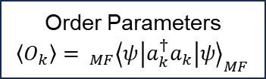
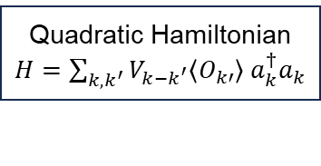

Interacting quantum problem
Quadratic Hamiltonian
$H=\sum_{k,k^{′}}{V_{k−k^{′}}\left\langle O_{k′}\right\rangle }$ $a_{k}^{†}a_{k}$
Hartree-Fock Approximation
Candidate states
Quantum phase diagram
Self-consistency
Energetically favorable states
Eigenstate ${\left|ψ\right\rangle }_{MF}$
Order Parameters
$\left\langle O_{k}\right\rangle ={ _{MF}\left\langle ψ\left|a_{k}^{†}a_{k}\right|ψ\right\rangle }_{MF}$
Self-consistent diagonalization

Slide 8

Hartree and Fock terms
Interacting quantum Hamiltonian
Fourier transform
Hamiltonian in momentum space
Wick’s theorem
Mean field decomposition
Simplify
Order Parameters

Slide 9
STEP 1:
Interacting quantum Hamiltonian
STEP 2:
Hamiltonian in momentum space
STEP 3:
Mean field decomposition
STEP 4:
Hartree and Fock terms
STEP 5:
Order Parameters
Lattice
Continuum
Identify order parameters in Hartree term
✘
First-quantized
Identify kinetic term (lattice)
Fourier transform noninteracting term to momentum space (lattice)
Wick's theorem expansion
Identify momentum transfer in interaction
Identify order parameters in Fock term
✓
Second-quantized
Identify interaction term (real space)
Fourier transform interacting term to momentum space (lattice)
Drop constant terms
Combine Hartree/Fock terms
Final form of interaction in quadratic terms

Slide 10
Choose method of HF
Define standard template for info extraction for HF
Template standard format + blanks
Prompt for reproduction
LLM info extraction
Papers
Choose a paper to reproduce
Yes
If using HF
No
Leave out
Template for
STEP i + blanks
Step i:
The Hamiltonian of {system} is ...
Human
Scoring
Score: 2
HF Framework Step 1: ...
Step 2: ...
Step 3: ...
Start with STEP i
Prompt
Given the following excerpt, fill the placeholders in the template. EXECERPT:
In this paper, we study the free fermion problem ... TEMPLATE:
The Hamiltonian of {system} is ...
Human
Output prompt for STEP i
The Hamiltonian of free fermion is ...
Extractor LLM
Rectifying
System : free fermion
...
Papers
Paper
\title{Title}
\begin{document}
...
\end{document}
Step-specific excerpt
In this paper, we study the free fermion problem ...
Correct output prompt for STEP i

Slide 11
Locate the position of requisite info
Read the portion for info extraction
Human purposeful reading
Papers
Choose a paper to read
Yes
If using HF
No
Leave out

Slide 12
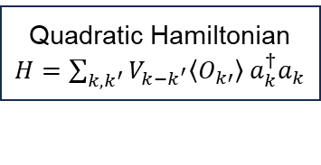


a
Interacting quantum problem
Quadratic Hamiltonian
$H=\sum_{k,k^{′}}{V_{k−k^{′}}\left\langle O_{k′}\right\rangle }$ $a_{k}^{†}a_{k}$
Hartree-Fock Approximation
Self-consistency
Eigenstate ${\left|ψ\right\rangle }_{MF}$
Order Parameters
$\left\langle O_{k}\right\rangle ={ _{MF}\left\langle ψ\left|a_{k}^{†}a_{k}\right|ψ\right\rangle }_{MF}$
Hartree and Fock terms
b
Mean field decomposition
Interacting quantum Hamiltonian
Fourier transform
Hamiltonian in momentum space
Wick’s theorem
Simplify
Order Parameters
c
Locate the position of requisite info
Read the portion for info extraction
Human purposeful reading
Papers
Choose a paper to read
Yes
If using HF
No
Leave out

Slide 13
a
STEP 1:
Interacting quantum Hamiltonian
STEP 2:
Hamiltonian in momentum space
STEP 3:
Mean field decomposition
STEP 4:
Hartree and Fock terms
STEP 5:
Order Parameters
Identify order parameters in Hartree term
Identify kinetic term (lattice)
Fourier transform noninteracting term to momentum space (lattice)
Wick's theorem expansion
Identify momentum transfer in interaction
Identify order parameters in Fock term
b
Identify interaction term (real space)
Fourier transform interacting term to momentum space (lattice)
Drop constant terms
Combine Hartree/Fock terms
Final form of interaction in quadratic terms
c
① Button Press
Project-specific information
system: free fermion
...
Standardize prompt template
STEP 1 Task i:
The Hamiltonian of {system} is ...
Human
Scoring
Physics logic: 1
Math derivation: 2
...
Human
Prompt 1
Task i:
The Hamiltonian of free fermion is ...
Output
The Hamiltonian of free fermion is $H=\sum_k\frac{k^2}{2m} c_k^\dag c_k$ ...
Rectifying
$H=\frac{1}{N_k}\sum_k\frac{k^2}{2m} c_k^\dag c_k$ ...
Execution LLM
Correct output STEP 1
② Conveyor Belt
Output STEP i
Template STEP i+1
…
Choose method of HF
Define standard template for info extraction for HF
Template standard format + blanks
Prompt for reproduction
LLM info extraction
Papers
Choose a paper to reproduce
Yes
If using HF
No
Leave out
Template for
STEP i + blanks
Step i:
The Hamiltonian of {system} is ...
Human
Scoring
Score: 2
HF Framework Step 1: ...
Step 2: ...
Step 3: ...
Start with STEP i
Prompt
Given the following excerpt, fill the placeholders in the template. EXECERPT:
In this paper, we study the free fermion problem ... TEMPLATE:
The Hamiltonian of {system} is ...
Human
Output prompt for STEP i
The Hamiltonian of free fermion is ...
Extractor LLM
Rectifying
System : free fermion
...
Papers
Paper
\title{Title}
\begin{document}
...
\end{document}
Step-specific excerpt
In this paper, we study the free fermion problem ...
Correct output prompt for STEP i

Slide 15

Physicist
P_{i}
: i-th prompt
: Solver LLM
$$\sum_{k=1}^{i}{ }$$
S_{i}
P_{i}
R_{i}
R_{i}
: i-th response
: Summarizer LLM
Naïve way
Summarization way (due to max token)
Round 1
P₁
Solver
P₁
Solver
P₁
R₁
P₁
R₁
Summarizer
Round 2
P₁
R₁
P₂
S₁
P₂
P₁
R₁
P₂
R₂
S₁
P₂
R₂
Round 3
P₁
R₁
P₂
R₁
P₃
S₂
P₃
R₃
R₃
Final
results
P₁
R₁
P₂
R₂
P₃
R₃
Final results
P₁
R₁
P₂
R₂
P₃
R₃
However, this naïve way can easily exceed the maximal token that GPT4 can support.

Slide 16
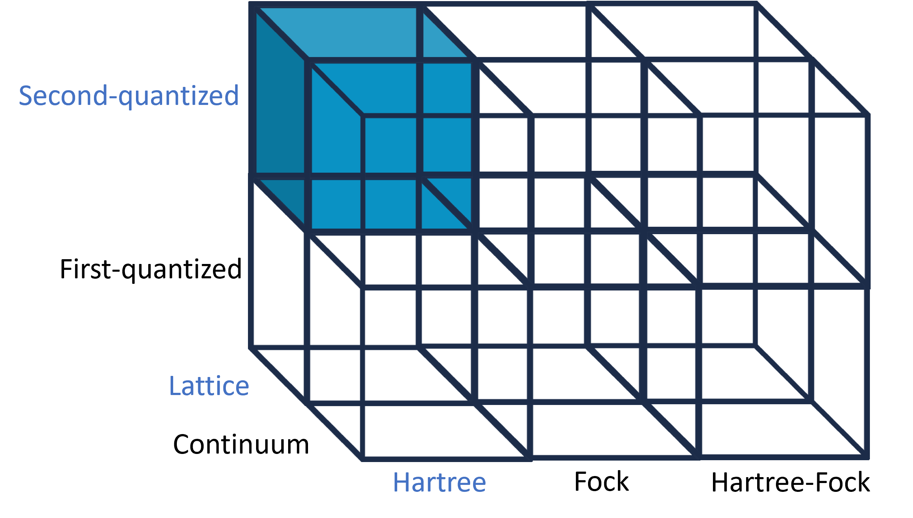
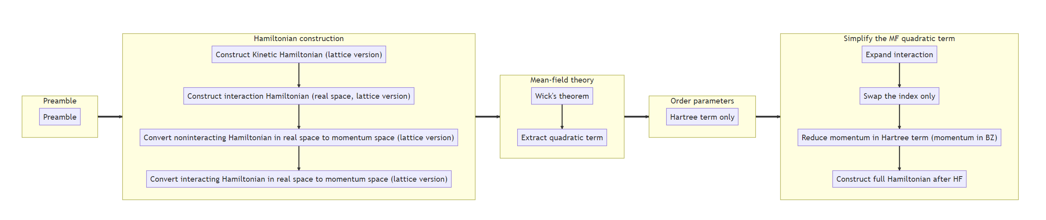
Extractor

Slide 17
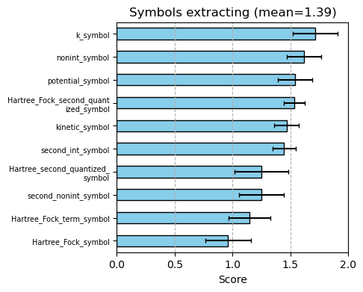
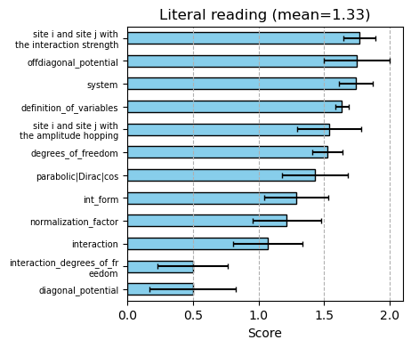
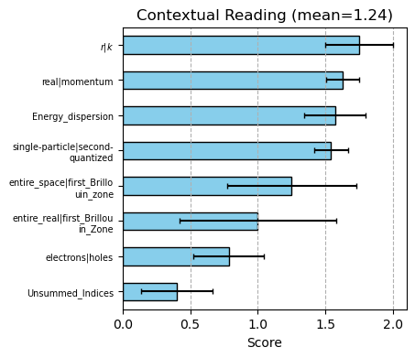
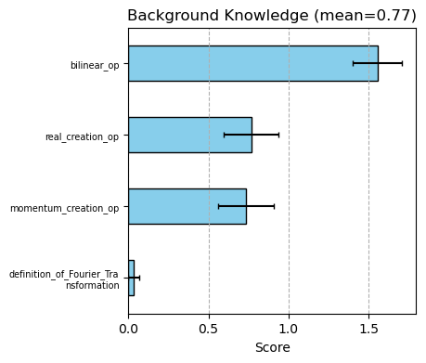
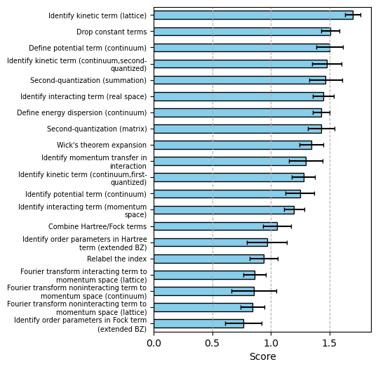
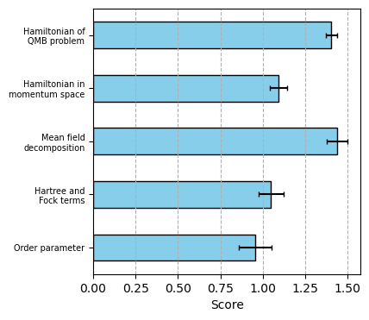
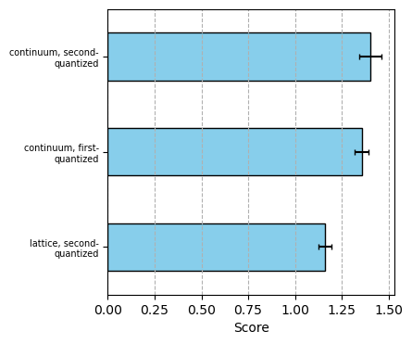
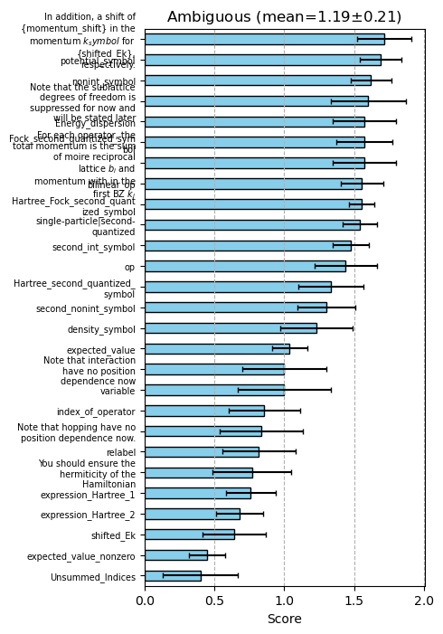
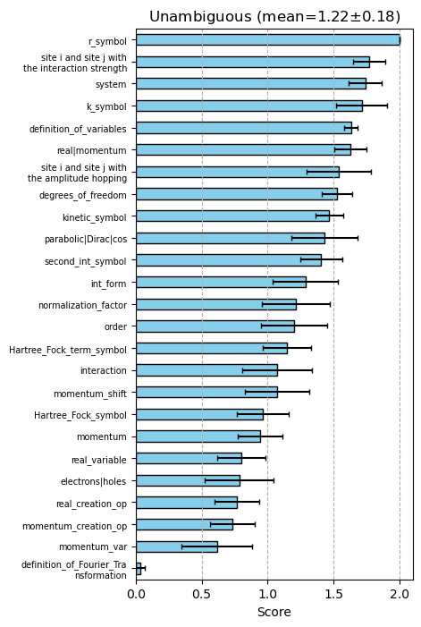
Results of reading
Notes:
* (Mean is Average of each placeholder)
(all these results are some representative placeholders)
(the placeholder name is too technical/not intuitive)
(a) The ability of extracting a symbol for a quantity from the paper
(b) The ability of reading information literally in the paper
(c)
(d)
(e) Score by tasks. (can be decompose further to type of task)
(f) Score by branch
(g,h) score by ambiguity, does not have a good story here, it seems that the ambiguity does not have significant effect.

Slide 18
Take average value between Y and H
Right now there are excessive figures, which I decide to put all and trim later

Slide 19
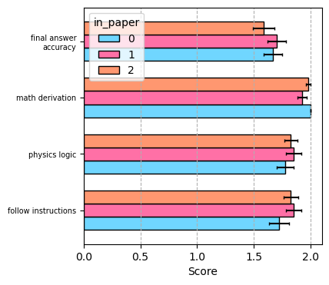
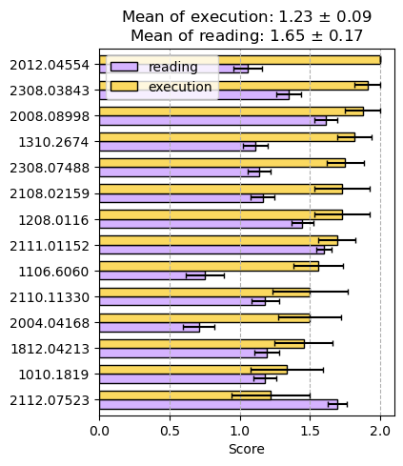
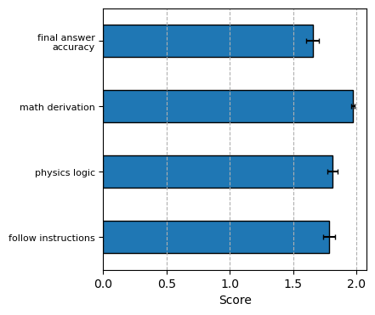
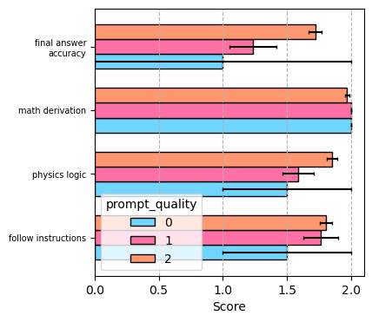
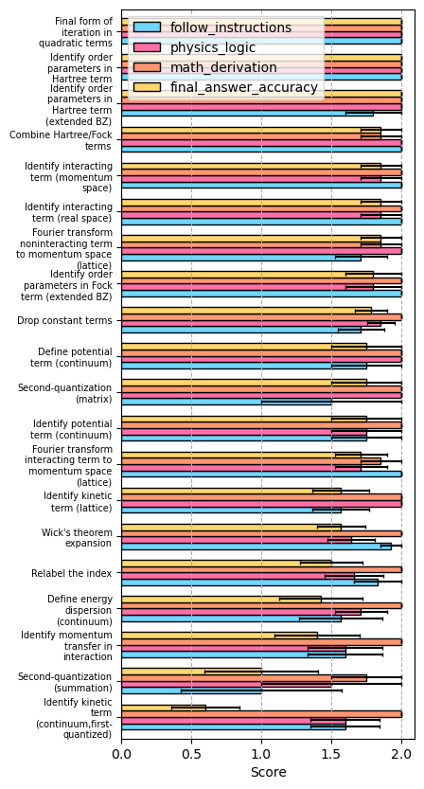
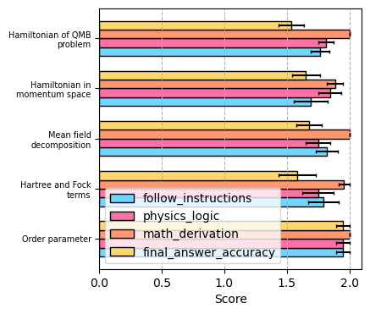
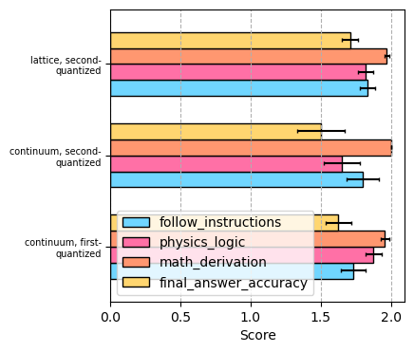
Notes:
(a) A direct visualization of execution is better than reading
(b) Four aspect
(c) Whether the answer is already in the paper, no significant difference
(d) Prompt quality has impact on the final answer accuracy , but not for math derivation
(e) Scores grouped by tasks [(1) Too much info and details, hard to read (2) There are some cases, where it score the full in the final accuracy but did not score full in individual aspects. Because (1) some results even give me the answer for the next task before I asked. (2) some prompt simply ignore my sign convention, but the final answer is physically correct. For example, t->-t in NN honeycomb lattice, just differ by a particle hole]
(f) Now grouped by type of task. The most difficult part is constructing the Hamiltonian, while the LLM an do the simplify order parameter well very. For math derivation it is mostly independent of the type of task
(g) Different branchs do not show particular differences

Slide 20
Example of correction happens at execution stage

