Slide 1
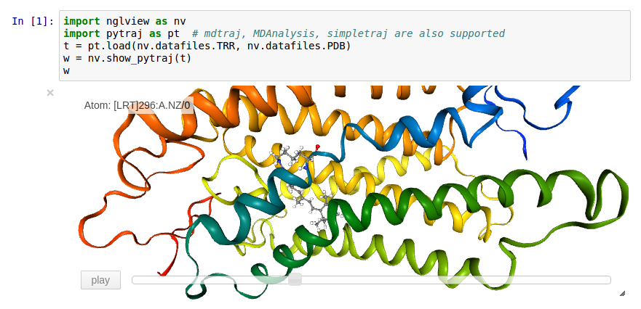
Pytraj, nglview: bring AmberTools to Python ecosystem

Slide 2
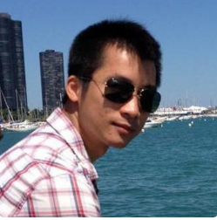

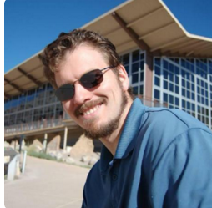
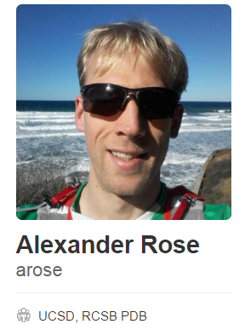
Team

Slide 3
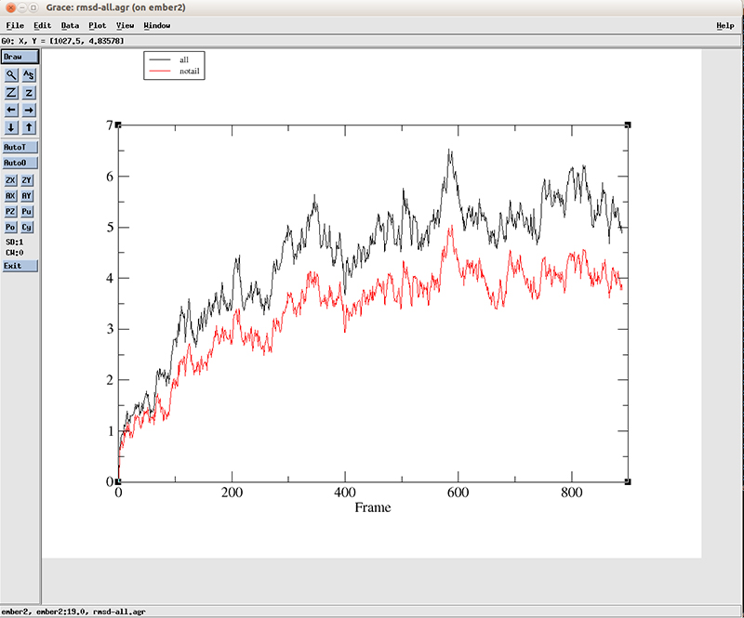
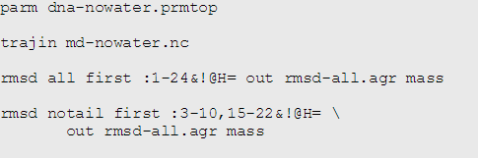
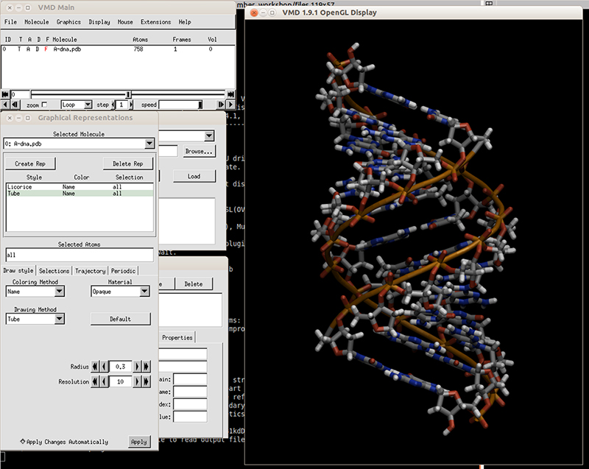
http://www.amber.utah.edu/AMBER-workshop/London-2015/DNA-tutorial/

Slide 4
Simpler workflow?
Not a professional programmer but still want to write cool analysis? (ask Dan?)
Read new trajectory format that cpptraj does not support? (XTC, ...)
Write parallel code for analysis? (Hint: how we can make parallel calculation with only one line of code?)
Interface with other programs? (pyrosetta, rdkit, cclib, …)

Slide 5
