Slide 1

Linear Regression with Multiple Variables

Slide 2

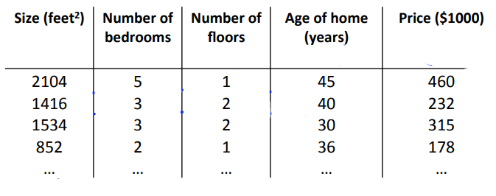
Multiple Feature
Have many information to evaluate something
Eg: Predict house price

Slide 3

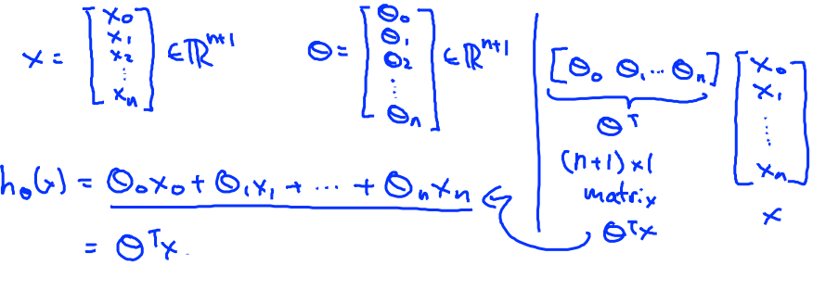
Hypothesis one variable
Hypothesis multiple variables
Represent by matrix

Slide 4
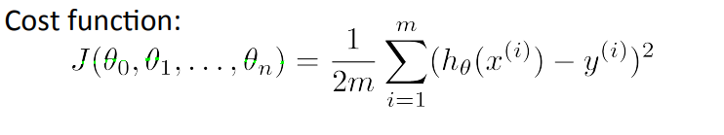
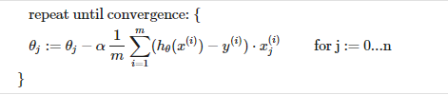
Gradient descent for multiple variables
Find theta

Slide 5
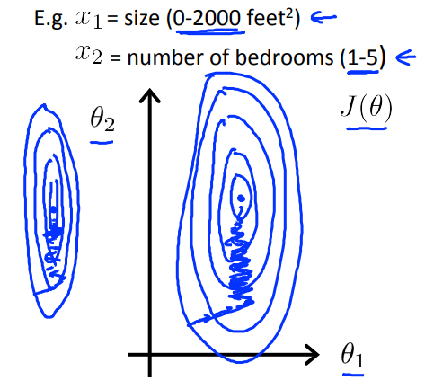
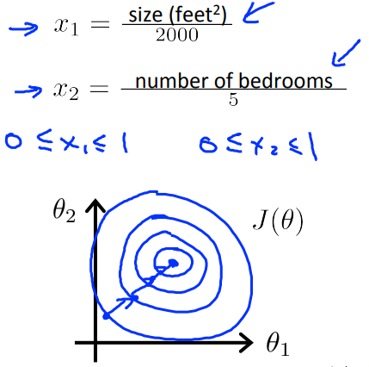
Feature Scaling
Why? ->>> Data contains feature highly varying in magnitudesm units and range
->>> Machine learning user Euclidean distance between 2 data point in their computations
Get every feature into approximately a -1 < X < 1 range

Slide 6
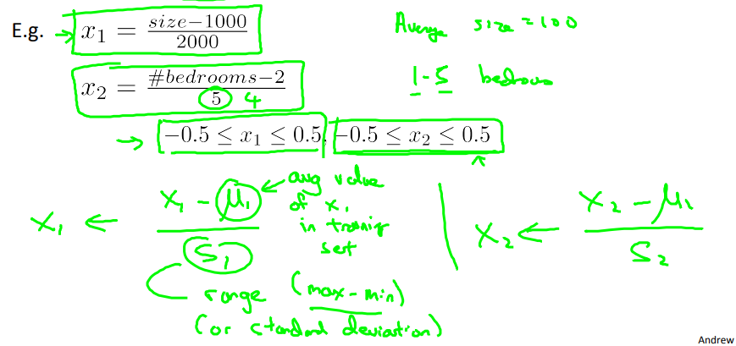
Mean normalization
Replace $x_{i}$ with${ x}_{i}− μ_{i}$ to make features have approximately zero mean

Slide 7

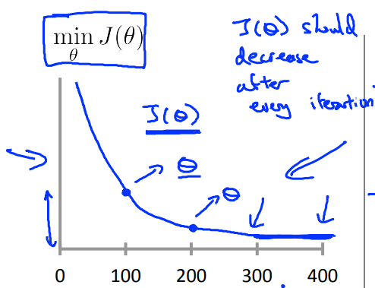
Learning rate
Make gradient descent working correctly
How to choose learning rate
Making sure gradient working correctly
=>> Test convergence
=>> Convergence if J(ϴ) decreases by less than epsilon small in one interation

Slide 8
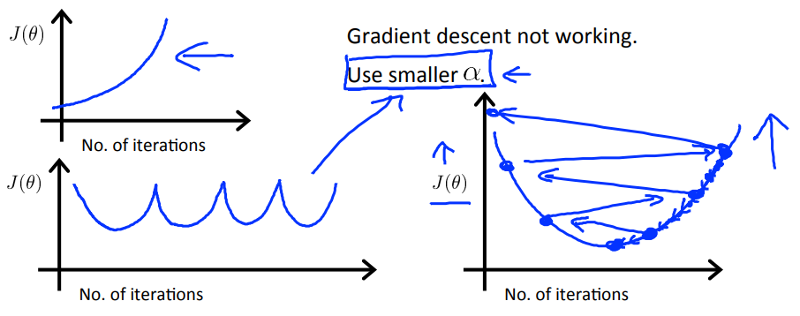
Case learning rate too big =>> Overshoot, can’t convergence
Solution: Decrease learning rate
Note: If learning rate too small, gradient descent can be slow to convergence

Slide 9
Step to choose fit learning rate
Draw figure to see J function
Choose α small enough for fas convergence and avoid overfit

Slide 10
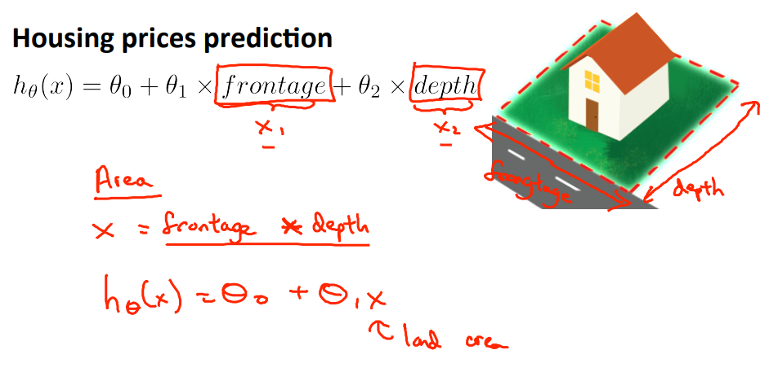
Features and polynomial regression
Why ? =>> To decrease feature, find not only linear regression but also polynomial regression function
Eg:

Slide 11
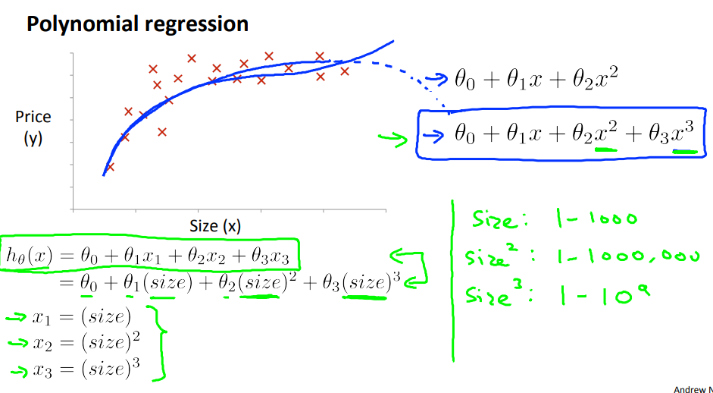
Problems: Some function cannot fit in data

Slide 12
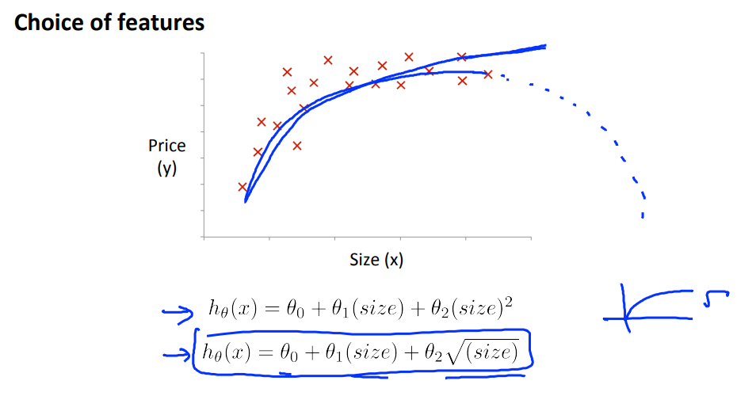
Solution: Depend on data set to choose function may be fit all data

Slide 13
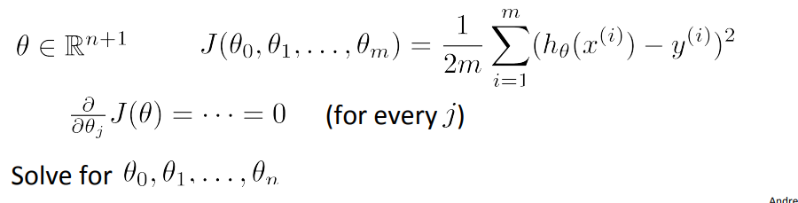

Normal equation
➔ Method to solve for ϴ analytically, don’t need use gradient descent
➔ Convert data to matrix to solve

Slide 14
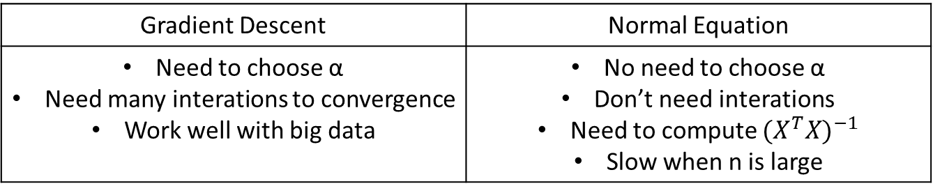
Advantage and Disadvantage 2 method
Gradient Descent | Normal Equation
Need to choose α Need many interations to convergence Work well with big data | No need to choose α Don’t need interations Need to compute ${(X^{T}X)}^{−1}$ Slow when n is large

Slide 15

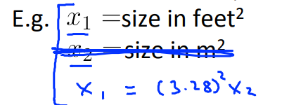
Normal equation noninvertibility
Don’t have invert
➔ Linearly dependent

