Slide 1
Linux DRM
haipingye/CE
2020/03/05
©2019 JLQ Technology Company Confidential

Slide 2
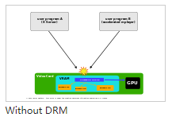
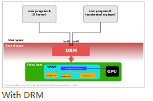
Introduction to DRM
DRM (Direct Render Manager)
The Direct Rendering Manager (DRM) is a subsystem of the Linux kernel responsible forinterfacing with GPUs of modern video cards. DRM exposes an API that user space programscan use to send commands and data to the GPU, and perform operations such as configuringthe mode setting of the display. DRM was first developed as the kernel space component ofthe X Server's Direct Rendering Infrastructure,[1] but since then it has been used by othergraphic stack alternatives such as Wayland. (https://en.wikipedia.org/wiki/Direct_Rendering_Manager)
DRM allows multiple programs concurrently access to the 3D video card avoiding collisions

Slide 3
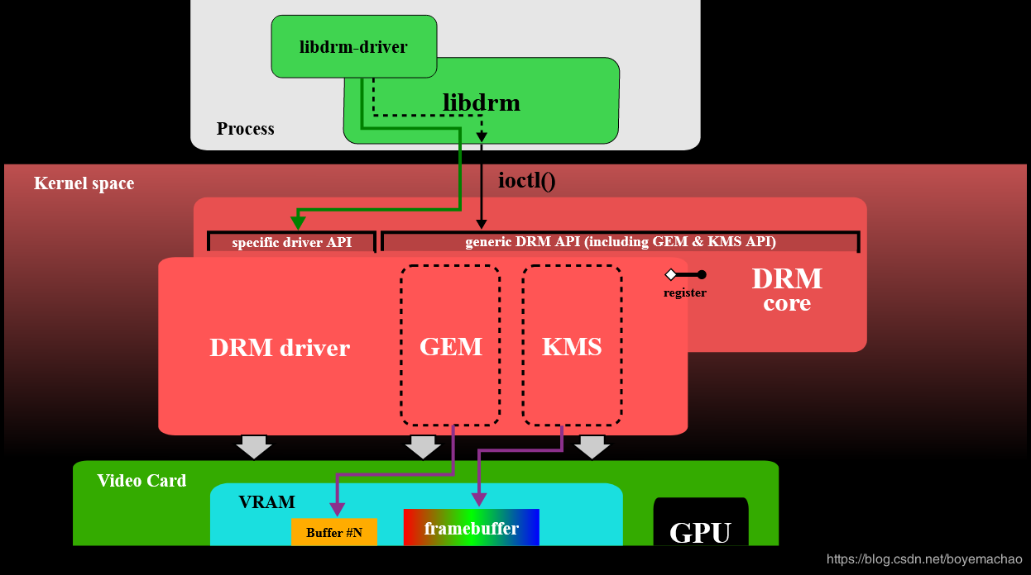
DRM architecture
Libdrm
KMS (Kernel Mode Setting)
GEM (Graphics Execution Manager)

Slide 4
libdrm
对底层接口进行封装，向上层提供通用的API接口，主要是对各种IOCTL接口进行封装。

Slide 5
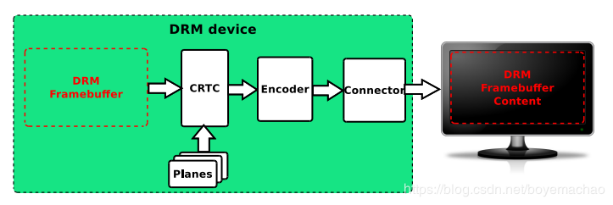
KMS
Kernel Mode Setting，所谓Mode setting，其实说白了就两件事：更新画面和设置显示参数。 更新画面：显示buffer的切换，多图层的合成方式，以及每个图层的显示位置。 设置显示参数：包括分辨率、刷新率、电源状态（休眠唤醒）等。
CRTCs
Encoders
Connectors
Planes
FB
VBLANK
Property

Slide 6
GEM
主要负责显示buffer的分配和释放，也是GPU唯一用到DRM的地方

Slide 7
CRTCs

Slide 8
Encoders

Slide 9
Connectors

Slide 10
Planes

Slide 32
©2019 JLQ Technology Company Confidential

