Slide 1
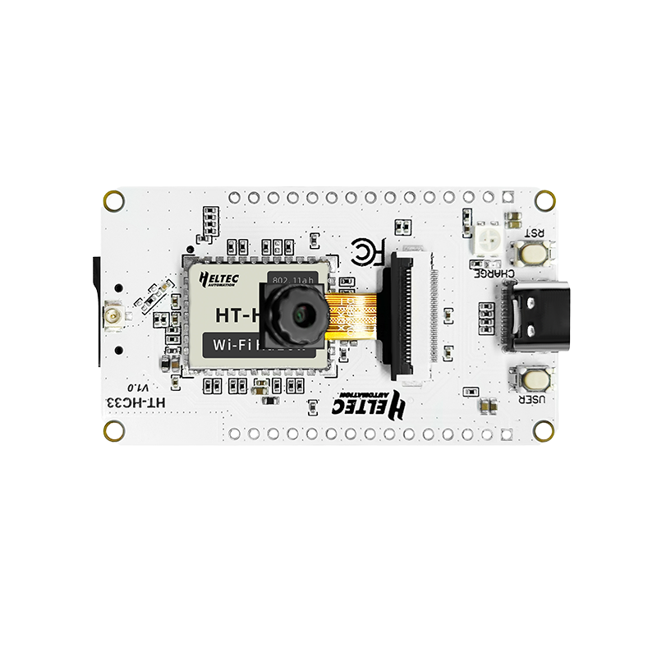
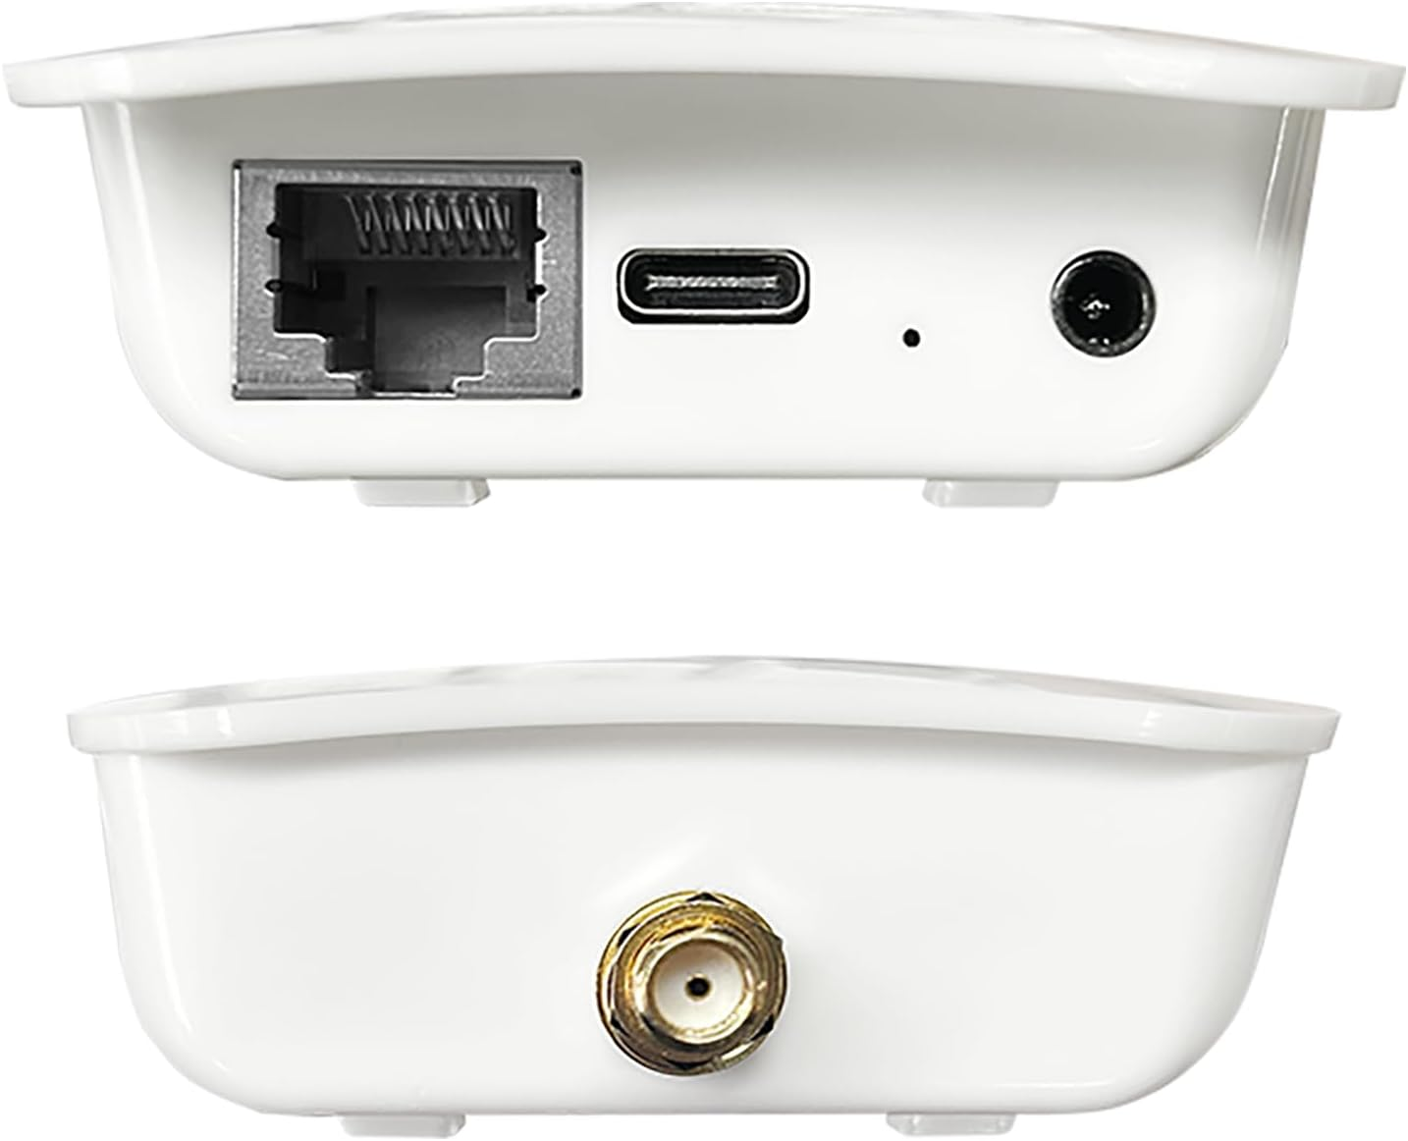
SageHaLow
A Low-Cost Modular Environmental Sensing Platform Using Wi‑Fi HaLow and the SAGE Edge Infrastructure
Hairik Honarchian Saki Ben Owusu-Amo
SAGE Summer Camp 2026 Electronic Visualization Laboratory (EVL)
University of Illinois Chicago
A proof-of-concept demonstrating long-range Wi-Fi HaLow communication between
low-cost sensing devices and the SAGE Edge Platform.

Slide 2
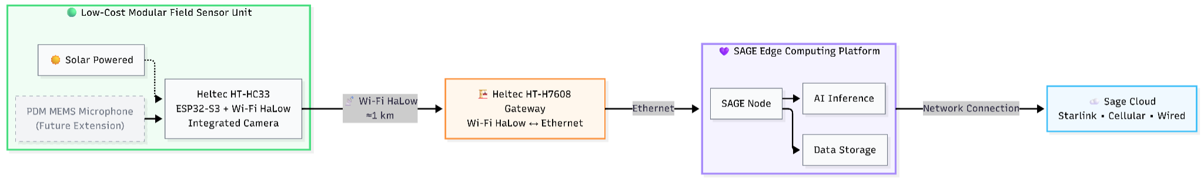
System Architecture
• Low-cost modular environmrntal sensing platform
• Long-range Wi‑Fi HaLow communication (~1 km)
• Integration with the SAGE Edge Platform

Slide 3
Project Accomplishments
Milestone | Outcome
Hardware | Configured and tested the Heltec HT-HC33 camera platform.
Communication | Established long-range Wi-Fi HaLow communication through the HT-H7608 gateway.
SAGE Integration | Transferred images to the SAGE Edge Platform.
System Validation | Demonstrated a low-cost environmental sensing architecture.

Slide 4
Future Development
Near-Term Development
• PDM MEMS microphone integration
• Event-driven image capture
Long-Term Vision
• Edge AI Inference
• Scalable environmental monitoring
The modular SageHaLow architecture provides a scalable foundation
for future AI-enabled environmental monitoring.

Slide 5
Learn More
GitHub Repository
github.com/hairikhs/sage-summer-camp-2026
Repository Contents
• Project Report
• System Architecture
• Firmware Documentation
• Future Development
Project materials and future updates are available in the GitHub repository.

