Slide 1

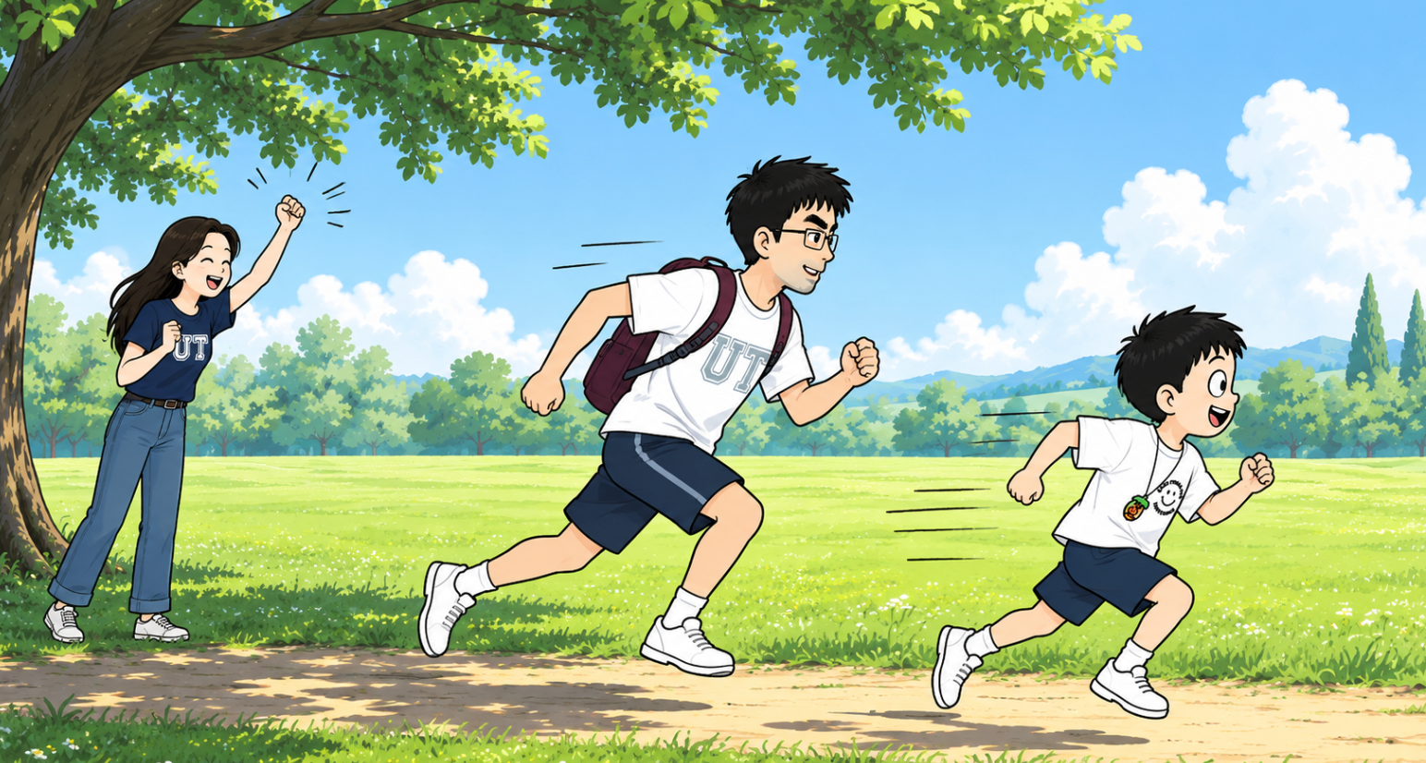
梦蝶世界(1)
Yǒu yì tiān, Pípí hé bàba zài shù yīn xià sài pǎo
有一天，皮皮和爸爸在树荫下赛跑
One day, Peter raced with Dad under a shady tree.
Māma yì shēng lìng xià Pípí xiàng huǒ jiàn yí yàng chōng le chū qù
妈妈一声令下。 皮皮 像 火箭 一样 冲了 出去！
“Ready, go!” Mom called. Peter shot off like a rocket!

Slide 2
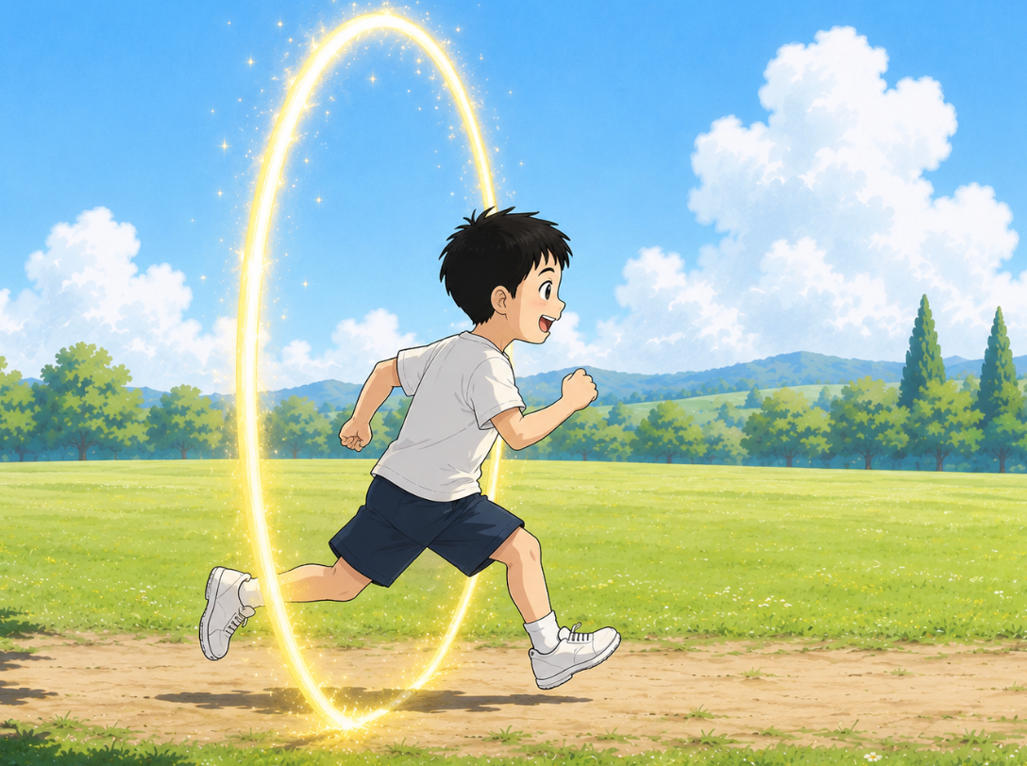
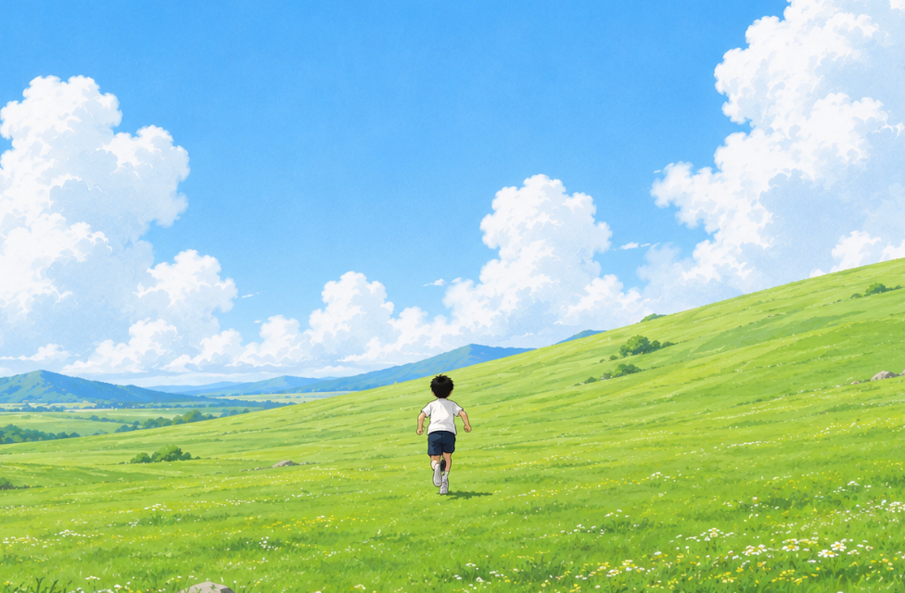
Pípí pǎo a pǎo a
Tā méi yǒu fā xiàn zìjǐ chuān guò le yí dào guāng quān
皮皮跑啊，跑啊。
他没有发现， 自己穿 过 了一道 光 圈。
Peter ran and ran.
He did not notice
a glowing portal.
Hūrán, sì zhōu dōu biàn le
Zhè lǐ bú shì gōng yuan shì yí piàn dà cǎo yuán
忽然，四周都变了。
这里不是公园，是一片大草原！
Suddenly, everything changed.
This was not the park.
It was a huge grassland!

Slide 3
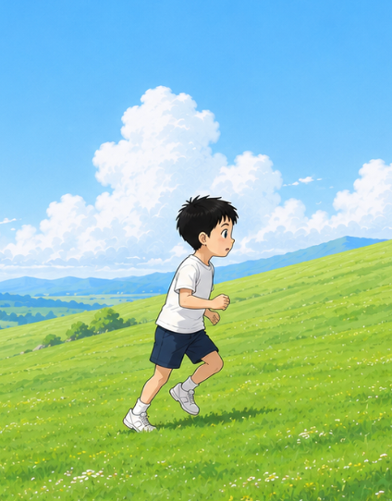
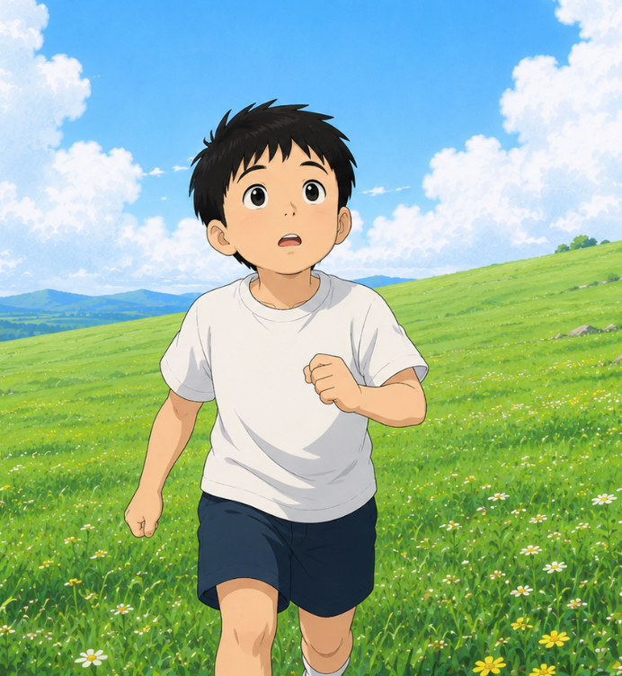
Pípí zuǒ kàn kan, yòu kàn kan.
Bàba māma dōu bú jiàn le
皮皮左看看，右看看。
爸爸妈妈都不见了。
Peter looked left.
He looked right.
Mom and Dad were gone.
Hū rán, yí ge sheng yīn xiǎng qǐ lai
忽然，一个声音响起来：
"Huān yíng lái dào Mèng dié Shì jiè!"
Then a voice said,
"欢迎来到梦蝶世界！"
"Welcome to Dream Butterfly World!"

Slide 4
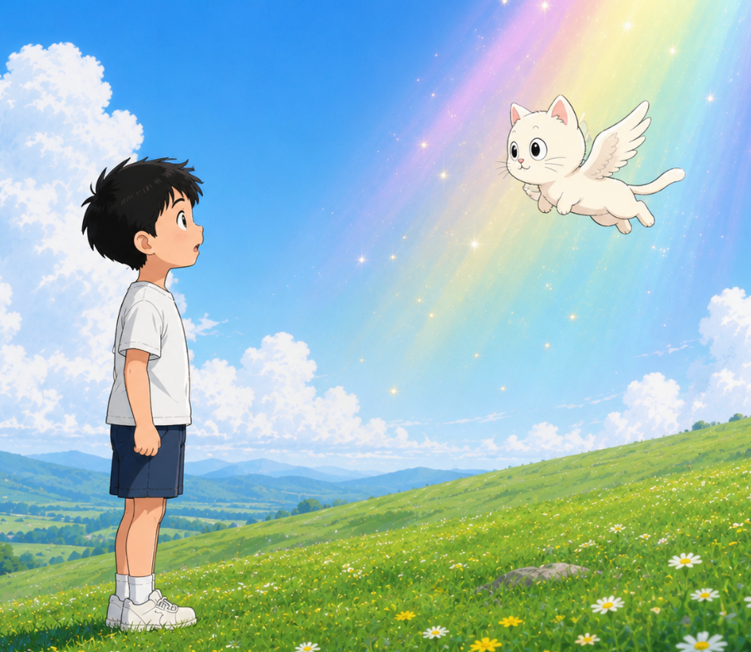
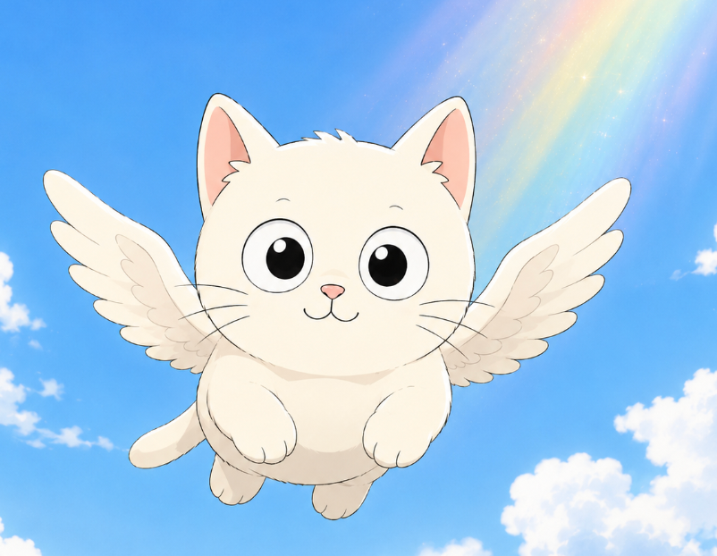
Pípí tái qǐ tóu. Yí dào cǎi guāng shǎn guò.
Yì zhī zhǎng zhe chì bǎng de xiǎo māo fēi le chū lái.
皮皮抬起头。一道彩光闪过。
一只 长 着 翅 膀 的 小 猫 飞了出来。
Peter looked up.
A rainbow flash filled the sky.
A little winged cat flew down.
Pípí wèn: "Nǐ shì shéi?"
Xiǎo māo xiào le.
皮皮问："你是谁？"
小猫笑了。
"Who are you?”, asked Peter.
The little cat smiled.

Slide 5
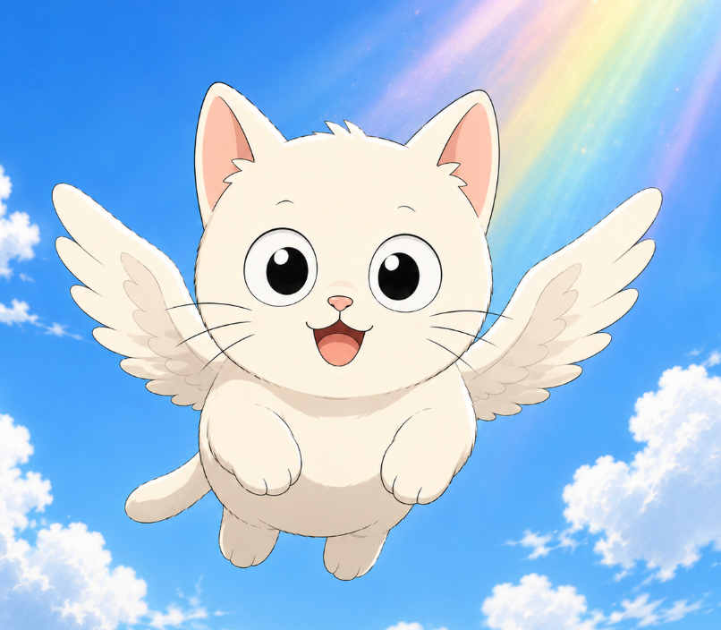
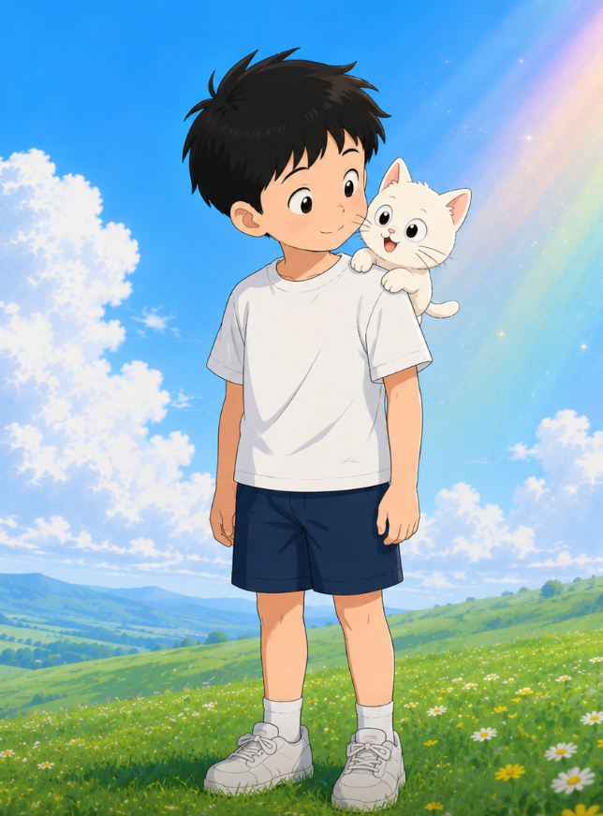
Wǒ jiào Fish.”
"Wǒ shì Mèng dié Shì jiè de jīng líng xiàng dǎo."
"我叫小鱼。"
“ 我 是 梦 蝶 世 界的 精 灵 向 导。"
"My name is Fish.
I am the guide of Dream Butterfly World."
Xiǎo yú fēi dào Pípí jiān shàng
niǐ de bēn pǎo dǎ kāi le Mèng dié Shì jiè
“Xiǎng hé wǒ yì qǐ qù tàn suǒ ma?”
Pípí xiào le. “Dāng rán xiǎng!"
小鱼飞到皮皮肩上。
"你的奔跑打开了梦蝶世界。"
“想和我一起去探索吗？"
皮皮笑了。"当然想！"
Fish landed on Peter’s shoulder.
“Your fast run opened Dream Butterfly World."
“Would you like to explore it with me?"
Peter smiled. "Yes!"

Slide 6
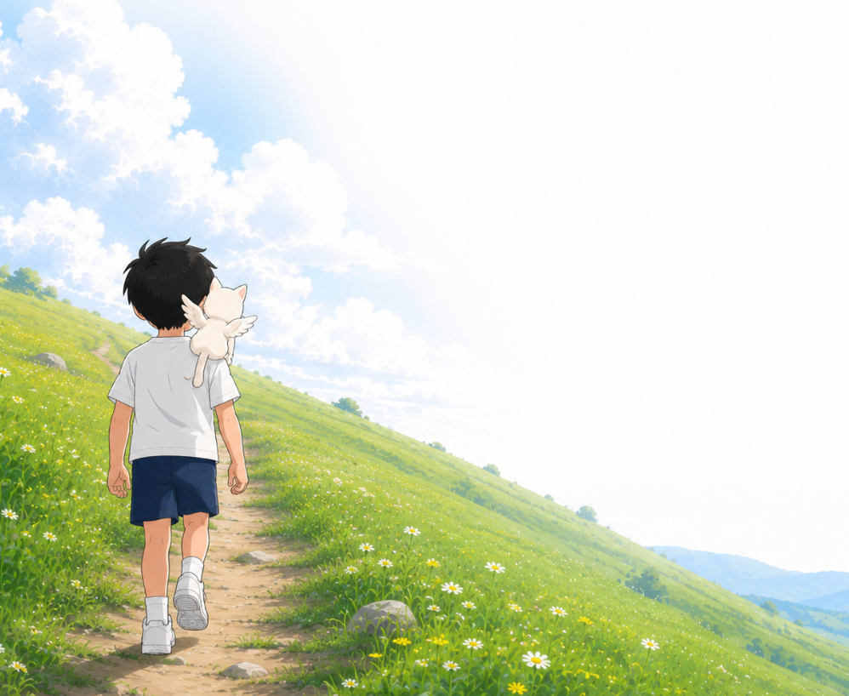
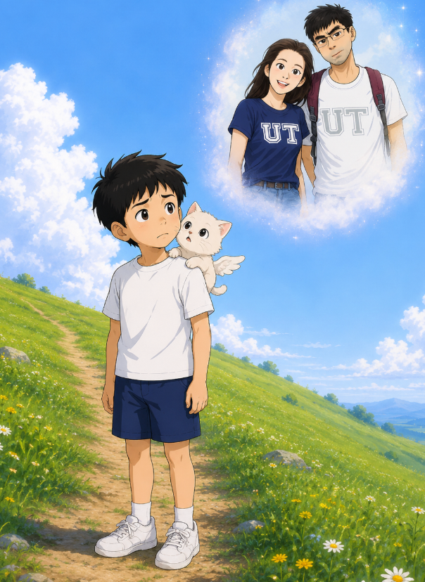
梦蝶世界(2)
pí pí hé xiǎo yú yì qǐ wǎng qián zǒu
皮皮和小鱼一起往前走。
yuǎn chù yǒu gāo gāo de shān
远 处 有 高高 的山，
hái yǒu bái bái de yún
还有 白白的云。
Peter and Fish walked on.
There were tall mountains and white clouds ahead.
zǒu zhe zǒu zhe
走着走着，
pí pí hū rán tíng xià
皮皮忽然停下。
bà ba mā ma zhǎo bú dào wǒ
“爸爸 妈妈 找 不 到 我，
huì bú huì hěn zháo jí
会不会很着急？”
Peter stopped.
“Will Mom and Dad be worried
because I am gone?”

Slide 7

xiǎo yú xiào zhe shuō
小鱼笑着说：
bié dān xīn lái dào zhè lǐ de zhǐ shì nǐ de mèng
“别担心。来到这里的，只是你的梦。”
bì shàng yǎn jing xiǎng yì xiǎng
“闭上眼睛，想一想。”
pí pí qīng qīng bì shàng yǎn
皮皮轻轻闭上眼。
pí pí kàn jiàn zì jǐ yíng le bǐ sài
皮皮看见，自己赢了比赛。
bà ba xiào zhe bǎ tā jǔ de gāo gāo de
爸爸笑着，把他举得高高的。
Fish smiled.
“Don’t worry. Only your dream is here.”
“Close your eyes,” said Fish. “Think.”
Peter gently closed his eyes.
Peter saw himself win the race.
Dad smiled and lifted him
high into the air.

Slide 8
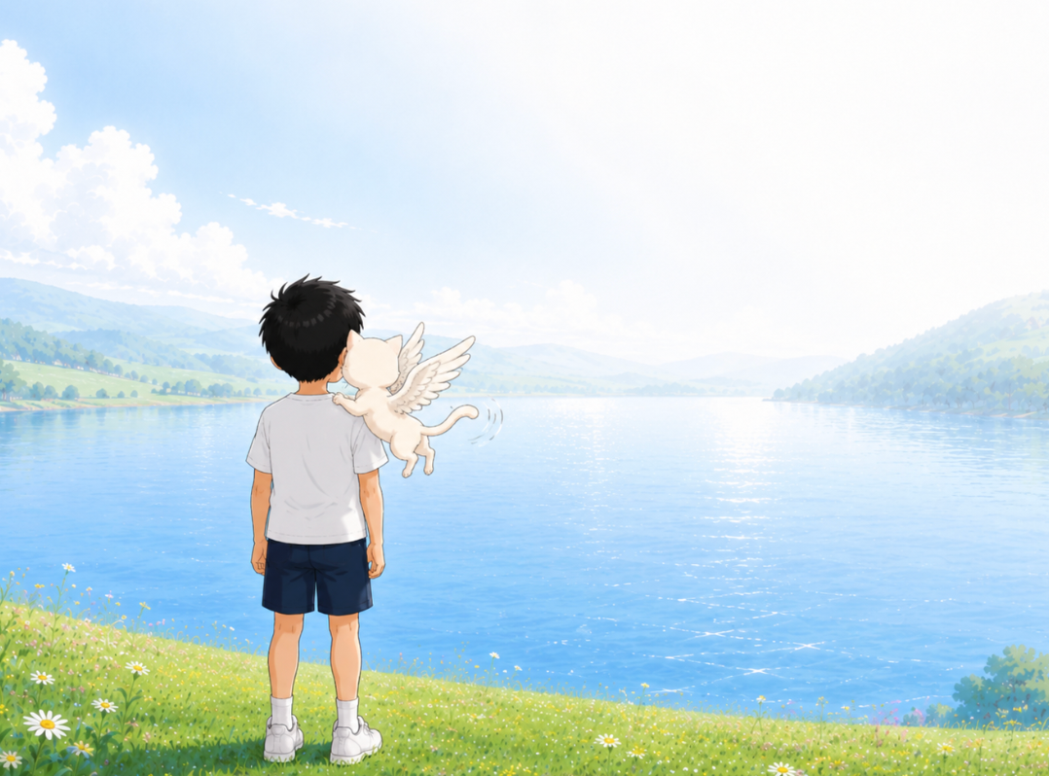
pí pí fàng xīn le
皮皮放心了。
wǒ men xiàn zài yào qù nǎ lǐ
“我们现在要去哪里？”
xiǎo yú huī huī wěi ba
小鱼挥挥尾巴。
qù jiàn wǒ de hǎo péng you
“去见我的好朋友！”
tài hǎo le pí pí gāo xìng de shuō
“太好了！”皮皮高兴地说。
tā men fān guò shān pō yòu zǒu guò shān gǎng
他们翻过山坡，又走过山岗。
hū rán yí piàn dà hú chū xiàn zài yǎn qián
忽然，一片大湖出 现 在 眼 前。
Peter felt better.
“Where are we going now?”
Fish waved its tail.
“We are going to meet my friend!”
“Great!” said Peter.
They crossed a hill.
Then another.
Suddenly, a huge lake appeared.

Slide 9
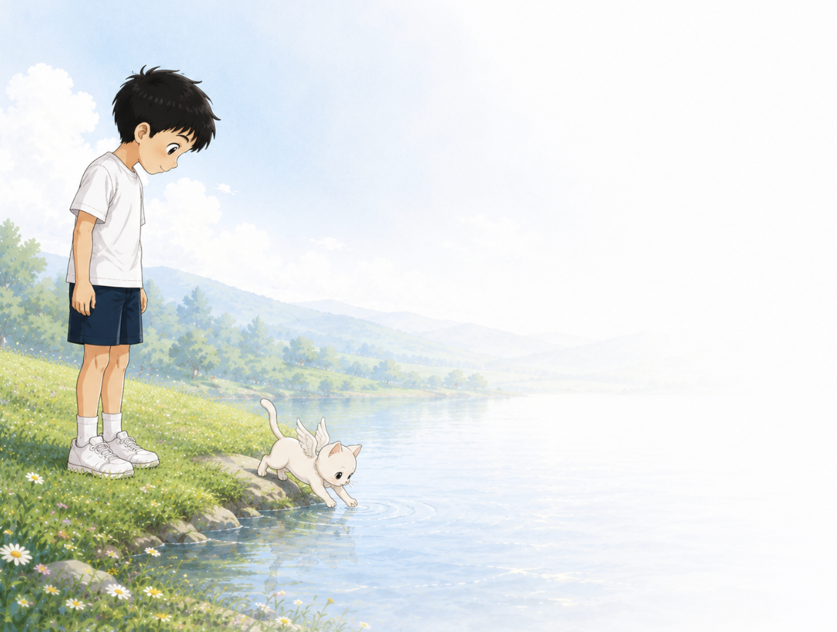
Wā pí pí zhēng dà yǎn jing zhè ge hú bǐ wǒ jiā de hú dà hǎo duō ya
“哇！”皮皮睁大眼睛。 “这个湖比我家的湖大好多呀！”
nǐ de péng you ne pí pí wèn
“你的朋友呢？”皮皮问。
xiǎo yú zhǎ zhǎ yǎn shēn chū máo róng róng de xiǎo zhuǎ zi
小鱼眨眨眼， 伸出毛绒绒的小爪子，
qīng qīng zhǐ xiàng hú miàn
轻轻指向湖面……
pí pí zhǎ le zhǎ yǎn
皮皮眨了眨眼。
hú miàn píng píng jìng jìng shén me yě méi yǒu
湖 面 平 平 静 静， 什么也没有。
pí pí kàn xiàng xiǎo yú
皮皮看向小鱼。
xiǎo yú tiào dào hú biān
小鱼跳到湖边，
bǎ xiǎo zhuǎ zi qīng qīng fàng jìn hú shuǐ lǐ
把小爪子 轻轻 放进湖水里。
“Wow!” Peter opened his eyes wide.
“This lake is much bigger than the one at home!”
“Where is your friend?” asked Peter.
Fish blinked, lifted a fluffy paw,
and pointed at the lake...
Peter blinked.
The lake was calm.
There was nothing there.
Peter looked at Fish.
Fish hopped to the lake
and dipped a tiny paw into the water.

Slide 10
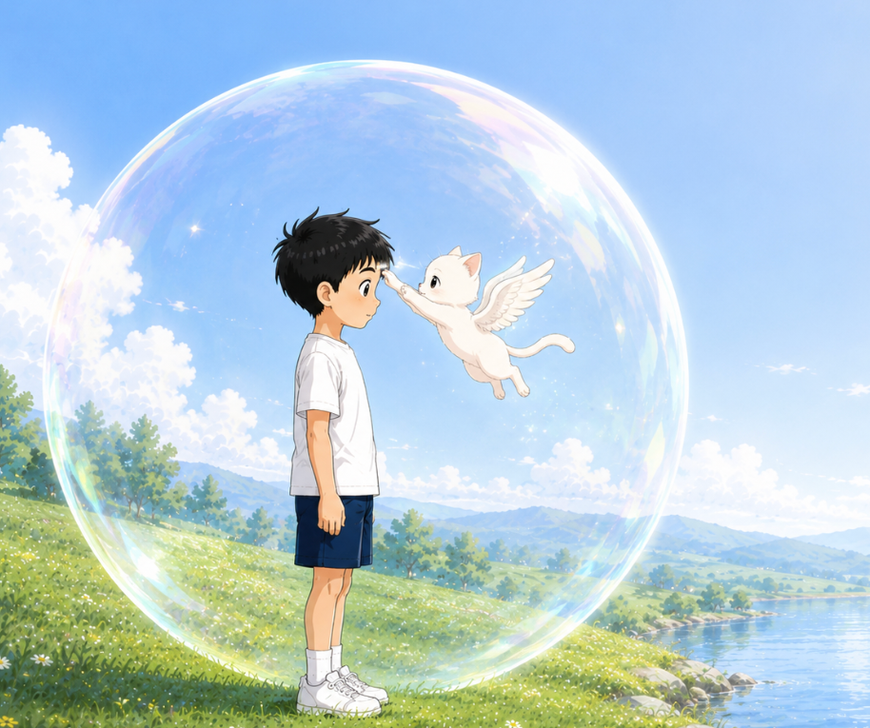
Fish stood up.
Its little front paws came together,
then turned in a circle.
Fish flew to Peter.
It gently touched the middle of
Peter’s forehead.
A tiny drop of water grew bigger.
In a blink, it became a giant bubble!
The giant bubble wrapped around them.
Peter reached out and touched it.
xiǎo yú zhàn le qǐ lái
小鱼站了起来。
liǎng zhī qián zhuǎ qīng qīng yì hé yòu zhuàn le yì quān
两只前爪轻轻一合，又转了一圈。
xiǎo yú fēi dào pí pí miàn qián
小鱼飞到皮皮面前。
tā shēn chū yòu zhuǎ qīng qīng diǎn le yí xià pí pí de méi xīn
它 伸 出 右 爪，轻 轻 点 了一下皮皮的眉心。
yì dī xiǎo shuǐ zhū màn màn biàn chéng le yí ge dà pào pao
一滴小水珠，慢慢变成了一个大泡泡！
dà pào pao bǎ tā men bāo le qǐ lái
大泡泡把他们包了起来。
pí pí qīng qīng shēn chū shǒu pèng le yí xià
皮皮轻轻伸出手，碰了一下。

Slide 11
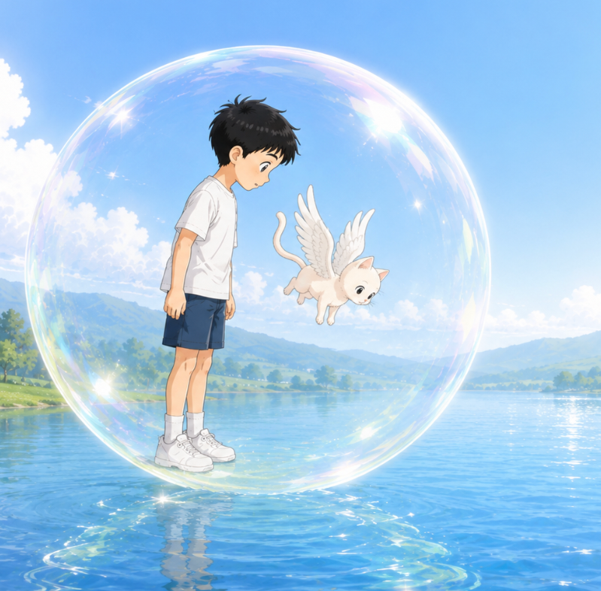
pào pao qīng qīng yáo le yáo
泡泡轻轻摇了摇。
yí dào cǎi hóng guāng màn màn liú guò qù
一道彩虹光慢慢流过去。
wā pí pí kàn dāi le
“哇——”皮皮看呆了。
pí pí xiào le wǒ hǎo xǐ huan zhè ge pào pao
皮皮笑了。“我好喜欢这个泡泡！”
xiǎo yú xiào zhe shuō zhè shì bì shuǐ pào pao
小鱼笑着说：“这是避水泡泡。”
tā néng dài zhe wǒ men zài shuǐ lǐ lǚ xíng
“它能带着我们在水里旅行。”
xiǎo yú qīng qīng yì diǎn 小鱼轻轻一点。
dà pào pao màn màn piāo qǐ
大泡泡慢慢飘起，
yòu qīng qīng luò jìn hú lǐ
又轻轻落进湖里。
tā men xiàng zhe hú dǐ shēn chù chū fā le
他们向着湖底深处出发了……
The bubble wobbled. Rainbow light flowed across it.
“Wow...” Peter whispered. He smiled. “I love this bubble!”
Fish smiled. “This is the Water Bubble. It lets us travel underwater.”
Fish gave the bubble a tap.
It floated, then slipped into the lake.
They were off to the deep water...

