Slide 1
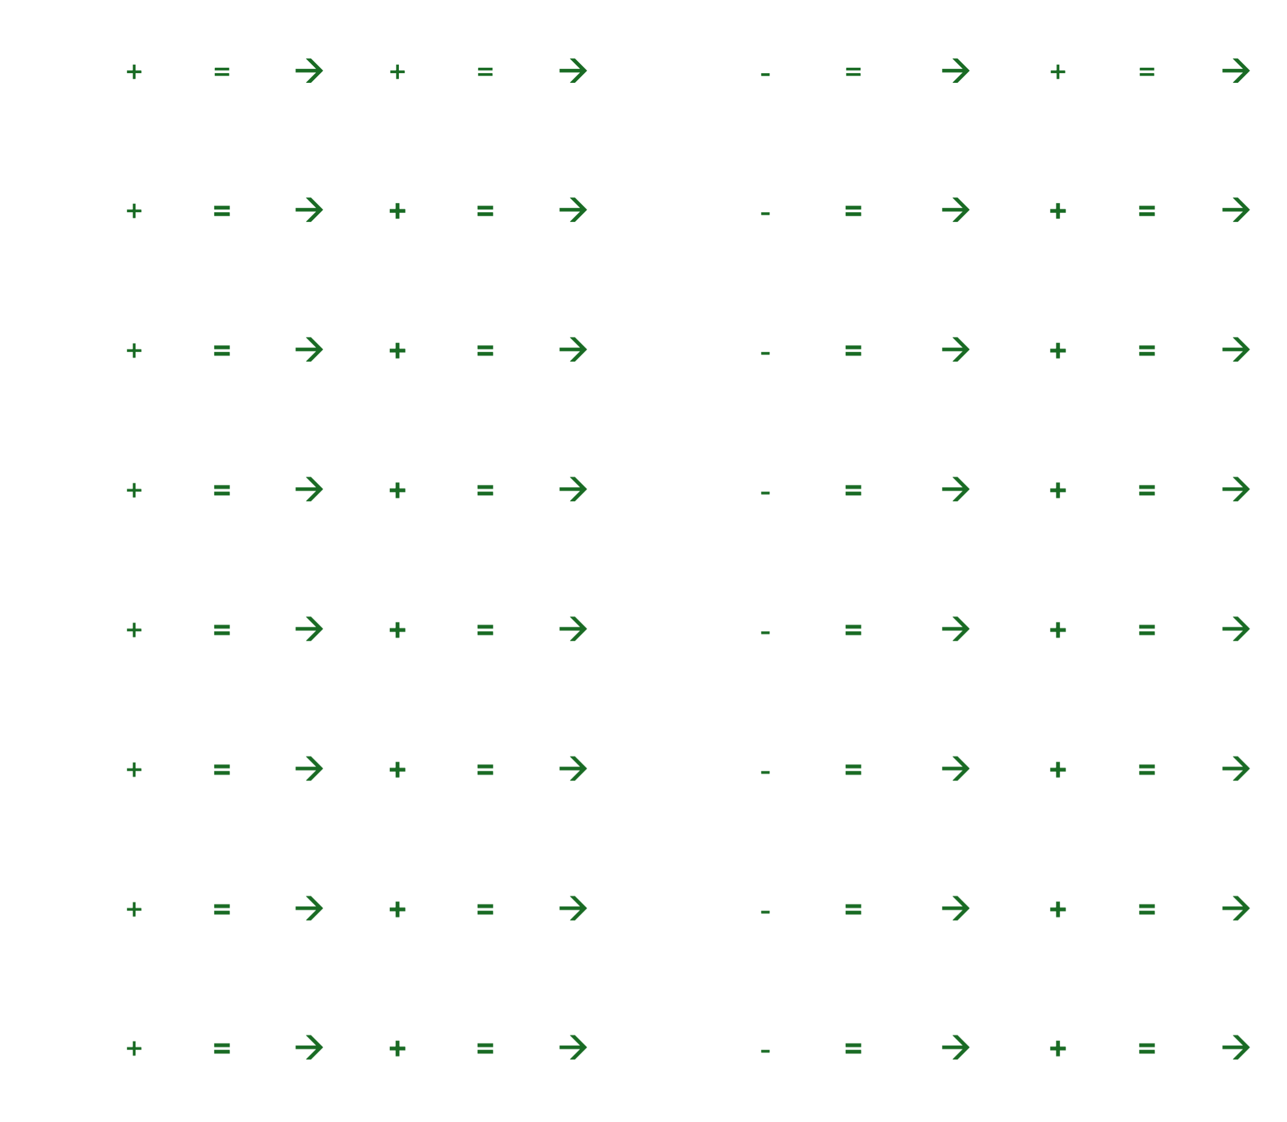


@海泩
DIGIT-SUM SECRET SENTENCE PUZZLE
Solve each Problem. The answer will be a number and add its digits to get the sum.
Then match that sum to a letter using the table below.
Example:
21 – 11 = 10
1 + 0 = 1
1 → A
Digit Sum
Letter
2-digit answer
Add the 2 digits
Match to the letter
1 |  |  |  |  |  |  |  | 9
2 |  |  |  |  |  |  |  | 10
3 |  |  |  |  |  |  |  | 11
4 |  |  |  |  |  |  |  | 12
5 |  |  |  |  |  |  |  | 13
6 |  |  |  |  |  |  |  | 14
7 |  |  |  |  |  |  |  | 15
8 |  |  |  |  |  |  |  | 16
SECRET SENTENCE
1 | 2 | 3 | 4 | 5 | 6 | 7 | 8 | 9 | 10 | 11 | 12 | 13 | 14 | 15 | 16
What is the secrete sentence?

Slide 2

DIGIT-SUM SECRET SENTENCE PUZZLE
Solve each Problem. The answer will be a 2-digit number.
Add the 2 digits together. Then match that number to a letter.
Example:
21 – 11 = 10
1 + 0 = 1
1 → A
Digit Sum | 1 | 3 | 4 | 6 | 9 | 16 | 17 | 18
Letter | A | C | D | F | I | Y | Z | R
2-digit answer
Add the 2 digits
Match to the code
1 | 9 | 3 |  |  |  |  |  | 9 | 38 | 23
2 | 52 | 47 |  |  |  |  |  | 10 | 100 | 1
3 | 4 | 6 |  |  |  |  |  | 11 | 68 | 41
4 | 47 | 42 |  |  |  |  |  | 12 | 48 | 35
5 | 39 | 40 |  |  |  |  |  | 13 | 64 | 54
6 |  |  |  |  |  |  |  | 14 | 97 | 9
7 |  |  |  |  |  |  |  | 15
8 |  |  |  |  |  |  |  | 16
SECRET SENTENCE
1 | 2 | 3 | 4 | 5 | 6 | 7 | 8 | 9 | 10 | 11 | 12 | 13 | 14 | 15 | 16
What is the secrete sentence?

Slide 3
1 | + | = | → | + | = | → | 9 | - | = | → | + | = | →
2 | + | = | → | + | = | → | 10 | - | = | → | + | = | →
3 | + | = | → | + | = | → | 11 | - | = | → | + | = | →
4 | + | = | → | + | = | → | 12 | - | = | → | + | = | →
5 | + | = | → | + | = | → | 13 | - | = | → | + | = | →
6 | + | = | → | + | = | → | 14 | - | = | → | + | = | →
7 | + | = | → | + | = | → | 15 | - | = | → | + | = | →
8 | + | = | → | + | = | → | 16 | - | = | → | + | = | →

Slide 4
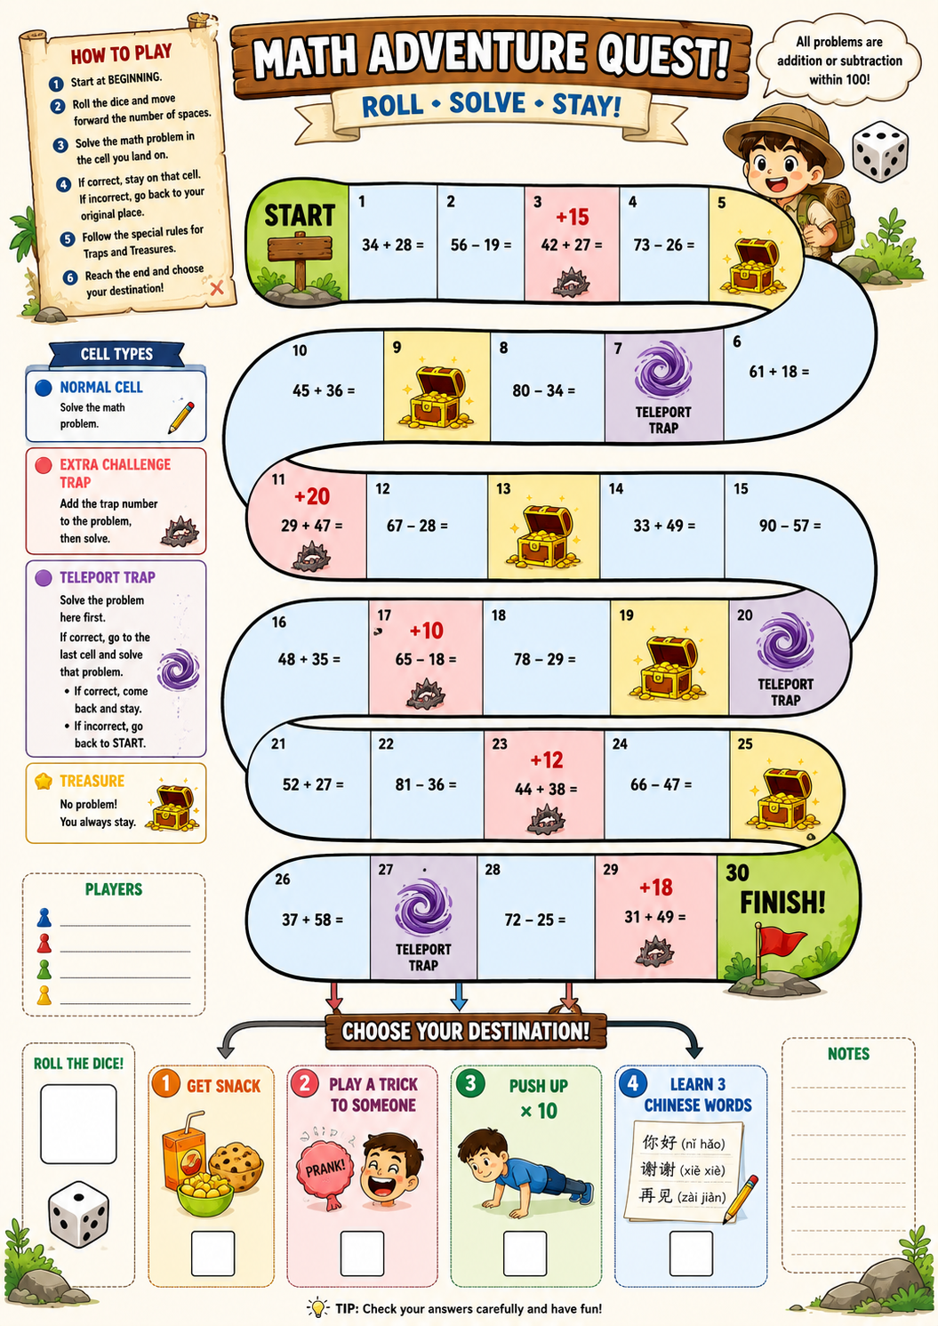




@一二七
28 + 12 =
53 + 38=
87 – 36 =
If you
reach D4,
you will
bounce
Back.

Slide 5











@海泩
20
19
18
17
16
After cell 30, you will encounter cells D1 to D4. If you reach D4, your turn ends with a bounce back

