Slide 1

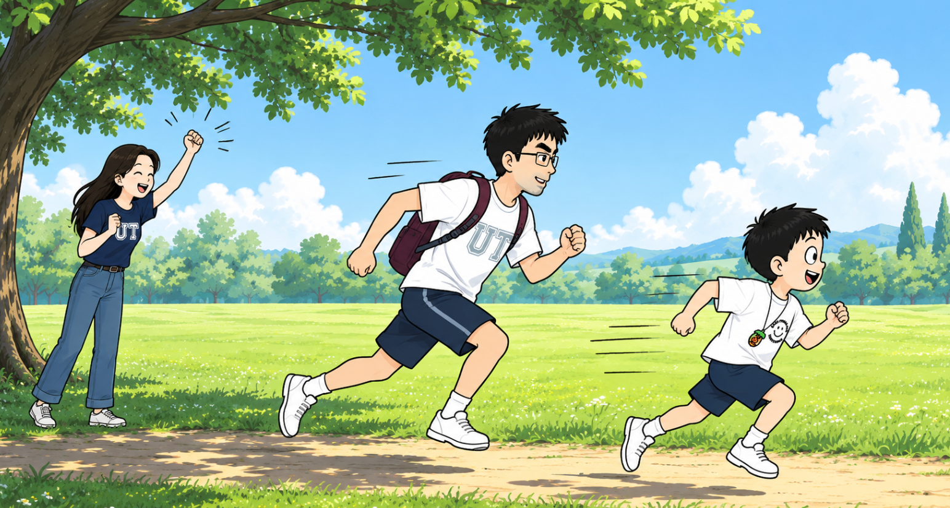
梦蝶世界(1)
Yǒu yì tiān, Pípí hé bàba zài shù yīn xià sài pǎo
有一天，皮皮和爸爸在树荫下赛跑
One day, Peter raced with Dad under a shady tree.
Māma yì shēng lìng xià Pípí xiàng huǒ jiàn yí yàng chōng le chū qù
妈妈一声令下。 皮皮 像 火箭 一样 冲了 出去！
“Ready, go!” Mom called. Peter shot off like a rocket!

Slide 2
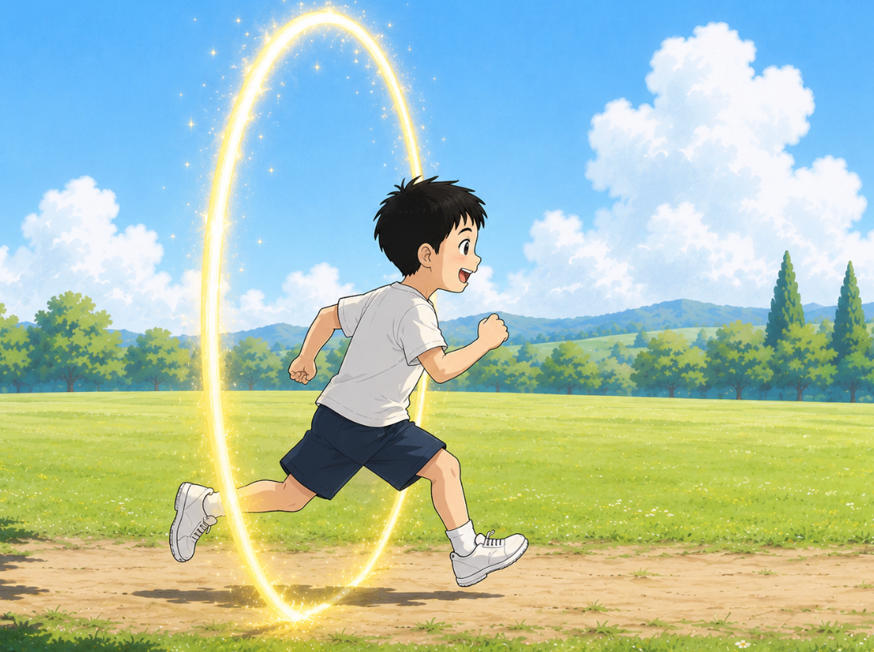
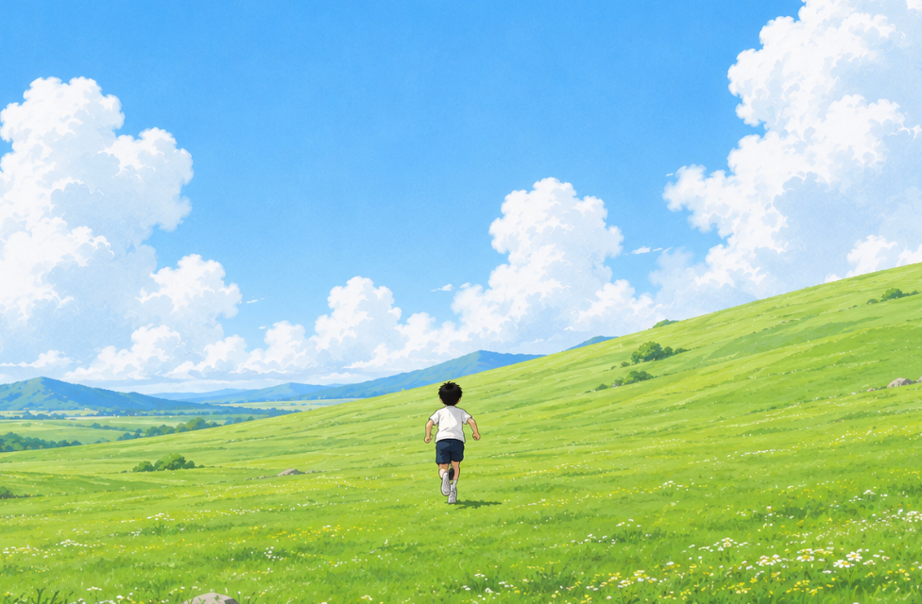
Pípí pǎo a pǎo a
Tā méi yǒu fā xiàn zìjǐ chuān guò le yí dào guāng quān
皮皮跑啊，跑啊。
他没有发现， 自己穿 过 了一道 光 圈。
Peter ran and ran.
He did not notice
a glowing portal.
Hūrán, sì zhōu dōu biàn le
Zhè lǐ bú shì gōng yuan shì yí piàn dà cǎo yuán
忽然，四周都变了。
这里不是公园，是一片大草原！
Suddenly, everything changed.
This was not the park.
It was a huge grassland!

Slide 3
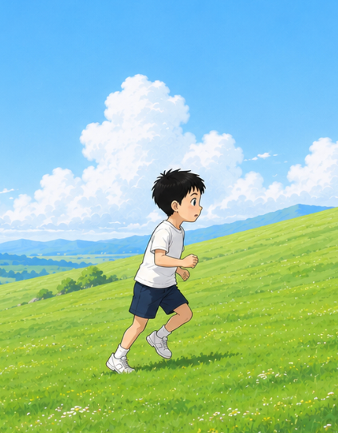
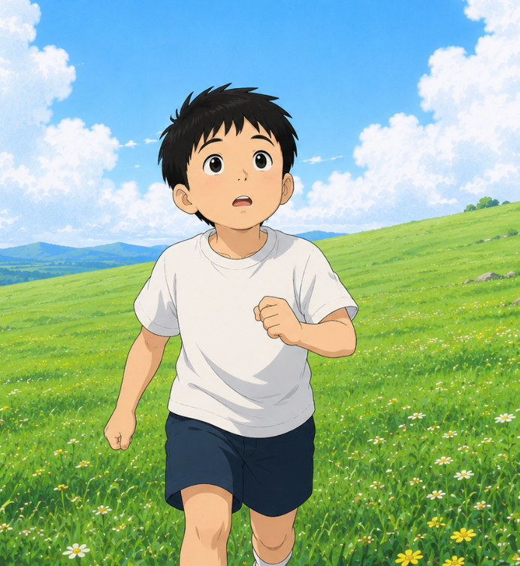
Pípí zuǒ kàn kan, yòu kàn kan.
Bàba māma dōu bú jiàn le
皮皮左看看，右看看。
爸爸妈妈都不见了。
Peter looked left.
He looked right.
Mom and Dad were gone.
Hū rán, yí ge sheng yīn xiǎng qǐ lai
忽然，一个声音响起来：
"Huān yíng lái dào Mèng dié Shì jiè!"
Then a voice said,
"欢迎来到梦蝶世界！"
"Welcome to Dream Butterfly World!"

Slide 4
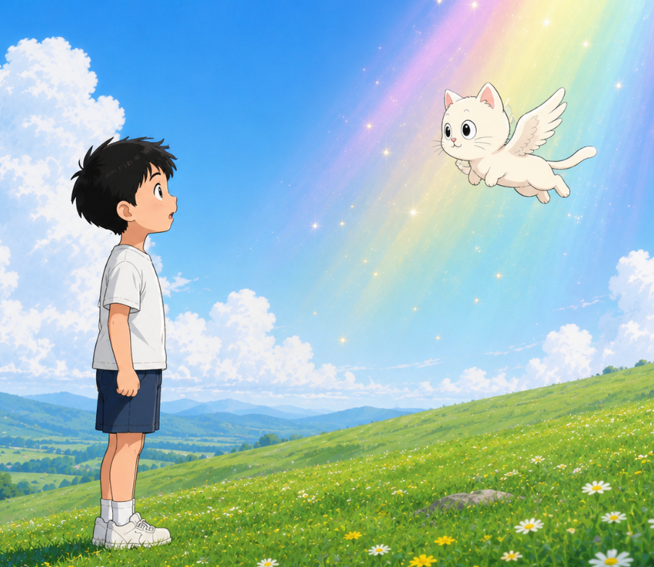
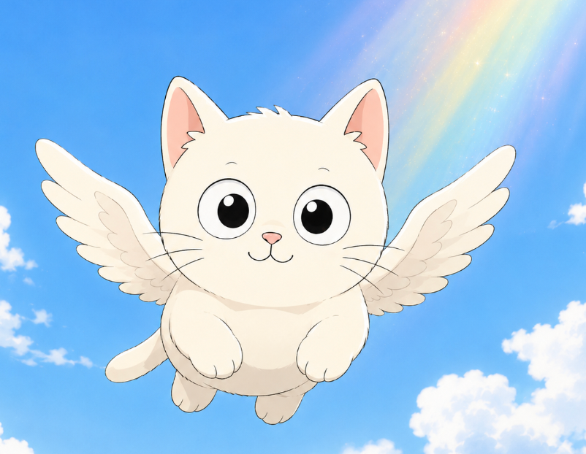
Pípí tái qǐ tóu. Yí dào cǎi guāng shǎn guò.
Yì zhī zhǎng zhe chì bǎng de xiǎo māo fēi le chū lái.
皮皮抬起头。一道彩光闪过。
一只 长 着 翅 膀 的 小 猫 飞了出来。
Peter looked up.
A rainbow flash filled the sky.
A little winged cat flew down.
Pípí wèn: "Nǐ shì shéi?"
Xiǎo māo xiào le.
皮皮问："你是谁？"
小猫笑了。
"Who are you?”, asked Peter.
The little cat smiled.

Slide 5
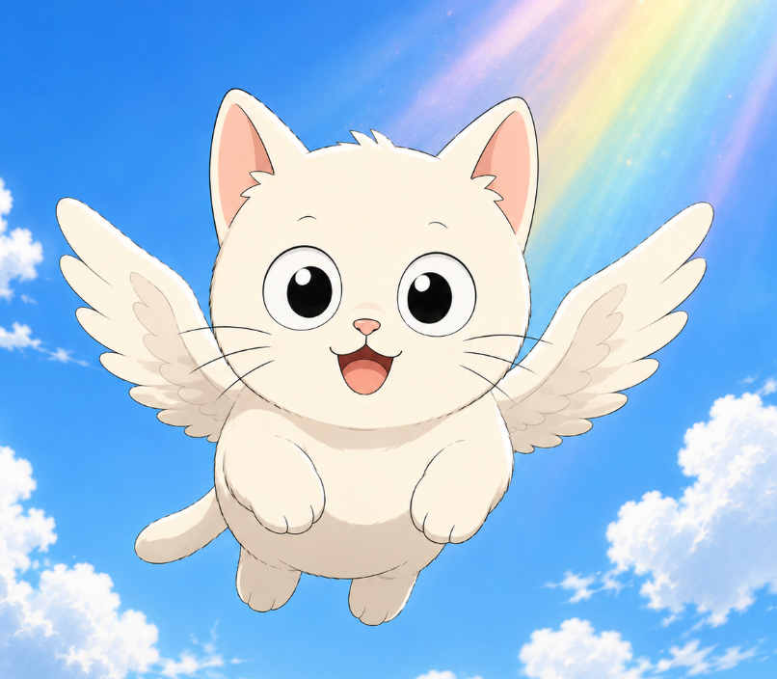
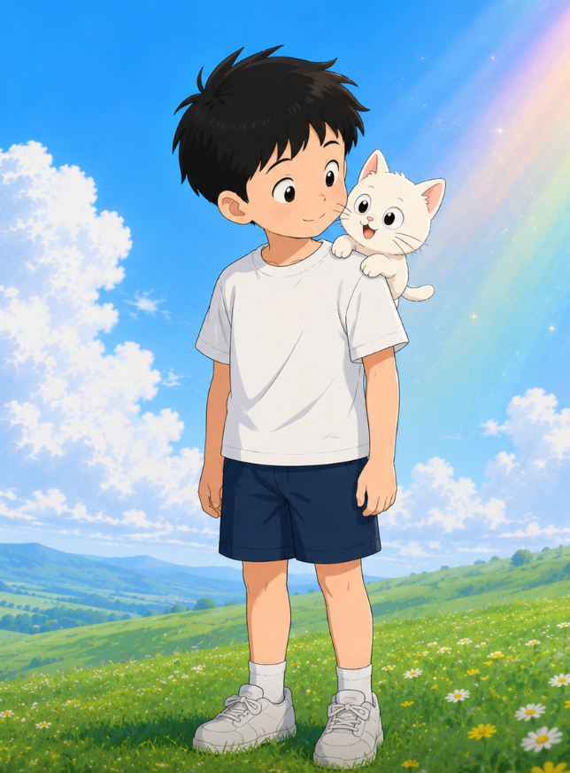
Wǒ jiào Fish.”
"Wǒ shì Mèng dié Shì jiè de jīng líng xiàng dǎo."
"我叫小鱼。"
“ 我 是 梦 蝶 世 界的 精 灵 向 导。"
"My name is Fish.
I am the guide of Dream Butterfly World."
Xiǎo yú fēi dào Pípí jiān shàng
niǐ de bēn pǎo dǎ kāi le Mèng dié Shì jiè
“Xiǎng hé wǒ yì qǐ qù tàn suǒ ma?”
Pípí xiào le. “Dāng rán xiǎng!"
小鱼飞到皮皮肩上。
"你的奔跑打开了梦蝶世界。"
“想和我一起去探索吗？"
皮皮笑了。"当然想！"
Fish landed on Peter’s shoulder.
“Your fast run opened Dream Butterfly World."
“Would you like to explore it with me?"
Peter smiled. "Yes!"

Slide 6
梦蝶世界(2)
pí pí hé xiǎo yú yì qǐ wǎng qián zǒu
yuǎn chù yǒu gāo gāo de shān hái yǒu bái bái de yún
皮皮和小鱼一起往前走。
远 处 有 高高 的山，还有 白白的云。
Peter and Fish walked on.
There were tall mountains and white clouds ahead.
zǒu zhe zǒu zhe pí pí hū rán tíng xià
bà ba mā ma zhǎo bú dào wǒ huì bú huì hěn zháo jí
走着走着， 皮皮忽然停下。
“爸爸 妈妈 找 不 到 我，会不会很着急？”
Peter stopped.
“Will Mom and Dad be worried ecause I am gone?”

Slide 7
xiǎo yú xiào zhe shuō
bié dān xīn lái dào zhè lǐ de zhǐ shì nǐ de mèng
小鱼笑着说：
“别担心。来到这里的，只是你的梦。”
Fish smiled.
“Don’t worry. Only your dream is here.”
bì shàng yǎn jing xiǎng yì xiǎng
pí pí qīng qīng bì shàng yǎn
“闭上眼睛，想一想。”
皮皮轻轻闭上眼。
“Close your eyes,” said Fish. “Think.”
Peter gently closed his eyes.

Slide 8
pí pí kàn jiàn zì jǐ yíng le bǐ sài
bà ba xiào zhe bǎ tā jǔ de gāo gāo de
皮皮看见，自己赢了比赛。
爸爸笑着，把他举得高高的。
Peter saw himself win the race.
Dad smiled and lifted him
high into the air.
pí pí fàng xīn le
wǒ men xiàn zài yào qù nǎ lǐ
皮皮放心了。
“我们现在要去哪里？”
Peter felt better.
“Where are we going now?”

Slide 9
xiǎo yú huī huī wěi ba
qù jiàn wǒ de hǎo péng you
tài hǎo le pí pí gāo xìng de shuō
小鱼挥挥尾巴。
“去见我的好朋友！”
“太好了！”皮皮高兴地说。
Fish waved its tail.
“We are going to meet my friend!”
“Great!” said Peter.
tā men fān guò shān pō yòu zǒu guò shān gǎng
hū rán yí piàn dà hú chū xiàn zài yǎn qián
他们翻过山坡，又走过山岗。
忽然，一片大湖出 现 在 眼 前。
They crossed a hill.
Then another.
Suddenly, a huge lake appeared.

Slide 10
Wā pí pí zhēng dà yǎn jing
zhè ge hú bǐ wǒ jiā de hú dà hǎo duō ya
“哇！”皮皮睁大眼睛。
“这个湖比我家的湖大好多呀！”
“Wow!” Peter opened his eyes wide.
“This lake is much bigger than the one at home!”
nǐ de péng you ne pí pí wèn
xiǎo yú zhǎ zhǎ yǎn
shēn chū máo róng róng de xiǎo zhuǎ zi
qīng qīng zhǐ xiàng hú miàn
“你的朋友呢？”皮皮问。
小鱼眨眨眼，
伸出毛绒绒的小爪子，
轻轻指向湖面……
“Where is your friend?” asked Peter.
Fish blinked, lifted a fluffy paw,
and pointed at the lake...

Slide 11
梦蝶世界(3)
pí pí zhǎ le zhǎ yǎn
hú miàn píng píng jìng jìng
shén me yě méi yǒu
皮皮眨了眨眼。
湖 面 平 平 静 静。
什么也没有。
Peter blinked.
The lake was calm.
There was nothing there.
pí pí kàn xiàng xiǎo yú
xiǎo yú tiào dào hú biān
bǎ xiǎo zhuǎ zi qīng qīng fàng jìn hú shuǐ lǐ
皮皮看向小鱼。
小鱼跳到湖边，
把小爪子轻轻放进湖水里。
Peter looked at Fish.
Fish hopped to the lake
and dipped a tiny paw into the water.

Slide 12
xiǎo yú zhàn le qǐ lái
liǎng zhī qián zhuǎ qīng qīng yì hé
yòu zhuàn le yì quān
小鱼站了起来。
两只前爪轻轻一合，
又转了一圈。
Fish stood up.
Its little front paws came together,
then turned in a circle.
xiǎo yú fēi dào pí pí miàn qián
tā shēn chū yòu zhuǎ qīng qīng diǎn le yí xià pí pí de méi xīn
小鱼飞到皮皮面前。
它 伸 出 右 爪，轻 轻 点 了一下皮皮的眉心。
Fish flew to Peter.
It gently touched
the middle of Peter’s forehead.

Slide 13
yì dī xiǎo shuǐ zhū màn màn biàn dà
yì zhǎ yǎn biàn chéng le yí ge dà pào pao
一滴小水珠，慢慢变大。
一眨眼，变成了一个大泡泡！
A tiny drop of water grew bigger.
In a blink, it became
a giant bubble!
dà pào pao bǎ tā men bāo le qǐ lái
pí pí qīng qīng shēn chū shǒu pèng le yí xià
大泡泡把他们包了起来。
皮皮轻轻伸出手，碰了一下。
The giant bubble
wrapped around them.
Peter reached out
and touched it.

Slide 14
pào pao qīng qīng yáo le yáo
yí dào cǎi hóng guāng màn màn liú guò qù
Wā pí pí kàn dāi le
泡泡轻轻摇了摇。
一道彩虹光慢慢流过去。
“哇——”皮皮看呆了。
The bubble wobbled.
Rainbow light flowed across it.
“Wow...” Peter whispered.
pí pí xiào le
wǒ hǎo xǐ huan zhè ge pào pao
皮皮笑了。
“我好喜欢这个泡泡！”
Peter smiled.
“I love this bubble!”

Slide 15
xiǎo yú xiào zhe shuō zhè shì bì shuǐ pào pao
tā néng dài zhe wǒ men zài shuǐ lǐ lǚ xíng
小鱼笑着说：“这是避水泡泡。”
“它能带着我们在水里旅行。”
Fish smiled.
“This is the Water Bubble.
It lets us travel underwater.”
xiǎo yú qīng qīng yì diǎn
dà pào pao màn màn piāo qǐ yòu qīng qīng luò jìn hú lǐ
tā men xiàng zhe hú dǐ shēn chù chū fā le
小鱼轻轻一点。
大泡泡慢慢飘起，又轻轻落进湖里。
他们向着湖底深处出发了……
Fish gave the bubble a tap.
It floated, then slipped into the lake.
They were off to the deep water...

