Slide 1
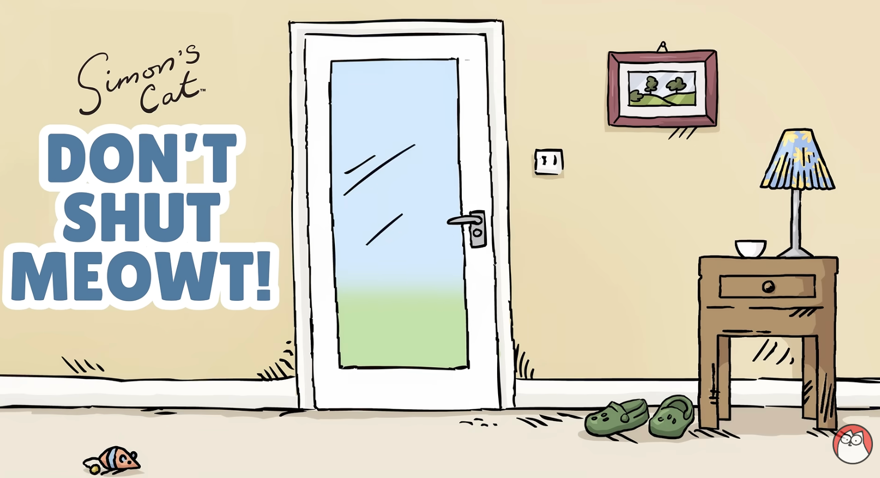
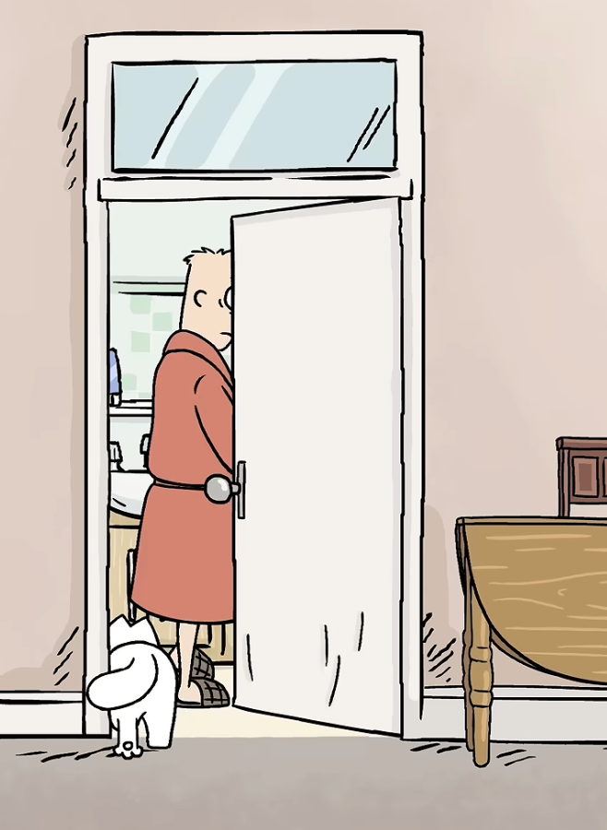
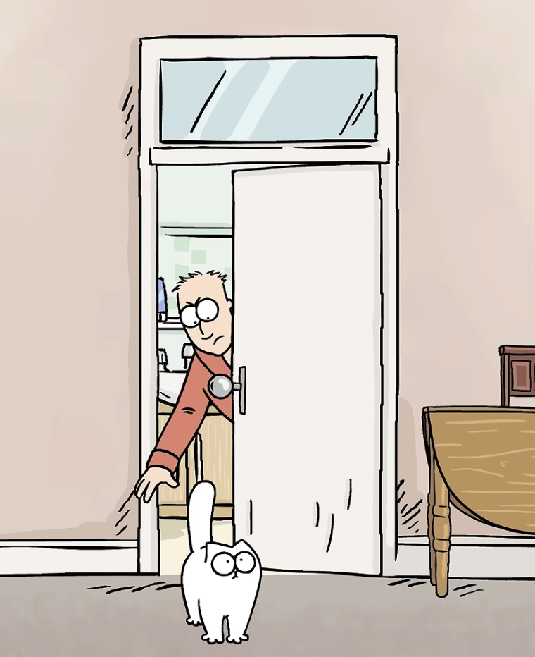
别把喵
关门外
xiǎo māo gēn zhe zhǔ rén jìn le fáng jiān
小猫跟着主人进了房间
The cat followed the man into the room.
zhǔ rén bǎ xiǎo māo gǎn chū lái le
主人把小猫赶出来了
The man put the cat outside

Slide 2
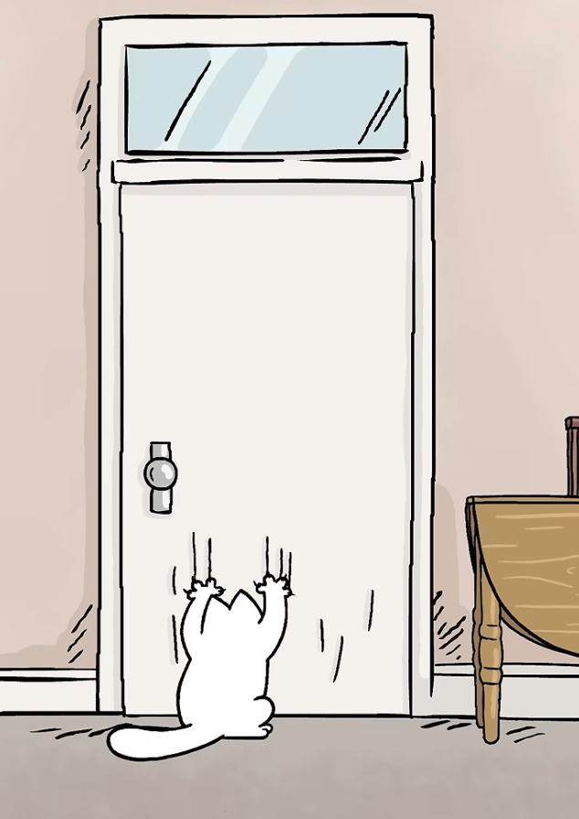
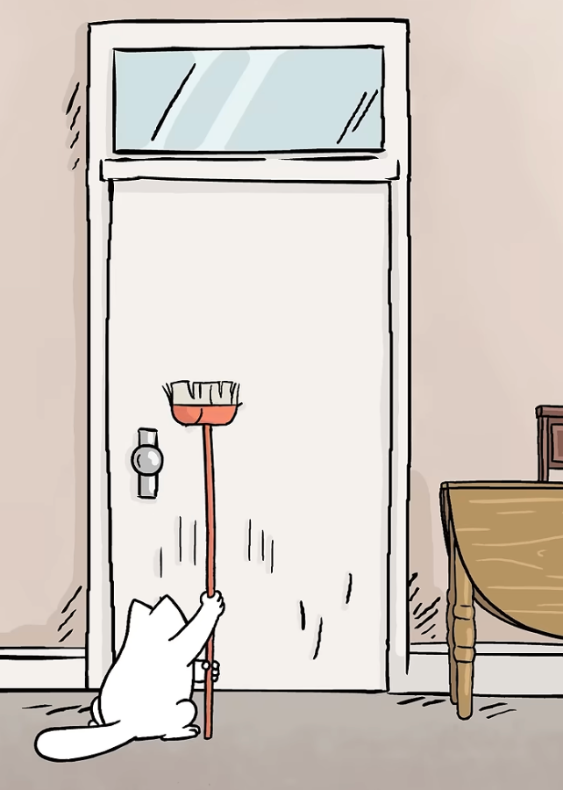
xiǎo māo shǐ jìn náo mén
小猫使劲挠门
The cat scratched the door hard
xiǎo māo zhǎo lái tuō bǎ qiāo mén
小猫找来拖把敲门
The cat found a mop and
knocked on the door

Slide 3
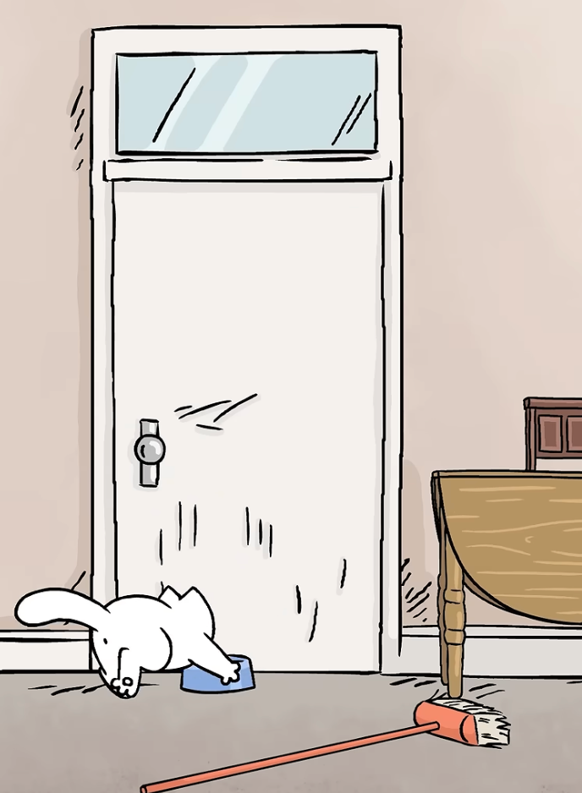
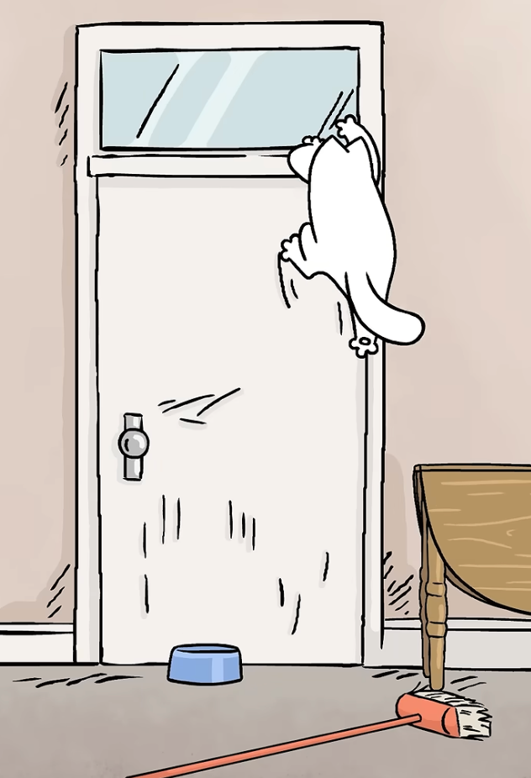
xiǎo māo bǎ fàn wǎn tuō guò lái
小猫把饭碗拖过来
The cat dragged its food bowl over
xiǎo māo pá dào le
小猫爬到了
mén kuàng shàng
门框上
The cat climbed up the doorframe

Slide 4
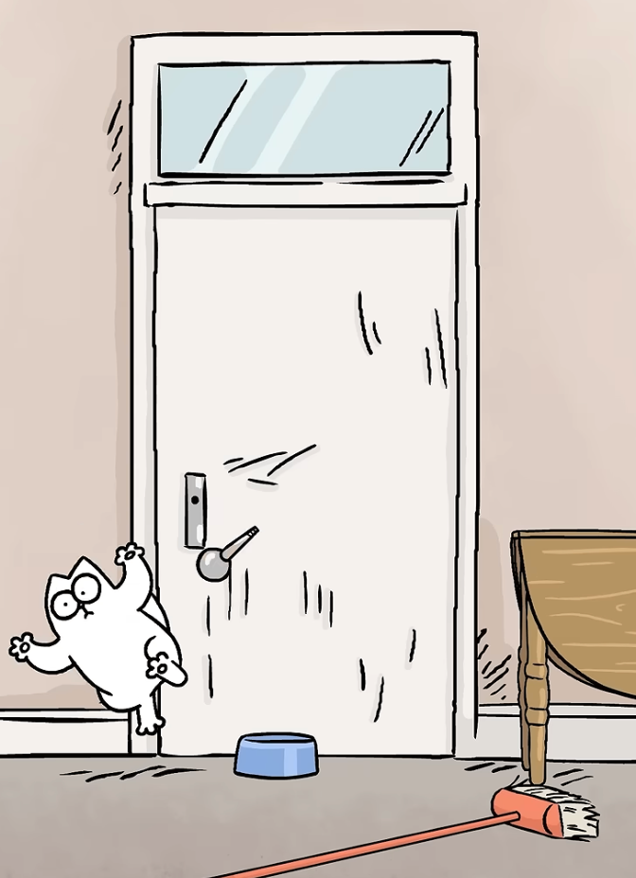
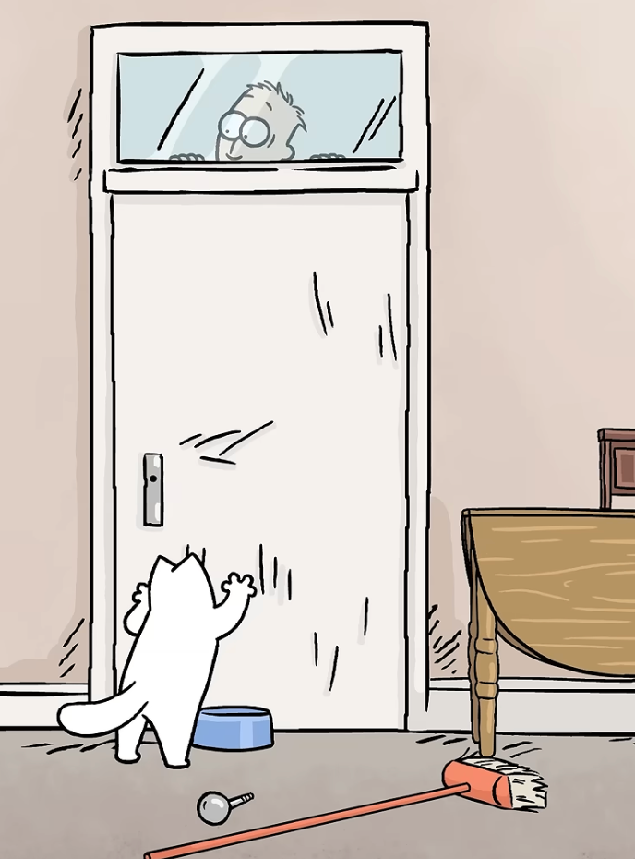
xiǎo māo bù xiǎo xīn bǎ mén bǎ shǒu
小猫不小心把门把手
zhuài xià lái le
拽下来了
The cat accidentally pulled
the door handle off
zhè xià zhǔ rén yě chū bù lái la
这下主人也出不来啦！
Now the man cannot get out either!

