Slide 1
MapReduce II

Slide 2
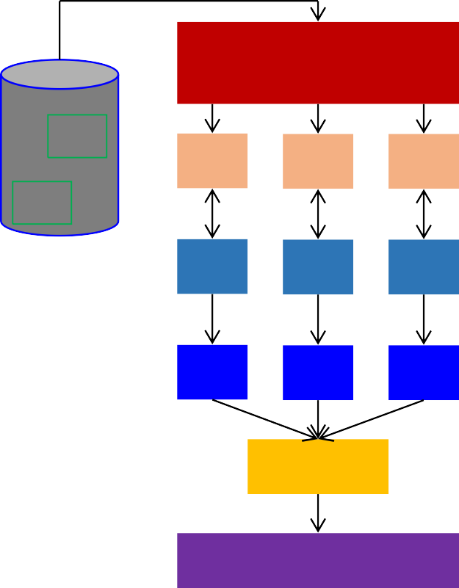
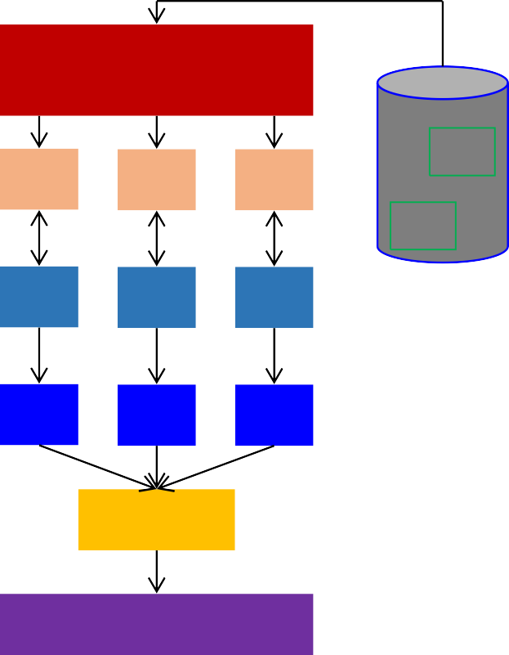
Hadoop MapReduce: A Closer Look
Node 1 Node 2
Files loaded from local HDFS store Files loaded from local HDFS store
InputFormat
InputFormat
file
file
Split
Split
Split
Split
Split
Split
file
file
RecordReaders
RR
RR
RR
RR
RR
RR
RecordReaders
Input (K, V) pairs
Input (K, V) pairs
Map
Map
Map
Map
Map
Map
Intermediate (K, V) pairs
Shuffling
Process
Intermediate (K, V) pairs
Partitioner
Partitioner
Sort
Intermediate (K,V) pairs exchanged by all nodes
Sort
Reduce
Reduce
Final (K, V) pairs
Final (K, V) pairs
Writeback to local HDFS store
OutputFormat
OutputFormat
Writeback to local HDFS store

Slide 3
Data Distribution
In a MapReduce cluster, data is distributed to all the nodes of the cluster as it is being loaded in
An underlying distributed file systems (e.g., GFS) splits large data files into chunks which are managed by different nodes in the cluster
Even though the file chunks are distributed across several machines, they form a single namespace
Input data: A large file
Node 1
Chunk of
input data
Node 2
Chunk of
input data
Node 3
Chunk of
input data

Slide 4
Input Files
Input files are where the data for a MapReduce task is initially stored
The input files typically reside in a distributed file system (e.g. HDFS)
The format of input files is arbitrary
  Line-based log files
  Binary files
  Multi-line input records
  Or something else entirely
file
file

Slide 5
InputFormat
How the input files are split up and read is defined by the InputFormat
InputFormat is a class that does the following:
  Selects the files that should be used for input
  Define the InputSplits that break a file
  Provides a factory for RecordReader objects that read the files
Files loaded from local HDFS store
InputFormat
file
file

Slide 6
InputFormat Types
Several InputFormats are provided with Hadoop:
InputFormat | Description | Key | Value
TextInputFormat | Default format; reads lines of text files | The byte offset of the line | The line contents
KeyValueInputFormat | Parses lines into (K, V) pairs | Everything up to the first tab character | The remainder of the line
SequenceFileInputFormat | A Hadoop-specific high-performance binary format | user-defined | user-defined

Slide 7
Input Splits
An input split describes a unit of work that comprises a single map task in a MapReduce program
By default, the InputFormat breaks a file up into 64MB splits
By dividing the file into splits, we allow several map tasks to operate on a single file in parallel
If the file is very large, this can improve performance significantly through parallelism
Each map task corresponds to a single input split
Files loaded from local HDFS store
InputFormat
file
Split
Split
Split
file

Slide 8
RecordReader
The input split defines a slice of work but does not describe how to access it
The RecordReader class actually loads data from its source and converts it into (K, V) pairs suitable for reading by Mappers
The RecordReader is invoked repeatedly on the input until the entire split is consumed
Each invocation of the RecordReader leads to another call of the map function defined by the programmer
Files loaded from local HDFS store
InputFormat
file
Split
Split
Split
file
RR
RR
RR

Slide 9
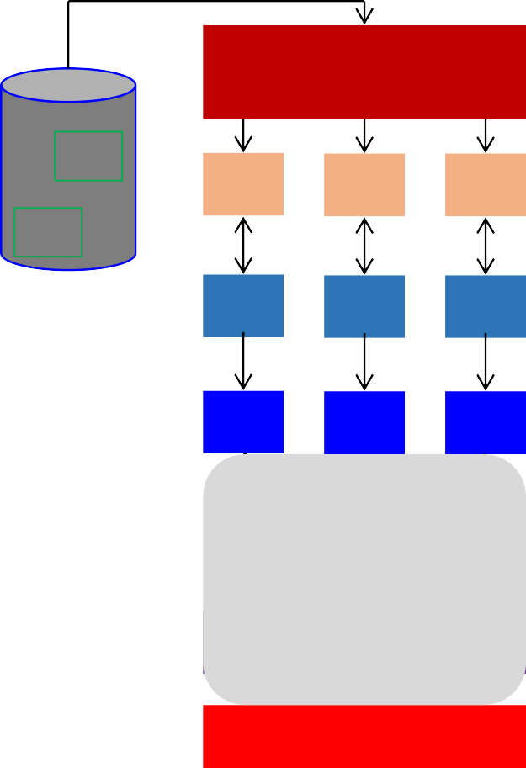
Mapper and Reducer
The Mapper performs the user-defined work of the first phase of the MapReduce program
A new instance of Mapper is created for each split
The Reducer performs the user-defined work of the second phase of the MapReduce program
A new instance of Reducer is created for each partition
For each key in the partition assigned to a Reducer, the Reducer is called once
Files loaded from local HDFS store
InputFormat
file
Split
Split
Split
file
RR
RR
RR
Map
Map
Map
Partitioner
Sort
Reduce

Slide 10
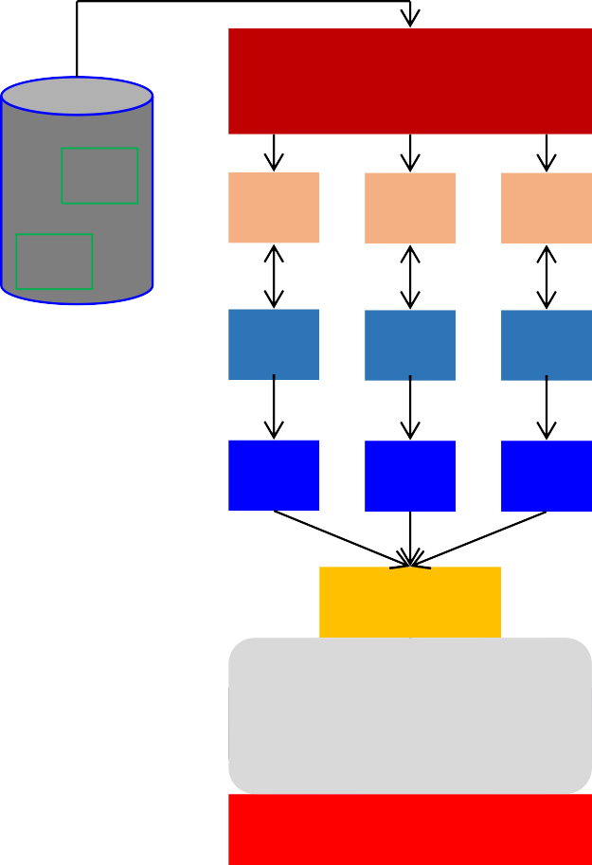
Partitioner
Each mapper may emit (K, V) pair to any partition
Therefore, the map nodes must all agree on where to send different pieces of intermediate data
The partitioner class determines which partition a given (K,V) pair will go to
The default partitioner computes a hash value for a given key and assigns it to a partition based on this result
Files loaded from local HDFS store
InputFormat
file
Split
Split
Split
file
RR
RR
RR
Map
Map
Map
Partitioner
Sort
Reduce

Slide 11
Partitions
In MapReduce, intermediate output values are not usually reduced together
All values with the same key are presented to a single Reducer together
More specifically, a different subset of intermediate key space is assigned to each Reducer
These subsets are known as partitions
Different colors represent different keys (potentially) from different Mappers
Partitions are the input to Reducers

Slide 12
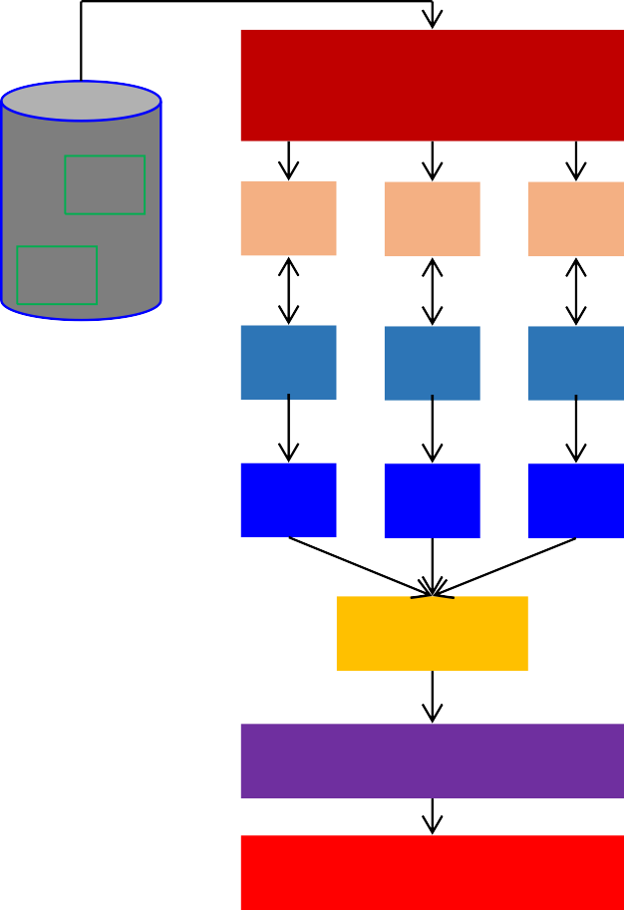
Sort
Files loaded from local HDFS store
Each Reducer is responsible for reducing the values associated with (several) intermediate keys
The set of intermediate keys on a single node is automatically sorted by MapReduce before they are presented to the Reducer
InputFormat
file
Split
Split
Split
file
RR
RR
RR
Map
Map
Map
Partitioner
Sort Reduce

Slide 13
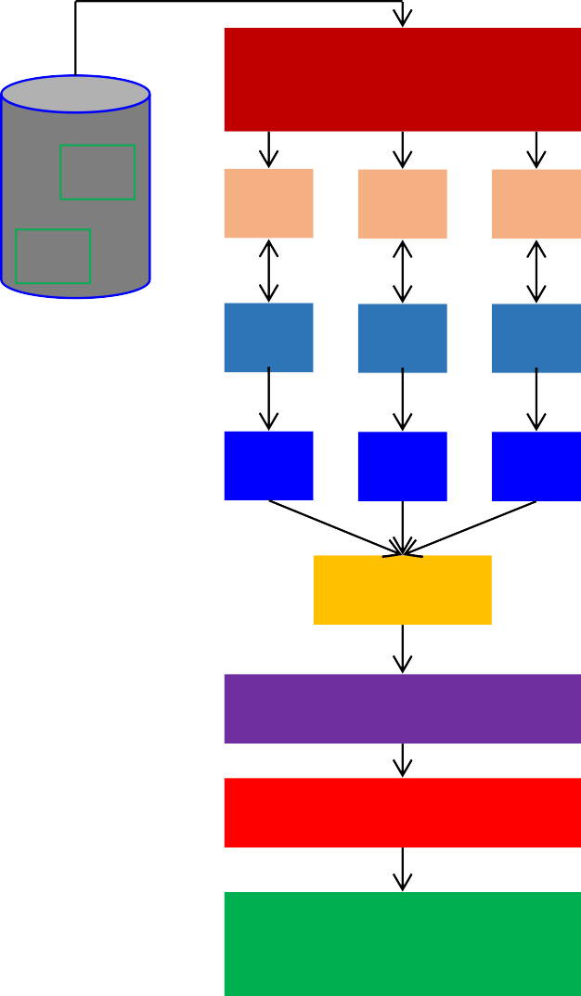
OutputFormat
Files loaded from local HDFS store
InputFormat
The OutputFormat class defines the way (K,V) pairs produced by Reducers are written to output files
The instances of OutputFormat provided by Hadoop write to files on the local disk or in HDFS
Several OutputFormats are provided by Hadoop:
file
Split
Split
Split
file
RR
RR
RR
Map
Map
Map
OutputFormat | Description
TextOutputFormat | Default; writes lines in "key \t value" format
SequenceFileOutputFormat | Writes binary files suitable for reading into subsequent MapReduce jobs
NullOutputFormat | Generates no output files
Partitioner
Sort Reduce
OutputFormat

Slide 14
MapReduce Terminology
Job – a “full program”-an execution of a Mapper and Reducer across a data set
Task – an execution of a Mapper or a Reducer on a slice of data
Task Attempt – a particular instance of an attempt to execute a task on a machine

Slide 15
Map Reduce Algorithms

Slide 16
Managing Dependencies
Remember: Mappers run in isolation
  You have no idea in what order the mappers run
  You have no idea on what node the mappers run
  You have no idea when each mapper finishes
Tools for synchronization:
  Ability to hold state in reducer across multiple key-value pairs
  Sorting function for keys
  Partitioner
  Cleverly-constructed data structures

Slide 17
What you as programmer can control?
Construct complex data structures as keys and values to store and communicate partial results
Execute user-specified initialization/termination code in a map or reduce task
Preserve state in both mappers and reducers across multiple input or intermediate keys
Control sort order of intermediate keys, and hence the order of how a reducer processes keys
Control partitioning of key space, and hence the set of keys encountered by a reducer

Slide 18
What is your goal
No inherent bottlenecks as algorithms are applied to increasingly large datasets
  linear scalability: an algorithm running on twice the amount of data should take only twice as long
  an algorithm running on twice the number of nodes should only take half as long

Slide 19
Motivating Example
Term co-occurrence matrix for a text collection
  M = N x N matrix (N = vocabulary size)
  M_{ij}: number of times i and j co-occur in some context (for concreteness, let’s say context = sentence)
Why?
  Distributional profiles as a way of measuring semantic distance
  Semantic distance useful for many language processing tasks
e.g., Mohammad and Hirst (EMNLP, 2006)

Slide 20
MapReduce: Large Counting Problems
Term co-occurrence matrix for a text collection = specific instance of a large counting problem
  A large event space (number of terms)
  A large number of events (the collection itself)
  Goal: keep track of interesting statistics about the events
Basic approach
  Mappers generate partial counts
  Reducers aggregate partial counts
How do we aggregate partial counts efficiently?

Slide 21
First Try: “Pairs”
Each mapper takes a sentence:
  Generate all co-occurring term pairs
  For all pairs, emit (a, b) → count
Reducers sums up counts associated with these pairs
Use combiners!
Note: in all these slides, a key-value pair denoted as k → v

Slide 22
“Pairs” Analysis
Advantages
  Easy to implement, easy to understand
Disadvantages
  Lots of pairs to sort and shuffle around (upper bound?)

Slide 23
Another Try: “Stripes”
Idea: group together pairs into an associative array
Each mapper takes a sentence:
  Generate all co-occurring term pairs
  For each term, emit a → { b: count_{b}, c: count_{c}, d: count_{d} … }
Reducers perform element-wise sum of associative arrays
(a, b) → 1
(a, c) → 2
a → { b: 1, c: 2, d: 5, e: 3, f: 2 }
(a, d) → 5
(a, e) → 3
(a, f) → 2
a → { b: 1, d: 5, e: 3 }
a → { b: 1, c: 2, d: 2, f: 2 }
a → { b: 2, c: 2, d: 7, e: 3, f: 2 }
+

Slide 24
“Stripes” Analysis
Advantages
  Far less sorting and shuffling of key-value pairs
  Can make better use of combiners
Disadvantages
  More difficult to implement
  Underlying object is more heavyweight
  Fundamental limitation in terms of size of event space

Slide 25
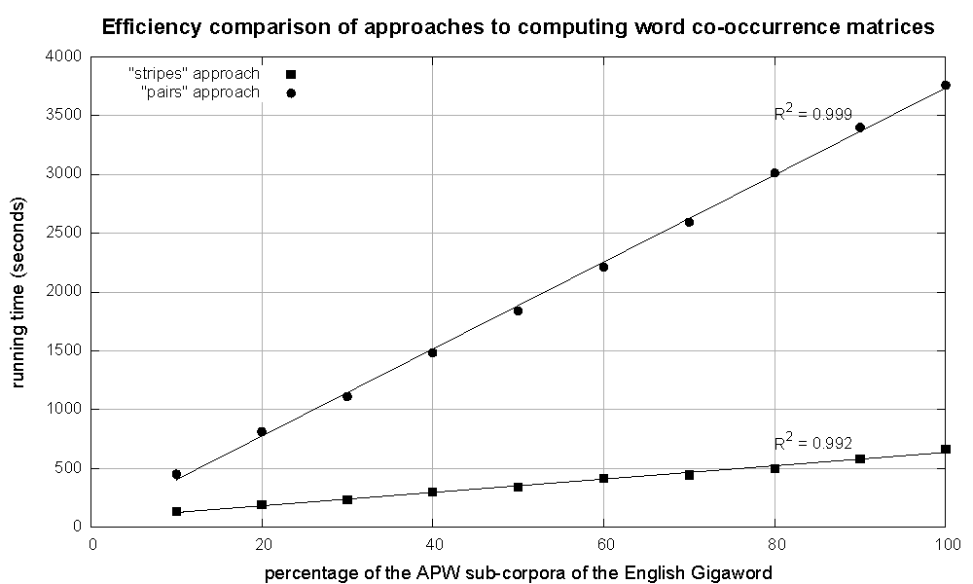
Cloud Appliction Development
Cluster size: 38 cores
Data Source: Associated Press Worldstream (APW) of the English Gigaword Corpus (v3), which contains 2.27 million documents (1.8 GB compressed, 5.7 GB uncompressed)

Slide 26

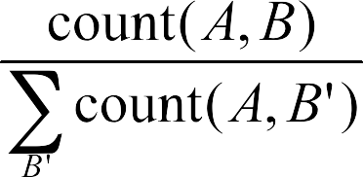
Conditional Probabilities
How do we compute conditional probabilities from counts?
Why do we want to do this?
How do we do this with MapReduce?

Slide 27
P(B|A): “Pairs”
(a, *) → 32
Reducer holds this value in memory
(a, b₁) → 3 / 32
(a, b₂) → 12 / 32
(a, b₃) → 7 / 32
(a, b₄) → 1 / 32
…
(a, b₁) → 3
(a, b₂) → 12
(a, b₃) → 7
(a, b₄) → 1
…
For this to work: Define multiple map reduce jobs? Or a single job with following:
  Must emit extra (a, *) for every b_{n} in mapper
  Must make sure all a’s get sent to same reducer (use partitioner)
  Must make sure (a, *) comes first (define sort order)
  Must hold state in reducer across different key-value pairs

Slide 28
P(B|A): “Stripes”
a → {b₁:3, b₂ :12, b₃ :7, b₄ :1, … }
Easy!
  One pass to compute (a, *)
  Another pass to directly compute P(B|A)

Slide 29
Issues and Tradeoffs
Number of key-value pairs
  Object creation overhead
  Time for sorting and shuffling pairs across the network
Size of each key-value pair
  De/serialization overhead
Combiners make a big difference!
  RAM vs. disk and network
  Arrange data to maximize opportunities to aggregate partial results

Slide 30
Map-Reduce Example: Average
Compute Avg of B for each distinct value of A
 | A | B | C
R1 | 1 | 10 | 12
R2 | 2 | 20 | 34
R3 | 1 | 10 | 22
R4 | 1 | 30 | 56
R5 | 3 | 40 | 17
R6 | 2 | 10 | 49
R7 | 1 | 20 | 44
Reducer 1
(1, 10)
(2, 20)
(1, 10)
(1, [10, 10, 30, 20])
MAP 1
(1, 17.5)
Reducer 2
MAP 2
(1, 30)
(3, 40)
(2, 10)
(1, 20)
(2, 10)
(3, 40)
(2, 15)
(3, 40)
Any issue?

Slide 31
Average calculation using Combiner

Slide 32
Map Reduce Simple Use Cases

Slide 33
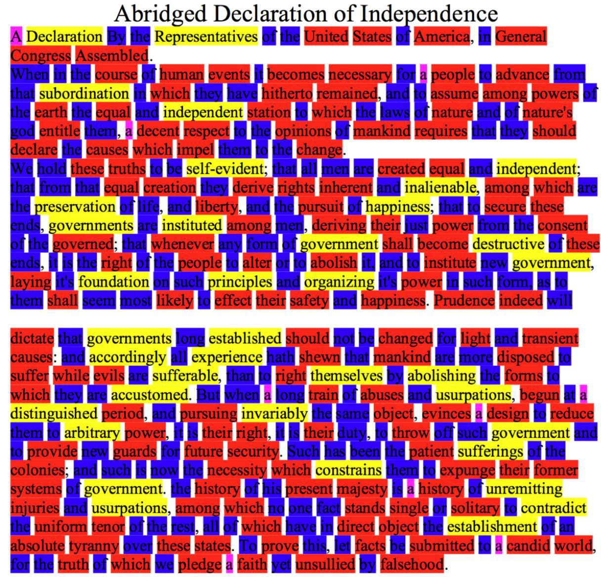
MapReduce Use Case: Word Length
Big = Yellow = 10+ letters Medium = Red = 5..9 letters Small = Blue = 2..4 letters Tiny = Pink = 1 letter
Big 37
Medium 148
Small 200
Tiny 9

Slide 34
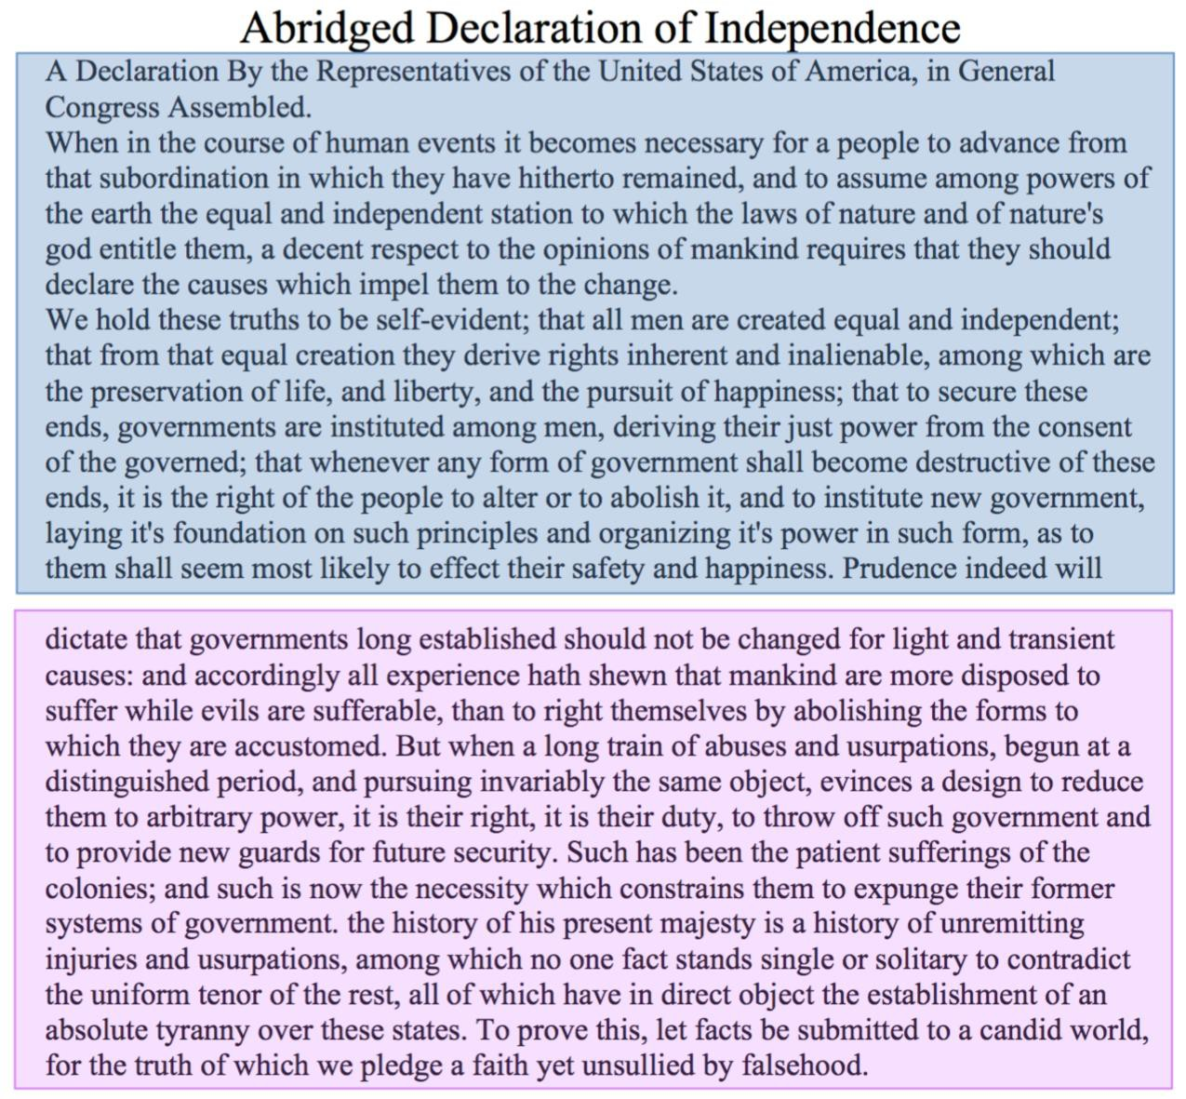
MapReduce Use Case: Word Length
Split the document into chunks and process each chunk
on a different computer

Slide 35
MapReduce Use Case: Word Length
Big 1
Big 1
Big 1
…
Big 1,1,1,1,…
Medium 1,1,1,..
Small 1,1,1,1,..
Tiny 1,1,1,1,…
Medium 1
Medium 1
…
Big 37
Medium 148
Small 200
Tiny 9
Small 1
Small 1
Small 1
…
Big 1,1,1,1,…
Medium 1,1,1,..
Small 1,1,1,1,..
Tiny 1,1,1,1,…
Tiny 1
Tiny 1
Tiny 1
…

Slide 36
Web Application
Text Retrieval
  Inverted Indexing
Data Mining
  Document Similarity
  TF-IDF
Graph Algorithms
  Shortest Path
  Page Rank

Slide 37
MapReduce Use Case: Inverted Indexing
Construction of inverted lists for document search
Input: documents: (docid, [term, term..]), (docid, [term, ..]), ..
Output: (term, [docid, docid, …])
  E.g., (apple, [Foo.txt, Bar.txt, Boo.txt, …])
© 2010, Jamie Callan

Slide 38
Inverted Index
Cloud Application Development
Term
Doc 1
Doc 2
Doc 3
Doc 4
Doc 5
Doc 6
Doc 7
Doc 8
Term
Postings
aid | 0 | 0 | 0 | 1 | 0 | 0 | 0 | 1
all | 0 | 1 | 0 | 1 | 0 | 1 | 0 | 0
back | 1 | 0 | 1 | 0 | 0 | 0 | 1 | 0
brown | 1 | 0 | 1 | 0 | 1 | 0 | 1 | 0
come | 0 | 1 | 0 | 1 | 0 | 1 | 0 | 1
dog | 0 | 0 | 1 | 0 | 1 | 0 | 0 | 0
fox | 0 | 0 | 1 | 0 | 1 | 0 | 1 | 0
good | 0 | 1 | 0 | 1 | 0 | 1 | 0 | 1
jump | 0 | 0 | 1 | 0 | 0 | 0 | 0 | 0
lazy | 1 | 0 | 1 | 0 | 1 | 0 | 1 | 0
men | 0 | 1 | 0 | 1 | 0 | 0 | 0 | 1
now | 0 | 1 | 0 | 0 | 0 | 1 | 0 | 1
over | 1 | 0 | 1 | 0 | 1 | 0 | 1 | 1
party | 0 | 0 | 0 | 0 | 0 | 1 | 0 | 1
quick | 1 | 0 | 1 | 0 | 0 | 0 | 0 | 0
their | 1 | 0 | 0 | 0 | 1 | 0 | 1 | 0
aid
all
back
brown
come
dog
fox
good
jump
lazy
men
now
over
party
quick
their
4 |  | 8
2 |  | 4 |  | 6
1 |  | 3 |  | 7
1 |  | 3 |  | 5 |  | 7
2 |  | 4 |  | 6 |  | 8
3 |  | 5
3 |  | 5 |  | 7
2 |  | 4 |  | 6 |  | 8
3
1 |  | 3 |  | 5 |  | 7
2 |  | 4 |  | 8
2 |  | 6 |  | 8
1 |  | 3 |  | 5 |  | 7 |  | 8
6 |  | 8
1 |  | 3
1 |  | 5 |  | 7

Slide 39




Map Reduce Algorithm: Inverted Index
Map
Reduce
Obama
Obama
Shuffling Key-Value Pairs
Obama Clinton Obama
Clinton
2
1
Obama
1
McCain
1
Obama
Obama McCain
McCain
Bush
Obama Bush Clinton
1
Obama
Bush
Clinton
1
29
1
Clinton

Slide 40
Inverted Index: Data flow
Foo
Foo map output
contains: Foo much: Foo page : Foo so : Foo
text: Foo This : Foo
This page contains so much text
Reduced output
contains: Foo, Bar much: Foo
My: Bar
page : Foo, Bar so : Foo
text: Foo, Bar This : Foo too: Bar
Bar
Bar map output
contains: Bar My: Bar page : Bar text: Bar
too: Bar
My page contains text too

Slide 41
MapReduce Use Case: Inverted Indexing
A simple approach to creating inverted lists
Each Map task is a document parser
  Input: A stream of documents
  Output: A stream of (term, docid) tuples
    (long, Foo.txt) (ago, Foo.txt) (and, Foo.txt) … (once, Bar.txt) (upon, Bar.txt) …
    We may create internal IDs for words.
Shuffle sorts tuples by key and routes tuples to Reducers
Reducers convert streams of keys into streams of inverted lists
  Input: (long, Foo.txt) (long, Bar.txt) (long, Boo.txt) (long, …) …
  The reducer sorts the values for a key and builds an inverted list
  Output: (long, [Foo.txt, Bar.txt, …])
© 2010, Jamie Callan
48

Slide 42
Pairwise Document Similarity
Used in several Applications
Clustering
Cross-document coreference resolution
“more-like-that” queries

Slide 43

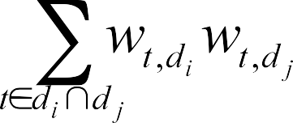
Problem Description
Consider similarity functions of the form:
But, actually…
Two step solution in MapReduce:
  Build inverted index
  Compute pairwise similarity from postings

Slide 44
Building the Inverted Index
Cloud Application Development

Slide 45
Computing Pairwise Similarity

Slide 46
Exercise: TF-IDF
Term Frequency : Inverse Document Frequency (TF-IDF)
  Relevant to text processing
  Common web analysis algorithm
Involve assigning a score(weight ) to each term/word in a document
Very common used in text processing and search
Merely counting the number of occurrences of a word in a document is not a good enough measure of its relevance
If the word appears in many other documents, it is probably less relevance
Some words appear too frequently in all documents to be relevant. Known as ‘stopwords’
TF-IDF considers both the frequency of a word in a given document and the number of documents which contain the word

Slide 47
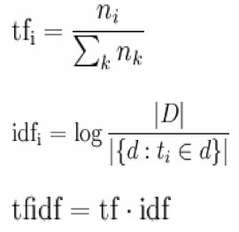
The Algorithm, Formally
n_i: number of times a work occurs
Tf: term frequency
Idf: inverse document frequency
D – the set of documents
|D| - the number of documents

Slide 48
Information We Need
Number of times term X appears in a given document
Number of terms in each document
Number of documents X appears in
Total number of documents

Slide 49
Job 1:Word Frequency in Doc
Mapper
  –Input: docname→ contents
  –Output: (word, docname) →1
Reducer –Sums counts for word in document
  –Outputs: (word, docname) → n
Combiner is same as Reducer

Slide 50
Job 2: Word Counts For Docs
Mapper
  –Input: (word, docname)→ n
  –Output: docname → (word, n)
Reducer
  –Sums frequency of individual n’s in same doc
  –Feeds original data through
  –Outputs (word, docname)→ (n, N)

Slide 51
Job 3: Word Frequency in Corpus
Mapper
  –Input: ((word, docname), (n, N))
  –Output: (word, (docname, n, N, 1))
Reducer
  –Sums counts for word in corpus
  –Outputs ((word, docname), (n, N, m))

Slide 52
Job 4: Calculate TF-IDF
Mapper
  –Input: ((word, docname), (n, N, m))
  –Assume D is known (or, easy MR to find it)
  –Output ((word, docname), TF*IDF)
Reducer
  –Just the identity function

Slide 53
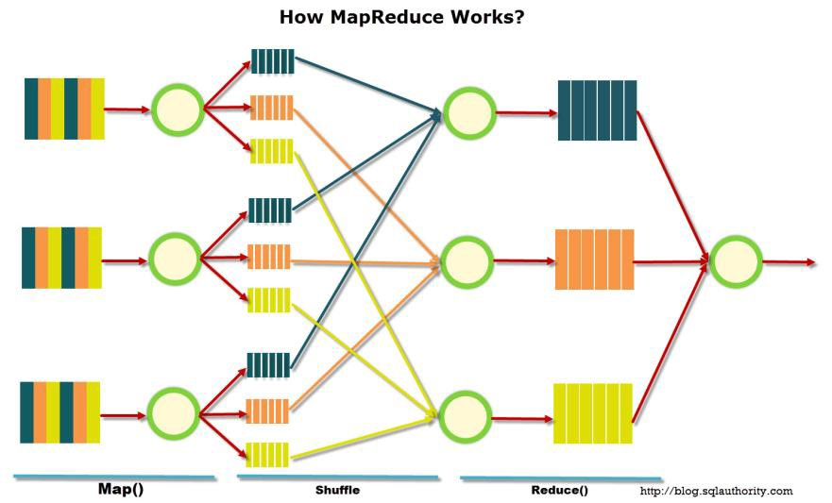
MapReduce Basic Programming Model
Transform a set of input key-value pairs to a set of output values:
Map: (k1, v1) → list(k2, v2)
MapReduce library groups all intermediate pairs with same key together.
Reduce: (k2, list(v2)) → list(v2)

Slide 54
How to access Hadoop

Slide 55
Using HDFS
hadoop dfs
  [-ls <path>]
  [-du <path>]
  [-cp <src> <dst>]
  [-rm <path>]
  [-put <localsrc> <dst>]
  [-copyFromLocal <localsrc> <dst>]
  [-moveFromLocal <localsrc> <dst>]
  [-get [-crc] <src> <localdst>]
  [-cat <src>]
  [-copyToLocal [-crc] <src> <localdst>]
  [-moveToLocal [-crc] <src> <localdst>]
  [-mkdir <path>]
  [-touchz <path>]
  [-test -[ezd] <path>]
  [-stat [format] <path>]
  [-help [cmd]]

Slide 56
Starting / Stopping Hadoop
Java Path
Environmental Variable to Set(if not set during installation)
export JAVA_HOME=/usr/java/default
export PATH=${JAVA_HOME}/bin:${PATH}
export HADOOP_CLASSPATH=${JAVA_HOME}/lib/tools.jar
bin/start-all.sh – starts all slave nodes and master node
bin/stop-all.sh – stops all slave nodes and master node
Run jps to check the status

Slide 57
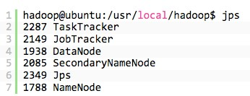
Checking Your Hadoop Status
jps – a tool for checking hadoop process running

Slide 58
Map Reduce Input and Output
MapReduce operates exclusively on <key, value> pairs
  Job Input: <key, value> pairs
  Job Output: <key, value> pairs
Key and value classes have to be serializable by the framework.
  Default serialization requires keys and values to implement Writable
  Key classes must facilitate sorting by the framework

Slide 59
Writables
Are types that can be serialized / deserialized to a stream
Are required to be input/output classes, as the framework will serialize your data before writing it to disk
User can implement this interface, and use their own types for their input/output/intermediate values
There are default for basic values, like Strings, Integers, Longs, etc.
Can also handle store, such as arrays, maps, etc.
Your application needs at least six writables
  2 for your input
  2 for your intermediate values (Map <-> Reduce)
  2 for your output
Adapted from slides by Jeffrey Dean and Sanjay Ghemawa
Notes:
collections

Slide 60
Writable Wrappers
Java class | Writable implementation
String | Text
byte[] | BytesWritable
Object | ObjectWritable
null | NullWritable
Java primitive | Writable implementation
boolean | BooleanWritable
byte | ByteWritable
short | ShortWritable
int | IntWritable VIntWritable
float | FloatWritable
long | LongWritable VLongWritable
double | DoubleWritable
Java collection | Writable implementation
array | ArrayWritable ArrayPrimitiveWritable TwoDArrayWritable
Map | MapWritable
SortedMap | SortedMapWritable
enum | EnumSetWritable

Slide 61
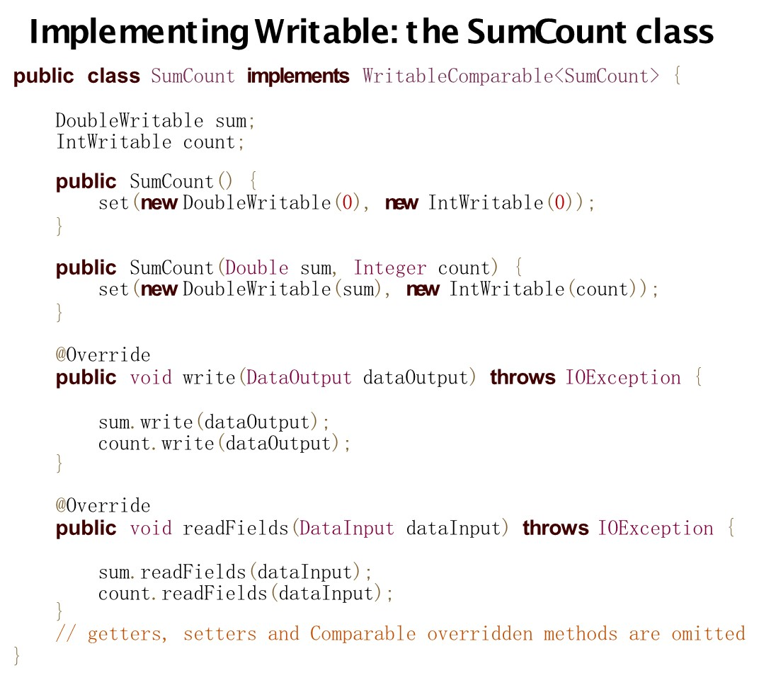

Slide 62
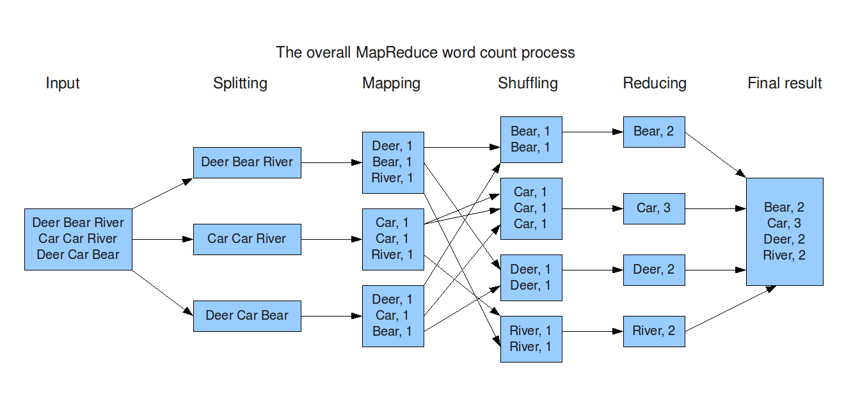
Word count again

Slide 63
Word-Count Map
Type of Output Key
Type of Output Value
public class WordCountMap extends Mapper<Object, Text, Text, IntWritable>{
public void map(LongWritable key, Text line, Context context){
String[] tokens = Tokenize(line);
for(int i=0; i<tokens.length; i++){
context.write(new Text(tokens[i]), new IntWritable(1));
}
}
}
Type of Input Key
Type of Input Value

Slide 64
Mapper Class
Mapper maps input key/value pairs to a set of intermediate key/value pairs
Implementing classes extend Mapper and override map()
Main Mapper engine contains:
    Mapper.run()
    setup() (optional)
    map() for each input record
    cleanup() (optional)
Output data is emitted from Mapper via the Context object
Hadoop MapReduce framework spawns one map task for each logical representation of a unit of input work for a map task
  E.g. a filename and a byte range within that file
The number of map task is driven by the total size of the input

Slide 65
Context Class
Context object: allows the Mapper to interact with the rest of the Hadoop system
Includes configuration data for the job as well as interfaces which allow it to emit output
Applications can use the Context
  to report progress
  to set application-level status messages
  update Counters
  indicate they are alive

Slide 66
Word Count Reduce
Type of Output Value
Type of Output Key
public class DataReadReduce extends Reducer<Text, IntWritable, Text, IntWritable>{
  private IntWritable result = new IntWritable();
  public void reduce(Text key, Iterable<IntWritable> values, Context context){
  int sum = 0;
  for (IntWritable val : values) {
  sum += val.get();
  }
  result.set(sum);
  context.write(key, result);
  }
}
Type of Input Key
Type of Input Value

Slide 67
Reducer Class
Reduces a set of intermediate values which share a key to a (usually smaller) set of values
Number of reduces for the job set by user via Job.setNumReduceTasks(int)
Reduce engine receives a Context containing job’s configuration as well as interfacing methods that return data back to the framework
Reducer.run()
  setup()
  reduce() per key associated with reduce task
  cleanup()

Slide 68
Word-Count Runner Class
outputPath
public class WordCount {
public static void main(String[] args){
Configuration conf = new Configuration();
  Job job = Job.getInstance(conf, "word count"); //Create a new job with the given configuration
  job.setMapperClass(WordCountMap.class); //Set Map as Mapper Class
  job.setReducerClass(WordCountReduce.class); //Set Reduce as Reducer class
  job.setJarByClass(WordCount.class);
  //Set Input file path
  FileInputFormat.addInputPath(job, new Path(args[0]);
  FileOutputFormat.addOutputPath(job, new Path(args[1]));
  //Set Job Output <key.class, value.class> as <Text, IntWritable>
  job.setOutputKeyClass(Text.class);
  job.setOutputValueClass(IntWritable.class);
  job.setNumReduceTasks(1);
  //Wait until Job is done and Return success if successful
  job.waitForCompletion(true);
}
}
inputFilesPath

Slide 69
“Job” Class
Primary interface for a user to describe a MapReduce job to the Hadoop framework for execution
Used to specify
  Mapper
  Combiner (if any)
  Partitioner (to partition key space)
  Reducer
  InputFormat
  OutputFormat
  Many user options; high customizability
Users can chain MapReduce jobs together to accomplish complex tasks which cannot be done with a single MapReduce job

Slide 70
Combiner (OPTIONAL)
Essentially an intermediate reducer
Is optional
Reduces output from each mapper, reducing bandwidth and sorting
Cannot change the type of its input
  Input types must be the same as output types
In previous example, one can set the combiner(in our case it is same as reducer class)
  job.setCombinerClass(WordCountReduce.class);
What is the number of records being shuffled?
  without combiners?
  with combiners?
Adapted from slides by Jeffrey Dean and Sanjay Ghemawa
Notes:
Example equiv to

Slide 71
Partitioner (Shuffler)
Decides which pairs are sent to which reducer
Default is simply:
  Key.hashCode() % numOfReducers
User can override to:
  Provide (more) uniform distribution of load between reducers
  Some values might need to be sent to the same reducer
    Ex. To compute the relative frequency of a pair of words <W1, W2> you would need to make sure all of word W1 are sent to the same reducer
  Binning of results
Adapted from slides by Jeffrey Dean and Sanjay Ghemawa

Slide 72
Compiling and Running your code
Compilation
$ hadoop com.sun.tools.javac.Main WordCount.java
$ jar cf wc.jar WordCount*.class
Assuming that:
/user/skgarg/wordcount/input - input directory in HDFS
/user/skgarg/wordcount/output - output directory in HDFS
Running the application
$hadoop jar wc.jar WordCount /user/skgarg/wordcount/input /user/skgarg/wordcount/output

Slide 73
Sample Exercise
Get WordCount running!!
Extend WordCount to count Bigrams:
  Bigrams are simply sequences of two consecutive words.
  For example, the previous sentence contains the following bigrams: "Bigrams are", "are simply", "simply sequences", "sequence of", etc.

Slide 74
Assignment 3(10%)
Will be published by today night with full details.
3 Parts
  Quiz based on Lecture 6 and 7 will be held in next lecture (3%)
  Map Reduce programs (5%+2%)
    Data : Weather data (several files)
      Each file has several record lines: Weather Station, Date, WeatherCondition, Value, characteristic1, characteristic2.
      WeatherCondion has either:TMAX (Maximum temperature), TMIN(Minimum Temperature), PRCP (Precipitation)
      We are interesting in Weather station, Date(YYYYMMDD), Temperatures, Value
    Program 1: find average maximum temperature at each station in different years
    Program 2: find similarity between different stations

