Slide 1

Distribution Charts (Histogram, Box, Violin)
Data Visualization

Slide 2
Learning outcomes
1) Concepts Refreshing:
(Central Tendency, Distribution Statistical Model, Distribution Shapes, Silhouette, Kernel Density Estimator KDE, Interquartile Range IQR)
2) Violin vs Histogram vs Box charts
3) Exercises

Slide 3
Relation vs Distribution charts
Relation Charts | How are data points related (Scatter & Bubble)? And how are nodes connected (Network)? Focus on Correlation: “how two variables move together?”
Distribution Charts | How are data points spread across a range? Focus on Shape, Spread, and Center of a single variable: “How are the values spread across the range, and where do most of them fall?"

Slide 4
Distribution charts
1) Central Tendency (The "Where"): Mean & Median.
2) Spread (The "How Wide"): Whiskers & IQR.
3) Shape (The "Personality"): Skew-shapes & Modality

Slide 5
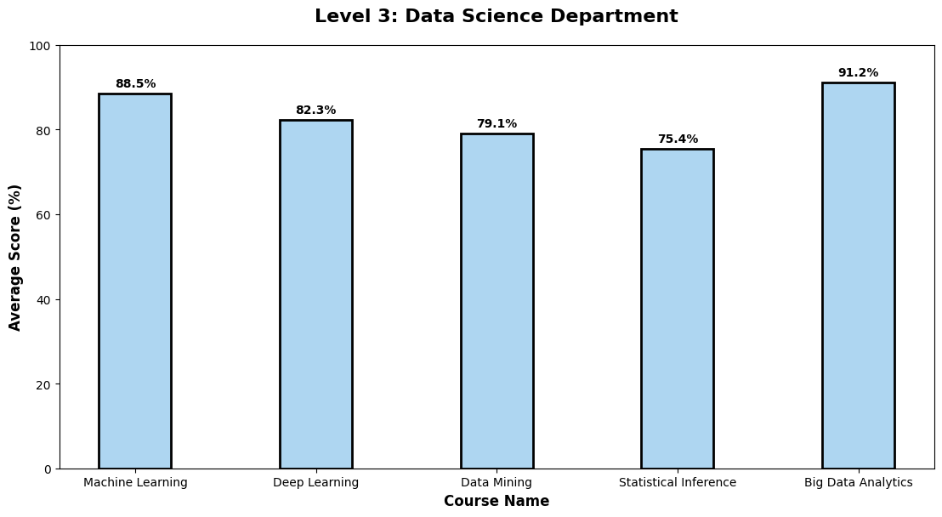

Slide 6
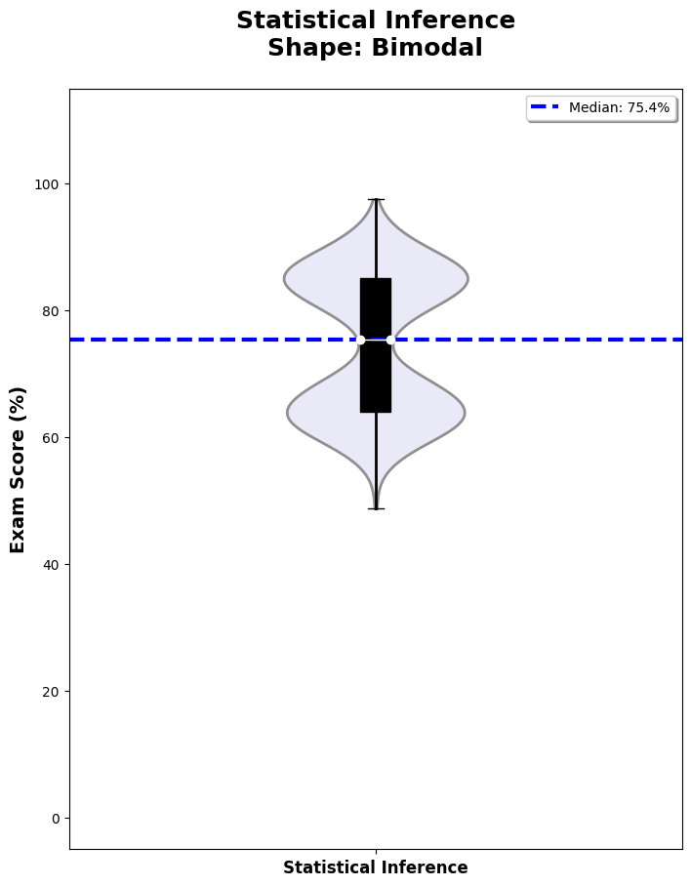

Slide 7
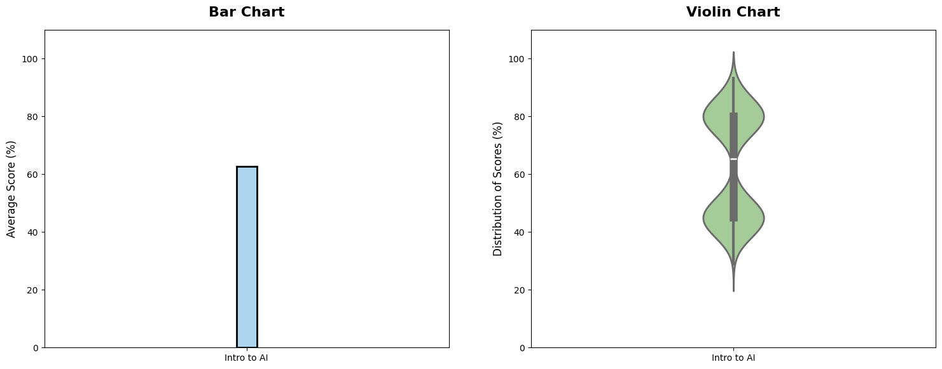

Slide 8
Distribution statistical model
The mathematical rule or formulas that creates that shape.
The Normal Distribution (The "Bell” Rule) | It the most famous statistical model. It always results in a Bell-Shaped curve. It is used for things that happen naturally and cluster around an average, like human height or exam scores.
The Poisson Distribution (The "Counting" Rule) | It is used to model how many times an event occurs in a specific time or space (e.g., "How many emails do I get per hour?").

Slide 9
Distribution statistical model
Shape | Can it be Normal? | Can it be Poisson?
Bell-Shaped | Yes (Always) | Yes (If average is high)
Right-Skewed | No | Yes (Usually)
Left-Skewed | No | No
Bimodal | No | No

Slide 10
Distribution shapes
Bell-Shaped (Normal) | Most data points are clustered in the center (the average), and the shape falls off symmetrically on both sides. Think of "Average Human Height.”
Left-Skewed | The "tail" of the data points to the left. This means most values are high, but there are a few very small values pulling the average down.
Right-Skewed | The "tail" points to the right. This means most values are low, but a few very high values (like "Income of Billionaires") pull the average up.
Bimodal | This looks like a camel with two humps. It means there are two different "most frequent" values.

Slide 11
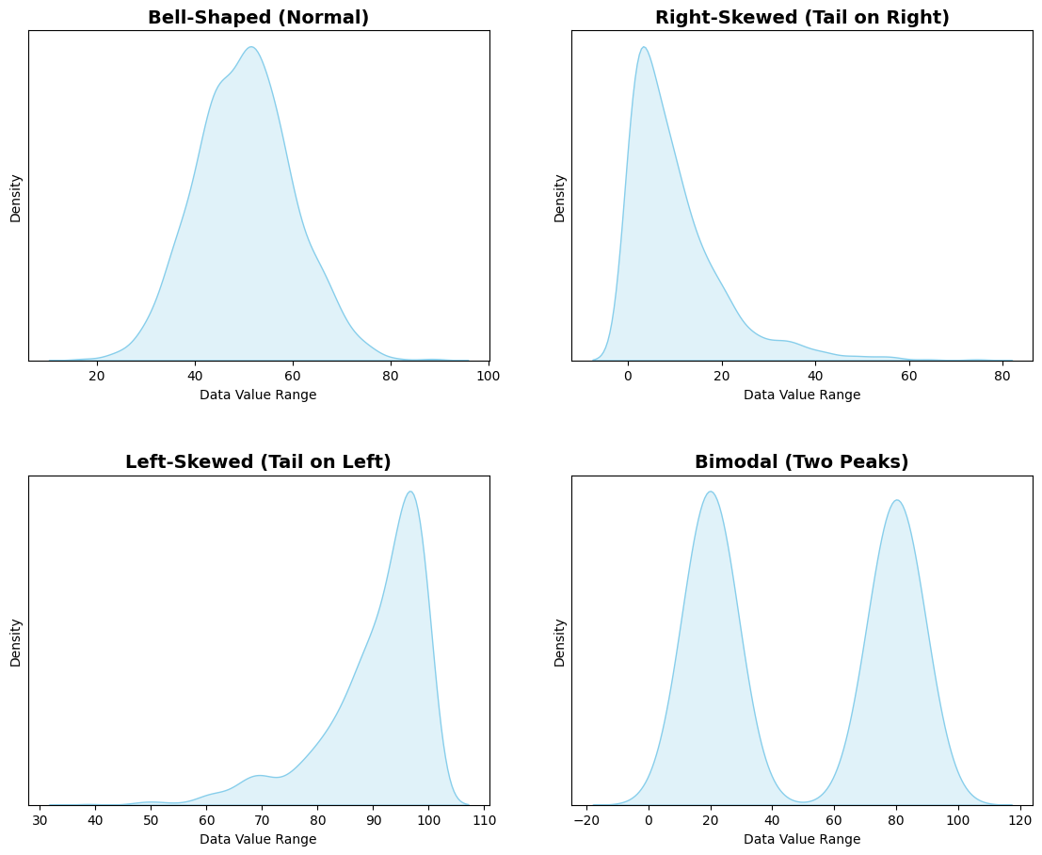
The "silhouette" or the "shape" of the data.

Slide 12
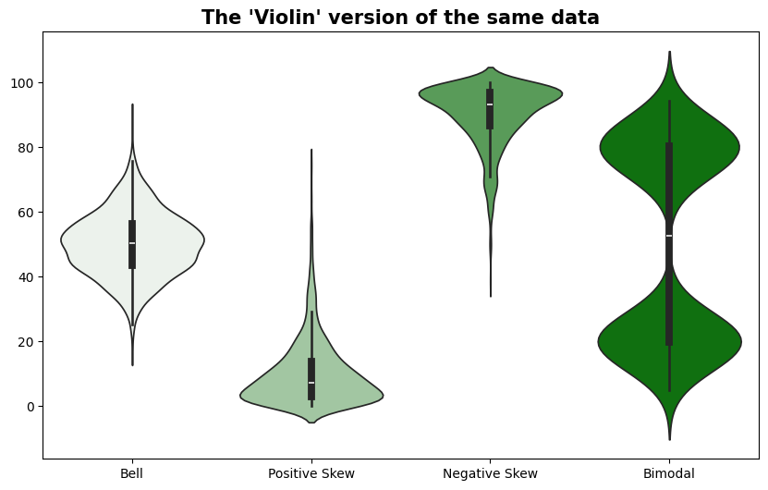
The "Violin" version of the data.

Slide 13
modality
Modality refers to a dataset that has one or two or more clear "peaks".
Unimodal | One peak (fat belly) in the middle (e.g., a bell shape).
Bimodal | Two peaks (e.g., looks like a peanut or a traditional musical violin).
Multimodal | Three or more peaks, looking like a wavy or "lumpy" silhouette.

Slide 14
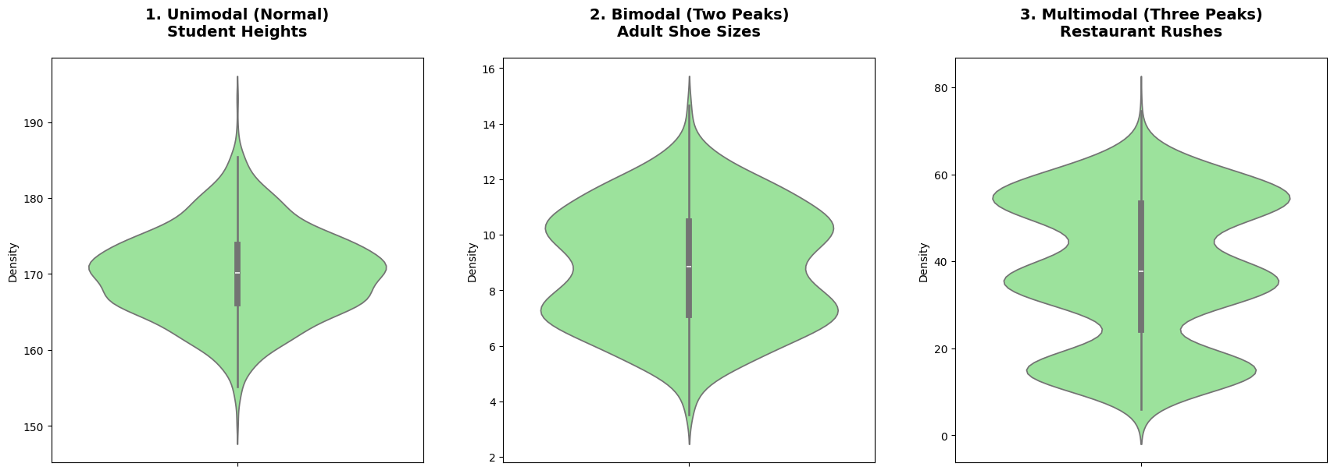

Slide 15
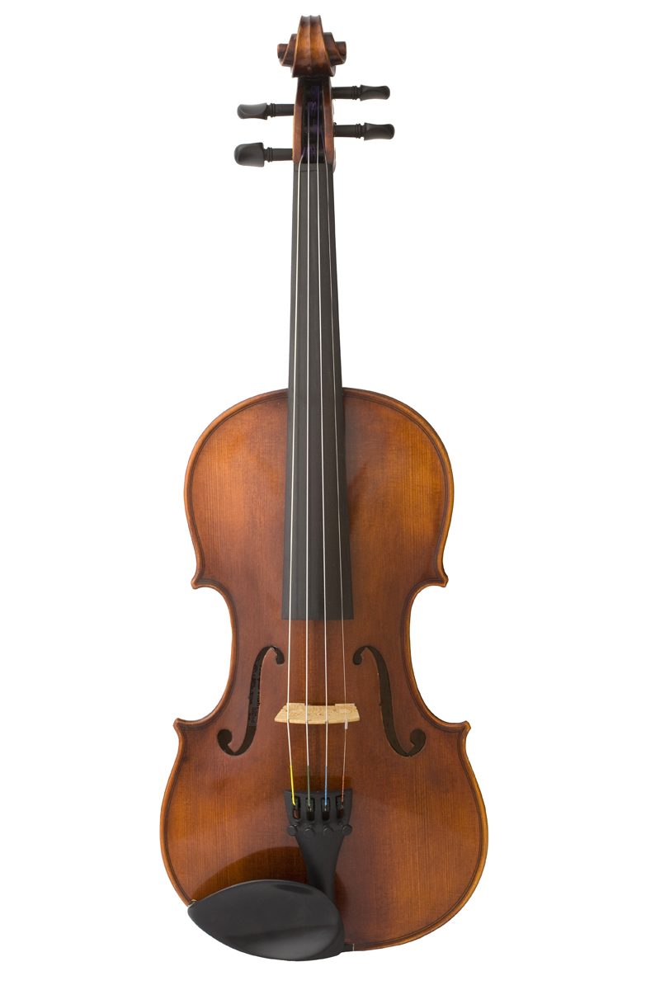
Violin chart
The Violin Chart, that looks like a musical instrument, shows you the entire physical shape of the data. where it is "fat" (many data points) and where it is "thin" (few data points).
A Violin Chart is a data visualization used to represent the distribution of a numeric variable across different categories. It displays the probability density of the data at different values, smoothed by a kernel density estimator (KDE).

Slide 16
Violin chart components
The "Silhouette" (The Outer Shape) | Where the violin is fat: This means there are many data points at that value (e.g., a lot of people are 170cm tall). Where the violin is thin: This means there are very few data points (e.g., only one person is 210cm tall).
The "Mirror" ("violin" or "vase" shape) | A violin chart is usually perfectly symmetrical. The left side and the right side are identical.
The "Interior" (The Center) | A white dot in the center usually represents the Median (the exact middle value). A thick black line represents the range where the middle 50% of your data lives.

Slide 17
The Silhouette
The outer "skin" of the violin that shows where data is most frequent.
It refers to the outer boundary or the outline of the violin.
It represents the Density of the data.

Slide 18
Kernel Density Estimator (KDE)
The KDE is the mathematical "artist" that draws the Silhouette (the outer skin) of the violin.
How it works:
Imagine you have 100 people standing on a football field at different yard lines.
If you just put a dot for every person, it's a Scatter Plot.
If you draw a smooth, flowing line over their heads to show where the crowd is thickest, that is a KDE.

Slide 19
Interquartile Range (IQR)
The IQR is the best way to measure Spread because it ignores the extremes (outliers). Imagine a long line of 100 people sorted from shortest to tallest.
To find the IQR, we simply "slice" that line of 100 people into four equal groups (25 people in each group):
Group 1 (The Shortest): The first 25 people.
Group 2 (Lower-Middle): The next 25 people.
Group 3 (Upper-Middle): The next 25 people.
Group 4 (The Tallest): The final 25 people.
The IQR is the height of the middle 50 people (Groups 2 and 3 combined).
We ignore the 25 shortest people.
We ignore the 25 tallest people.
We only care about the spread of the people in the middle.

Slide 20
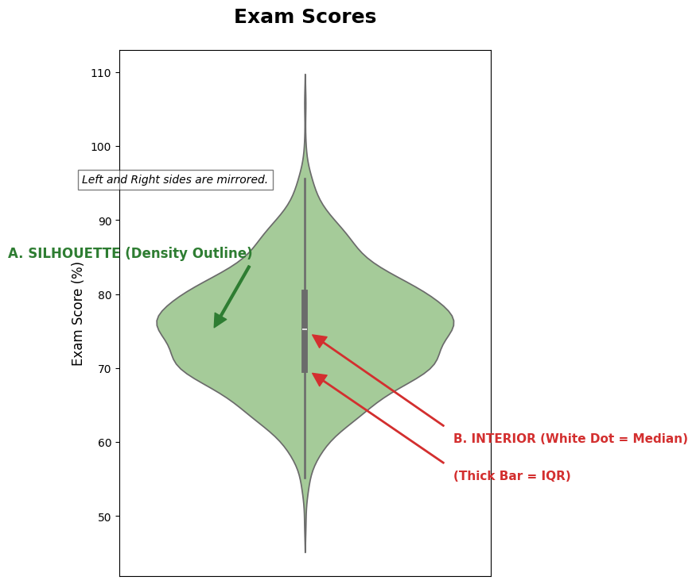
The "Interior” (The Center)
The White Dot: This is the Median. If the dot is at 75%, it means exactly half the students scored above 75 and half scored below.
The Thick Black Bar (IQR): This represents the Interquartile Range (IQR). It shows where the "middle 50%" of the students sit. If the bar is short, most students got very similar grades. If it is long, the grades are widely spread out.
The Thin Black Line (Whiskers): This shows the total range (from the lowest to the highest scores), excluding extreme outliers.

Slide 21
Violin chart
When to use it ? To show the reality of data distribution.
You should draw a Violin Chart when the "average" (Mean) is not enough to tell the story, or when you suspect your data has multiple peaks, heavy skewness, or you want to compare the density of different groups side-by-side.

Slide 22
Violin chart
Reason for Use (Conditions) | Unique Keywords | Effective Data Types (Axes)
Visualizing the "Personality" of Data: Used when you need to see the exact density of data points along with the statistical summary (Median/IQR). | Modality, Silhouette, KDE, Mirrored Distribution | Y-Axis: Numerical (Continuous) X-Axis: Categorical while it can use numbers, it is most effective with categories.

Slide 23
How to draw the violin chart? (our guidelines)
Rule # | Guideline | Purpose / Description
Rule 1 | Chart Border | Ensure a black frame surrounds the data area to define the workspace.
Rule 2 | Zero Baseline | The Y-axis must start at 0 to avoid distorting the magnitude of the violin.
Rule 3 | Horizontal/Vertical Text | All labels in the chart, such as those in the X-axis, Legends, Bottom, and Top titles, must be horizontal for easy reading, except the Y-axis, which must be vertically oriented.
Rule 4 | Show Median Magnitude | Place the specific value directly on or above the white dot of the median.
Rule 5 | Include Legend | Place a legend (top-right) to explain what the colors represent.
Rule 6 | Clear Titles | Every chart needs three: a Main Title, an X-axis Title, and a Y-axis Title.
Rule 7 | Color Strategy | Use the following colors: 1) A uniform light color (e.g., lightblue) for the Silhouette (outer skin). 2) A white dot for the median. 3) A black color for all the IQR, whiskers, chart titles, and labels.
Rule 8 | Gridlines | Draw the gridlines to assist in reading the values.

Slide 24
Practical Exercise 1: violin chart
1. The Task
Perform a Categorical vs Numerical bivariate analysis to compare the distribution of student exam scores between two academic tracks: Specialized and General.
2. The Dataset
The table shows the records for a sample of 20 students of two academic tracks: Specialized and General.
Student ID | Track | Score (%) |  | Student ID | Track | Score (%)
101 | Specialized | 58.0 |  | 111 | General | 59.1
102 | Specialized | 77.0 |  | 112 | General | 61.1
103 | Specialized | 67.0 |  | 113 | General | 58.5
104 | Specialized | 58.0 |  | 114 | General | 60.2
105 | Specialized | 56.0 |  | 115 | General | 59.8
106 | Specialized | 36.0 |  | 116 | General | 85.5
107 | Specialized | 51.0 |  | 117 | General | 81.2
108 | Specialized | 52.0 |  | 118 | General | 81.6
109 | Specialized | 53.0 |  | 119 | General | 84.0
110 | Specialized | 50.0 |  | 120 | General | 83.5

Slide 25
Practical Exercise 1: violin chart
3. The Audience Question
“Which track is normally distributed? based on the Silhouette of the scores for both tracks.”
Draw the most accurate visualization possible to answer the audience's question and follow the visualization guidelines.
Student ID | Track | Score (%) |  | Student ID | Track | Score (%)
101 | Specialized | 58.0 |  | 111 | General | 59.1
102 | Specialized | 77.0 |  | 112 | General | 61.1
103 | Specialized | 67.0 |  | 113 | General | 58.5
104 | Specialized | 58.0 |  | 114 | General | 60.2
105 | Specialized | 56.0 |  | 115 | General | 59.8
106 | Specialized | 36.0 |  | 116 | General | 85.5
107 | Specialized | 51.0 |  | 117 | General | 81.2
108 | Specialized | 52.0 |  | 118 | General | 81.6
109 | Specialized | 53.0 |  | 119 | General | 84.0
110 | Specialized | 50.0 |  | 120 | General | 83.5

Slide 26
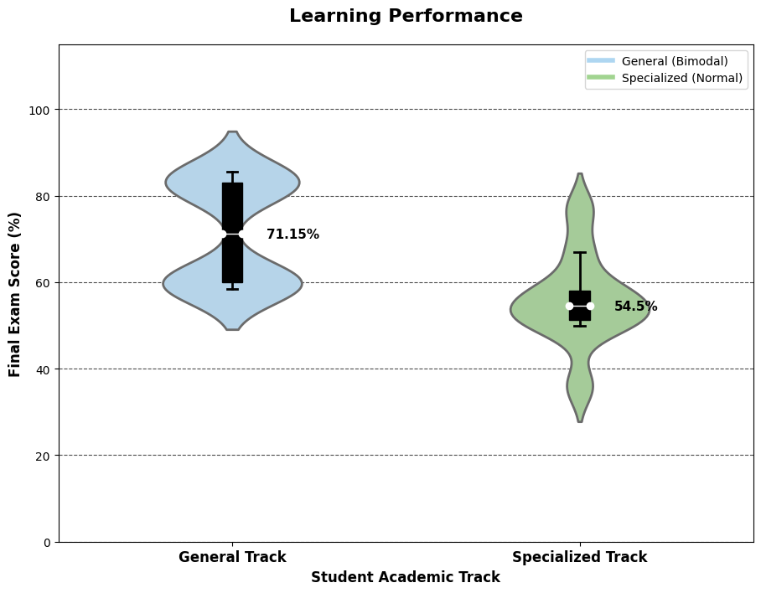
Answers 1: violin chart

